Slide 1
Apache Kafka

Slide 2
Agenda
Kafka in LinkedIn
Kafka Vs JMS
Kafka Architecture.
Kafka Demo
Kafka demo Prerequisites.

Slide 3
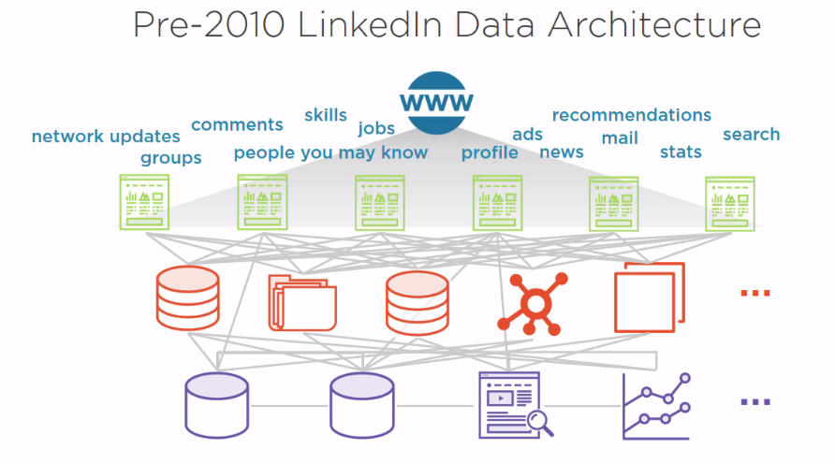
Kafka in Linked In

Slide 4
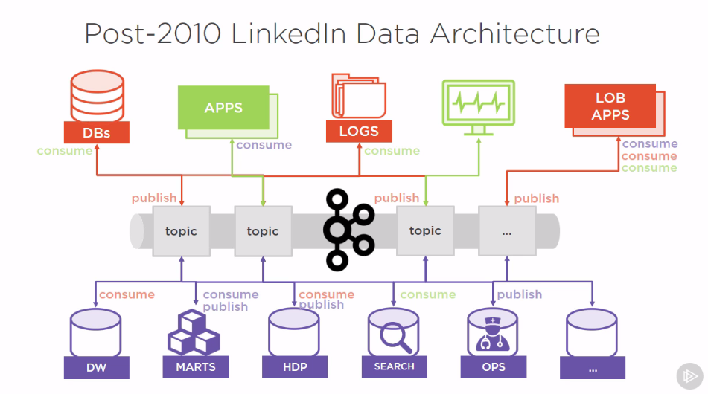
Kafka in Linked In

Slide 5
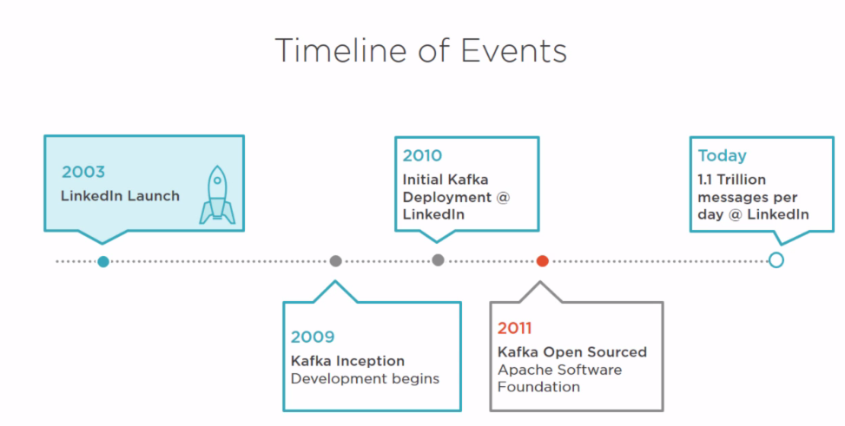
Kafka in Linked In

Slide 6
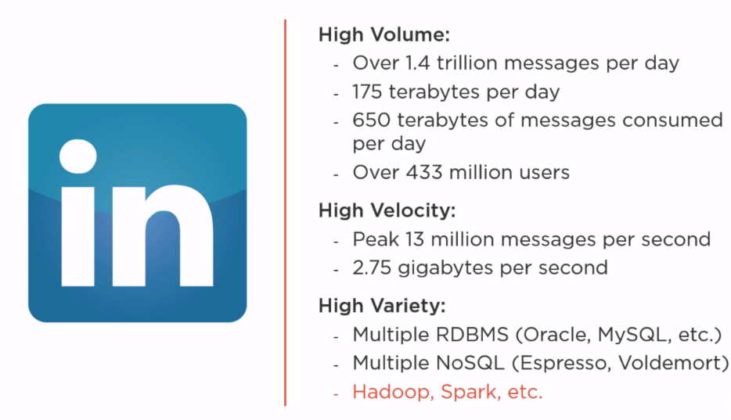
Kafka in Linked In

Slide 7
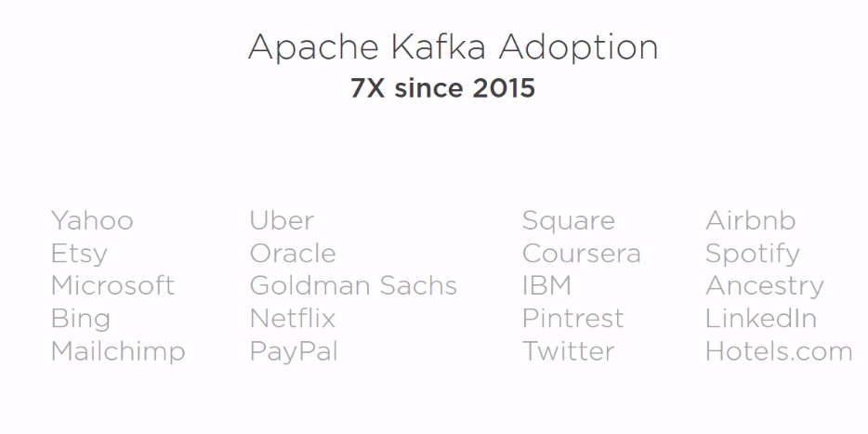
Top Organizations using Kafka.

Slide 8
Kafka Vs Traditional JMS
Kafka | JMS
High Through Out | Relatively Low through Out
Relatively High Latency | Low latency
Distributed | Non Distributed
Horizontally Scalable | Vertically Scalable
Messages are available even after consumption | Messages are deleted once consumed from message broker

Slide 9
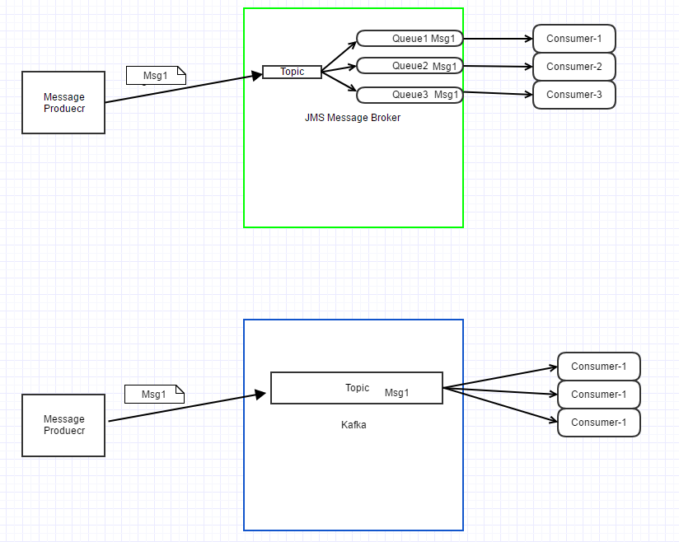
Kafka Vs JMS

Slide 10
Kafka Terminologies.
Broker
Zoo Keeper
Topic
Partition
Replica
Leader Replica
Follower Replica
Consumer
Consumer Group

Slide 11
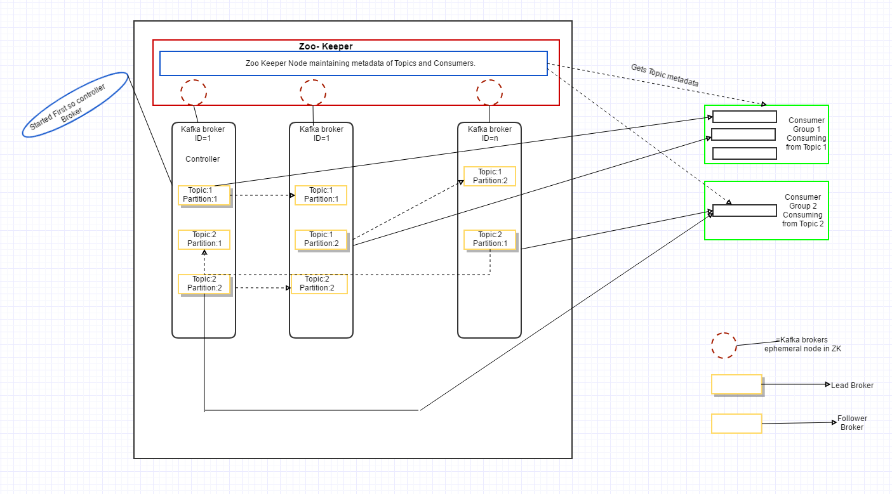
Kafka Architecture.

Slide 12
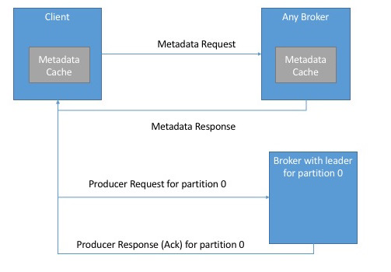
Clients Accessing Kafka

Slide 13
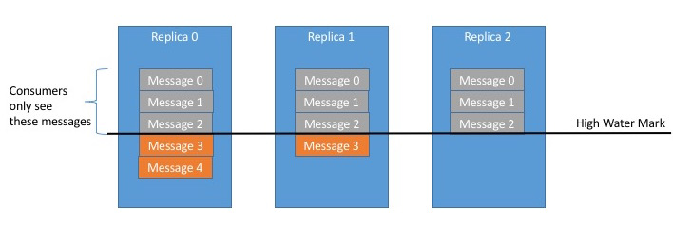
Clients Accessing Kafka

Slide 14
Physical Storage
The basic storage unit of Kafka is a partition replica.
Partitions cannot be split between multiple brokers and not even between multiple disks on the same broker. So the size of a partition is limited by the space available on a single mount point.
Location where Messages will be stored?
Format in which messages are stored in Kafka?
Kafka to use the zero-copy optimization:
Kafka doesn’t stage the message in memory before sending over network because the serialization format in which message is stored on the disk is same as the format in which message is sent over network.

Slide 15
Kafka Demo.

Slide 16
Code Walk Through.

Slide 17
Kafka Utility commands.
1. Kafka Home Directory: HDP VM Comes with Single node Kafka instance and Kafka will be installed in /usr/hdp/current/kafka-broker location.
cd /usr/hdp/current/kafka-broker
2. Execute the below command to start Kafka Server:
bin/kafka-server-start.sh config/server.properties
Broker Starts on port 6667 by default
3. Use the below command to see the list of Topics:
bin/kafka-topics.sh --list --zookeeper localhost:2181
By default Zookeeper runs on 2181 port on HDP VM.
4. Command to create a Kafka Topic.
bin/kafka-topics.sh --create --zookeeper localhost:2181 --replication-factor 1 --partitions 1 --topic demo_topic

Slide 18
Kafka Utility commands.
5. Command to publish messages to Kafka topic using the utilities provided with in Kafka.
bin/kafka-console-producer.sh --broker-list sandbox.hortonworks.com:6667 --topic demo_topic
Use the below command to run a java code (Built for demo) to publish messages to Kafka topic.
java -cp /root/kafka/kafka-1.0-jar-with-dependencies.jar kafka.SimpleProducer_VM -topic demo_topic -brokers sandbox.hortonworks.com:6667 -file /root/kafka/picked_order_messages/picked_order_messagebody.txt -messagingMode Sync –messagKay Picked_order
6. Command to consume messages from Kafka Topic using Kafka utilities.
bin/kafka-console-consumer.sh --zookeeper localhost:2181 --topic demo_topic --from-beginning
Use the below command to run a java code (Built for demo) to consume messages from Kafka topic.
java -cp /root/kafka/kafka-1.0-jar-with-dependencies.jar kafka. BasicConsumerExample_VM -topic demo_topic -brokers sandbox.hortonworks.com:6667
7. Command to increase number of Partitions for a Kafka Topic.
bin/kafka-topics.sh --zookeeper localhost:2181 --describe --topic demo_topic
bin/kafka-topics.sh --zookeeper localhost:2181 --alter --topic demo_topic --partitions 2
bin/kafka-topics.sh --zookeeper localhost:2181 --describe --topic demo_topic
8. Command to sun the Spark Consumer.
spark-submit --class sparkStreaming.VM_Hive_Checkpoint /root/kafka/kafka-1.0-jar-with-dependencies.jar sandbox.hortonworks.com:6667 samplekafkaconsumer KVJ1 test.KVJ_Topic_Offsets
sandbox.hortonworks.com:6667 is broker URL
samplekafkaconsumer : Consumer Group
KVJ1 : Topic To Consume From
test.KVJ_Topic_Offsets : MySql Table in which offsets are maintained.

Slide 19
Things to do before demo.
Create the below hive table:
CREATE TABLE `tmp_picked_order`(
`orderid` string,
`recommendedfulfillmenttime` string,
`tenantid` string,
`lineitemid` string,
`tpnb` string)
2. Create the below Mysql Table (user name= root, password= blank)
create table test.KVJ_Topic_Offsets (insert_date_time text, topic text, partition text, fromoffset text, untilloffset text);

Slide 20
Things to do before demo.
3. Place the below files in /root/kafka/picked_order_messages

Slide 21
Things to do before demo.
Build a jar file using the below pom.xml and code.

Slide 22
Questions.

