Slide 1
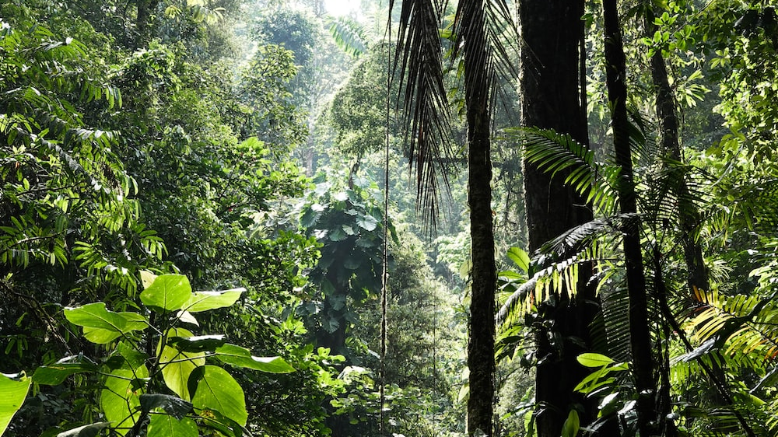
Biodiversity

Slide 2
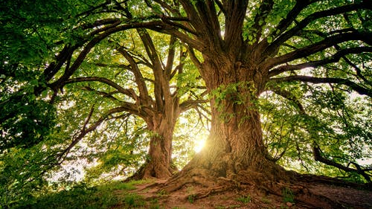
सोडा Virtual
आणि
जगा Actual

Slide 3
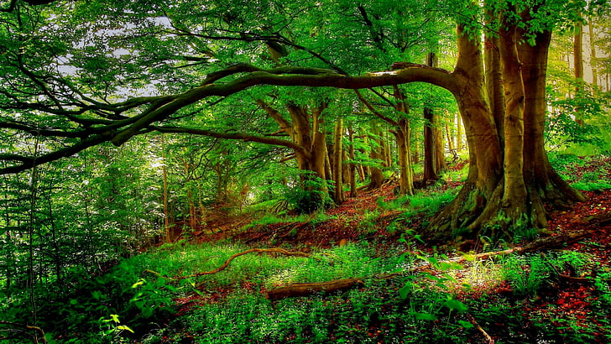
1
3
REUSE
REDUCE
2
RECYCLE

Slide 4

Pls Save The Mother Earth!!
Go Green!!!
There is no planet B.
The more
Variety,
The Better
Society
Biodiversity
Is The Key
So We Can All
Live In Green

Slide 5
Pls Save The Mother Earth!!
Go Green!!!
There is no planet B.
The more
Variety,
The Better
Society
Biodiversity
Is The Key
So We Can All
Live In Green

Slide 6

Pls Save The Mother Earth!!
Go Green!!!
There is no planet B.
The more
Variety,
The Better
Society
Biodiversity
Is The Key
So We Can All
Live In Green

Slide 7
Pls Save The Mother Earth!!
Go Green!!!
There is no planet B.
The more
Variety,
The Better
Society
Biodiversity
Is The Key
So We Can All
Live In Green

Slide 8
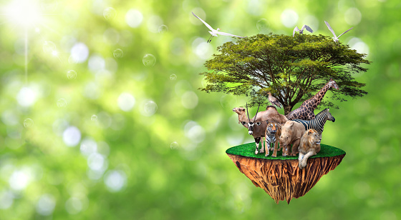
Thankyou!!
Vinay Bobade

