Slide 1
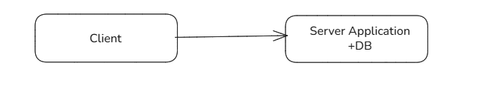

Single Server
Application and DB Server Seperation

Slide 2
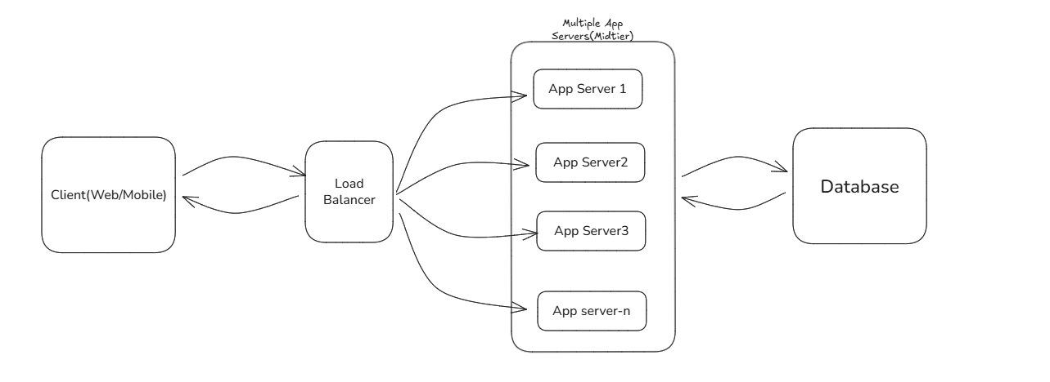
Load Balancer With Multiple Server

Slide 3
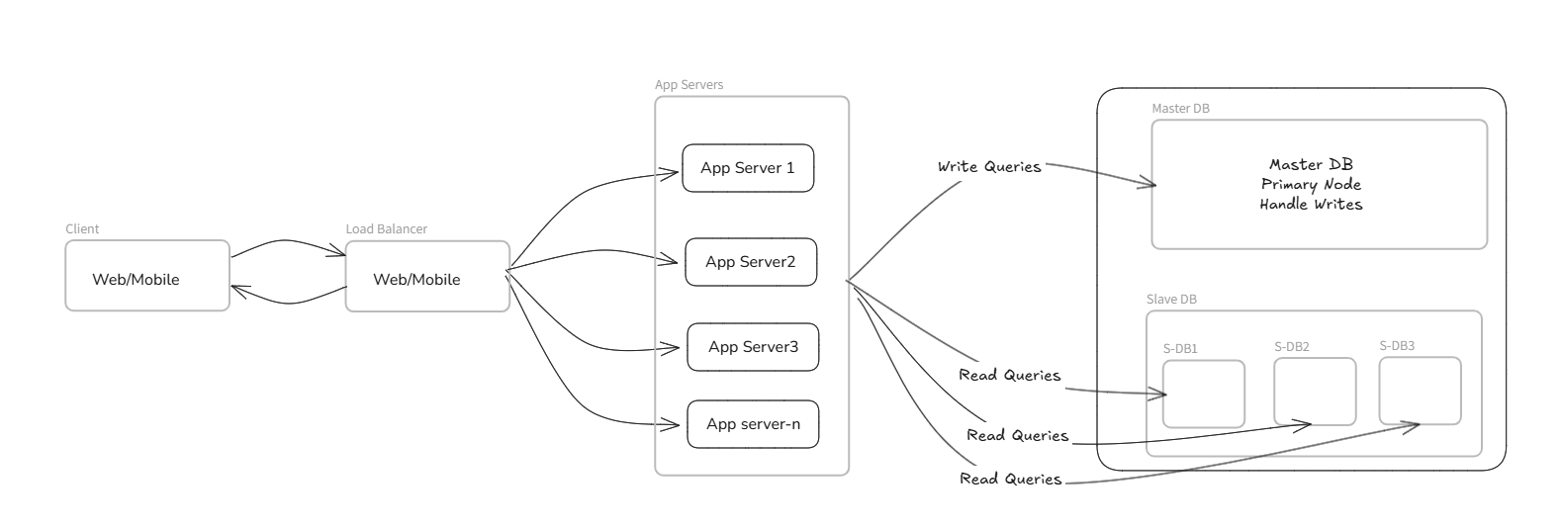
Database Replication

Slide 4
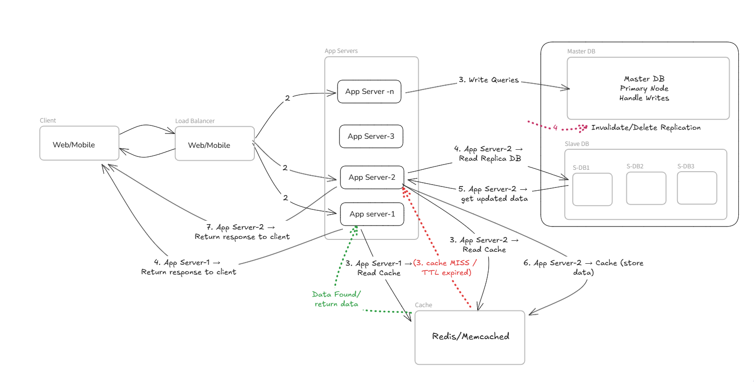
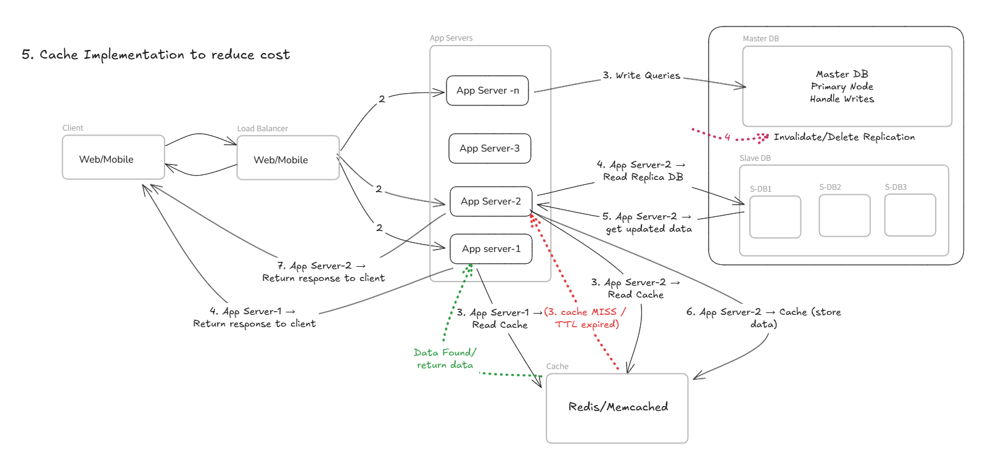
Cache Implementation

Slide 5
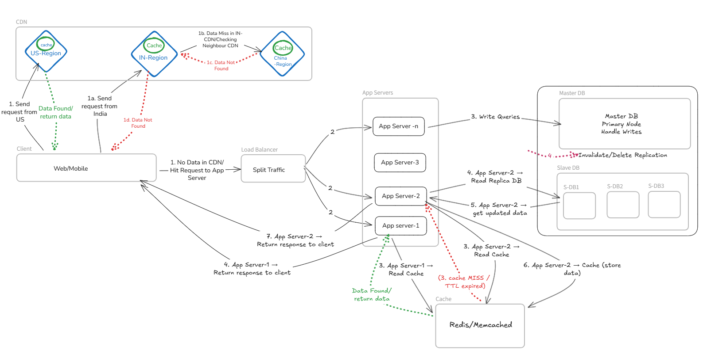
Add CDN

Slide 6
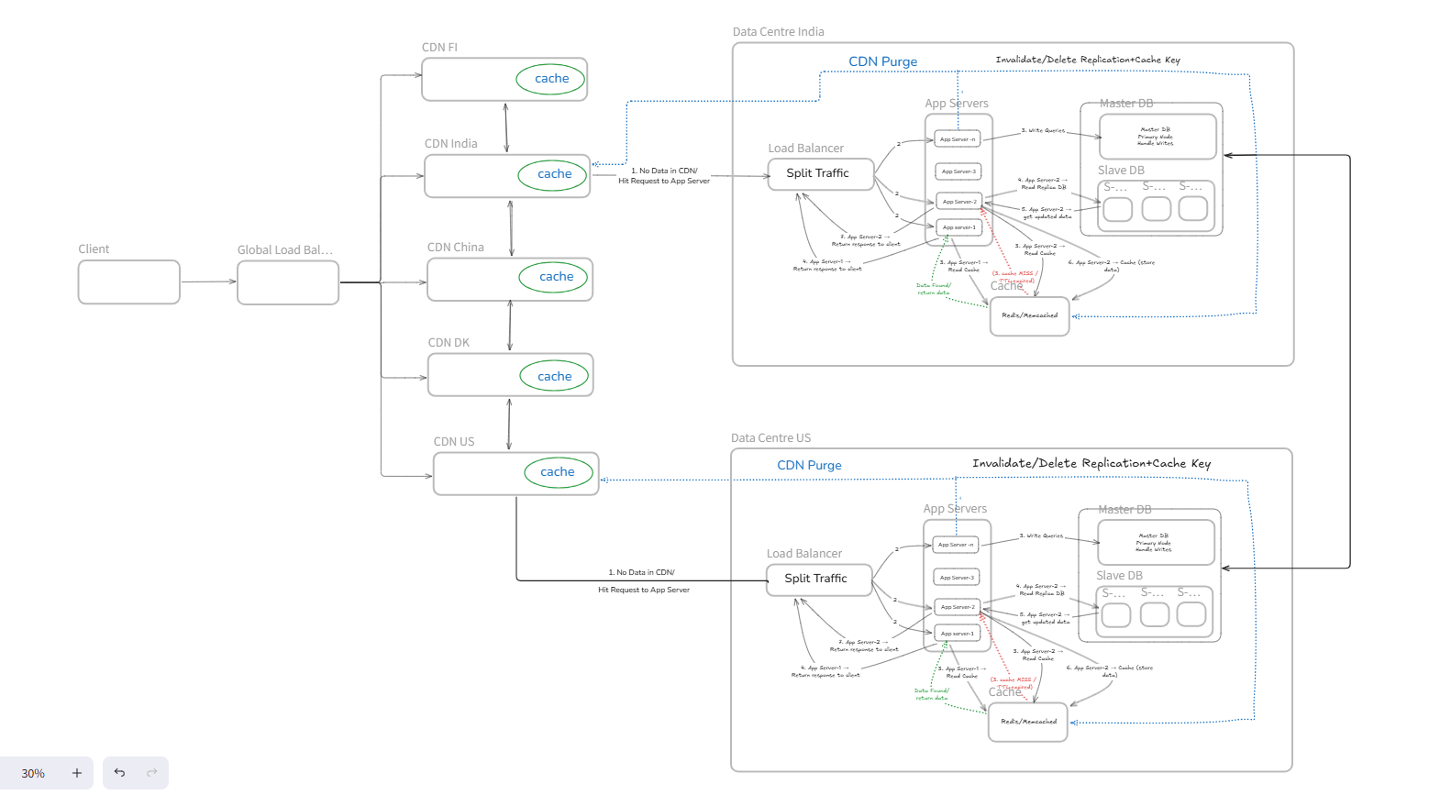
Data Centre

Slide 7
Multi Master Replication

