Slide 1
“DISCOVER INDIA:
Where Heritage
Meets Adventure”

Slide 2
OUR TEAM
VINAY YADAV
VIBHOR SHARMA
PRASHANT TRIVEDI

Slide 3
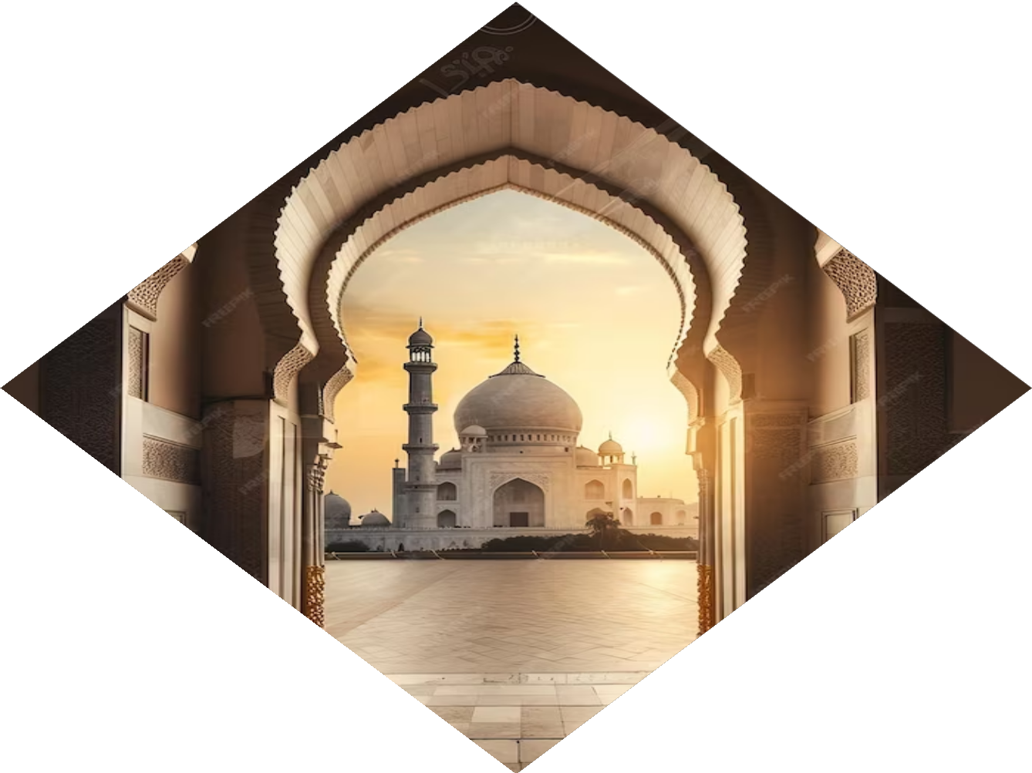
Introduction
Our Project is a interactive frontend website that serves as a comprehensive platform for exploring India's rich heritage and thrilling adventure opportunities.
"Frontend" typically refers to the client-side of a software application or website. It is the part of the application that users interact with directly. Frontend development involves creating and implementing the user interface (UI) and user experience (UX) of an application, making sure it is visually appealing, functional, and user-friendly.
Frontend developers use coding languages like HTML, CSS, and JavaScript to create the frontend of a website.

Slide 4
“A nation is not complete until its story is known by its people, every corner explored, every voice heard. Begin at home, traveler, and discover the roots that bind you.“
"The world is a book, and those who do not travel read only one page." - Saint Augustine

Slide 5
Problem Statement
Lack of Information And Awareness: Many people
may not be familiar with the diverse attractions,
cultural richness, and historical significance of a
country like India.
2. Tourism Promotion: The tourism industry often
faces the challenge of attracting visitors.
3. Connecting with the Diaspora: People from a particular country living abroad may face challenges in staying connected with their cultural roots.
4. Uncertainties and limited accessibility: Travelers with disabilities or specific needs may struggle to find appropriate information and resources for an accessible and inclusive travel experience.
5.Most of the time, travelers have an outdated perception of a place.
that may affect the local craftsmanship and economy of that place.

Slide 6
Why “Discover India” ?
ATTRACTIVE OPPORTUNITIES: India is geographically diverse and offers a variety of cultures that come with its own experiences, making it one of the leading countries in terms of international tourism expenditure.
ROBUST DEMAND: International tourist arrivals are expected to reach 30.5 million by 2028.
Market SIZE : Travel and tourism are two of the largest industries in India, with a total contribution of about INR 16.4 Trillion to the country’s GDP i.e. 6.8% of the total economy.
4. Educational value : As a developer, developing a frontend website like "Discover India" .
The project allowed me to deepen my understanding of HTML, CSS, JavaScript, and potentially
additional frameworks like Bootstrap or GSAP Animation.
It offered a chance to experiment with UI/UX design principles and create an engaging user
experience.
5. In 2023, India is the 22nd most visited country in the world.

Slide 7
5.In 2023, India is the 22nd most visited country in the world.
6. Regional Art And Crafts Promotion : This website will give exposure to regional craftsmanship and cultural literacy.

Slide 8
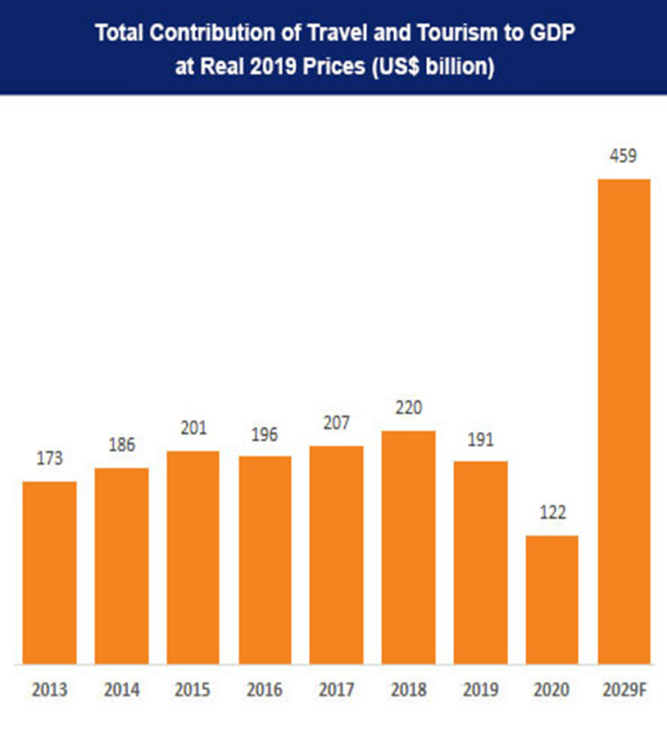

Slide 9
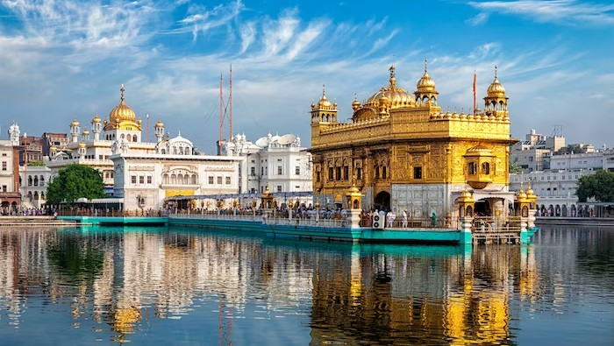
Project Objective
Main objective of our project is to create a visually appealing website that serves as a comprehensive and educative platform for exploring India's rich heritage and thrilling adventure opportunities.
This website can serve as a promotional tool, showcasing the beauty and uniqueness of the country to potential travelers, thus boosting tourism.
Showcase the country's diverse attractions, historical sites, cultural events, natural beauty, and more, encouraging people to visit and explore.
To make it easy for adventure seekers to plan and discover thrilling trips within the country.
Make every individual of my country aware of his/her glorious past and present.

Slide 10
Technologies Used
HTML
CSS
JAVASCRIPT
TECHNOLOGY
BOOTSTRAP
GSAP
GITHUB

Slide 11
HTML : For basic structure of the website.
CSS : For Styling and Layouts
JS : For adding interactivity, dynamic behavior, and enhanced user experiences.
GSAP : For Animation
Bootstrap : For advanced styling and galleries.
Github : For storing, sharing, and continuous integration and debugging of code.

Slide 12
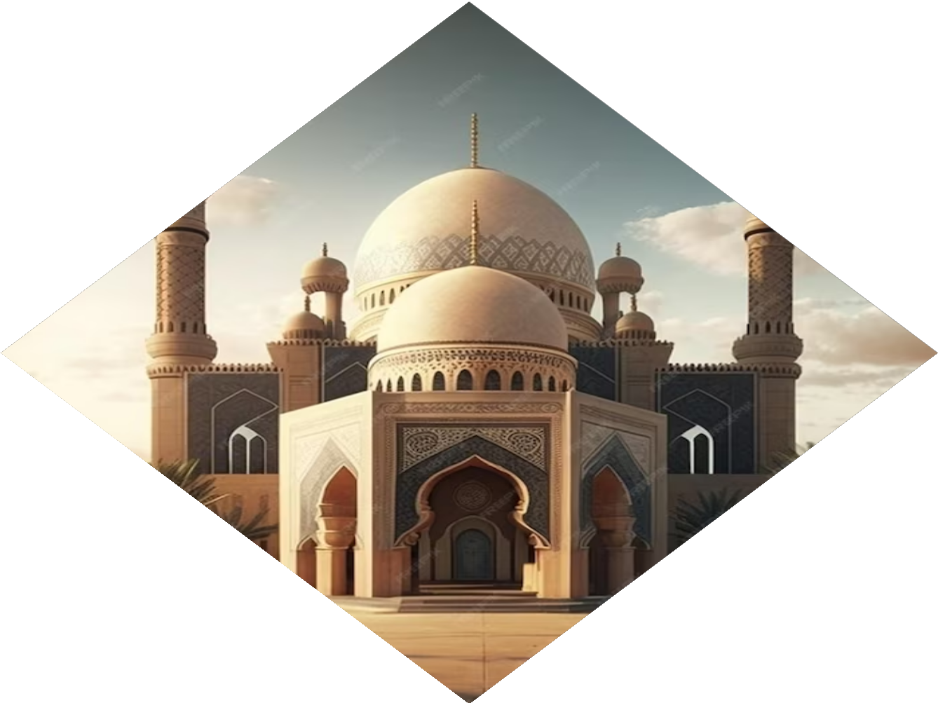
Features
Historical Exploration
Cultural Exploration
Architectural Marvels
Natural Wonders
Interactive And High Quality Multimedia
Expert Travel Tips
User Friendly
Travel Blogs And Articles
Adventure Planning
Regular Updates

Slide 13
Progress Done So Far
"The project is progressing according to the schedule."
Milestones Achieved :
Landing Page
Geographical Section
Technology Section
Galleries

Slide 14
Remaining Work:
Adding Blog And Article Section
Trip Planner
Adding Data
"We have a series of milestones planned, and we're aiming to achieve them on schedule.“
"The team is actively addressing the remaining tasks on our checklist."

Slide 15
Team Collaboration:
"Team collaboration has been excellent, and everyone is contributing effectively.“
"I want to commend the team for their dedication and collaborative efforts.“
"The synergy within the team is playing a crucial role in our progress.“
It is being a exciting and wonderful experience working on this project.

Slide 16
Thank You!

