Slide 1
I Semester
Principles of Programming using C(Integrated) BPOPS103/203
Module 1 Introduction To C
Course Instructor Mr.Naveen Kumar C Professor and Head
Department of CSE

Slide 2


C Programming
Module 1
Introduction to C Programming
Introduction to Computing: Introduction, Art of Programming through Algorithms and Flowcharts, Basic structure of C program, executing a C program.
Constants, Variable and Data Types: Introduction, Character Set, C Tokens, Keywords and Identifiers, Constants, Variables, Data Types, Declaration of Variables, Assigning Values to Variables, Defining Symbolic Constants.
Managing Input and Output Operations: Reading a Character, Writing a Character, Formatted Input, Formatted Output.
Operators and Expressions: Introduction, Arithmetic Operators, Relational Operators, Logical Operators, Assignment Operators, Increment and Decrement Operators, Conditional Operator, Bitwise Operators, Special Operators, Arithmetic Expressions, Evaluation of Expressions, Precedence of Arithmetic Operators, Type Conversions in Expressions, Operator Precedence and Associativity.

Slide 3

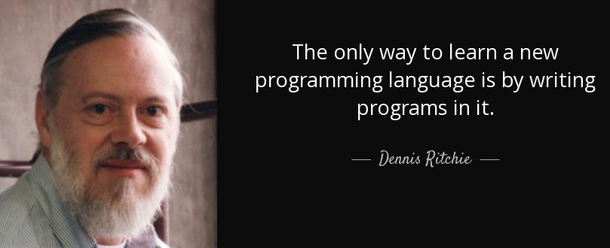
Introduction to C Programming
C Programming
Dennis Ritchie
Father of C

Slide 4
Introduction to C Programming
C Programming
A computer program is a sequence of instructions to perform a specified task by the
computer.
A computer program is also called a computer software, which can range from two lines to millions of lines of instructions.
Computer program instructions are also called program source code and computer
programming is also called program coding.
A computer without a computer program is just a dump box; it is programs that make computers active.

Slide 5
C Programming
Art of Programming through Algorithms and Flowcharts
Algorithm
Step by step procedure to develop a program.
Flowchart
Pictorial representation of flow of logical steps followed in an algorithm.

Slide 6
Algorithm
An algorithm is a sequence of instructions that are carried out in a predetermined sequence in order to solve a problem or complete a work.
A set of instructions for resolving an issue or carrying out a certain activity.
In computer science, algorithms are used for a wide range of operations, from fundamental math to intricate data processing.

Slide 7
Features of the Algorithm
It defines several important features of the algorithm, including:
Input: An algorithm has zero or more inputs. Each that contains a fundamental operator must accept zero or more inputs.
Output: An algorithm produces at least one output. Every instruction that contains a fundamental operator must accept zero or more inputs.
Clear and Unambiguous: The algorithm should be clear and unambiguous. Each of its steps should be clear in all aspects and must lead to only one meaning..
Finiteness: The algorithm must be finite, i.e., it should terminate after a finite time.
Feasible: The algorithm must be simple, generic, and practical, such that it can be executed with the available resources. It must not contain some future technology or anything.

Slide 8
6. Effectiveness: An algorithm must be developed by using very basic, simple, and feasible operations so that one can trace it out by using just paper and pencil.
7. Language Independent: The algorithm designed must be language-independent, i.e., it must be just plain instructions that can be implemented in any language, and yet the output will be the same, as expected.
8. Definiteness: All instructions in an algorithm must be unambiguous, precise, and easy to interpret. By referring to any of the instructions in an algorithm one can clearly understand what is to be done. Every fundamental operator in instruction must be defined without nay ambiguity.

Slide 9
Properties of Algorithm:
It should terminate after a finite time.
It should produce at least one output.
It should take zero or more input.
It should be deterministic means giving the same output for the same input case.
Every step in the algorithm must be effective i.e. Every step should do some work.
Advantages of Algorithms:
It is easy to understand.
An algorithm is a step-wise representation of a solution to a given problem.
In algorithm the problem is broken down into smaller pieces or steps hence, it is easier for the programmer to convert it into an actual program.
Disadvantages of Algorithms:
Writing an algorithm takes a long time so it is time-consuming.
Understanding complex logic through algorithms can be very difficult.
Branching and looping statements are difficult to show in algorithms.

Slide 10
Flowcharts
Flowcharts is a graph used to depict or show a step by step solution using symbols which represent a task.
The symbols used consist of geometrical shapes that are connected by flow lines.

Slide 11
Flow Chart Symbols
Symbols | Meaning
 | Terminal Symbol: Indicates the beginning and end points of an algorithm
 | Process Symbol: shows an instruction other than input, output or selection.
 | Input-Output Symbol : shows an input or output operation
 | Selection Symbol: shows a selection process for two-way selection
 | On-page connector: provides continuation of logical path at another point in the same page.
 | Looping statement

Slide 12
 | Flow Lines: indicates the logical sequence of execution steps in the algorithm
 | Disk storage I/O Symbol : indicates input from or output to disk storage
 | Printer Output Symbol: Shows hardcopy printer output

Slide 13
Examples
Flow chart to find sum of two numbers
Start
To find sum of two numbers
Algorithm: sum of two numbers
Step1: Start
Step2: Read a , b
Step3: c=a + b
Step4: Print or display c
Step5: Stop
Read a, b
C=a+ b
Write C
Stop

Slide 14
C Programming
Art of Programming through Algorithms and Flowcharts
Flow Chart to calculate Simple Interest.
Start
Input P, T, R
Algorithm to calculate Simple Interest.
Algorithm SIMPLE INTEREST Step 0 START
Step 1 Input P, T, R
Step 2 COMPUTE SI = (P * T * R)/100 Step 3 DISPLAY SI
Step 4 END
SI = (P * T * R) / 100
Display SI
End

Slide 15
C Programming
Art of Programming through Algorithms and Flowcharts
Flow Chart
Start
Algorithm to divide one number by another and find quotient.
Algorithm DIVISION Step 0 START
Step 1 Input first number A Step 2 Input second number B Step 3 IF B!=0 THEN
Q=A/B
DISPLAY Q END IF
Step 4 END
Input A, B
No
B !=0
Yes
Q = A/B
Display Q
End

Slide 16
C Programming
Art of Programming through Algorithms and Flowcharts
Flow Chart
Algorithm to generate numbers from 1 to 10.
Start
Algorithm LOOPING
c = 1
Step 0
Step 1
Step 2
START
Initialize c = 1
WHILE c<=10 repeatedly do
print c
c = c + 1 END WHILE END
Print c
c = c + 1
No
Stop
c <= 10 ?
Step 3
Yes

Slide 17
C Programming
Art of Programming through Algorithms and Flowcharts
Do it yourself
Write algorithm and flowchart to input radius of a circle, find the area and circumference of the circle.
Write algorithm and flowchart to find total and average of five numbers taken as input from the user.
Write algorithm and flowchart to input an integer n and check whether it is odd or even.
Write algorithm and flowchart to find maximum of two numbers input by the user.
Write algorithm and flowchart to generate numbers from 10 to 100.

Slide 18
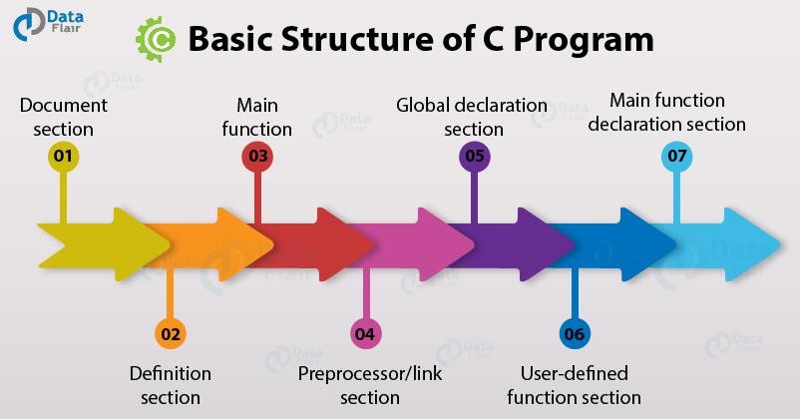

Slide 19
Basic Structure of C Programming
Documentation Section
statement specified at the beginning of a program - program's name, date, description, and title
Preprocessor Directive Section
header files used in a program.
Example : #include<stdio.h>
Link Section
Definition Section
Constants declared using the define keyword. Example: #define PI 3.14
Global declaration Section
Example : float num = 2.54; int a = 5;
main() function Section
{
Declaration part
Executable part
}
main() is the first function to be executed by the computer.
It is necessary for a code to include the main().
It is like any other function available in the C library.
Parenthesis () are used along with main.
Sub program Section
Function 1 User defined Functions Function 2
-------
user defined functions specified the functions specified as per the requirements of the user.
Examples: color(), sum(), division()

Slide 20
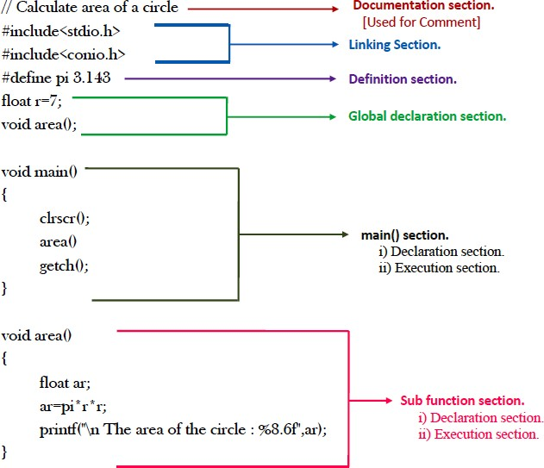
Basic Structure of C Programming
C Programming
Note :
Comment is non executable statement. It is used as a label of the program.
Every C program must have a main() function.
The execution always starts from main().
The main must be followed by a pair of
parenthesis ()
The body of the main() is enclosed within a pair of curly brackets { }
Every executable statement must be
terminated by semicolon ;
C is case sensitive.

Slide 21
Execution of a C Program

Slide 22
Executing a C Programming
C Programming
System Ready
Program Code
Enter program
Edit Source pgm
C Compiler
Compile source pgm
Syntax Errors?
Yes
No
System Library
Link with System Library

Slide 23
Executing a C Programming
Edit source program
No
System Library
Link with System
Library
Input Data
Execute Object Code
Yes
Logical Errors?
No
Correct Output
Stop

Slide 24
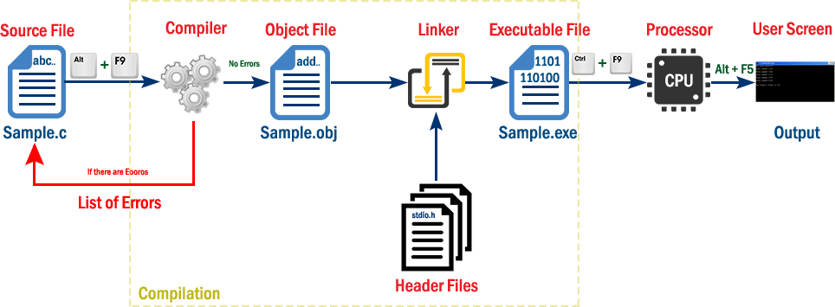
Executing a C Programming
C Programming

Slide 25
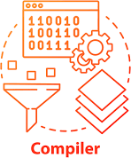

Slide 26

Compiler
C Programming
A compiler is a computer program that translates computer code written in one programming language (the source language) into another language (the target language).
The name "compiler" is primarily used for programs
that translate programming
source language
code from a high-level to a
lower level language (e.g. assembly language, object code,
or machine code) to create an executable program.

Slide 27







Steps to execute a program
C Programming
Creating the C program sample.c
1
Compiling the program
sample.obj
2
3
Linking the program with functions that are needed from C library
Executing the program
sample.exe
4

Slide 28

Program
First

Slide 29
First C Program
C Programming
Try in any of the C Compilers
Online Compiler
Dev C++
Borland C++
GCC (GNU’s Compiler Collection)
/* First C Program */
#include<stdio.h> void main()
{
printf(“Hello World!!!”);
}
To open the editor
gedit filename.c
Ex: gedit sample.c
To compile the program
Gcc filename.c
Ex: gcc sample.c
To see the output
./a.out
Output:
Hello World!!!

Slide 30
C Program examples
C Programming
// Three lines of statement
#include<stdio.h>
void main()
{
printf(“Two types of Software”); printf(“1.System Software”); printf(“2.Application Software”);
}
Output :
Two types of Software 1.System Software 2.Application Software

Slide 31
C Programming
Backslash constants (Escape sequence)
Non printing characters can be printed using escape sequence.
It always starts with \ followed by a character.
Escape sequence | Description
\a | System alarm
\b | Backspace
\n | Newline
\t | Horizontal tab
\” | Double quote
\’ | Single quote
\\ | \ (backslash)
\0 | Null character

Slide 32
C Programming
Examples
1.
#include<stdio.h>
void main()
{
printf(“Global Academy of Technology\n”);
printf(“R.R.Nagar\tBangalore”);
}
Output
Global Academy of Technology R.R.Nagar Bangalore

Slide 33
C Programming
Write C programs to get the following outputs
1.
Students’ of GAT Semester I \ II “Bangalore”
2.
Marks Grade
75 – 100 A
60 – 74 B
50 – 59 C
40 – 49 D
<40 E

Slide 34
C Programming
Examples
2.
#include<stdio.h>
void main()
{
printf(“A\nA\tB\nA\tB\tC\nA\tB\tC\tD”);
}
Output
A
A B
A B C
A B C D

Slide 35


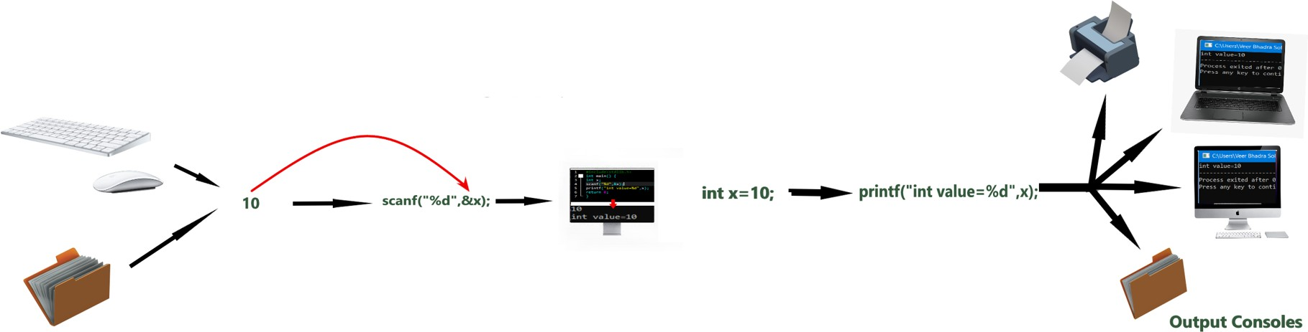
C Programming
C Input and Output Functions

Slide 36
C Input and Output Functions
C Programming
Input
provide the program with some data to be used in the program.
Output
display data on the screen or write the data to a printer or a file.
The C programming language provides standard library functions to read any given input and to display data on the console.

Slide 37
C Input and Output Functions
C Programming
printf() - Output function
The most used function in the C language.
Defined in the stdio.h header file
Used to show output on the console (standard output)
Used to print a simple text sentence or value of any variable

Slide 38


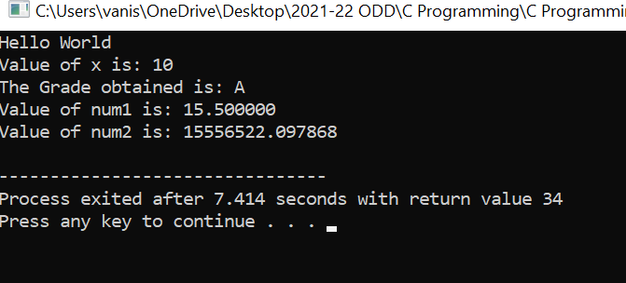
C Programming
#include<stdio.h>
void main()
{
printf("Hello World\n");
int x = 10;
printf("Value of x is: %d\n", x);
char grade = 'A';
printf("The Grade obtained is: %c\n", grade);
float num1 = 15.50;
double num2 = 15556522.0978678;
printf("Value of num1 is: %f \n", num1);
printf("Value of num2 is: %lf\n", num2);
}
printf() - Output function

Slide 39
C Programming
Format Specifiers
Data type | Format specifier
int | %d
short int | %hd
unsigned int | %u
long int | %li
float | %f
double | %lf
char | %c

Slide 40
C Input and Output Functions
C Programming
scanf() - Input function
The most used function in the C language.
Defined in the stdio.h header file
Used to read the value from the console (standard input)
When we take input from the user, we store the input value into a variable.

Slide 41
scanf() - Input function
C Programming
#include<stdio.h> void main()
{
int age; printf("Enter age: "); scanf("%d", &age);
printf("The entered age is: %d\n", age);
float marks; printf("Enter marks: "); scanf("%f", &marks);
printf("The entered marks is: %f", marks);
}
Output:
Enter age: 18
The entered age is: 18 Enter marks:
89.5
The entered marks is: 89.5

Slide 42
More Examples

Slide 43
C Input and Output Functions
1. Write a C program to input marks in 3 subjects, find total, average and print all of them on the screen.
#include<stdio.h> void main()
{
float m1, m2, m3, total, average; printf("Enter marks in 3 subjects\n"); scanf("%f%f%f", &m1, &m2, &m3); total=m1+m2+m3;
average=total/3.0; printf("Marks1=%f\nMarks2=%f\nMarks3=%f\n", m1, m2, m3); printf("Total=%f\nAverage=%f\n", total, average);
}

Slide 44
C Input and Output Functions
1. Write a C program to input marks in 3 subjects, find total, average and print all of them on the screen.
Output:
Enter marks in 3 subjects 65
78
77
Marks1=65.000000 Marks2=78.000000 Marks3=77.000000 Total=220.000000
Average=73.333336

Slide 45
C Input and Output Functions
2. Write a C program to input radius of circle and print area of circle.
#include<stdio.h> void main()
{
float r, area; printf("Enter radius: "); scanf("%f", &r); area=3.14*r*r;
printf("Area of circle is: %f", area);
}

Slide 46
C Input and Output Functions
2. Write a C program to input radius of circle and print area of circle.
Output:
Enter radius: 4.6
Area of circle is: 66.442398

Slide 47
C Character set

Slide 48
C Language
Alphabets
Tokens
Instructions
Programs

Slide 49
C Character set
Letters
(A to Z and a to z)
Digits
(0, 1, 2, ….. 9)
Character set
of C Language
Special characters
($, #, &, *, (, { , }, ), /)
White spaces Blank space, tab, new
line

Slide 50
In a C program, the smallest individual units are called as tokens.
Keywords
Identifiers
Constants
Strings
Special symbols
Operators
C Tokens

Slide 51
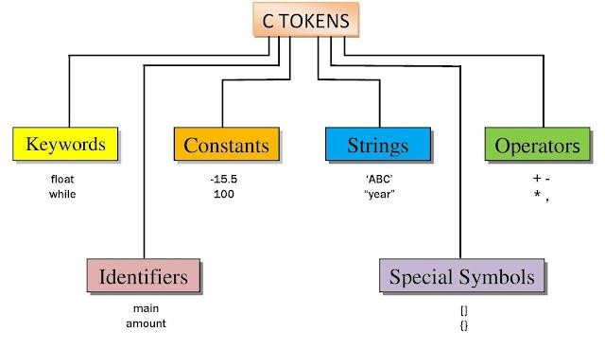
C Tokens
int float
12
6.88
“CSE”
“2021”
+
*
sum avg
[]
()

Slide 52
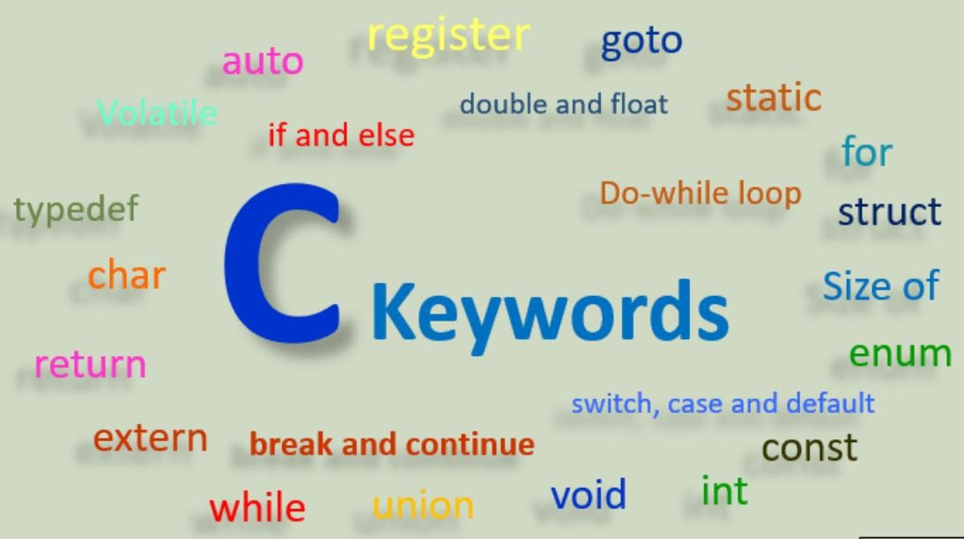
C Tokens
Keywords
Identifiers
Constants
Strings
Special Symbols
Operators

Slide 53
C Tokens
1. Keywords
Also called as Reserved words
All keywords have fixed meanings (predefined meanings) and these meanings cannot be changed.
Keywords serve as basic building blocks for program statements.
All keywords must be written in lowercase.
2. Identifiers
3. Constants
4. Strings
5. Special Symbols
6. Operators

Slide 54
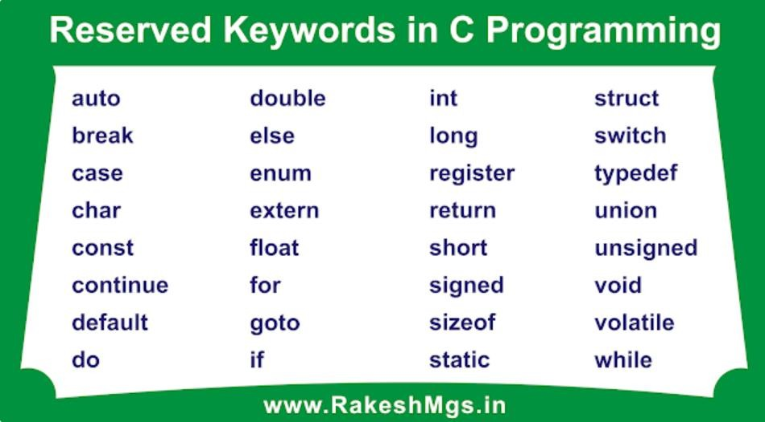

C Tokens
Keywords
Identifiers
Constants
Strings
Special Symbols
Operators

Slide 55
C Tokens
Keywords
Identifiers
Names provided to the elements of the program such as variables, functions and arrays.
3. Constants
4. Strings
Special Symbols
Operators

Slide 56
C Tokens
1. Keywords
Rules for naming an identifier
Can consist of alphabets, digits and _ (underscore).
Must always begin with an alphabet or _ and can be followed by digits.
Only first 31 characters are significant.
Must NOT contain special symbols or white spaces.
Case sensitive.
CANNOT use a keyword.
2. Identifiers
3. Constants
4. Strings
5. Special Symbols
6. Operators

Slide 57
C Tokens
Valid examples of Identifiers
1. Keywords
Total Voter_ID
sum1 roll_no
2. Identifiers
3. Constants
Invalid Identifiers for
sum-of-digits #USN NO
void
4. Strings
1stname roll number I Class
stream(branch)
5. Special Symbols
6. Operators

Slide 58
C Tokens
Keywords
Identifiers
Constants in C refer to fixed values that do not change during the execution of a program.
3. Constants
4. Strings
Special Symbols
Operators

Slide 59
C Tokens
Constants
1. Keywords
Numeric
Character
2. Identifiers
Integer |  |  | Float
 |  | Decimal
 |  | Octal
 |  | Hexa Decimal
Single
character
String
3. Constants
4. Strings
12, 6788, 906723, +45, -566
5. Special Symbols
-012, 06711, -0566
6. Operators
0XAB04, 0x78F, 0XEFFF

Slide 60
C Tokens
1. Integer constant
Whole numbers without decimal part.
1. Keywords
a) Decimal
Constants having
between 0–9
Can be + or –
Valid example:
digit
combination
2. Identifiers
3. Constants
4. Strings
-45 756 1234
Invalid example :
102 56 4.50
5. Special Symbols
6. Operators
-+56

Slide 61
C Tokens
b) Octal
Constants having digit combination between 0–7
Can be + or –
The constant must have the prefix 0 (Zero)
1. Keywords
2. Identifiers
3. Constants
4. Strings
Valid example:
077 -0756
Invalid example :
0102 56 -017.7 856
01234
5. Special Symbols
6. Operators

Slide 62
C Tokens
Hexa Decimal
  Constants having between 0–9 and A–F
digit
combination
1. Keywords
A ---> 10 F --->15
Can be + or –
The constant must have the prefix 0X / 0x
2. Identifiers
3. Constants
4. Strings
Valid example:
0X917 -0x1AF0x304a
Invalid example :
18C 0X1GA0x4.6E
5. Special Symbols
6. Operators

Slide 63
C Tokens
1. Keywords
2. Float constant
2. Identifiers
Represents a number having fractional part
May be + or –
3. Constants
4. Strings
Examples
-221.45
5. Special Symbols
44567.34 0.000009
6. Operators

Slide 64
C Tokens
3. Character constant
Represents a single character within a pair
of ‘ ‘
Stored as integers in computer’s memory
1. Keywords
2. Identifiers
Examples:
char op = ‘+’; char choice = ‘Y’; char num = ‘7’; printf(“%c”,op);
3. Constants
4. Strings
5. Special Symbols
6. Operators

Slide 65
C Tokens
3. Character constant
1. Keywords
Example: to find ASCII equivalent of a character
American Standard Code for Information Interchange, is
2. Identifiers
3. Constants
a character communication.
encoding standard for electronic ASCII codes represent text in
4. Strings
computers, telecommunications equipment, and other devices.
5. Special Symbols
6. Operators

Slide 66
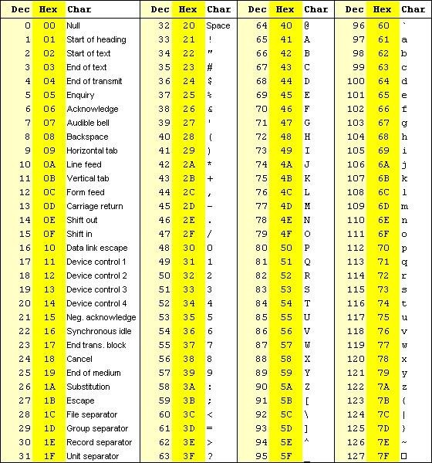
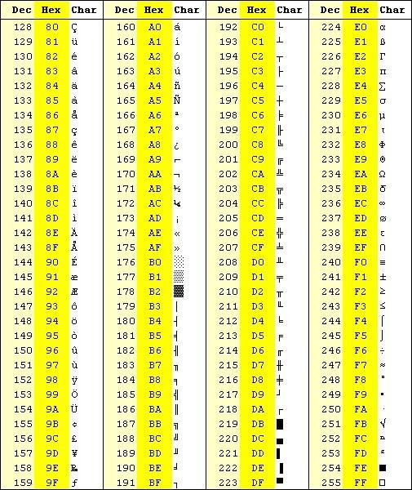

Slide 67
3. Character constant
C Tokens
Example: to find ASCII equivalent of a character
1. Keywords
#include<stdio.h>
void main()
{
char x='A';
printf("Char = %c\n",x);
printf("Eq. ASCII = %d\n",x);
2. Identifiers
3. Constants
4. Strings
5. Special Symbols
int y=97;
printf("Int = %d\n",y);
printf("Eq. Char = %c",y);
6. Operators
}

Slide 68
3. Character constant
C Tokens
Keywords
Identifiers
Constants
Strings
Special Symbols
Operators
Char constant | ASCII value
‘A’ | 65
‘B’ | 66
‘a’ | 97
‘b’ | 98
‘0’ | 48
‘1’ | 49

Slide 69
C Tokens
Represents a sequence of characters within a
pair of “ “
1. Keywords
2. Identifiers
3. Constants
Examples: “Good Morning” “10 + 40” “G.A.T”
4. Strings
5. Special Symbols
6. Operators

Slide 70
Variable

Slide 71
Variable
Variable is a data name that may be used to store a data value.
Unlike constants that remain unchanged during the execution of a program, a variable may take different values at different times during execution.
A variable name can be chosen by the programmer in a meaningful way so as to reflect its function or nature in the program.

Slide 72
Variable
Variable names may consist of letters, digits, and the underscore(_) character, subject to the following conditions:
They must begin with a letter. Some systems permit underscore as the first character.
ANSI standard recognizes a length of 31 characters.
Uppercase and lowercase are significant. That is, the variable Total is not the same as
total or TOTAL.
It should not be a keyword.
Special symbols and White space are not allowed.

Slide 73
Variable
Declaring a Variable
Every variable has to be declared before its first use.
Syntax:
Datatype variablename;
Examples:
int a;
float num1, num2;
char grade;

Slide 74
Variable
Initializing a Variable
Here, the value can be assigned to a variable by the programmer. For every execution, the value of the variable may be same.
Examples:
int a =40;
float num1, num2; num1=67; num2=6.8;
char grade=‘A’;

Slide 75
Variable
Note :
When a variable is defined, it is not initialized. We must initialize any variable requiring prescribed data when the function starts.
Example of uninitialized variable
#include<stdio.h> void main()
{ | int x, y, z;
 | z=34;
 | printf("x=%d | y=%d | z=%d\n", x, y, z);
 | x=z;
 | y = x + 10;
 | printf("x=%d | y=%d | z=%d\n", x, y, z);
}
Output
x=1643488 y=32762 z=34
x=34 y=44 z=34

Slide 76
Data Types

Slide 77
Data Types
Defines the type of data that is stored in a variable.
Determines how much storage should be allocated to a variable.

Slide 78
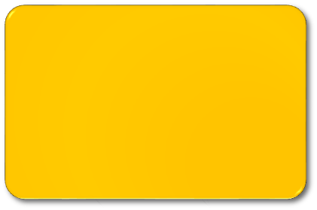








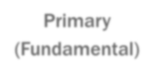





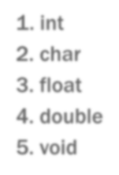


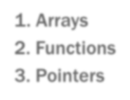
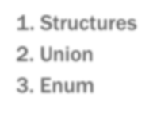
Data Types
Data Types
Primary (Fundamental)
Derived
User-defined
int
char
float
double
void
Arrays
Functions
Pointers
Structures
Union
Enum

Slide 79
Data Types - Primary (Fundamental) Datatype
Data type | Description | Size (bytes) | Range
int | Stores integer values | 2 | - 32768 to 32767
char | Stores single character | 1 | -128 to 127
float | Stores real numbers | 4 | 3.4 e⁻³⁸ to 3.4 e³⁸
double | Stores real numbers | 8 | 1.7 e⁻³⁰⁸ to 1.7 e³⁰⁸
void | Stores no values Returns no values | - | -

Slide 80
Data Types - Primary (Fundamental) Datatype
Data type | Modifiers | Size (bytes) | Range
int | signed int | 2 (16 bits) | -32768 to 32767
 | unsigned int | 2 | 0 to 65535
 | short int | 1 | -128 to 127
 | long int | 4 | -2147483648 to 2147483647
 | unsigned short int | 1 | 0 to 255
 | unsigned long int | 4 | 0 to 4294967295
char | signed char | 1 | -128 to 127
 | unsigned char | 1 | 0 to 255
double | double | 8 | 1.7 e⁻³⁰⁸ to 1.7 e³⁰⁸
 | long double | 10 | 3.4 e⁻⁴⁹³² to 3.4 e⁴⁹³²

Slide 81
#include <stdio.h>
int main()
{
// integer value with positive data.
int a = 9;
// integer value with negative data.
int b = -9;
// u or u is used for unsigned int in c.
unsigned int c = 89;
// l or l is used for long int in c.
long int d = 99998l;
printf("integer value with positive data: %d\n", a);
printf("integer value with negative data: %u\n", b);
printf("integer value with an unsigned int data: %u\n", c);
printf("integer value with an long int data: %ld", d);
return 0;
}

Slide 82
#include <stdio.h>
int main()
{
char a = 'a';
char c;
printf("Value of a: %c\n", a);
a++;
printf("Value of a after increment is: %c\n", a);
// c is assigned ASCII values
// which corresponds to the
// character 'c'
// a-->97 b-->98 c-->99
// here c will be printed
c = 99;
printf("Value of c: %c", c);
return 0;
}

Slide 83
Managing I/O operations

Slide 84
Managing I/O operations
Reading a character
Writing a character
Formatted Input
Formatted Output

Slide 85
Managing I/O operations
Reading a character
  We can use scanf() with %c format
char ch; scanf(“%c”, &ch);
Example :
2. We can use getchar()
char ch; ch=getchar();
Example:

Slide 86
Managing I/O operations
Writing a character
  We can use printf() with %c format
char ch=‘$’; printf(“%c”, ch);
Example :
2. We can use putchar()
char ch=‘$’; putchar(ch);
Example:

Slide 87
Managing I/O operations
//demo of getchar() and putchar()
#include<stdio.h> void main()
{
char ans;
printf("Enter a character: "); ans=getchar();
printf("The entered character is: ");
putchar(ans);
}
Output:
Enter a character: K
The entered character is: K

Slide 88
Managing I/O operations
Character Test Functions #include<ctype.h>
isalnum(c) | Is c alphanumeric character | Returns non-zero if it is alphanumeric character, else returns 0
isalpha(c) | Is c alphabet | Returns non-zero if it is alphabet, else returns 0
isdigit(c) | Is c digit | Returns non-zero if it is digit, else returns 0
islower(c) | Is c lowercase letter | Returns non-zero if it is lowercase letter, else returns 0
isupper(c) | Is c uppercase letter | Returns non-zero if it is uppercase letter, else returns 0
isspace(c) | Is c white space | Returns non-zero if it is white space, else returns 0
toupper(c) | Convert the letter to uppercase | Converts lowercase alphabet to uppercase.
tolower(c) | Convert the letter to lowercase | Converts uppercase alphabet to lowercase.

Slide 89
#include<ctype.h>
#include<stdio.h>
void main(){
char n;
printf("\nEnter a character=");
n=getchar();
if(isalpha(n))
printf("\nYou typed an alphabet");
if(isdigit(n))
printf("\nYou typed a digit");
if(isalnum(n))
printf("\nYou typed an alphabet or digit");
if(isspace(n))
printf("\nYou typed a blank space");
if(ispunct(n))
printf("\nYou typed punctuator");
if(isupper(n))
printf("\n you typed uppercase character\n");
if(islower(n))
printf("\nyou typed lower case character\n");
}

Slide 90
Managing I/O operations
//demo of getchar() and putchar() #include<stdio.h> #include<ctype.h>
void main()
{
char ch, res;
printf("Enter a lowercase letter: ");
ch=getchar();
res=toupper(ch);
printf("The uppercase character is: "); putchar(res);
}
Output:
Enter a lowercase letter: r
The uppercase character is: R

Slide 91
Managing I/O operations
//demo of character test functions #include<stdio.h> #include<ctype.h>
void main()
{
char ch;
printf("Enter a character: "); ch=getchar();
Output:
Enter a character: B isalnum(ch)=1 isalpha(ch)=1 isupper(ch)=1 islower(ch)=0 isdigit(ch)=0 isspace(ch)=0
printf("isalnum(ch)=%d\n",isalnum(ch)); printf("isalpha(ch)=%d\n",isalpha(ch)); printf("isupper(ch)=%d\n",isupper(ch)); printf("islower(ch)=%d\n",islower(ch)); printf("isdigit(ch)=%d\n",isdigit(ch)); printf("isspace(ch)=%d\n",isspace(ch));
}

Slide 92
Managing I/O operations
c) Formatted Input: Input data that has been arranged in a particular format.
Inputting integer numbers Example:
#include<stdio.h> void main()
{
int num1, num2;
printf("Enter 2 numbers\n"); scanf("%2d %5d", &num1, &num2);
printf("num1=%d num2=%d",num1, num2);
Run1
Enter 2 numbers
1235 67
num1=12 num2=35
Run2
Enter 2 numbers
31426 50
num1=31 num2=426
}

Slide 93
Managing I/O operations
Data Type | Format Specifier
int | %d
char | %c
float | %f
double | %lf
short int | %hd
unsigned int | %u
long int | %li
long long int | %lli
unsigned long int | %lu
unsigned long long int | %llu
signed char | %c
unsigned char | %c
long double | %Lf

Slide 94
Managing I/O operations
d) Formatted output:
printf() is used for formatted output.
Example:
Example:
y=1234;
printf("%d\n",y);
y=5;
printf("%d\n",y);
1 | 2 | 3 | 4
5
printf("%6d\n",y);
 |  | 1 | 2 | 3 | 4
printf("%2d\n",y);
5
printf("%6d\n",y);
 |  |  |  |  | 5

Slide 95
Managing I/O operations
Example: integers
int y=9876; printf("%d",y);
printf("%6d",y);
printf("%2d",y);
printf("%-6d",y);
printf("%06d",y);
9 | 8 | 7 | 6
 |  | 9 | 8 | 7 | 6
9 | 8 | 7 | 6
9 | 8 | 7 | 6
0 | 0 | 9 | 8 | 7 | 6

Slide 96
Managing I/O operations
Example: real numbers
float y=98.7654;
printf("%7.4f",y);
printf("%7.2f",y);
printf("%-7.2f",y);
printf("%f",y);
9 | 8 | . | 7 | 6 | 5 | 4
 |  | 9 | 8 | . | 7 | 7
9 | 8 | . | 7 | 7
9 | 8 | . | 7 | 6 | 5 | 4

Slide 97
Managing I/O operations
Example: real numbers
float y=98.7654;
printf("%10.2e",y);
printf("%11.4e",-y);
printf("%-10.2e",y);
printf("%e",y);
 |  | 9 | . | 8 | 8 | e | + | 0 | 1
- | 9 | . | 8 | 7 | 6 | 5 | e | + | 0 | 1
9 | . | 8 | 8 | e | + | 0 | 1
9 | . | 8 | 7 | 6 | 5 | 4 | 0 | e | + | 0 | 1

Slide 98
#Iclude<stdio.h> void main()
{
Output
Enter 3 marks
78.65433
98.444
79.5
Marks1=78.65 Marks2=98.44 Marks3=79.50 Total=256.60 Average=85.53
float m1, m2, m3, total, avg; printf("Enter 3 marks\n"); scanf("%f%f%f", &m1, &m2, &m3); total=m1+m2+m3;
avg=total/3; printf("Marks1=%5.2f\n",m1);
printf("Marks2=%5.2f\n",m2); printf("Marks3=%5.2f\n",m3); printf("Total=%5.2f\n",total); printf("Average=%5.2f\n",avg);
}

Slide 99

Operators and expressions

Slide 100
Operators and expressions
An operator is a symbol that tell the computer to perform certain mathematical or logical manipulations.
Operators are used to manipulate data and variables.

Slide 101
Types of operators
Arithmetic operators
Relational operators Logical operators Assignment operator
Increment and decrement operators
Conditional operator Bitwise operators Special operators

Slide 102
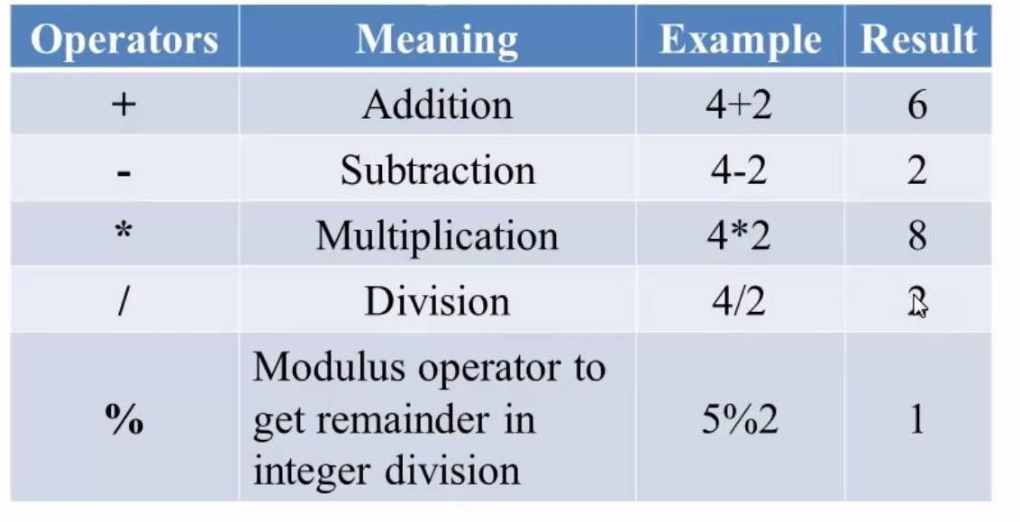
1. Arithmetic operators
Note
% works only with int datatype

Slide 103
1. Arithmetic operators
Examples 7 + 3 = 10
‘1’ + 3 = 49 + 3 = 52
‘A’ * 2 = 65 * 2 = 130
– 5 / 2 = -2
7 / 2 = 3
– 5 % 2 = -1
7.5 / 2 = 3.75
5 / -2 = -2
7.0 / 2 = 3.5
5 % 2 = 1
10 % 3 = 1
-5 / -2 = 2
‘a’ % 10 = 97 % 10 = 7
-5 % -2 = -1
5.6%2 = ERROR

Slide 104
1. Arithmetic operators
1. Write a program to input an integer and find the right most digit.
#include<stdio.h> void main()
{
int num, rem;
printf("Enter an integer\n"); scanf("%d",&num); rem=num%10;
printf("The right most digit is %d", rem);
}

Slide 105
1. Arithmetic operators
2. Write a program to input an integer and find its digit at 10’s place.
#include<stdio.h> void main()
{
int num, rem;
printf("Enter an integer\n"); scanf("%d",&num); num=num/10; rem=num%10;
printf("The digit at ten's place is %d", rem);
}

Slide 106
1. Arithmetic operators
3. Write a program to input 2 integers and find the remainder without using % operator.
#include<stdio.h> void main()
{
int a, b, q, rem;
printf("Enter 2 integer values\n"); scanf("%d%d",&a, &b);
q=a/b; rem=a-(q*b);
printf("Quotient=%d\nRemainder=%d", q, rem);
}

Slide 107
2. Relational operators
Used to compare the values of two expressions.
If the result is true, return 1. If the result is false, returns 0.
The operators are
1. Less than | <
2. Less than or equal to | <=
3. Greater than | >
4. Greater than or equal to | >=
5. Equal to | = =
6. Not equal to | !=

Slide 108
2. Relational operators
Examples
1. int a = 4 , b = 78 , c;
c = a ==b ; printf(“%d ”,c);
c = 4 != 78 ; printf(“%d”,c);
Output :
0 1
Note:
Avoid using float or double with relational operators
2. int a=12, b=3;
printf(“%d\n”, (a==b));
printf(“%d”, (a=b));
Output :
0
3
3. int a=6,b=8, c; c= a+10 >=b; printf(“%d”,c);
Output :
1

Slide 109
3. Logical operators
Used to combine two expressions. The result will be either true or false.
Types of Logical operators
Logical NOT !
Logical AND &&
Logical OR ||

Slide 110
3. Logical operators
Logical NOT !
It reverses the logical value of a variable or a constant or an expression.
Truth table
A | ! A
0 | 1
1 | 0

Slide 111
3. Logical operators
Logical NOT !
Examples
! (3 > 4) ----> !(false) = true = 1
!(4==4) ------> !(true) = false = 0
! 7 -----> ! (true) = false = 0
! 0 ------> ! (false) = true = 1
! (-45) ------> !(true) = false = 0
In C, 0 is considered as false and any non-zero value is considered as true

Slide 112
3. Logical operators
Logical AND &&
Works on 2 operands.
Result is true if values of both expressions are true.
Result is false, if any one expression value is false.
Truth table
A | B | A && B
0 | 0 | 0
0 | 1 | 0
1 | 0 | 0
1 | 1 | 1

Slide 113
3. Logical operators
Logical AND &&
Example
78 > 3 && 4 <=3;
= (78>3) && (4<=3) = 1 && 0 = 0
Write a C expression to check whether marks is between 75 and 100 marks >= 75 && marks<=100;

Slide 114
3. Logical operators
Logical OR ||
Works on 2 operands.
Result is false if values of both expressions are false.
Result is true, if any one expression value is true.
Truth table
A | B | A || B
0 | 0 | 0
0 | 1 | 1
1 | 0 | 0
1 | 1 | 1

Slide 115
3. Logical operators
Logical OR ||
Example
78 > 3 || 4 <=3;
= (78>3) || (4<=3) = 1 || 0 = 1

Slide 116
3. Logical operators
Evaluate the following expressions 1. 10!=10 || 5<4 && 8
(10!=10) || (5<4) && 8
false || false && true false || (false && true) false || false = false

Slide 117
3. Logical operators
Evaluate the following expressions
2. a>=b && ! (a+b > a+1) if a=3, b=0
3>=0 && !(3+0 > 3+1)
True && !( 3 > 4)
True && !(false) = true && true = true

Slide 118
4. Assignment operator
It is used to assign the value of a constant or variable or value of an expression to a variable on the left side of = operator.
Types
Simple assignment statement Ex : int x; x = 40;
Multiple assignment statement Ex : int x, y, z; x= y = z = 78;
Shorthand expression + = , - = , * = , / = , % =
Examples on shorthand expressions
1. a+= 3 -----> a=a+3
2. z - = x*y -----> z = z – (x*y)
3. n/=10 ------> n = n/10
4. b* = (b + 4 * d) -----> b = b * (b + (4 * d))
5. a% = 2 -----> a = a%2
6. x+ = a/b*c -----> x = x + ((a/b) * c)

Slide 119
5. Increment and decrement operators
Used to add/subtract 1 from the same variable. Example:
a = a + 1 ====> a++ or ++a
Types
Prefix expression
Postfix expression

Slide 120
5. Increment and decrement operators
Prefix expression
Consists of only ++ and - -
Increments / decrements value by 1 only
Consists of one operand preceded by the operator
Rule of prefix : change the value of the variable and then use it in the expression.

Slide 121
5. Increment and decrement operators
Prefix expression
1) int a = 4;
printf("a=%d\n",a);
printf("Pre incremented value of a=%d\n",++a);
printf("a=%d",a);
2) int a = 6, b = 4, c;
c = ++a + ++b;
printf("a=%d b=%d c=%d",a, b, c);
a=4
Pre incremented value of a=5 a=5
a=7 b=5 c=12

Slide 122
5. Increment and decrement operators
Prefix expression
3) int x = 6, y; y = 3 * x--;
printf("x=%d y=%d\n", x, y);
x = ++y;
printf("x=%d y=%d\n", x, y);
x=5 y=18 x=19 y=19
4) int a = 5, b;
b= --a + a;
printf("a=%d b=%d",a, b);
a=4 b=8

Slide 123
5. Increment and decrement operators
Postfix expression
Consists of only ++ and - -
Increments / decrements value by 1 only
Consists of one operand followed by the operator
Rule of postfix : Use the current value in the expression and then change it.

Slide 124
5. Increment and decrement operators
Postfix expression
1) int a = 4;
printf("a=%d\n",a);
printf("Post incremented value of a=%d\n", a++);
printf("a=%d",a);
2) int a = 6, b = 4, c;
c = a++ + b++;
printf("a=%d b=%d c=%d",a, b, c);
a=4
Post incremented value of a=4 a=5
a=7 b=5 c=10

Slide 125
5. Increment and decrement operators
Prefix expression
3) int a = 3, b;
b = a++ + a++ + a++;
printf("a=%d b=%d",a,b);
a=6 b=12
4) int x = 6, y; y = 3 * x++;
printf("x=%d y=%d\n", x, y);
y++;
printf("x=%d y=%d\n", x, y);
x=7 y=18 x=7 y=19

Slide 126
6. Conditional operator
Also known as Ternary operator
Decision making statement
Syntax :
Expression ? True Expression : False expression;
If the value of the expression is true, the True expression is executed, otherwise the False
expression is executed, not both.

Slide 127
6. Conditional operator
Example :
int x , y =7, z = 10; x = y>=z ? 70 : 100;
x = 7 >= 10 ? 70 : 100
Working :
Since 7 >= 10 is false, 100 is evaluated to x; x = 100

Slide 128
6. Conditional operator
1) Write a C program to input principal and time. If time is more than 8 years, assign rate of
interest as 12% , else as 18%. Calculate simple interest and display. #include<stdio.h>
void main()
{
float P, SI; int T, R;
printf("Enter principal and time\n");
scanf("%f%d",&P, &T);
R = T > 8 ? 12 : 18;
SI = (P * T * R ) / 100;
printf("SI = %f", SI);
}

Slide 129
6. Conditional operator
2) Write a C program to input marks, if marks is more than 80, assign grade as ‘A’
otherwise as ‘B’ #include<stdio.h> void main()
{
int marks; char grade;
printf("Enter marks:");
scanf("%d",&marks);
grade = marks >= 80 ? 'A' : 'B'; printf("Grade = %c", grade);
}

Slide 130
6. Conditional operator
3) Write a C program to find the smallest of two numbers using conditional operator.
#include<stdio.h> void main()
{
int a,b,small;
printf("Enter 2 numbers\n"); scanf("%d%d", &a, &b); small=a<b? a:b;
printf("The smallest number is %d",small);
}

Slide 131
7. Bitwise operators
Used to manipulate bits of the given data
Work only on integers
Types
Bitwise negate (one’s compliment) ~
Bitwise AND
Bitwise OR
Bit left shift
Bit right shift
&
|
<<
>>

Slide 132
7. Bitwise operators
Bitwise negate (one’s compliment) ~
Interchanges 0s and 1s in the specified operand
Examples
a=12;
b=~a;
Working
a | 0 | 0 | 0 | 0 | 0 | 0 | 0 | 0 | 0 | 0 | 0 | 0 | 1 | 1 | 0 | 0
~a | 1 | 1 | 1 | 1 | 1 | 1 | 1 | 1 | 1 | 1 | 1 | 1 | 0 | 0 | 1 | 1
Output a=12 b= -13
Sign bit
0 +ve, 1 -ve

Slide 133
7. Bitwise operators
Bitwise AND &
If the corresponding bit positions in both the operands are 1, result is 1 , else result is 0.
Example
int a=10, b=6, c;
c = a & b;
printf(“%d”,c); Output : 2
a | 0 | 0 | 0 | 0 | 0 | 0 | 0 | 0 | 0 | 0 | 0 | 0 | 1 | 0 | 1 | 0
b | 0 | 0 | 0 | 0 | 0 | 0 | 0 | 0 | 0 | 0 | 0 | 0 | 0 | 1 | 1 | 0
a & b | 0 | 0 | 0 | 0 | 0 | 0 | 0 | 0 | 0 | 0 | 0 | 0 | 0 | 0 | 1 | 0

Slide 134
7. Bitwise operators
Bitwise OR |
If the corresponding bit positions in both the operands are 0, result is 0 , else result is 1.
Example
int a=10, b=6, c;
c = a | b;
printf(“%d”,c); Output : 14
a | 0 | 0 | 0 | 0 | 0 | 0 | 0 | 0 | 0 | 0 | 0 | 0 | 1 | 0 | 1 | 0
b | 0 | 0 | 0 | 0 | 0 | 0 | 0 | 0 | 0 | 0 | 0 | 0 | 0 | 1 | 1 | 0
a | b | 0 | 0 | 0 | 0 | 0 | 0 | 0 | 0 | 0 | 0 | 0 | 0 | 1 | 1 | 1 | 0

Slide 135
7. Bitwise operators
Bitwise XOR ^
If the corresponding bit positions in both the operands have odd number of 1’s, result is 1 ,
else result is 0.
Example
int a=10, b=6, c;
c = a ^ b; printf(“%d”,c); Output : 12
a | 0 | 0 | 0 | 0 | 0 | 0 | 0 | 0 | 0 | 0 | 0 | 0 | 1 | 0 | 1 | 0
b | 0 | 0 | 0 | 0 | 0 | 0 | 0 | 0 | 0 | 0 | 0 | 0 | 0 | 1 | 1 | 0
a ^ b | 0 | 0 | 0 | 0 | 0 | 0 | 0 | 0 | 0 | 0 | 0 | 0 | 1 | 1 | 0 | 0

Slide 136
7. Bitwise operators
Bit Left Shift <<
Used to shift the data by a specified number of bit positions towards left.
Example :
5 << 1 means 5 is shifted towards left by 1 bit position = 10
5 | 0 | 0 | 0 | 0 | 0 | 0 | 0 | 0 | 0 | 0 | 0 | 0 | 0 | 1 | 0 | 1
5<<1 | 0 | 0 | 0 | 0 | 0 | 0 | 0 | 0 | 0 | 0 | 0 | 0 | 1 | 0 | 1 | 0

Slide 137
7. Bitwise operators
Bit Left Shift <<
Used to shift the data by a specified number of bit positions towards right.
Example :
5 >> 1 means 5 is shifted towards right by 1 bit position = 2
5 | 0 | 0 | 0 | 0 | 0 | 0 | 0 | 0 | 0 | 0 | 0 | 0 | 0 | 1 | 0 | 1
5>>1 | 0 | 0 | 0 | 0 | 0 | 0 | 0 | 0 | 0 | 0 | 0 | 0 | 0 | 0 | 1 | 0

Slide 138
8. Special operators
Comma operator
The comma operator can be used to link the related expressions together.
A comma-linked list of expressions are evaluated left to right and the value of right-most
expression is the value of the combined expression.
Example :
value = (x = 10, y = 5, x+y);
First assigns the value 10 to x, then assigns 5 to y, and finally assigns 15 (i.e. 10 + 5) to
value.
Since comma operator has the lowest precedence of all operators, the parentheses are necessary.

