Slide 1

PROJECT ON
EXPLORATORY DATA ANALYSIS ON THE AMEO DATASET

Slide 2


AGENDA:
1. INTRODUCTION
2. DATASET EXPLORATION
3. DATA PRE-PROCESSING
4. EXPLORATORY DATA ANALYSIS (EDA)
5. OVERALL CONCLUSION
6. Q/A
7. THANK YOU

Slide 3

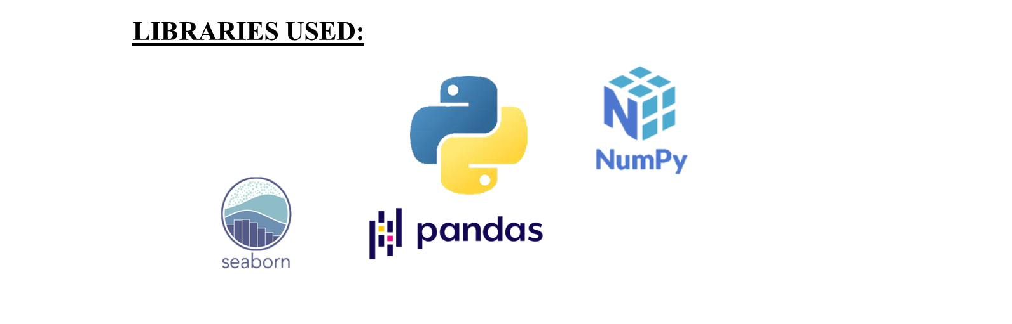

1. INTRODUCTION
OBJECTIVE:
The goal of this Exploratory Data Analysis (EDA) is to extensively investigate the provided dataset, with a particular emphasis on understanding the link between various variables and the target variable, Salary.
The key aims of this analysis include:
- Providing a detailed explanation of the dataset's features.
- Find any observable patterns or trends in the data.
- Investigating the relationships between the independent factors and the target variable (salary).
- Identify any outliers or abnormalities in the dataset.
- Offering practical insights and recommendations based on the analysis.

Slide 4

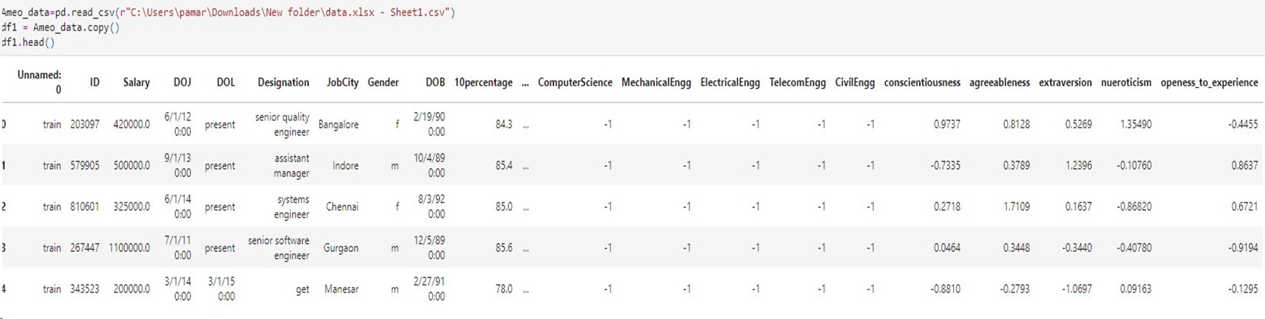
2. DATASET EXPLORATION
Description:
The Aspiring Mind Employment Outcome 2015 (AMEO) dataset, provided by Aspiring Minds, is designed to examine the employment outcomes of engineering graduates. It comprises essential variables like Salary, Job Titles, and Job Locations, as well as standardized scores reflecting cognitive skills, technical skills, and personality traits. Featuring approximately 40 independent variables and a dataset size of 4000 entries, this dataset encompasses a mix of continuous and categorical data. Additionally, it incorporates demographic characteristics and unique identifiers for individual candidates.

Slide 5

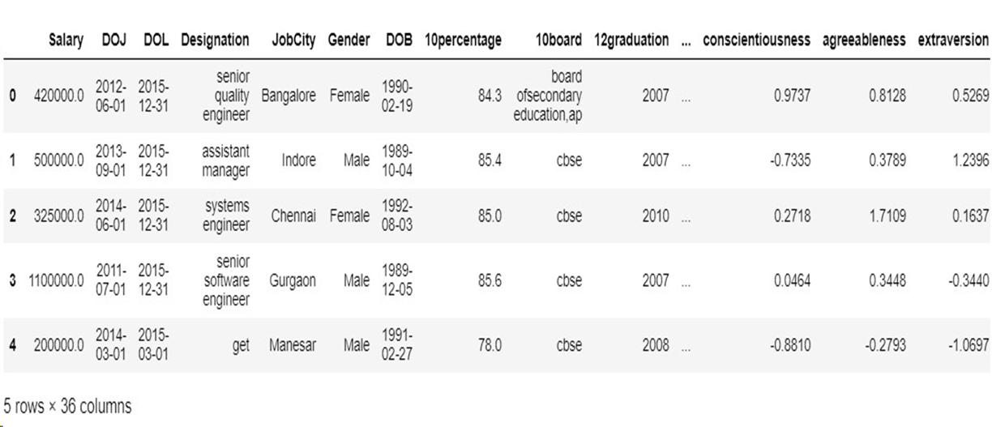
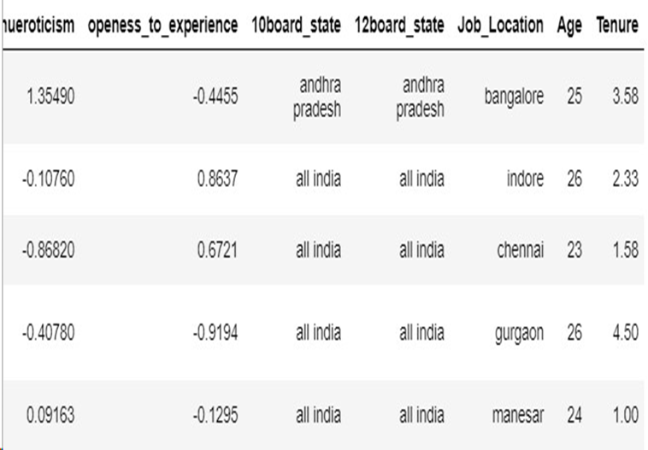
3. DATA PRE-PROCESSING
Data Cleaning and Data Manipulation in EDA Process:
1. Data Cleaning:
Identifying and Handling Missing Values:
Explore the dataset to identify any missing values.
Decide on an appropriate strategy for handling missing data (imputation or removal).
Handling Duplicate Entries:
Check for and eliminate duplicate rows or columns that may skew the analysis.
Dealing with Inconsistent Data:
Identify and rectify inconsistencies in data, ensuring uniformity.
Addressing Outliers:
Detect and evaluate outliers that could impact the analysis.
Decide whether to remove, transform, or keep outliers based on the context.
2. Data Manipulation:
Feature Engineering:
Create new relevant features that might enhance the analysis.
Combine or transform existing features to extract more meaningful information.
Standardizing and Normalizing:
Standardize or normalize data to ensure consistency in scales across different features.
Handling Categorical Data:
Convert categorical variables into numerical formats for analysis.
Filtering and Subsetting:
Focus on relevant subsets of data based on specific criteria for more targeted analysis.
Data Aggregation:
Aggregate data as needed to facilitate higher-level insights.
AFTER DATA CLEANING AND MANIPULATION

Slide 6

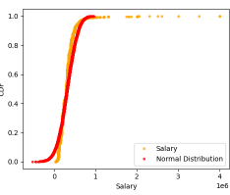
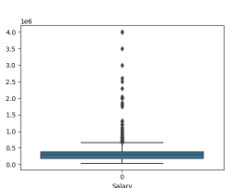
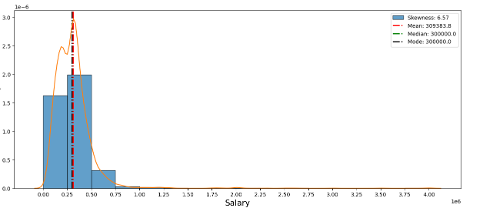
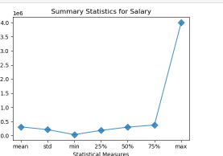
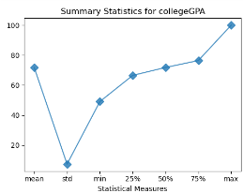
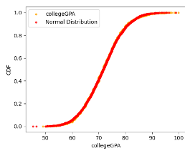
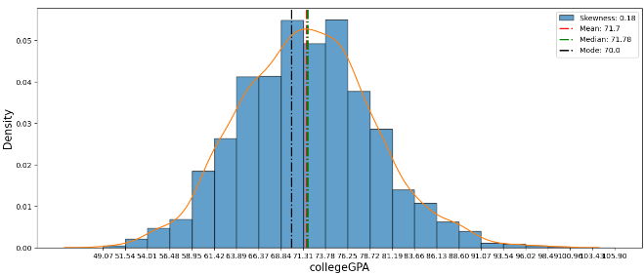
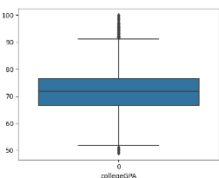
4. EXPLORATORY DATA ANALYSIS (EDA)
UNIVARIATE ANALYSIS:
Univariate analysis involves the examination of a single variable, providing insights into its distribution, central tendency, and dispersion. In this analysis, we focus on individual variables without considering their relationships with other variables.
Salary:
Summary Plot: The summary plot for salary provides a quick overview of its statistical measures, such as mean, median, and quartiles.
Histogram: A histogram visualizes the distribution of salary values, revealing skewness and central tendencies.
Box Plot: The box plot helps identify outliers and displays the overall distribution of salary.
Cumulative Distribution Function (CDF): CDF illustrates the cumulative probability distribution of salary values.
COLLEGE GPA:
Summary Plot: Similar to salary, a summary plot presents statistical measures for COLLEGE percentage.
Histogram: Visualizes the distribution of COLLEGE percentage values and highlights measures like mean and median.
Box Plot: Displays the spread and central tendency of COLLEGE percentage.
CDF: Cumulative Distribution Function for COLLEGE percentage provides insights into the data's cumulative distribution.

Slide 7

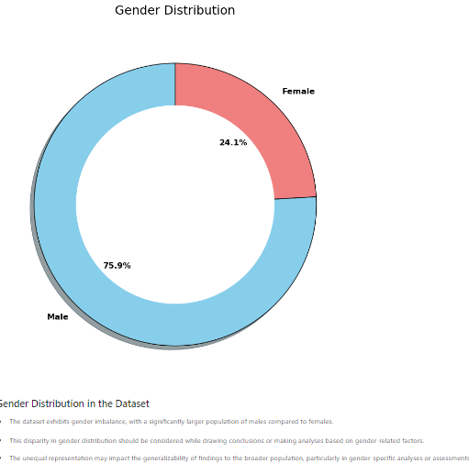
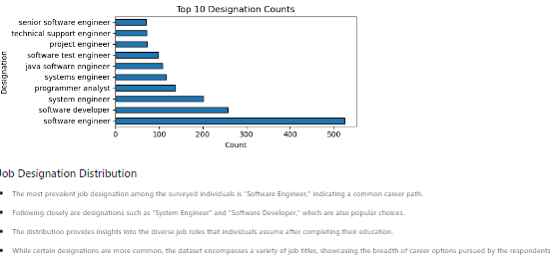
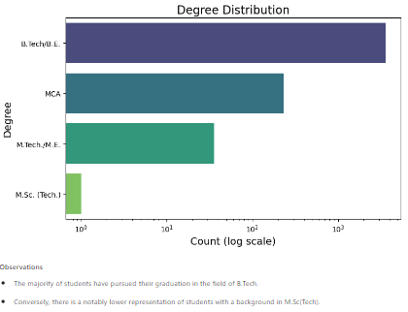
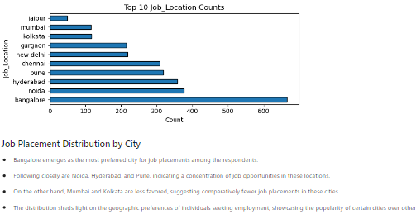
CATEGORICAL FEATURES ANALYSIS: UNIVARIATE
Gender Distribution:
The gender distribution reveals that the dataset comprises both male and female students.
Job Designation:
The job designation distribution showcases the variety of roles students take on after graduation.
Degree Distribution:
There is a mix of different degrees among the students, including both engineering and non-engineering disciplines.
Job Location Distribution:
The distribution of job locations indicates that students secured employment in various cities.

Slide 8

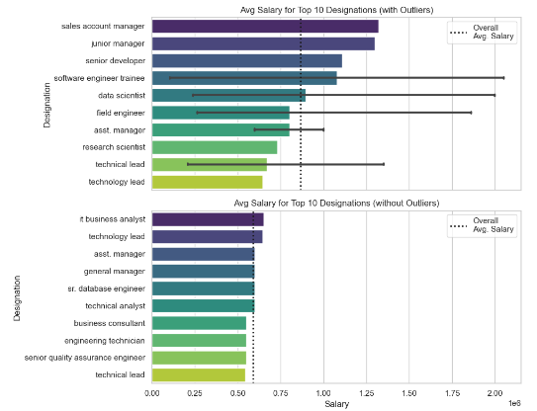
BIVARIATE ANALYSIS
Bivariate analysis involves exploring the relationships and patterns between two variables. By examining the interactions between pairs of features, we gain insights into how they influence each other and contribute to the overall dataset. In this analysis, we focus on specific pairs of features and evaluate their joint behavior.
1. Continuous vs. Continuous Features
Correlation Analysis: Investigating the correlation between pairs of continuous features to understand how changes in one variable correspond to changes in another.
Scatter Plots: Visualizing the distribution of data points in a scatter plot to identify trends, patterns, and potential outliers.
2. Categorical vs. Continuous Features
Box Plots: Utilizing box plots to compare the distribution of continuous variables across different categories.
Bar Plots: Visualizing the average or aggregated values of continuous features for each category.
3. Categorical vs. Categorical Features
Stacked Bar Plots: Creating stacked bar plots to display the distribution of one categorical variable within each category of another.
Chi-Square Test: Applying statistical tests to assess the independence or association between two categorical variables.
4. Time-Series Analysis
Line Plots: Analyzing the trends and patterns in time-series data to identify seasonality or other temporal patterns.
Correlation Over Time: Examining how the correlation between two variables evolves over different time intervals.
Average Salary for each Designation
Observations:
The bar plot illustrates the maximum salary for each designation. Notably, the Senior Software Engineer position commands the highest salary, but it also exhibits the maximum standard deviation, indicating a wider range of salaries within this role. Additionally, only two designations, namely Software Developer and Technical Support Engineer, have salaries below the average salary

Slide 9

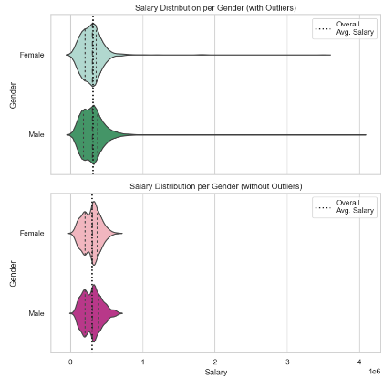
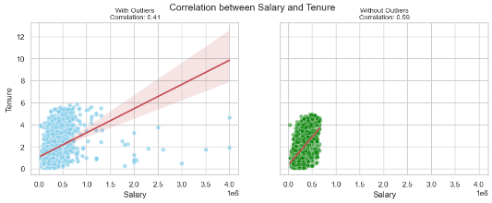
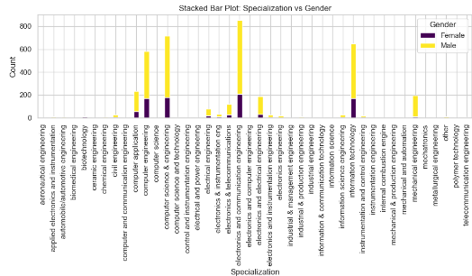
Average Salary for each Gender:
Observations:
The violin plot reveals that the average salary for both male and female employees is approximately equal, suggesting no significant gender bias in terms of salary. However, it is noteworthy that the distribution for female salaries tends to have a slightly wider range, with some salaries falling below the overall average salary.
Salary & Tenure:
Observations:
After removing outliers, a clear positive correlation between Salary and Tenure emerges, with a correlation coefficient of 0.59. This indicates that, on average, salary tends to increase with tenure, and the relationship is stronger without the influence of outliers compared to the correlation of 0.41 with outliers.
Gender and Specialization:
Observations:
The bar plot displays the distribution of specializations within the domain of Engineering. Electronic and Communication Engineering is the most prevalent specialization, followed by Computer Engineering. The plot further breaks down the distribution by gender, highlighting the proportions of both male and female students in each specialization.

Slide 10

OVERALL CONCLUSION:
The project focused on analyzing a comprehensive dataset capturing the employment outcomes of engineering graduates, particularly emphasizing the variable "Salary." The endeavour involved multiple stages, including data understanding, manipulation, and visualization, to derive meaningful insights.
Here are the key conclusions drawn from the analysis:
Data Understanding:
The dataset provided a rich source of information, including standardized scores for cognitive, technical, and personality skills.
The target variable, "Salary," was central to the analysis, aiming to understand the factors influencing variations in compensation.
Data Manipulation:
Initial data cleaning involved handling duplicates and missing values, ensuring a robust dataset for analysis.
The dataset comprised 4000 rows and 40 columns, necessitating careful preprocessing for meaningful insights.
Data Visualization:
Univariate Analysis: Utilized CDFs, histograms, box plots, and summary plots to understand probability and frequency distributions.
Bivariate Analysis: Employed scatterplots, barplots, crosstabs, pivot tables, and pie charts for comparisons and identification of outliers.
Key Observations:
Balanced gender distribution among engineering graduates.
Salary variations across different job locations and designations.
Notable gender-based salary differences in certain job roles.
Variations in educational performance indicators impacting salary ranges.
Region-Specific Insights:
Explored salary trends in cities like Bangalore, Chennai, Mumbai, and Hyderabad.
Highlighted specific job designations with competitive average salaries for both genders.
Overall Insights and Recommendations:
Identified potential gender pay gaps and regional variations, signalling areas for organizational attention.
Emphasized the significance of educational performance indicators in salary determination.
Proposed further analysis, potentially incorporating machine learning, for deeper insights into salary influencers.
Conclusion:
The project not only shed light on the existing employment landscape for engineering graduates but also uncovered crucial insights for organizations and policymakers. Addressing gender-based pay gaps and understanding the nuanced relationship between education and salary can contribute to more equitable and informed employment practices. The project serves as a foundation for future, in-depth explorations into the complex dynamics of salary determinants in the engineering sector.## Conclusion

Slide 11


6.Q/A

Slide 12


