Slide 1
Selenium Automation Testing Project
Automating Luma Majento E-commerce website
CHINTHA VINAY KUMAR
Batch - 4

Slide 2
Project Overview
Objective : Automate testing of Majento luma
E-commerce website.
Key Work-flows Automated : Registration, Login, Add to Cart, Edit product count, Checkout.
Tools Used : Java, Selenium, Git, Jenkins, TestNG, BDD Cucumber, Maven, Apache POI.

Slide 3
Framework & Approach
Framework Used : Page Object Model(POM).
Components :
→Base Class : Manages WebDriver Setup & takes screenshot.
→Page Classes : Encapsulate UI Interactions.
→Test Classes : Implement test scripts.
→StepDef : Implements test scripts for BDD Cucumber.
→Utilities : Reads data from properties file.
→TestNG : Manage Extent Report and Runner file.

Slide 4
Automated Test Scenarios
User Registration Testing.
User Login Testing.
Product Searching and Add to Cart Testing.
Editing the Cart Testing.
Checkout Process Validation.

Slide 5
Exception Handling & Parallel Execution
Exceptions Handled :
NoSuchElementException for missing elements.
Try-catch blocks for error handling.
Parallel Execution :
TestNG XML setup for Firefox, Chrome. Edge.

Slide 6



Reporting & Data Driven Testing
Extent & Allure Reports for Test execution logs.
Apache POI : Fetches test data from Excel File.
Config Reader : Reads data from properties file.

Slide 7
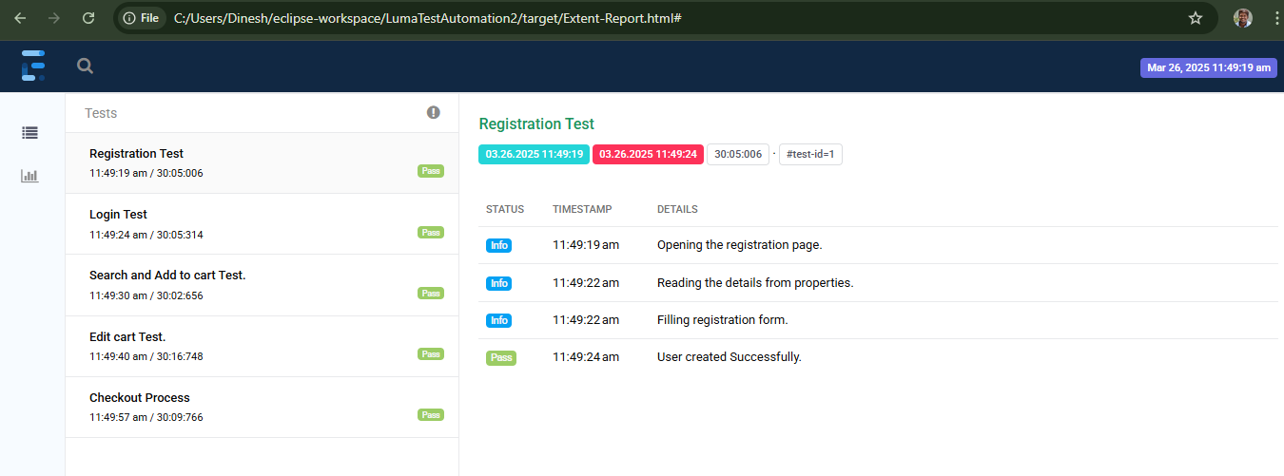
Extent Report

Slide 8
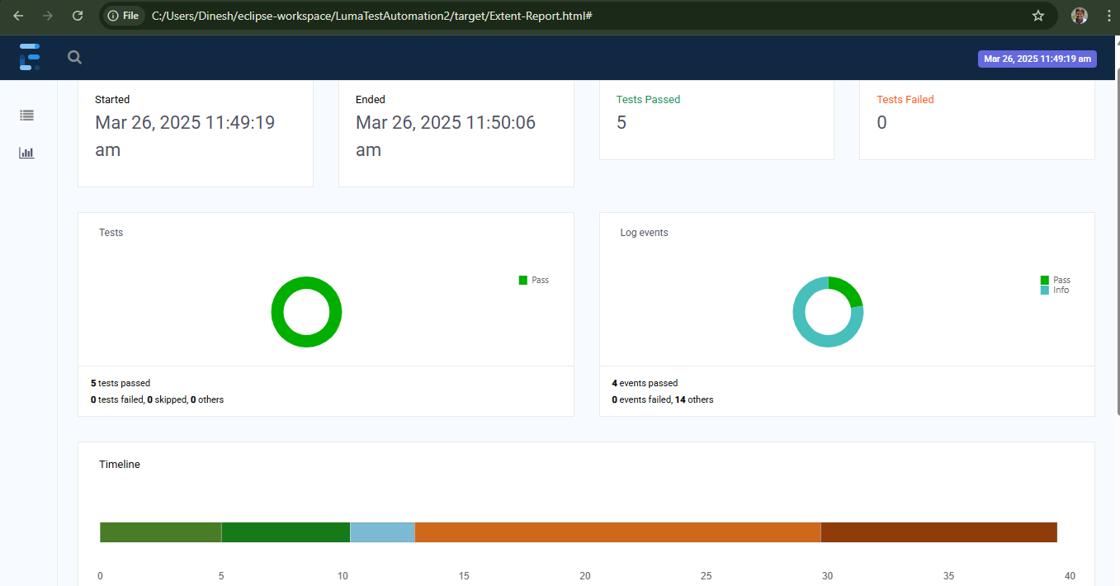

Slide 9
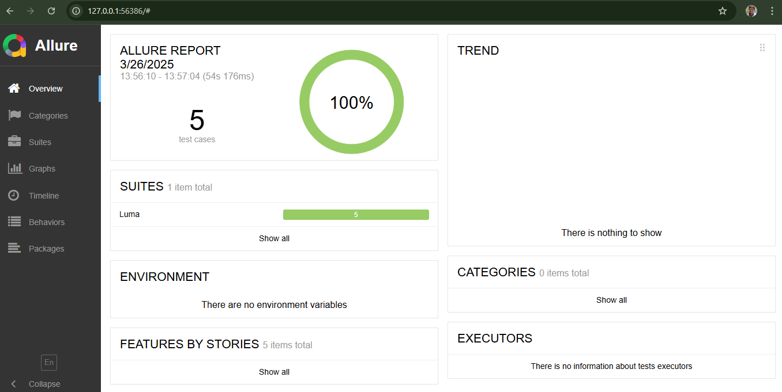
Allure Report

Slide 10
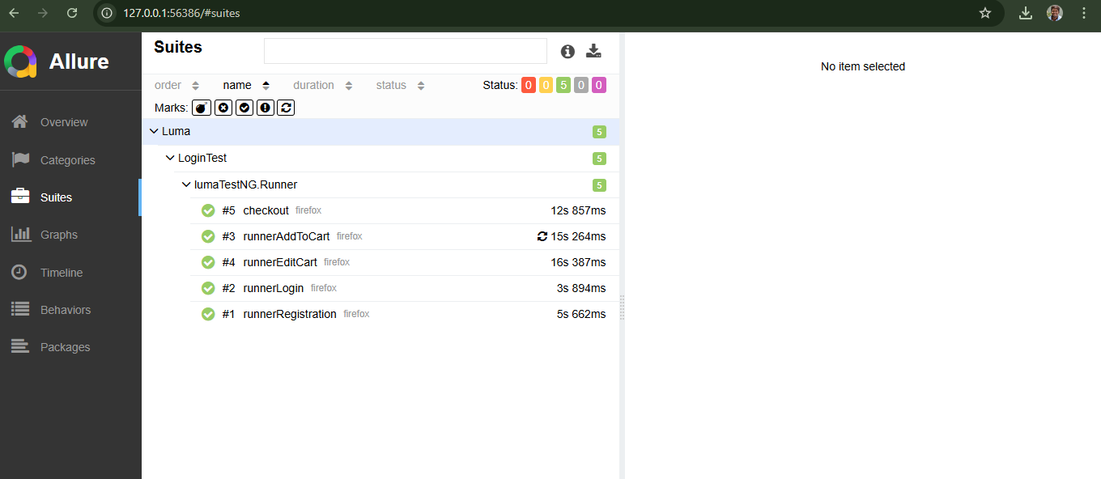
Allure Report

Slide 11
Challenges & Solutions
Challenges Faced :
Elements not loading immediately after navigating to the page.
Elements not found.
Synchronisation issues causing intermittent failures
Solutions Implemented :
Used Explicit waits for stable element interaction.
Applied Thread.sleep() and Implicit waits for execution stability.

Slide 12
Thank You

