Slide 1
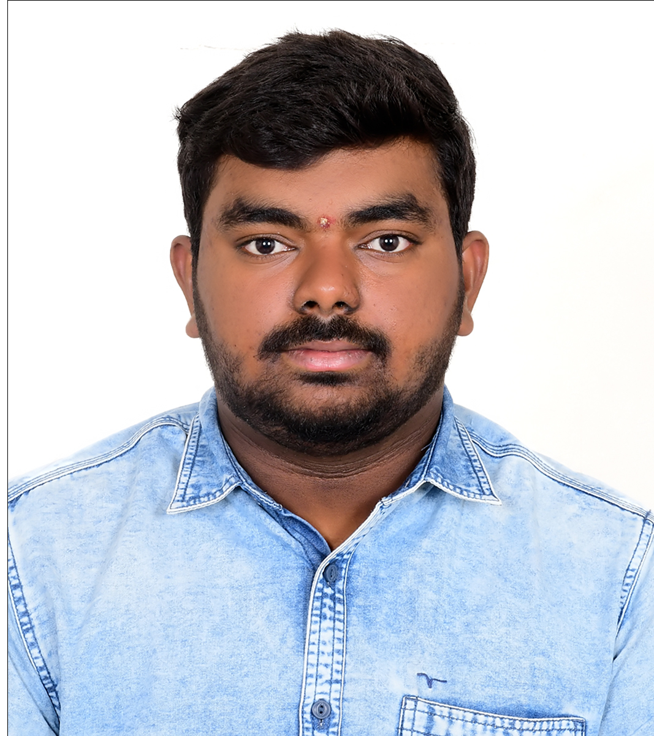

Guddati Vinay
Analyst/Software Engineer
Bachelor of Engineering
electrical and electronics : 2018- 2022
Skills
Navi Mumbai
guddati.vinay@capgemini.com
Java 8 /J2EE | Java Basics, OOPS, Generics, Collections, Arrays, Loops, Lambda Exp, Stream API Junit.
Spring core | IOC & Dependency Injection, Autowired
Spring REST | REST controllers, Implementation of GET, POST, PUT & DELETE, Bean Validation & Exception Handling, Testing Services, Controller & Repository layer
Spring Boot Microservices | Spring Boot Starters, annotations, Swagger API documents
Spring Cloud | Eureka,Netflix Server
React | Components, Hooks, Event handling, Redux, Reducers
Database | MongoDB
UI Tech | HTML 5 & CSS 3,JavaScript, ES6 & TypeScript, Optimized UI Designed
Tools | Git, Postman
Add On skills | Communications, Team management. Peer learning
+91 9381395779
A4
Full Stack Developer
Hands on experience in creating microservices with Springboot, Spring Security, Spring Cloud API Gateway, Eureka server.
Hands on experience in implementing Microservices architecture with NodeJs & spring boot
Experience in creating documentation with Java docs and swagger and in unit testing using Junit.
A team player with good communication skill always ready to work for the enrichment of knowledge
On Demand Car Wash Application
Completed end to end case study of on demand car wash Application along with Swagger and responsive UI with CSS and Angular used for user interface.
Successful Completion of "Step into Robotic Process Automation"during GUVI's RPA SKILL-A-THON 2020

