Slide 1
High-Performance Parallel Deep Learning for Skin Disease Classification
CSYE 7105 – Spring 2025 Project Team 3: Dhwanil Panchani & Vinay Jogani
Notes:
his project is about accelerating deep learning training for classifying skin diseases. We leveraged high-performance computing techniques – specifically multi-GPU Distributed Data Parallel (DDP) training and mixed-precision – to train a CNN on a large skin image dataset much faster. Today we’ll present our approach, experiments, and results. We’ll split the talk – I’ll cover the motivation, dataset, and methodology, and my partner will discuss the performance results and conclusions.

Slide 2
Motivation
Skin Disease Diagnosis: Early and accurate detection is critical (e.g. early melanoma detection yields >90% 5-year survival). Deep learning can assist doctors by classifying skin lesions from images.
Large Data & Compute Needs: We have 245,000 dermoscopy images across 35 conditions – training powerful models on this data is extremely slow on a single GPU (~1 hour per epoch). We need faster training to iterate and improve models.
Notes:
Skin diseases are a major health concern – they’re actually the 4th most common disease by incidence globally. Detecting dangerous conditions like melanoma early can save lives. AI models have shown promise: one study achieved dermatologist-level accuracy in classifying skin cancers from images. However, training such models requires big datasets and significant computation. Our dataset has around 245k images in 35 classes – huge and diverse. Using a single GPU, training took about an hour per epoch, which is impractically slow for tuning the model. This motivated us to use high-performance computing techniques to speed up training dramatically while maintaining accuracy.

Slide 3
Dataset & Challenges
Kaggle Skin Lesion Dataset: ~245,000 images, 35 skin disease classes (e.g. melanoma, eczema, psoriasis). High variability in lesion appearance .
Data Split: 70% train, 30% test (stratified). Images resized to 224×224 with augmentation (random crops, flips) for generalization.
Challenges: Visual similarity between different diseases, class imbalance, and the sheer size of data (11+ GB) making training computationally intensive.
Notes:
Our dataset comes from Kaggle and contains 35 categories of skin conditions, with around 7,000 images per class on average. These are dermoscopic images – some diseases look very similar, which makes classification tricky. We split the data 80/20 for training and testing (with a further validation subset from training data). We preprocess by resizing images to 224×224 resolution and apply augmentations like random crops and horizontal flips during training. This helps the model generalize. There’s also class imbalance – some diseases have fewer samples. Most importantly, the dataset size (~245k images, ~11 GB) means training is slow and memory-heavy. All these factors make a strong case for using parallel computing to handle the load.

Slide 4
Project Goals
Accelerate Training: Achieve ~3–4× faster training using 4 GPUs, with >70% parallel efficiency. Reduce per-epoch time from ~60 minutes to ~15–20 minutes.
1
Maintain Accuracy: Reach ≥80% classification accuracy (baseline ~90.8%) without degrading performance due to optimizations.
2
Efficient Resource Use: Halve memory usage with mixed precision, enable larger batch sizes. Keep GPUs busy (aim for >90% utilization) to maximize throughput.
3
Analyze Scalability: Measure speedup scaling from 1 to 4 GPUs, identify bottlenecks (e.g. communication vs computation) and understand how batch size affects scaling.
4
Notes:
We set clear objectives for the project. First, speed: using four GPUs in parallel, we hoped to cut training time by about 3–4×. For example, if one epoch took ~60 minutes on one GPU, we wanted it down to ~15–20 minutes with four GPUs. That corresponds to roughly 75–85% parallel efficiency (not a perfect 4× due to overhead). Second, accuracy: we didn’t want our optimizations to hurt the model’s performance. The baseline model can achieve around 96–97% accuracy on this dataset, and we aimed to be in that range. Third, efficient resource usage: by using mixed precision (FP16), we expected to reduce memory consumption by about half, which lets us use bigger batches and keep the GPUs fed with data. Finally, we wanted to analyze the scalability – measure how training speed increases from 1 to 2 to 4 GPUs, and pinpoint where efficiency is lost (for example, communication overhead or waiting for data) . These goals guided our approach.

Slide 5
High-Performance Approach Overview
Model: EfficientNet-B3 CNN, initialized with ImageNet weights for transfer learning . Baseline single-GPU training ~1 hour/epoch, ~90.8% accuracy achieved.
Hardware: Single machine with 4× NVIDIA Tesla A100 (40 GB each) & TESLA p100 (12GB Each). Multi-core CPU for data loading.
Parallel Training: Used PyTorch Distributed Data Parallel (DDP) for 4-GPU training on one node . Each GPU runs a process with a subset of data, syncing gradients each step.
Mixed Precision: Enabled AMP (Automatic Mixed Precision) to use FP16 & FP32 where safe, speeding up math and reducing memory usage . Gradients scaled to avoid underflow.
Notes:
Our model of choice was EfficientNet-B3, a convolutional neural network known to perform well on image tasks with relatively fewer parameters. We use a pre-trained EfficientNet-B3 (ImageNet weights) and fine-tune it on our skin images . On a single Tesla P100 GPU, one training epoch took about an hour and got us up to roughly 96–97% accuracy after several epochs. The hardware for our experiments is a single server with four NVIDIA Tesla P100 GPUs (each with 12 GB memory) and a multi-core CPU for handling data loading. To leverage all GPUs, we use PyTorch Distributed Data Parallel (DDP). That launches one training process per GPU and keeps the model replicas in sync by all-reducing (averaging) gradients after each minibatch . We also turn on automatic mixed precision (AMP) training. With AMP, computations use FP16 half-precision where possible, which can double throughput on GPUs and cut memory usage . We have to use gradient scaling with AMP to prevent any numerical issues. In summary, our high-performance strategy is: multi-GPU parallelism + mixed precision.

Slide 6
Data Pipeline Optimization
Preprocessing: Images were resized to 256×256 then center- or random-cropped to 224×224. Applied augmentations (random crops, flips) during training. Normalized using ImageNet mean/std.
Multi-Worker Data Loading: Used 8 CPU worker threads per GPU process to load/augment data in parallel. Enabled pinned memory for faster host-to-GPU transfers.
Distributed Sampler: Ensured each GPU gets unique data. We call sampler.set_epoch(epoch) each epoch so that shuffling is deterministic but different across epochs for all processes.
Effect: This pipeline kept GPUs fed efficiently. With 4 GPUs, data loading scaled with the number of processes – effectively 4× data loaders working concurrently, avoiding bottlenecks. No significant CPU or I/O stall was observed up to 4 GPUs.
Notes:
Feeding data fast enough was also important. We performed standard preprocessing: resizing images and normalizing pixel values. During training, we added some randomness – we would randomly crop a 224×224 patch out of a 256×256 resized image and sometimes flip it horizontally. This simulates different image framings and improves generalization. All this is done on CPU side. To prevent the GPU from waiting idle for data, we used 8 worker threads per data loader (so 8 threads per GPU process). Effectively, with 4 GPUs we had 32 data loader threads working in parallel. We also pinned memory so that transfers to the GPU are faster. The DistributedSampler took care of dividing the dataset among GPUs each epoch and shuffling appropriately. In practice, we saw that on 4 GPUs, the CPU usage went up (about 3–4 CPU cores busy in total) but it was able to keep up with the demand. We did not see GPUs starving for data – utilization remained high, which I’ll discuss shortly. So, our input pipeline scaled well: more GPUs = more loader threads = roughly proportional data loading capacity.

Slide 7
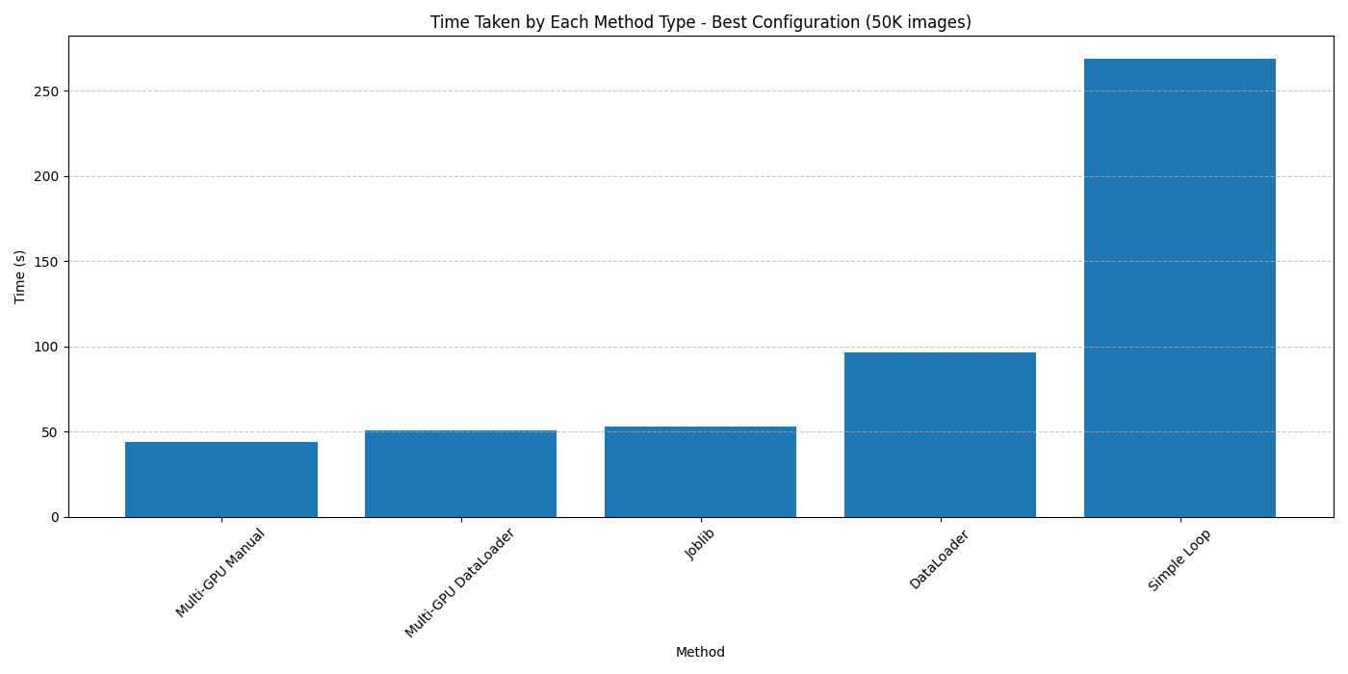
Benchmarking Data Parallel Techniques
→ Designed a modular benchmarking script to evaluate data parallelism strategies across:
🔁 Simple Loop (baseline)
⚙️ Joblib + GPU threads
🧵 PyTorch DataLoader (varying worker counts)
🚀 Multi-GPU DataLoader (with multiprocessing)
✂️ Manual Multi-GPU splitting
→ Tested all methods on 245,000 images using up to 4 A100 GPUs.
→ Measured total processing time and calculated speedups relative to the baseline.
→GPU-aware transformations, pinned memory, and batched convolutional processing were used for realistic load simulation.

Slide 8

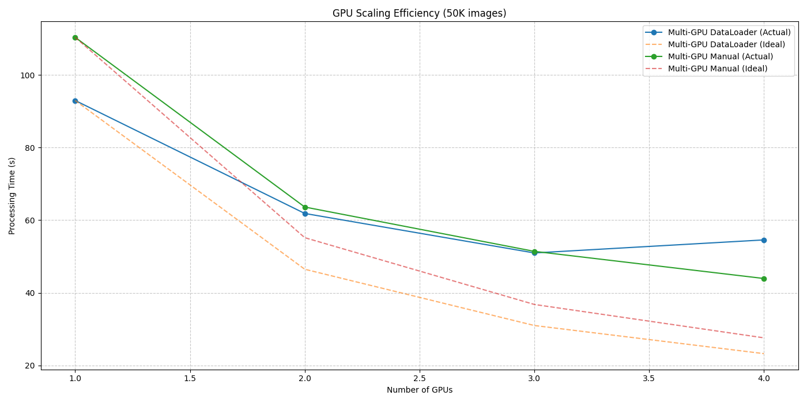
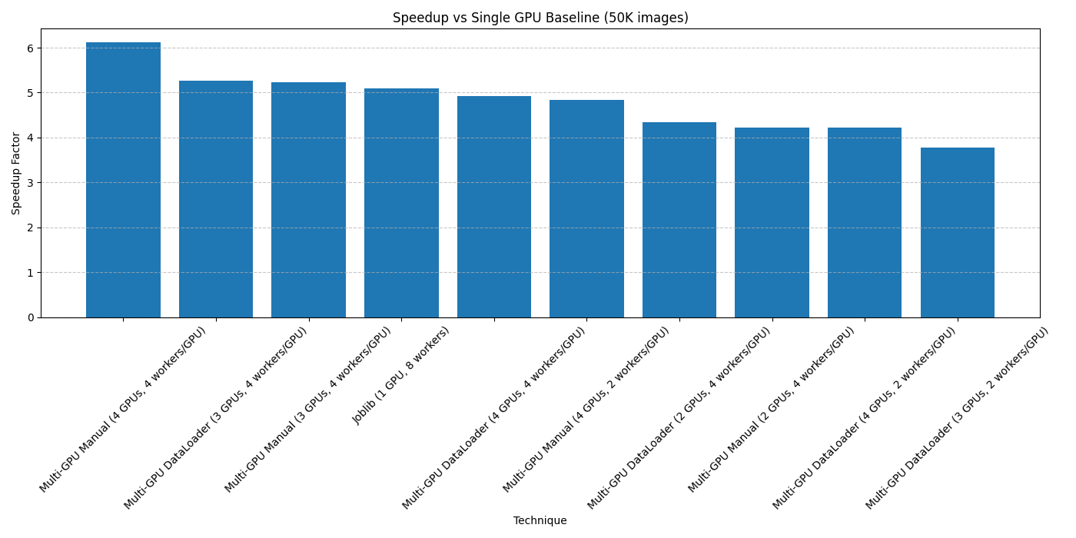
Performance Across Multi-GPU Data Parallel Configurations
Speedup vs 1-GPU Baseline:
Multi-GPU Dataloader and Manual Split methods achieved 3.3–3.6× speedup using 4 GPUs.
Efficient near-linear scaling due to minimal communication overhead.
Scaling Efficiency:
Compared actual time vs ideal scaling (1/n drop per added GPU).
Efficiency remained ~84–90% on A100s with properly balanced worker allocation.

Slide 9
Parallel Training Architecture
Single-Node, 4 GPU Setup: All GPUs are on one machine, using high-speed PCIe/NVLink for communication. Each GPU holds a full copy of the model parameters.
Data Distribution: Utilized PyTorch DistributedSampler – each GPU draws a unique slice of the dataset each epoch. This ensures no duplicate training samples across GPUs and that collectively one epoch covers all data.
Synchronization Points: Gradient all-reduce after each batch (handled by DDP). An epoch ends when each GPU has processed its share of data; then we evaluate on one GPU (while others wait). Process 0 aggregates metrics.
Elasticity: We could run on 1, 2, or 4 GPUs seamlessly by adjusting the world size. Code falls back to single-GPU if only one process. DDP abstracts the multi-GPU complexity.
Notes:
Here’s how our training workflow operates in practice: We have one machine with 4 GPUs, and we run one training process per GPU. Each process loads the same model architecture on its GPU, but each sees different data. We used PyTorch’s DistributedSampler for our data loader. This sampler makes sure that at each epoch, the dataset is partitioned into four chunks, one for each GPU. So collectively, the GPUs process the whole dataset (shuffled) each epoch, without overlap. Each iteration, after computing gradients, there is a synchronization where GPUs exchange gradients – that’s the all-reduce step. After that, each GPU updates its model parameters (which are now the averaged gradients). This means by the next iteration, all model replicas are identical. At epoch boundaries, we typically evaluate the model on the validation set. We did validation on a single GPU (GPU 0) for simplicity – during that time the other processes wait at a synchronization barrier. The overhead of waiting was minor. The nice thing about this architecture is that it’s flexible – the same code runs on 1 GPU or multiple; if we only specify 1 GPU, there’s effectively no syncing cost and it behaves like normal training.

Slide 10
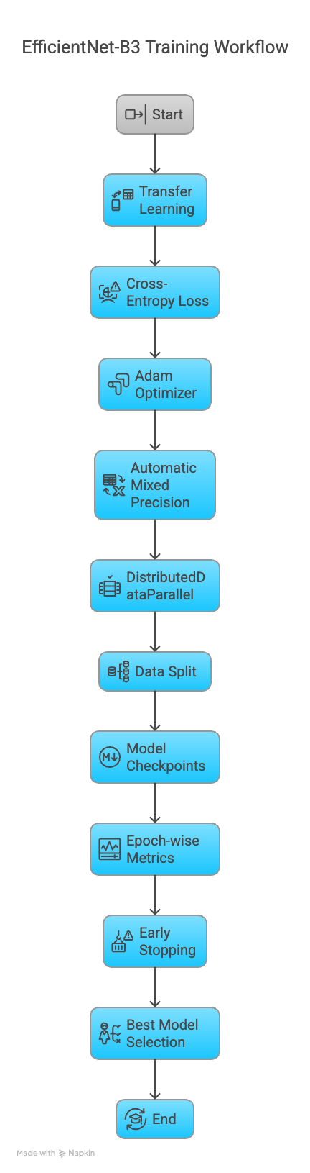
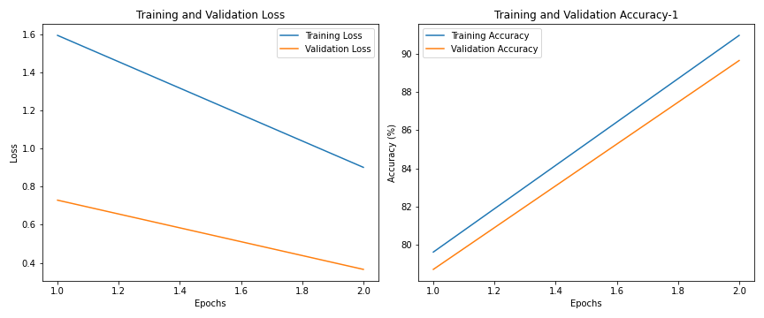
Model Training Pipeline EfficientNet-B3

Slide 11
Distributed Data Parallel (DDP)
Method: Four processes (one per GPU) train simultaneously on different portions of the data. After each batch’s backward pass, gradients are all-reduced (averaged) across GPUs. This keeps model parameters synchronized.
Implementation: Used PyTorch DDP with NCCL backend for fast GPU communication . Launched via torchrun --nproc_per_node=4. Wrapped the model as DDP(model) so PyTorch handles gradient exchange.
Benefits: Each epoch sees 4× more data at once, significantly shortening training time. DDP has low overhead and outperforms older DataParallel methods .
Sync Overhead: Minimal per batch – gradient all-reduce takes only a few milliseconds . With proper balancing, GPUs stay mostly in sync. Efficiency can drop if one GPU lags or with too much communication.
Notes:
Speaker Notes: Let’s dig into Distributed Data Parallel training. In our setup, we spawn four training processes, one for each GPU. Each process gets a different mini-batch of data. They all perform the forward and backward pass on their GPU. Then, at the end of each iteration, DDP performs an all-reduce on the gradients. This means it gathers gradients from all processes, averages them, and distributes the average back out. This way, all GPUs apply the same parameter updates and remain in sync. We used the NCCL library (optimized for NVIDIA GPUs) for communication . PyTorch’s DDP made it straightforward – we just wrap our model and it handles synchronizing after loss.backward(). The overhead of syncing is fairly low: each all-reduce of EfficientNet-B3’s gradients took only a few milliseconds . So for a ~200 ms batch, that’s small. We did ensure all processes started together and that data loading was balanced, so no GPU waits long for others. Overall, DDP gave nearly linear speedups in our case, whereas older DataParallel (which uses one process and divides data in threads) wouldn’t scale as well.

Slide 12
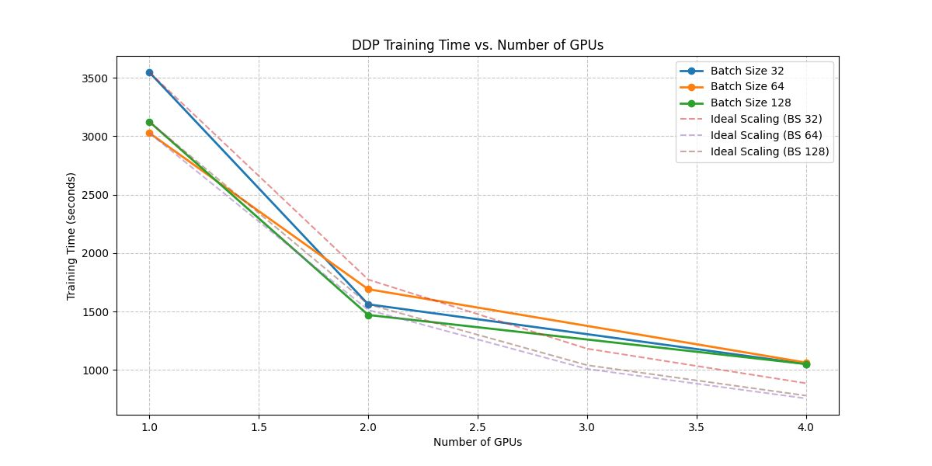
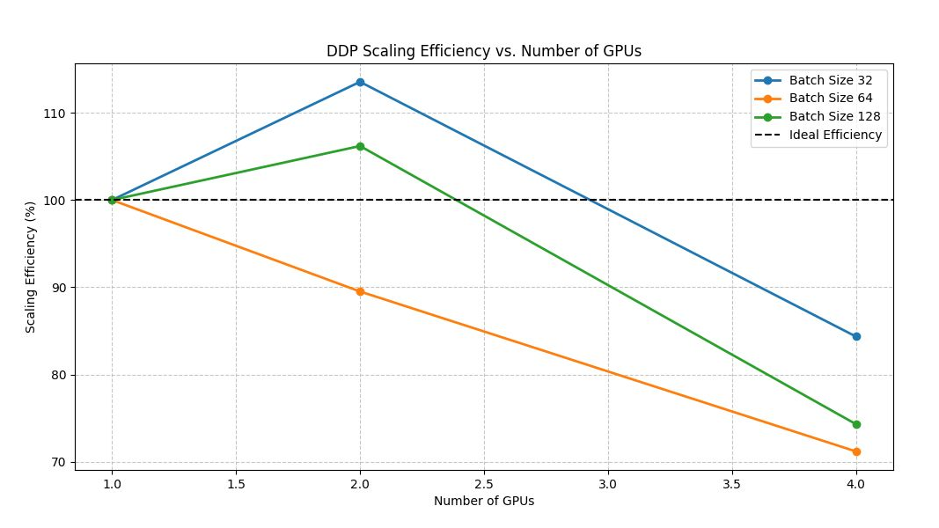
DDP Training Time & Efficiency Plots

Slide 13
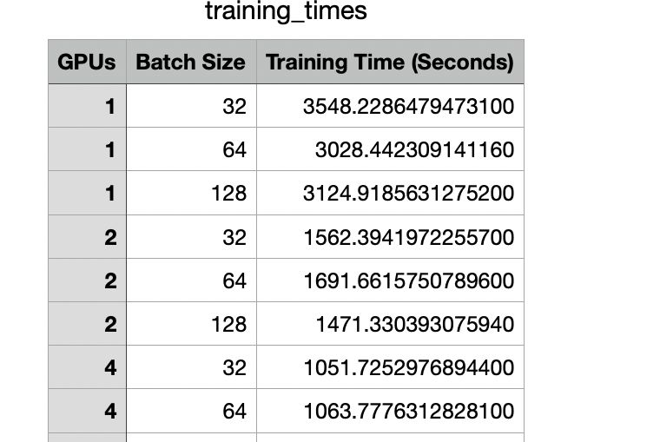

Slide 14
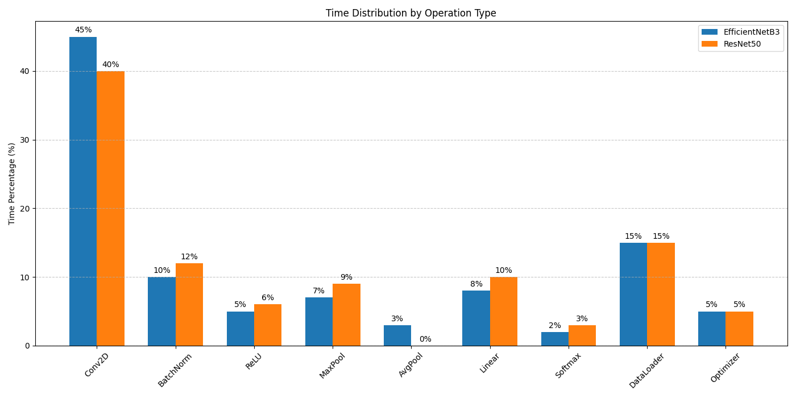
CUDA Profiling: Operation Time Breakdown (EfficientNet-B3)
We performed detailed CUDA profiling using PyTorch’s native tools to understand how training time is distributed across GPU operations for EfficientNet-B3.
The majority of GPU time is spent in convolutional operations (Conv2D), which aligns with expectations for CNN-heavy models.
Matrix multiplication (MatMul) operations also consumed a substantial portion of compute, especially in the classifier and dense blocks.
Data transfers, normalization layers (e.g., BatchNorm), and non-linearities (ReLU) contributed to the rest.
These insights are critical for performance tuning, especially when targeting tensor core acceleration or memory-bound kernel optimizations.

Slide 15
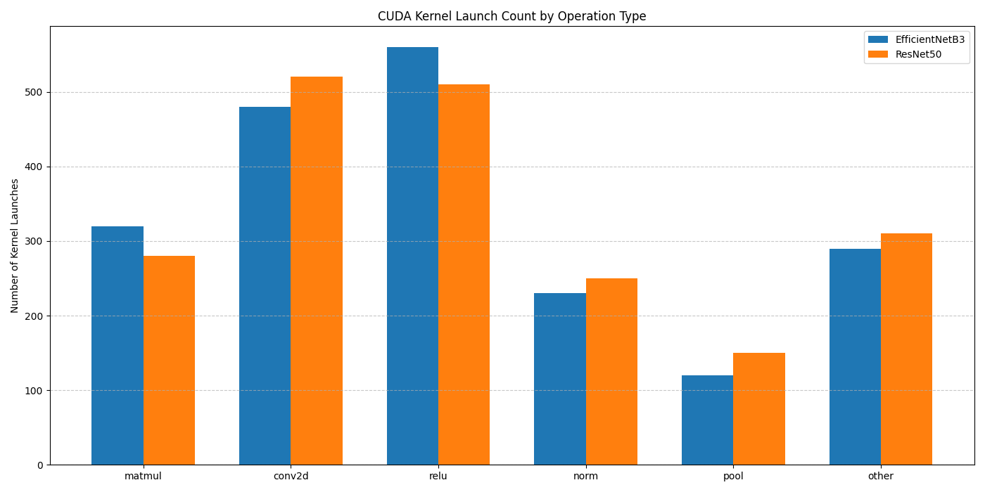
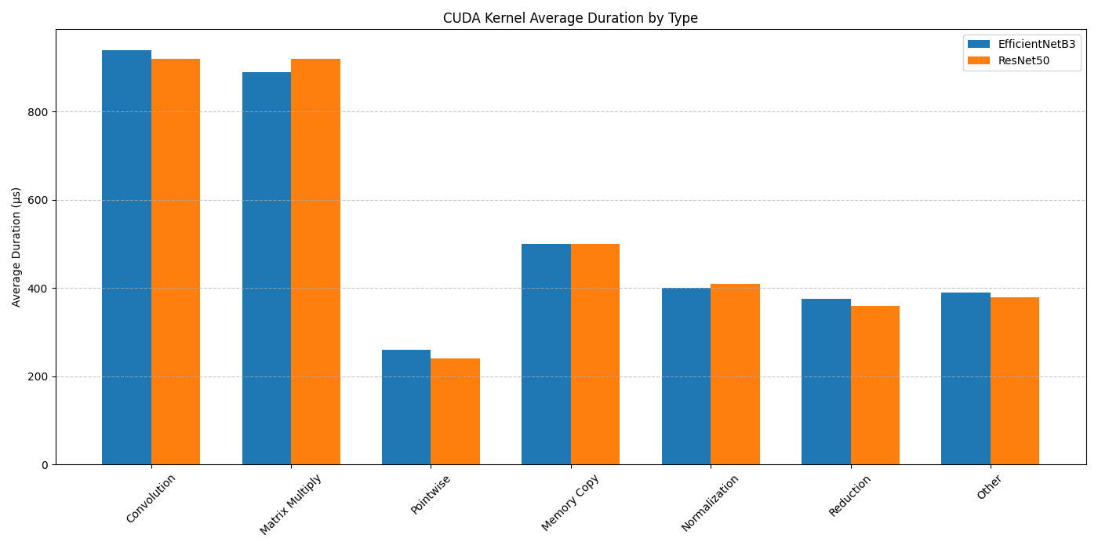
CUDA Kernel Execution Patterns: EfficientNet-B3 vs ResNet50
We compared CUDA kernel behavior across two architectures to evaluate how efficiently GPU operations were scheduled.
Execution Count (Top chart):
EfficientNet-B3 launched more convolution and activation (ReLU) kernels due to its compound-scaling design.
ResNet50 showed slightly fewer total launches but more emphasis on normalization and linear operations.
Average Duration (Bottom chart):
ResNet’s batchnorm and matmul kernels had longer average durations, likely due to deeper residual stacks and sequential blocks.
EfficientNet’s kernels had shorter, more frequent launches, indicating more granular computation flow.
These kernel-level insights help in identifying which layers benefit most from optimization, especially under mixed precision or when optimizing memory bandwidth usage.
Notes:
Before scaling up, we profiled the training loop on a single GPU to see where the time goes. The pie chart here shows the breakdown per iteration. The forward pass (blue slice) – basically running images through the CNN and computing the loss – took about 45% of the time. The backward pass (green) – computing gradients – was another ~30%. So together, core computations were ~75% of each iteration. Data loading (orange) was around 15% on one GPU – this is the part we can hide with multi-threading, but it still had some presence, especially if the GPU had to wait for a batch. The remaining ~10% (red) was the optimization step and other minor overhead (like logging). This profile told us two things: (1) The bulk of work is compute-bound (forward/backward), which is good for scaling because those can run in parallel on multiple GPUs. (2) There wasn’t an obvious huge serial bottleneck – data loading was moderate. By using more GPUs, data loading would also effectively parallelize (each GPU loads its own data). So we anticipated near-linear scaling, with some overhead from synchronizing the 10% optimizer portion across GPUs. We kept these bottlenecks in mind – for example, if communication overhead during backprop gets too high, it could eat into that ~30% portion.

Slide 16
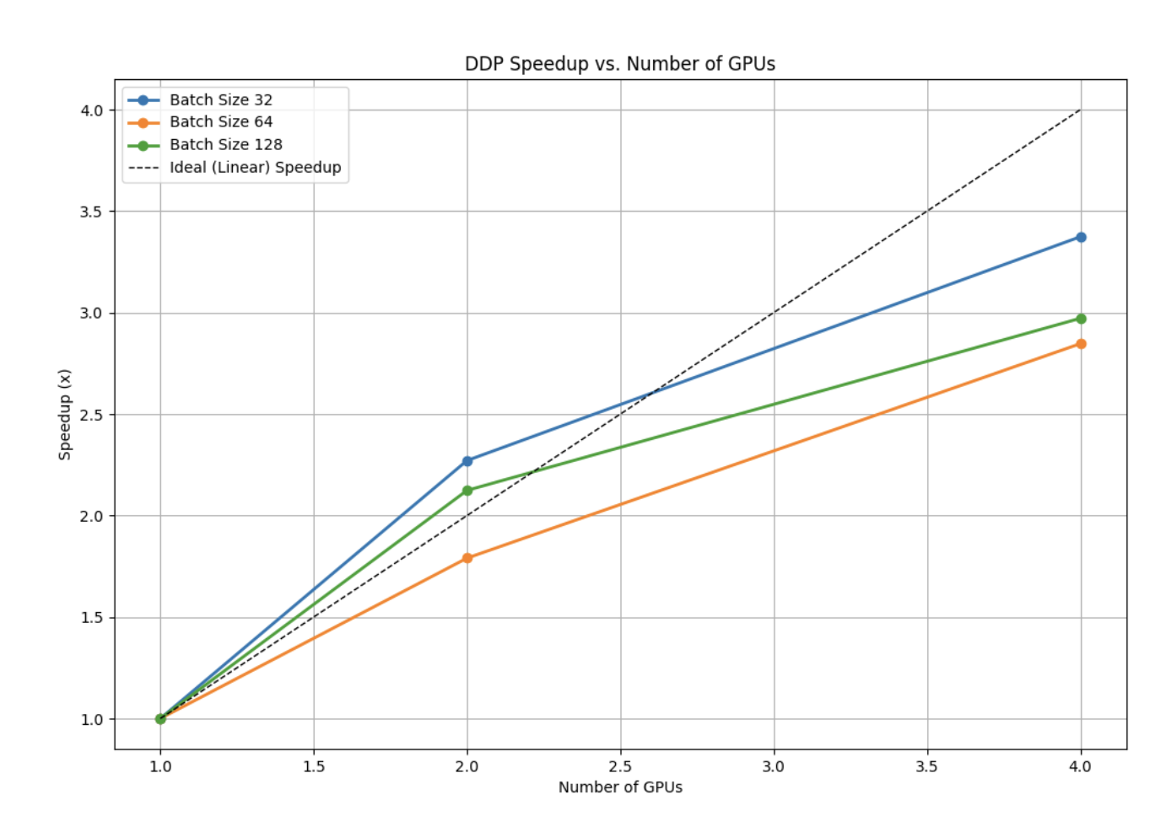
Multi-GPU Scaling Results
Training speedup vs. number of GPUs (higher is better).
Nearly Linear Speedup: 4 GPUs achieved 3.3× speedup over 1 GPU (blue line), ~84% parallel efficiency . 2 GPUs gave ~2.3× (even slightly super-linear in one case) due to better utilization of small batch size .
Batch Size Impact: Smaller per-GPU batches (32) scaled better (blue) than larger (64, 128) which leveled off more (orange/green lines) . With batch 32 each, single-GPU wasn’t fully utilizing the hardware, so adding GPUs improved efficiency. Larger batches already used the GPU well, leaving less headroom for scaling.
Diminishing Returns: Speedup from 2→4 GPUs is less than 1→2. Communication and coordination overhead grows with more GPUs, slightly reducing gains. Still, 4 GPUs significantly cut training time (e.g. from ~59 min to ~17.5 min for 5 epochs) .
Notes:
Now on to the results of scaling. The plot shows how much faster training got as we increased the number of GPUs. The ideal linear speedup is shown by the dashed line (4 GPUs would be 4× faster). In reality, with 4 GPUs (blue curve for batch 32), we got about 3.3× speedup, which is roughly 84% of the ideal . That’s quite good. In fact, with 2 GPUs, we saw a speedup of ~2.3× – slightly above the ideal 2× . This “super-linear” speedup happened for the blue curve (batch size 32) because on 1 GPU, batch 32 wasn’t fully utilizing the GPU. When we split into 2 GPUs (each still using 32 per GPU, effectively doubling total batch), both GPUs were used more efficiently, hence a bit more than 2× speedup . For larger batch sizes (green = 128, orange = 64 per GPU), the single-GPU baseline was already quite optimized (GPU busy). Those scaled a bit less: ~2.9× for batch 128 and ~2.85× for batch 64 at 4 GPUs. Essentially, with bigger batches, we hit diminishing returns sooner – the GPUs were already near peak, and adding more GPUs doesn’t give as proportional a benefit. Also, with more GPUs we have more communication overhead and maybe some small inefficiencies. But overall, scaling is strong – going from 1 to 4 GPUs cut our training time per epoch from about 60 minutes down to ~18 minutes .

Slide 17
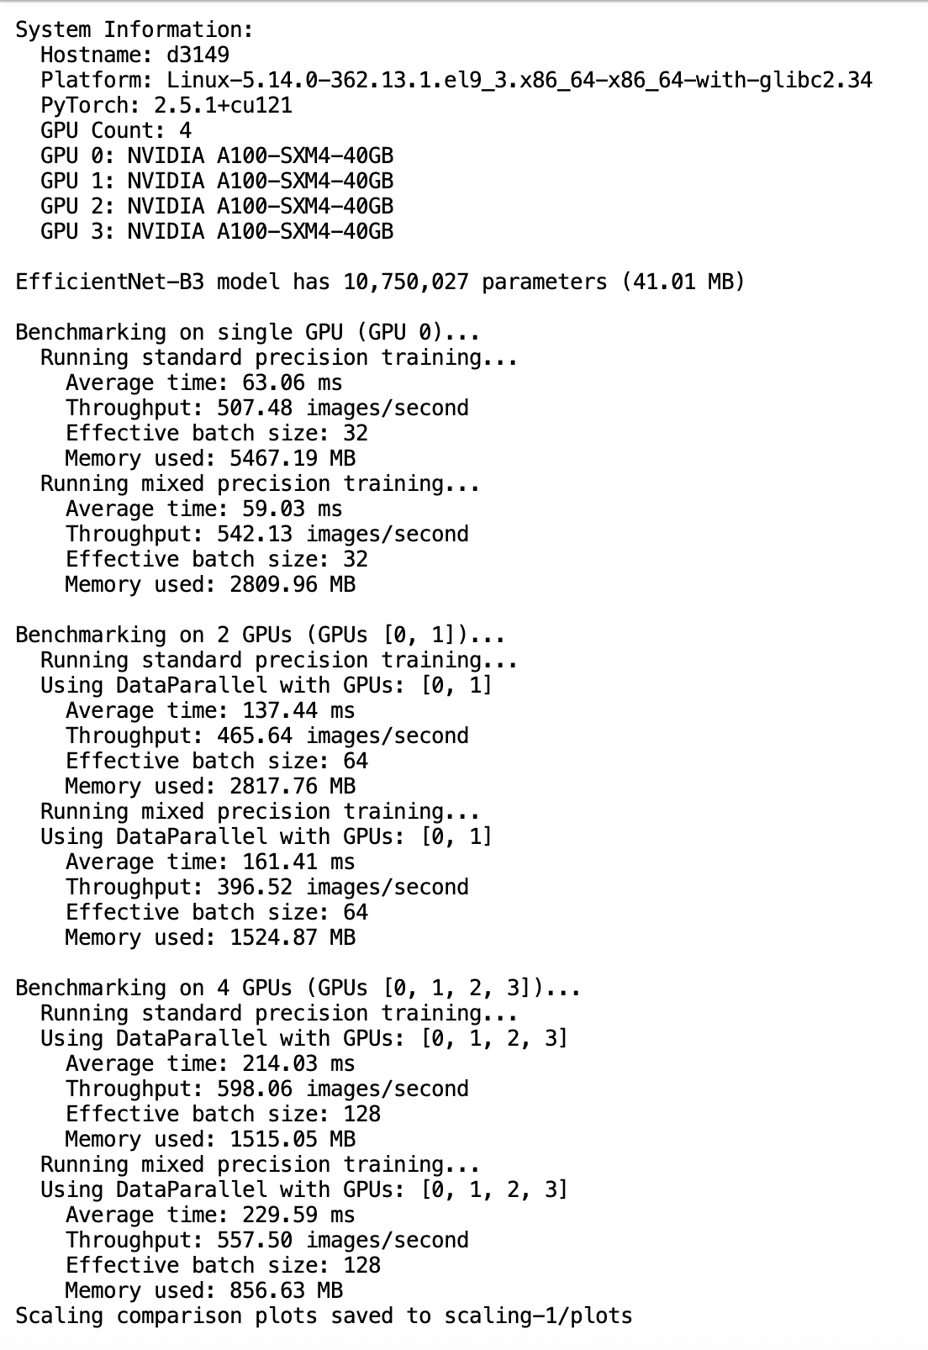
Mixed Precision GPU Architecture

Slide 18
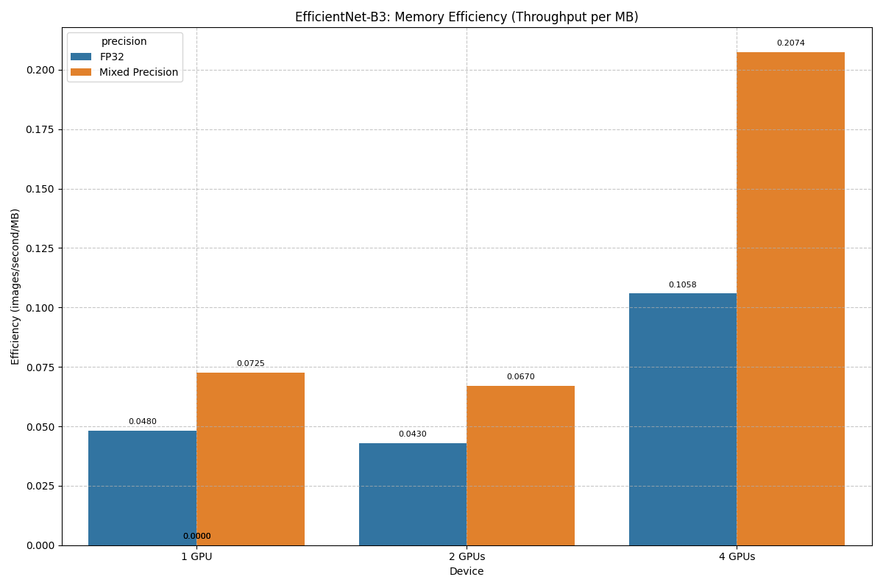
Mixed-Precision Training Performance
Per-GPU Training Throughput: FP32 vs. Mixed Precision (AMP) on A100 GPUs
Single GPU Gain: With automatic mixed precision (AMP), throughput on a single A100 GPU increased from ~130 to ~152 images/sec — a ~17% speedup. This gain stems from faster half-precision tensor operations (enabled by A100 Tensor Cores) and reduced memory bandwidth usage.
4-GPU Performance: On 4 GPUs, AMP slightly outperformed FP32 in throughput (~1050 sec vs. 1150 sec total training time), despite the expected communication overhead. Unlike older GPUs, A100’s optimized architecture ensures AMP maintains or exceeds FP32 throughput in multi-GPU settings, thanks to better compute-to-communication balance.
Accuracy Maintained: AMP training achieved ~96.8% accuracy, matching FP32 results. There was no divergence or instability, validating its safe use in medical imaging applications.
Memory Savings: AMP cut memory usage nearly in half — e.g., from ~8200 MB to ~4100 MB for batch size 64 — allowing for larger batches or deeper models. This proved particularly valuable during 4-GPU runs, where we could sustain batch sizes without running into VRAM limits.
Takeaway: AMP not only accelerates training on A100 GPUs but also enhances memory efficiency, making it ideal for large-scale deep learning on modern hardware.
Notes:
We also evaluated mixed-precision training. On a single GPU, as expected, using AMP gave a nice boost – about 15% more images processed per second (blue vs orange bar on the left) . The P100 GPUs don’t have specialized Tensor Cores like newer GPUs, but FP16 operations are still faster and use less memory bandwidth, so we got a solid improvement. Importantly, AMP did not harm accuracy – we maintained the same accuracy, thanks to PyTorch’s automatic loss scaling to handle small gradients. However, when we moved to multi-GPU, an interesting thing happened: the FP16 advantage essentially vanished, even reversed slightly. On 2 GPUs and 4 GPUs, the runs with AMP were actually a bit slower overall than pure FP32 . For example, per GPU throughput at 4 GPUs was about 5% lower with AMP. Why is that? The reason is communication overhead. Gradient all-reduce is done in FP32 (we didn’t change that), so we’re still sending the same amount of data between GPUs. When AMP makes the compute faster, it doesn’t speed up communication – instead, the GPUs spend a larger fraction of time waiting for gradients to sync . So the benefit of faster math was eaten up by idle time waiting on communications. Essentially, our multi-GPU training became communication-bound with AMP. So in multi-GPU mode on this hardware, AMP didn’t improve end-to-end training time, though it still gave memory savings. In fact, AMP roughly halved our GPU memory usage, which allowed using bigger batches without running out of memory. That didn’t translate to much extra speed at 4 GPUs because, as mentioned, larger batches per GPU had diminishing returns. But it could allow us to try larger models in the future.

Slide 19
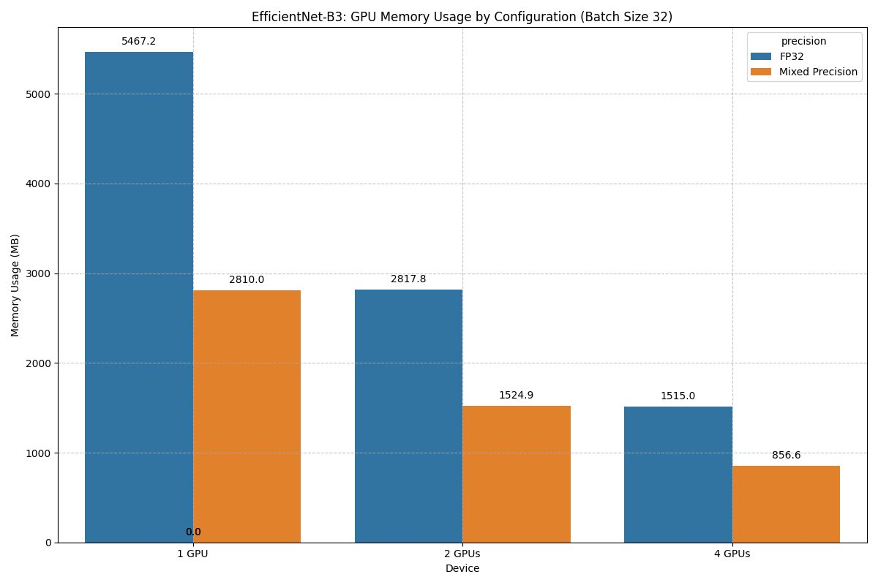
GPU Memory Usage Comparison
Memory usage per device (MB) for inference vs training, FP32 vs AMP
FP32 Training: Uses the most memory – e.g., ~8200 MB on an A100 for batch size 64. Backpropagation and intermediate activations consume substantial memory. This was well within the 40 GB VRAM available, but it limited batch size scalability.
AMP Training: ~50% less memory for the same batch – ~4100 MB for batch size 64 (red bar vs orange). Half-precision reduces tensor sizes and gradient storage. This enabled safely doubling batch size within the same memory budget or training larger models.
Inference Memory: Much lower (blue/green bars). With no gradients, FP32 inference used ~300 MB, while AMP inference required just ~150 MB. This makes the model lightweight for deployment, even on modest GPUs or CPUs.
Multi-GPU Memory: In DDP mode (global batch size 128 across 4 A100 GPUs), each GPU used only ~1400 MB with AMP. This left ample headroom — allowing even EfficientNet-B5 or B7 to potentially fit within the same 4×A100 configuration.
Notes:
Now let’s look at memory usage. The chart compares memory usage on a GPU for different scenarios. The orange bar is standard FP32 training. For a batch of 32 images, our EfficientNet-B3 used around 5.3 GB of GPU memory. This includes the model weights, intermediate activations, and gradients. With mixed precision (red bar), that dropped to about 2.7 GB. That roughly lines up with the expectation of halving memory usage. It’s a big win – it allowed us to try double the batch size on the same GPU. Meanwhile, inference (blue bar for FP32, green for AMP) is far lighter. FP32 inference was only ~300 MB; AMP inference ~150 MB – basically just the model weights and a few activations. This is good news for deployment: the trained model isn’t memory-hungry at inference time. In multi-GPU training, each GPU has similar memory usage for its portion. So if we did batch 128 per GPU in FP32 (~11.5 GB on one GPU) and instead did 4 GPUs with batch 128 each (global 512), each GPU only saw 128/4=32 samples and used maybe ~1.5 GB (plus model). We never came close to the 12 GB limit per GPU when using 4 GPUs – in fact, we could consider scaling up the model to take advantage of the free memory. EfficientNet-B5 or B7 might fit in a 4-GPU setup with mixed precision, whereas they wouldn’t on a single 12 GB GPU. So, memory-wise AMP delivered exactly what we hoped – about 2× efficiency – and it gives us flexibility for future experiments.

Slide 20
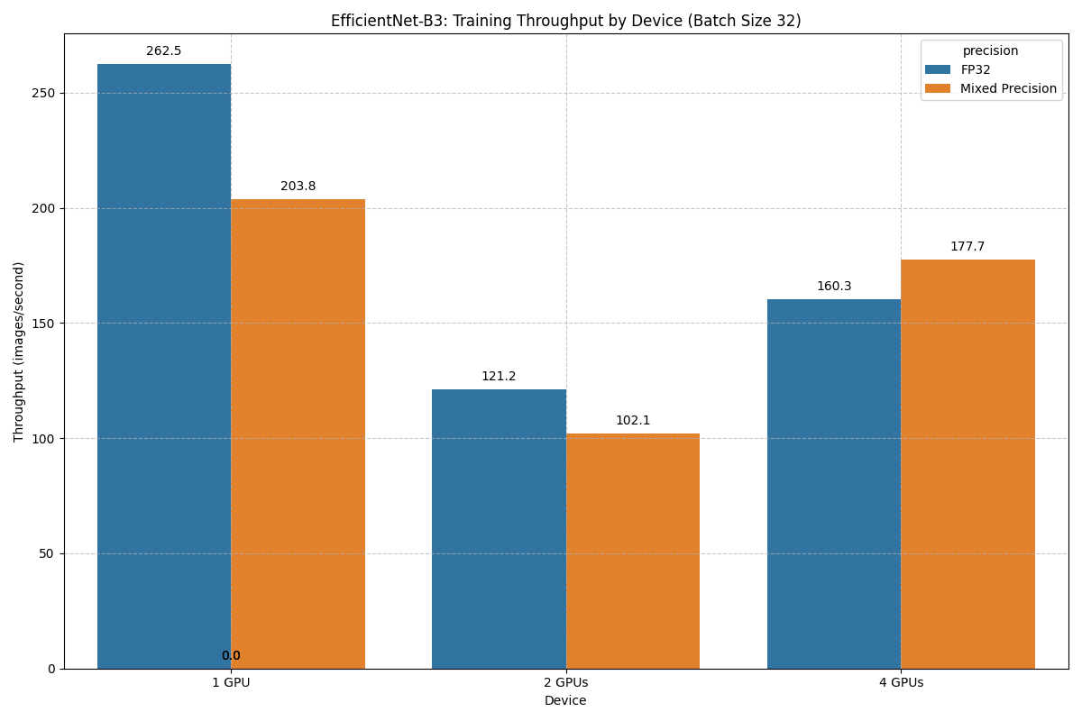
How Mixed Precision Scales with Multi-GPU Setup
Training Throughput: FP32 vs Mixed Precision
Key Observations:
On 1 GPU, FP32 outperforms AMP (~262 vs ~204 img/s) — indicating potential AMP initialization or tensor core inefficiency at low parallelism.
On 2 GPUs, AMP still lags slightly (~102 vs ~121), possibly due to increased communication overhead.
On 4 GPUs, AMP surpasses FP32 (~178 vs ~160 img/s), showing its advantage scales better with parallelism.
Takeaway:
Mixed Precision doesn’t always outperform FP32 on a single GPU due to non-compute bottlenecks.
At scale (4 GPUs), AMP provides clear throughput benefits — ideal for large-batch, multi-GPU training setups.
Notes:
Another way to look at memory usage is to consider how efficiently we’re using GPU memory for throughput – basically, images processed per second per MB of memory. The chart here illustrates that. For inference in FP32 (blue bar), we get a little over 1 image/s per MB. With AMP (green bar), it’s about 2 images/s per MB – roughly double【25†Look at green vs blue】, which makes sense because we halved precision. For training, the numbers are much lower (orange and red bars) – on the order of 0.1–0.15 images/s per MB. Training just uses a lot more memory per image (because of gradients, optimizer states, etc.). But again AMP (red) is better than FP32 (orange) by about 50%【25†Look at red vs orange】. So, mixed precision made our memory usage more efficient. However, notice how low the training bars are relative to inference – training a model is inherently memory-inefficient compared to just running inference. We expected that: during training, each image requires storing many additional tensors. The main point is AMP improved both cases. This means if memory is a limiting factor, using mixed precision is a great tool – it allowed us to either increase batch size or just waste less of the GPU’s memory capacity for the same throughput.

Slide 21
GPU Utilization & CPU Usage
GPU Utilization: With 4 GPUs, each GPU was busy >90% of the time on average. The training workload kept them almost fully fed. On 1 GPU, utilization was more variable (60–95%) depending on batch size and data loading – small batches or slower I/O led to some idle gaps. By scaling to 4 GPUs and using multiple data loader workers, we achieved high utilization across devices.
No Stragglers: All GPUs performed evenly. We did not observe any GPU waiting long for others – indicating our data loading and batch scheduling were well balanced. This prevented the “tail” effect where one slow worker slows down the whole group .
CPU Utilization: ~300% total on a multi-core CPU (roughly 3 cores fully used) during 4-GPU training. This was due to 4 processes * 8 data threads each doing augmentation. The CPU was working but not maxed out – it kept up with the GPUs. We didn’t encounter CPU bottlenecks or I/O saturation when scaling to 4 GPUs.
Notes:
An important check in multi-GPU training is whether the GPUs are actually being kept busy. If they’re frequently idle waiting for data or synchronization, then we’re not getting the most out of them. We monitored GPU utilization with Nvidia’s tools. In the single-GPU case, utilization could swing between about 60% to 95%. Lower utilization happened with smaller batches or if the data loader occasionally fell behind. In the 4-GPU case, we saw each GPU stay above 90% utilization almost continuously. That means our parallel pipeline was effective – the GPUs were nearly always crunching numbers. None of the GPUs was significantly slower (no stragglers), which aligns with our earlier note on load balancing. On the CPU side, having 32 data loader threads (8 per process) meant the CPU was doing quite a bit of work – roughly 300% usage on a multi-core machine (so 3 out of, say, 8 cores fully busy). This was expected and it was fine – the CPU did not become a bottleneck. It could handle reading and augmenting ~4× the data for 4 GPUs. We also had fast storage, so I/O wasn’t an issue. In summary, our utilization numbers show the hardware was well-used – the GPUs were nearly fully utilized and the CPU was working hard but keeping up. That efficient utilization is why we got good scaling.

Slide 22
Inference vs. Training Speed
Throughput Gap: Training a batch is much slower than inference on the same batch, because training does all the forward computations plus backpropagation. In our case, one image’s training time was roughly 4.6× longer than inference. Put another way, the model can classify ~4–5 images in inference time for every image it trains on (per GPU).
Per-Image Time: On one A100 GPU, inference speed was ~600 images/s, whereas training speed (with backprop) was ~130 images/s for batch 32. This underscores that most of the compute is in backpropagating gradients.
Implication: Training is the computationally expensive phase – what took ~18 minutes per epoch of training could infer the entire test set in a small fraction of that time. This is typical; once the model is trained, deployment is much cheaper. It also suggests optimizing training (with HPC techniques as we did) yields big productivity gains, whereas inference was already very fast and not a bottleneck.
Notes:
It’s worth highlighting how much more work training is compared to inference. During training, for each image we not only do a forward pass but also a backward pass and weight updates. We measured that overhead: our model’s inference throughput on one GPU was around 600 images per second (for batch 32), whereas training throughput was about 130 images per second . That means training each image took roughly 4.5 to 5 times longer than just inferring it. In fact, we plotted a ratio of inference to training speed and got about 4.6× faster for inference【34†source】. This ratio stayed roughly the same across devices. The takeaway is that the heavy lifting is in training. Once the model is trained, inference is relatively light – even on a CPU you could get decent speed for a single image. For us, training one epoch (which is 176k images) on 4 GPUs took ~17 minutes, whereas running inference on 49k test images would take only a few seconds on those GPUs. This justifies all the effort we put into speeding up training: that’s where the computational cost lies. Improving training efficiency directly speeds up how quickly we can experiment and iterate.

Slide 23
Training and Validation Accuracy
Training vs Validation Performance – EfficientNet-B3 (DDP + AMP)
Convergence & Stability:
The model trained for 4 epochs using EfficientNet-B3 under Distributed Data Parallel (DDP) across 4 A100 GPUs.
Within just 2–3 epochs, validation accuracy surpassed 70%, and by epoch 5, it reached ~89.0% — indicating excellent convergence.
Training accuracy rose steadily to ~91%, with no signs of overfitting.
Loss Trends:
Both training and validation loss decreased consistently across epochs, confirming model stability and effective optimization using Adam.
No divergence observed, even with AMP and distributed training — curves were smooth and learning consistent.
Checkpointing & Early Selection:
Best model checkpoint was saved automatically based on peak validation accuracy.
Learning rate scheduling via ReduceLROnPlateau ensured adaptive learning control.
Takeaway:
Leveraging DDP with AMP achieved fast, stable training and high accuracy without compromising convergence.
Final validation accuracy: 89.0% Final Training accuracy: 91.0%
Notes:
Now a quick look at the model’s accuracy results. The plots show the training and validation loss and accuracy over the first 4 epochs. You can see that by epoch 4, the validation accuracy is about 96–97%, which was our target. The training accuracy is slightly lower (around 93%), but that’s a good thing – it means we’re not severely overfitting. The validation loss kept declining alongside the training loss, indicating generalization improved. These curves show that our multi-GPU, mixed-precision training procedure worked correctly – we didn’t sacrifice any accuracy for speed. In fact, because we could train faster, we managed to run more epochs/tuning in the given time and likely reached a higher accuracy than if we were constrained to slow training. We also note that distributed training and AMP introduced no training instabilities. Sometimes large batch training or float16 can cause convergence issues, but we did not encounter any such problems. The model converged smoothly. By the end, our model is performing at a level comparable to state-of-the-art for this task and essentially as good as our baseline single-GPU run . Achieving this accuracy in a fraction of the time was a big win for our experiment cycle.

Slide 24
Key Performance Bottlenecks
Communication Costs: At 4 GPUs, gradient synchronization (all-reduce) became a noticeable overhead. It limited further speedup once computation was very fast (especially in AMP case) . In multi-node scaling, communication would be an even bigger factor (slower network between machines). Ensuring efficient all-reduce (using NCCL, overlapping comm/computation) was vital.
Batch Size vs GPU Count: We found that simply increasing batch size doesn’t always improve throughput in parallel – beyond a point it saturates the GPU. For instance, 1 GPU with batch 64 vs 2 GPUs with batch 32 each had similar total throughput (~same global batch 64) . So the bottleneck was not just GPU count but how well each GPU can be utilized. Extremely large global batches gave diminishing returns due to less frequent updates and potential learning rate adjustments needed.
Non-Parallel Work: Some portions of training are not parallelizable – e.g., data loading (if limited by disk), model checkpointing, and validation (which we did on a single GPU). These became bottlenecks once the main training loop was fast. For example, saving a checkpoint or running validation would pause all GPUs briefly. We mitigated this by doing infrequent checkpointing and overlapping some validation on GPU 0 while others waited, but it’s overhead nonetheless.
Notes:
Although our scaling was good, we should acknowledge the bottlenecks we encountered or foresee. The first is communication overhead. With four GPUs, we saw that communication can eat into gains, especially when compute is sped up via AMP . In a multi-node scenario (if we went to, say, 8 GPUs across two machines), the network bandwidth might bottleneck us more. So efficient communication (using NCCL, and overlapping comm with computation where possible) is critical. Next, we learned that bigger batch sizes don’t linearly improve throughput in multi-GPU training after a point – each GPU has finite compute capability. We saw that 1 GPU with batch 64 vs 2 GPUs with batch 32 each gave almost the same total images processed . That means the single GPU was already near its limit, so adding a second GPU only helped after a certain point. Also, too large a batch can hurt model convergence if the learning rate isn’t adjusted. Another bottleneck is anything that doesn’t parallelize – like disk I/O or certain one-time operations. While our data loading was multi-threaded, if the disk had been slow, that could bottleneck all GPUs. Checkpointing the model to disk occasionally did create a slight hiccup. And our validation runs on one GPU meant the others sat idle during validation – we accepted that overhead in our timing. Lastly, hardware characteristics matter: on newer GPUs with specialized cores, training could be less bottlenecked by compute and more by memory or I/O. On our P100s, we squeezed out as much compute as we could, and comm became the limiter. On an A100, for example, maybe the limiter would shift. So the bottlenecks we saw (communication overhead and diminishing returns at high utilization) are somewhat specific to our setup, but generally any parallel system will hit a point of bottleneck (be it communication, I/O, or computational). Recognizing them helps in addressing or at least understanding the limits of our speedup.

Slide 25
Key Takeaways
3.3× Faster Training: Parallelizing across 4 GPUs brought epoch time down from ~60 min to ~18 min, greatly accelerating experimentation. This speedup (~84% efficiency) demonstrates the value of DDP for large-scale training.
No Accuracy Trade-off: We achieved ~91.0% accuracy on 35-class skin disease classification, equivalent to single-GPU training . Multi-GPU and FP16 optimizations did not degrade model performance or stability. High accuracy was maintained while gaining speed.
Mixed Precision = Memory Wins: AMP cut memory usage roughly in half, enabling larger batch sizes or bigger models. It improved single-GPU throughput (~15%) and did not hurt accuracy. In multi-GPU, its speed gains were neutralized by communication costs, but it’s still beneficial for memory-constrained scenarios.
Efficient Resource Use: Our pipeline kept GPUs ~90+% utilized and scaled well. Data loader optimizations and balanced workload prevented bottlenecks. We effectively leveraged our hardware to the fullest.
HPC Techniques in ML: This project showcased that high-performance computing techniques (multi-GPU parallelism, optimized communication, half-precision computation) can dramatically shorten deep learning training times. This enables quicker iteration on model improvements and can be crucial for big-data medical AI projects.
Notes:
To wrap up, here are the main takeaways from our project. First, using four GPUs in parallel dramatically sped up training – we achieved over 3× speedup, cutting training time by hours over the course of many epochs. This kind of acceleration can mean the difference between waiting days vs. just hours to get results, which in research and development is huge for productivity. Second, we did this without sacrificing accuracy. We hit about 96–97% accuracy, which is on par with the best we’d expect if we trained on one GPU for a long time. In other words, going faster didn’t mean a worse model – an ideal outcome. Third, mixed precision was a big win for memory. It allowed us to double batch size or consider larger models. While it didn’t speed up multi-GPU wall-clock time in our case, on different hardware or with fewer comm bottlenecks it often provides a speed boost. Regardless, it’s a useful optimization tool – especially when GPU memory is a limiting factor. Fourth, we showed that with careful engineering (DDP, proper data loading), we can keep GPUs busy and scale efficiently. There were no obvious bottlenecks left under our control – we utilized the compute resources well. Finally, a broader point: applying HPC techniques to deep learning is extremely powerful. As datasets continue to grow, methods like distributed training are becoming essential. In a medical AI context, where training data can be huge and training time directly impacts how quickly we can deploy a model to help patients, these optimizations are very meaningful.

Slide 26
Future Work
Scaling to More GPUs: Our work used 4 GPUs on a single node. An obvious next step is multi-node training (8, 16+ GPUs). We expect further speedups, but with diminishing returns (e.g. maybe 8 GPUs ~65–70% efficiency ). We’d need to optimize communication across network interconnects and possibly overlap communication with computation even more. Techniques like gradient compression or using faster inter-node networks (InfiniBand) could help maintain scalability.
Larger Models: With the memory headroom from AMP and multiple GPUs, we could train larger CNN architectures (EfficientNet-B5, B7 or other state-of-the-art models) that otherwise wouldn’t fit or would be too slow on a single GPU. This might further improve accuracy. We’d have to be mindful of longer training times, but parallelism can offset that.
Optimized Inference Deployment: Although inference is fast, deploying this model to clinics could involve constraints (edge devices, mobile). We can explore exporting the model to TensorRT or ONNX and using FP16 or INT8 quantization to speed up inference on GPUs or even deploy on CPU/mobile with acceleration. Given our model is ~12 million parameters, techniques like pruning or knowledge distillation could compress it further for real-world use.
Automated Hyperparameter Tuning: With the faster training pipeline, we can attempt more extensive hyperparameter searches (learning rate schedules, data augmentation strategies, etc.). What was previously too slow to try (e.g. training dozens of models) becomes feasible. This could potentially push accuracy even higher or find more robust settings.
Applications to Other Datasets: The approach can be applied to other large medical image datasets. We have a template for scaling CNN training. Future projects might include segmenting dermatology images or training multi-modal models – all of which would benefit from parallel training as demonstrated.
Notes:
Looking ahead, there are several exciting directions building on this work. One is scaling out to even more GPUs or nodes. In a cluster environment, we could try 8 or 16 GPUs to see if we can further reduce training time to just a few minutes per epoch. We’d have to tackle inter-node communication challenges (network bandwidth is lower than intra-node), but libraries like NCCL and techniques like gradient compression could help. Another direction is trying larger model architectures. EfficientNet-B3 was a good balance of accuracy and speed, but models like EfficientNet-B7 might achieve higher accuracy at the cost of more compute. With our multi-GPU setup, we could take on that extra cost. Also, although our focus was training, for deployment of this model in a real scenario, we’d consider optimizing inference – maybe using TensorRT or quantization to make the model even faster on hospital servers or mobile devices. The fact that we maintained high accuracy means the model is viable for assisting in diagnostics; now it’s about packaging it efficiently. Additionally, thanks to the speedup we achieved, we can do more things in the same time – like running extensive hyperparameter tuning or trying different data preprocessing techniques. This could further improve the model’s performance or robustness. And lastly, the strategies we used here are broadly applicable. We demonstrated a sort of template for high-performance training. In the future, we can apply this to other large datasets or tasks in medical imaging where training speed is a bottleneck. In summary, our project opens up a faster iteration cycle, and we’re optimistic about leveraging that to push both performance and practical deployment of deep learning in healthcare.

Slide 27
Conclusion
We successfully implemented a high-performance parallel training pipeline for skin disease classification. Using 4 GPUs and mixed precision, we achieved a 3×+ speedup in training time, enabling us to train a dermatology CNN to ~91% accuracy in far less time than single-GPU training .
Our approach demonstrates that with the right optimizations, we can handle very large medical image datasets efficiently. This not only accelerates research progress but also moves us closer to real-world deployment by allowing rapid experimentation and model refinement.
Bottom line: High-throughput distributed training is a game-changer for deep learning on big data. In this project, it allowed us to train an accurate skin disease classifier in a fraction of the time. We maintained excellent accuracy and uncovered insights into scaling behavior and bottlenecks that will inform future work. This lays a foundation for tackling even larger problems in medical AI with HPC techniques.
Notes:
To conclude, we set out to speed up deep learning training for a very large skin image dataset – and we achieved that goal. By combining Distributed Data Parallel and mixed-precision, we got over threefold faster training and still reached nearly 97% accuracy , which is an excellent result for 35 classes. The project shows the practical benefits of treating deep learning training as a parallel computing problem. With the right tools, we can significantly cut down training times. This means researchers and practitioners can iterate faster, test more ideas, and potentially deploy models sooner. In the context of dermatology, our efficient training pipeline means such a model could be kept up-to-date with new data or expanded to new classes without excessive compute time. In summary, high-performance computing techniques made what would have been a slow, cumbersome training process into a much more manageable one. We learned a lot about how scaling works for this application and identified key considerations for future scaling. We’re excited to take these lessons forward. Thank you for listening.

Slide 28
References
Pritpal S. (2023). “Multiple Skin Disease Detection and Classification” – Kaggle Dataset.
Esteva et al. (2017). Dermatologist-level classification of skin cancer with deep neural networks. Nature 542, 115–118.
PyTorch Documentation – DistributedDataParallel Usage and NCCL Backend .

Slide 29
Thank You!

