Slide 1
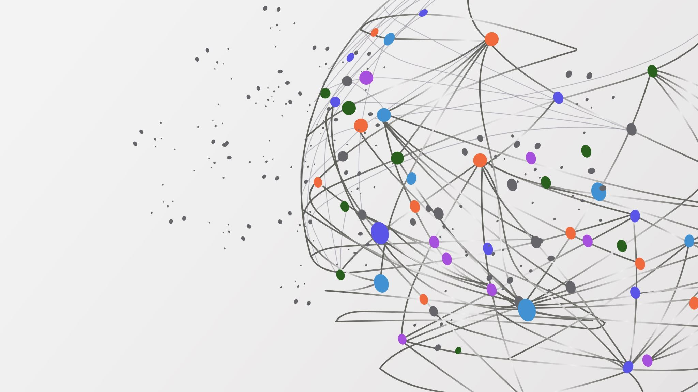
RETAIL DATA ANALYTICS USING GRAPH DATABASE
Group 4 : LLM Minesweepers
Shruti Dhamdhere
Vinay Jogani
Rishabh Shah

Slide 2
Problem Statement
Current retail systems address isolated needs, not the full supply chain
Customers want personalized shopping; retailers need forecasting and inventory tools; suppliers require delivery and demand insights
Lack of an integrated solution leads to inefficiencies and missed opportunities
Project aims to build a unified retail platform using Neo4j and a large language model (LLM)
Uses Instacart dataset to start with customer recommendations and purchase predictions
Expands to provide retailers with sales insights, customer segmentation, and inventory management
Suppliers get visibility into delivery schedules, demand forecasting, and shipment tracking
Synthetic data will simulate missing supplier and shipment information
Knowledge graph models relationships between all stakeholders for advanced queries
LLM translates complex data into simple, actionable insights
Platform improves decision-making, efficiency, and satisfaction across the retail ecosystem

Slide 3
Reference Paper
Source - "Retail Data Analytics Using Graph Database" by Rashmi Priya, University of Kentucky, 2018.
Problem Addressed: Traditional relational databases struggle to handle the highly connected and large-scale data generated by retail transactions. The thesis aims to explore graph databases—specifically Neo4j—as a better alternative for modeling and analyzing complex relationships in retail data.
Approach: The paper models retail transaction data from the Instacart dataset as a graph using Neo4j, capturing relationships between customers, orders, products, aisles, and departments. It then applies the Louvain community detection algorithm to cluster products based on co-purchase behavior.
Recommendation System: A collaborative filtering-based recommendation system is built by identifying product clusters and calculating a customer's “belonging factor” to each cluster, helping suggest relevant products.
Conclusion: Graph databases offer powerful tools for uncovering hidden insights in retail data, enabling personalized recommendations and efficient decision-making. The work validates Neo4j’s performance and shows its scalability and relevance for real-world retail applications.

Slide 4
Dataset
Dataset Overview:
1. The dataset is from Instacart, an online grocery delivery service.
2. It contains over 16000 million grocery orders from more than 1000 customers and over 49000 products.
3. The data was published in 2017 for research purposes and is anonymized, with unique identifiers for customers.

Slide 5
Dataset Structure
Products.csv
Contains product details:
product_id, product_name, aisle_id, department_id
Aisle ID: Identifies where the product is placed in the store.
Department ID: Represents the category to which the product belongs.
Order.csv
Contains order details:
order_id, user_id, order_number, order_dow, order_hour_of_day, days_since_prior_order
Order_Products__.csv
Links orders with purchased products:
order_id, product_id, add_to_cart_order, reordered
Aisle.csv
Metadata for aisles:
aisle_id, aisle
Departments.csv
Metadata for departments:
department_id, department
Shipments.csv
Suppliers.csv
Contains shipment details:
shipment_id, supplier_id, retailer_id, product_id, shipment_date, expected_delivery_date, actual_delivery_date, shipment_status, department_id
supplier_id, supplier_name, location, contact_name, contact_email, department_id, product_id
Contains supplier details:

Slide 6
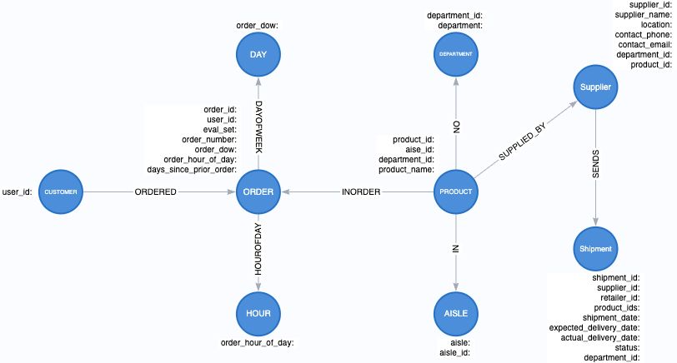
KNOWLEDGE GRAPH

Slide 7
Algorithms Used
Louvain Algorithm: Detects communities in a graph by optimizing modularity through hierarchical clustering.
Page Rank: Measures the importance of nodes based on link structure.
Betweenness: Identifies nodes that act as bridges by calculating how often they appear on shortest paths.
Degree Centrality: Ranks nodes based on the number of direct connections they have.
Node Similarity: Calculates how similar two nodes are based on shared neighbors or structural features.

Slide 8
Questions?

Slide 9
Customer Lifecycle & Behavior
Customer Journey Evolution
- How does the average cart size evolve over a customer's lifetime (by order number)?
- What's the typical progression of departments that new customers explore over their first 5 orders?
- How many aisles do new clients usually browse throughout their first 5 orders?
- How does order hour preference evolve for departments over time?
- How does customer/basket share vary across product categories over time?
Customer Retention & Segmentation
- How does customer retention vary over time based on their preferred shopping department?
- Which products play a central role in the early purchasing patterns of retained customers?
- Can we identify distinct customer segments based on ordering day/time patterns?
Purchase Pattern Transitions
- Which products are most frequently transitioned into by loyal customers?
- Which products serve as 'gateway purchases' that lead to exploration of new departments?

Slide 10
Reorder Behavior & Loyalty Drivers
Reorder Dynamics
- Are customers reordering items popular with others in their first order?
- How does reorder frequency vary with days_since_prior_order for frequently purchased items?
- What's the relationship between a product's department and reorder likelihood?
Promotions & Reorder Uplift
- Which products are most often added to cart in the first 3 positions?
- Do users prefer reordering familiar products early or exploring new ones in the first 3 cart additions?
- Which product categories have the highest uplift in sales?

Slide 11
Product Affinity, Graphs & Recommendations
Co-Purchase Patterns & Product Graphs
- What are the top product pairings based on co-purchase frequency?
- What products have the highest cross-department purchase correlation?
- Which items act as a 'bridge' between different product communities?
Community Detection & Recommendation Modeling
- Do high-centrality products (high betweenness) make better recommendations than low-centrality ones?

Slide 12
Demand Trends & Seasonality
Product Lifecycle & Decline
- Which products show the sharpest drop in demand over time?
Seasonal Effects
- Which product categories exhibit strong day-of-week effects?
- What is the day-of-week effect on order size across different product categories?

Slide 13
Supply Chain & Delivery Performance
Delivery Success Factors
- Which suppliers have the highest delivery success rates?
- What proportion of shipments are in transit, delivered and dispatched?
Efficiency Drivers
- What is the average delivery delay (in days) for shipments by category?
- How does product category mix affect on-time delivery?
- How does supply chain performance vary with seasonal demand fluctuations?

Slide 14
Performance Metrics & Sales KPIs
Priority stocking & display strategy
- Which products connect the widest variety of departments and have high co-purchase influence?
Resource allocation and marketing focus
- Which departments contribute most to overall order volume?

