Slide 1
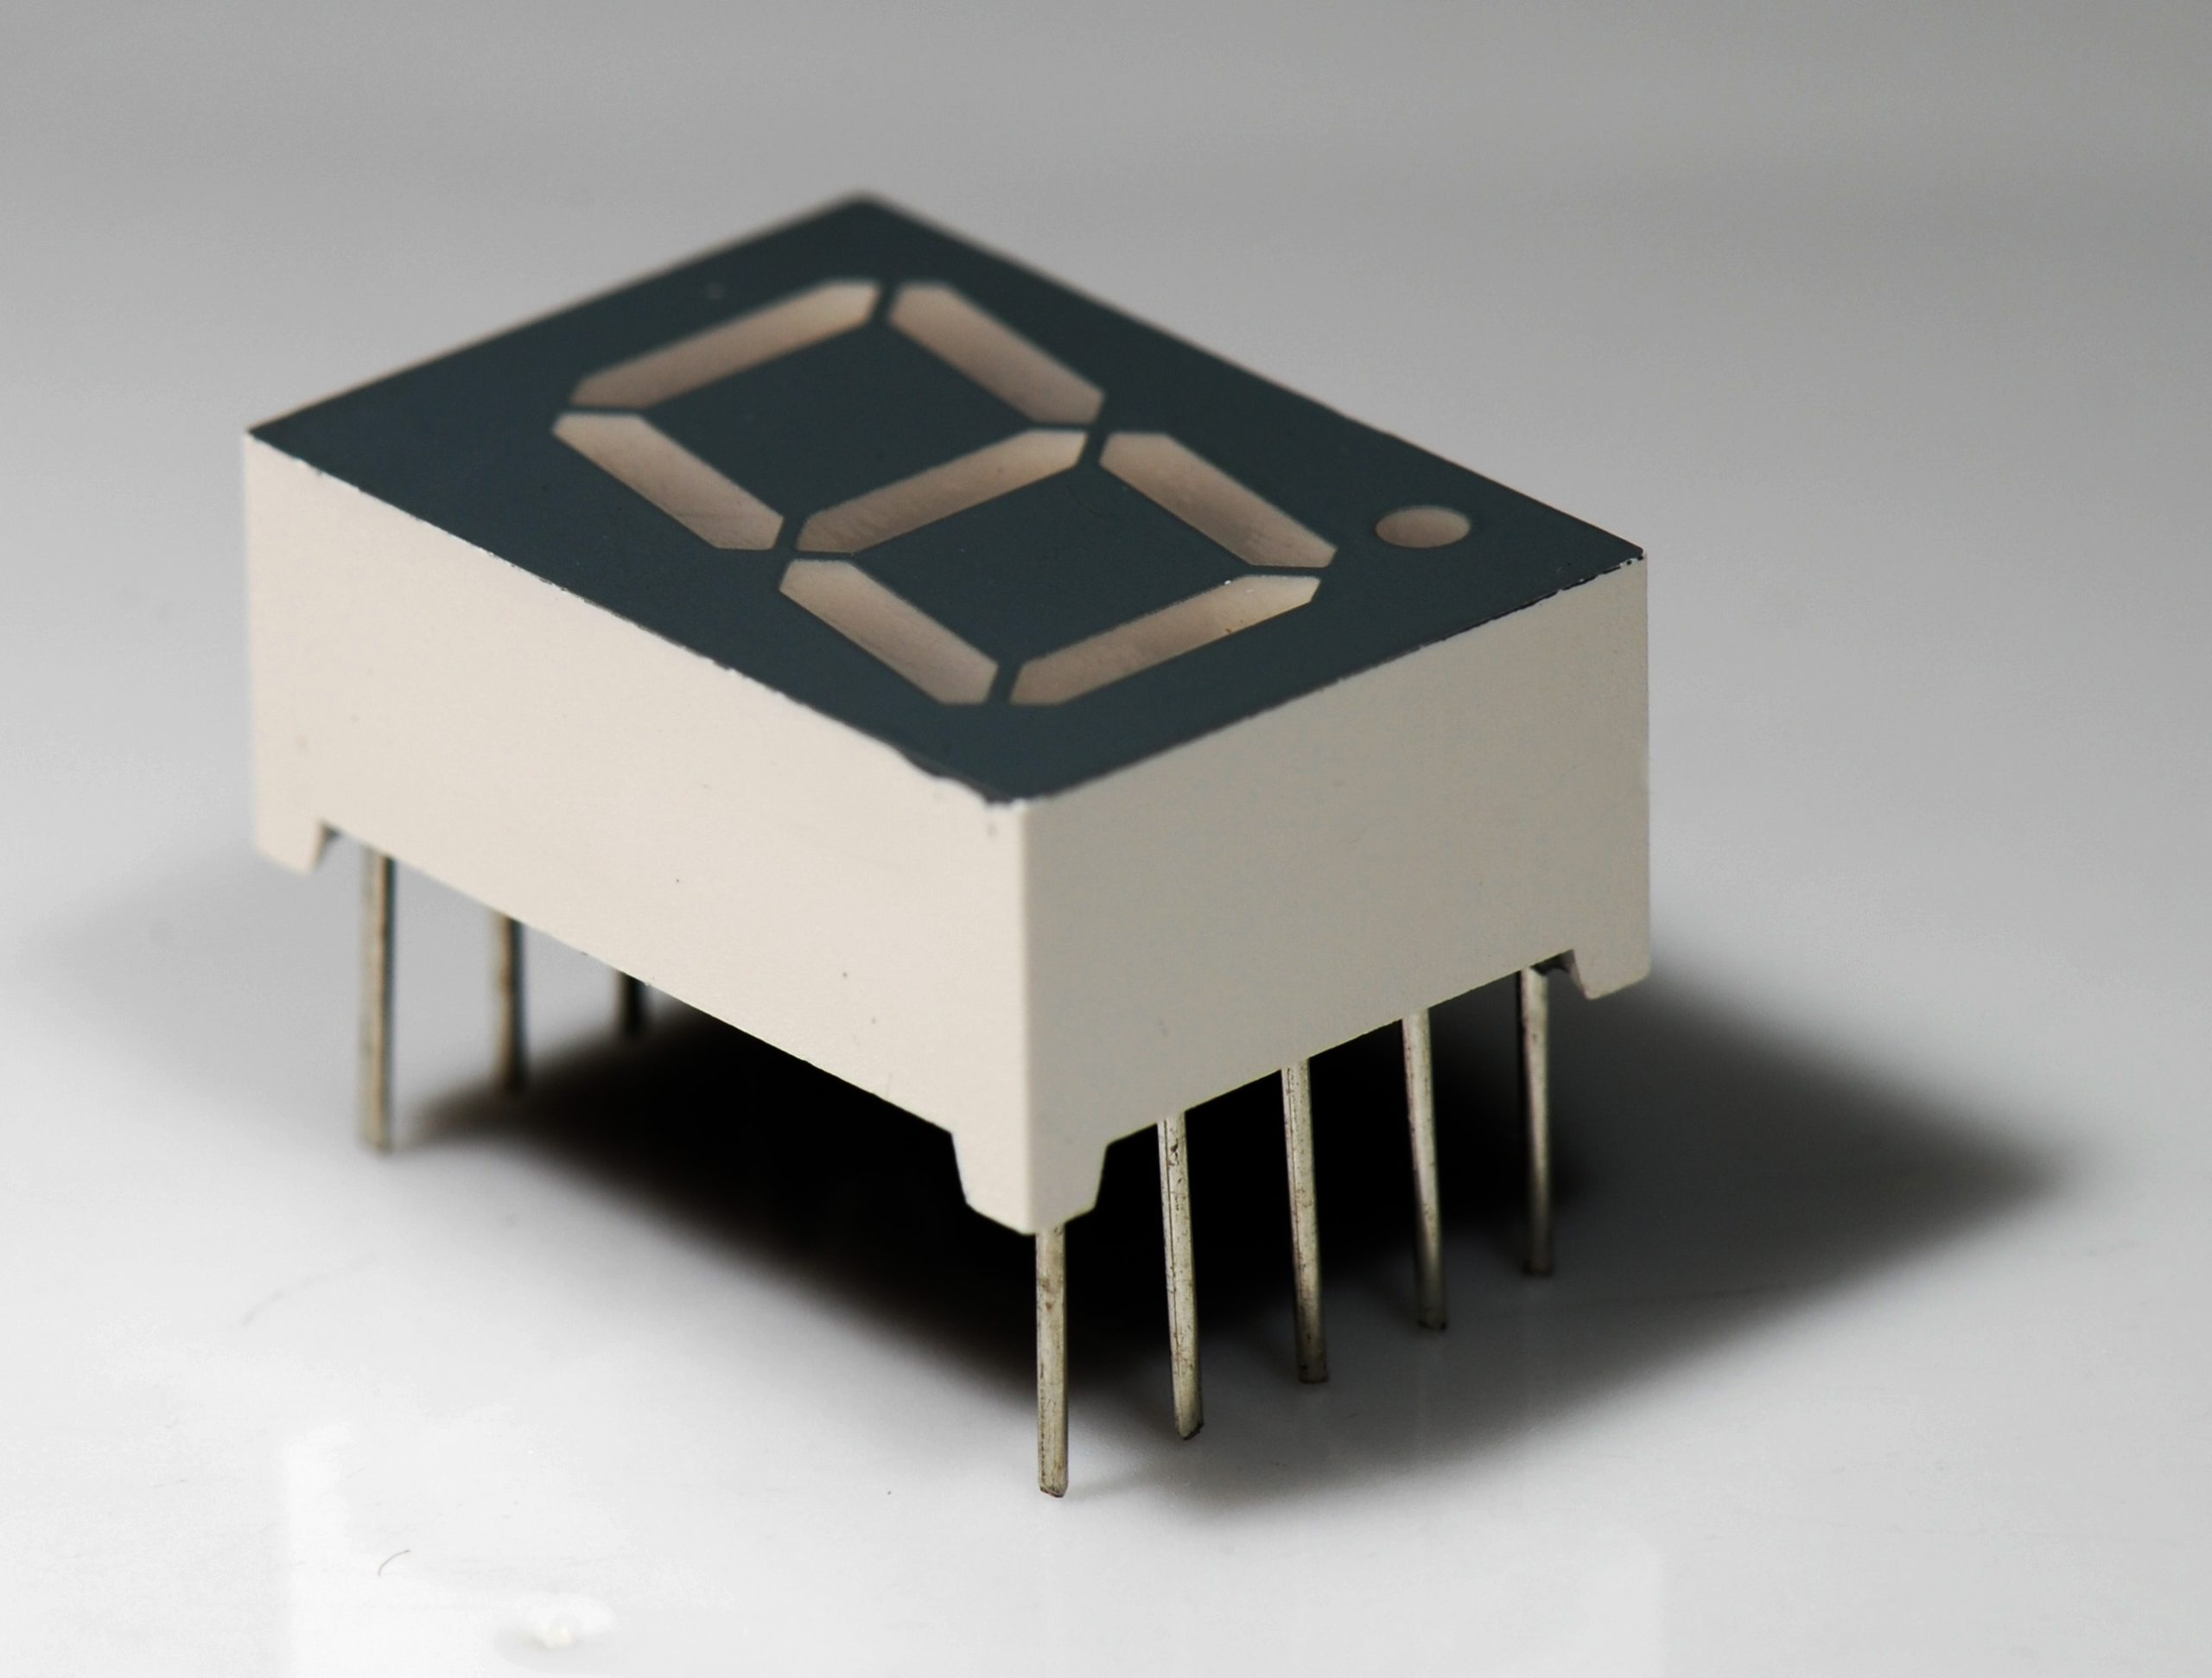
7 Segment Display
What is 7 segment display?
Seven segment displays are the output display device that provide a way to display information in the form of image or text or decimal numbers.
In simple words 7 segment display are used to show numbers decimal points or text.
They are used in digital clocks, basic calculators and other electronics that display numerial information.

Slide 2
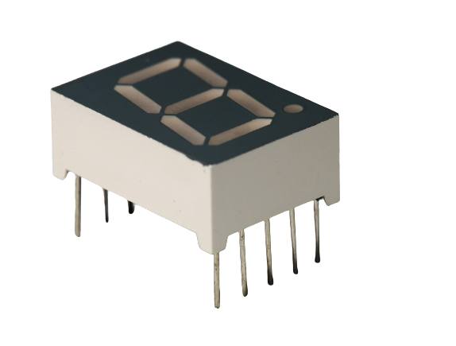
7 Segment Display
Working of 7 Segment Display
1
7
3
5
Seven segment displays Actually has 7 because it has 7 LEDs in it. It also has a decimal point led on it.
2
point
4
6
Each LED can be made ON or OFF individually.
By making LEDs ON and OFF in different pattern makes different digits or characters on Display.
With 7 Segment Display we can make numbers from 0 to 9 and Alphabets from A to F.

Slide 3
7 Segment Display
Pins of 7 Segment Display
gnd
g
f
a
b
8LEDs(including decimal point) on 7 segment display has the segments named a, b, c, d, e, f, g, and dp respectively.
a
f
b
g
e
c
The segment display can be divided into two types: common anode and common cathode segment displays, by internal connections.
d
dp
d
dp
e
c
gnd
For a common-anode LED, the common anode should be connected to the power supply (VCC); for a common-cathode LED, the common cathode should be connected to the ground (GND).

Slide 4
7 Segment Display
Pins of 7 Segment Display
gnd
g
f
a
b
In each display there are LEDs segmented so we need resistor for protecting LEDs.
a
f
b
g
e
c
The segment display can be divided into two types: common anode and common cathode segment displays, by internal connections.
d
dp
d
dp
e
c
gnd
For a common-anode LED, the common anode should be connected to the power supply (VCC); for a common-cathode LED, the common cathode should be connected to the ground (GND).

