Slide 1
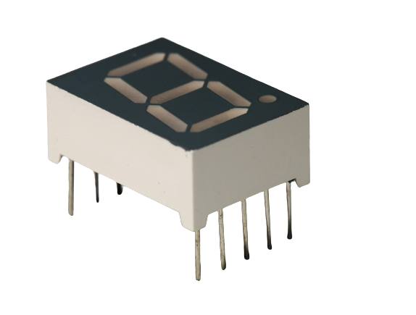
7 Segment Display
Working of 7 Segment Display
1
7
3
5
Seven segment displays Actually has 7 because it has 7 LEDs in it. It also has a decimal point led on it.
2
point
4
6
Each LED can be made ON or OFF individually.
By making LEDs ON and OFF in different pattern makes different digits or characters on Display.
With 7 Segment Display we can make numbers from 0 to 9 and Alphabets from A to F.

Slide 2
7 Segment Display
Pins of 7 Segment Display
gnd
g
f
a
b
8LEDs(including decimal point) on 7 segment display has the segments named a, b, c, d, e, f, g, and dp respectively.
a
f
b
g
e
c
The segment display can be divided into two types: common anode and common cathode segment displays, by internal connections.
d
dp
d
dp
e
c
gnd
For a common-anode LED, the common anode should be connected to the power supply (VCC); for a common-cathode LED, the common cathode should be connected to the ground (GND).

Slide 3
7 Segment Display
Pins of 7 Segment Display
gnd
g
f
a
b
In each display there are LEDs segmented so we need resistor for protecting LEDs.
a
f
b
g
e
c
The segment display can be divided into two types: common anode and common cathode segment displays, by internal connections.
d
dp
d
dp
e
c
gnd
For a common-anode LED, the common anode should be connected to the power supply (VCC); for a common-cathode LED, the common cathode should be connected to the ground (GND).

Slide 4
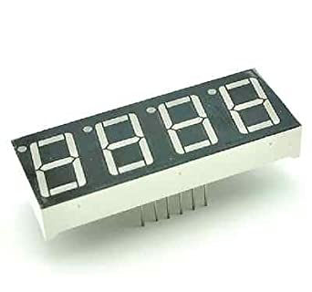
4 Digit 7 Segment Display
Pins of 4 Digit 7 Segment Display
The 4-digit segment display is a 4*8-shaped LED display device composed of 32 LEDs (including four decimal points). The segments arenamed respectively a, b, c, d, e, f, g, h, dig1, dig2, dig3, and dig4.
dig1
dig3
a
dig2
b
f
a
a
a
a
For a common-anode LED, the common anode should be connected to the power supply (VCC); for a common-cathode LED, the common cathode should be connected to the ground (GND).
f
b
f
b
f
b
f
b
g
g
g
g
e
c
e
c
e
c
e
c
d
dp
d
dp
d
dp
d
dp
d
c
g
e
dp
dig4

Slide 5
4 Digit 7 Segment Display
Pins of 4 Digit 7 Segment Display
dig1
dig3
a
dig2
b
The 4-digit segment display is a 4*8-shaped LED display device composed of 32 LEDs (including four decimal points). The segments arenamed respectively a, b, c, d, e, f, g, h, dig1, dig2, dig3, and dig4.
f
a
a
a
a
f
b
f
b
f
b
f
b
g
g
g
g
e
c
e
c
e
c
e
c
d
dp
d
dp
d
dp
d
dp
For a common-anode LED, the common anode should be connected to the power supply (VCC); for a common-cathode LED, the common cathode should be connected to the ground (GND).
d
c
g
e
dp
dig4

Slide 6
Ultrasonic
Sensor
Arduino Uno
Relay module
Tank Pump
LCD
Screen
Relay module
Plant Water Pump
Soil Moisture
Sensor
Power Supply
GSM SIM900
Module

