Slide 1
ABI
Healthcare
300
3
Patients
Facilities
Wound Care Billing
Automation Pipeline
5
4
API Endpoints
Note Formats
ABI Frameworks Hackathon · Vinay Kumar

Slide 2
THE CHALLENGE
The
Goal
Billers spend hours manually reviewing patient charts to find who qualifies for Medicare Part B wound care billing.
Automate the entire triage pipeline — from API to biller-ready decision — in one run.
ingest.py → extract.py → rules.py → app.py
Data locked in EHR
PointClickCare API — rate-limited, no direct DB access
4 note formats
SOAP, Prose, Multi-wound, Envive — each requires different parsing
Manual process today
Every patient reviewed by hand for coverage + wound documentation

Slide 3
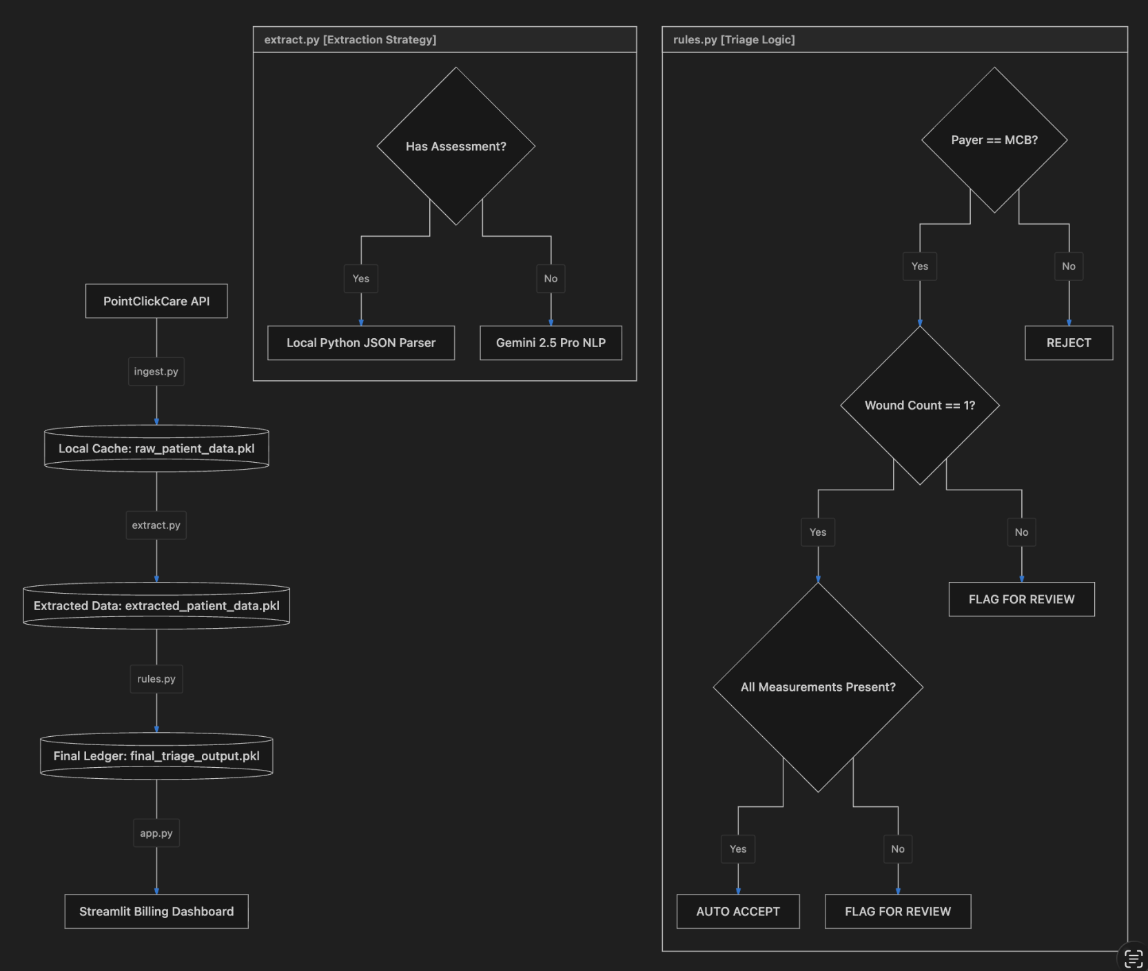
System Architecture
ingest.py
extract.py
rules.py
app.py
Left: pipeline data flow · Right: triage decision logic (rules.py)

Slide 4
INGEST.PY
RATE LIMIT STRATEGY
API Ingestion &
Rate Limit Handling
30% of requests
return HTTP 429
GET /pcc/patients
1
Send Request
facility_id → 300 patients, 3 facilities
Call endpoint with patient/facility ID
GET /pcc/diagnoses
patient_id (string FA-001) → ICD-10 codes
2
429 Received
Read Retry-After header value
GET /pcc/coverage
patient_id (string) → payer / MCB status
3
Wait & Retry
GET /pcc/notes
Exponential backoff — honour header delay
id (integer) → free-text clinical notes
GET /pcc/assessments
4
Cache Result
id (integer) → structured wound forms
Persist to raw_patient_data.pkl
⚠ Dual IDs: string FA-001 for /diagnoses & /coverage · integer for /notes & /assessments

Slide 5
EXTRACT.PY
Wound Data Extraction
Has structured assessment? YES → Local Python JSON Parser NO → Gemini 2.5 Pro NLP
SOAP
PROSE
Local JSON Parser
Gemini 2.5 Pro
Fully structured. Wound type, stage, and dimensions are explicit labeled fields — parsed directly.
Abbreviated free text (e.g. Meas 4.2×3.1×1.5cm). No assessment → Gemini extracts wound fields.
MULTI-WOUND
ENVIVE
Gemini 2.5 Pro + Flag
Gemini 2.5 Pro
Two wounds in one note. Gemini extracts both; rules.py flags for review (wound_count > 1).
Dense unstructured narrative. No assessment available → Gemini 2.5 Pro extracts all clinical wound fields.
Fields extracted: wound type · stage · location · length × width × depth (cm) · drainage level

Slide 6
RULES.PY
Eligibility & Routing Logic
Payer == MCB?
Wound Count == 1?
All Measurements Present?
→ Outcome
AUTO
ACCEPT
FLAG FOR
REVIEW
REJECT
· Payer = MCB ✓
· Payer = MCB ✓
· Payer ≠ MCB
· Wound Count = 1 ✓
· Multi-wound note OR
· (Part A, Medicaid, HMO)
· All measurements present ✓
· Missing any measurement
· Regardless of wound data
Route directly to billing queue. No further review needed.
Clinician or biller must verify before claim submission.
Do not route to billing. Patient ineligible for Part B billing.
~60% Medicare Part B (eligible) · ~15% Part A · ~10% Medicaid · ~15% HMO — only MCB patients enter the routing flow

Slide 7
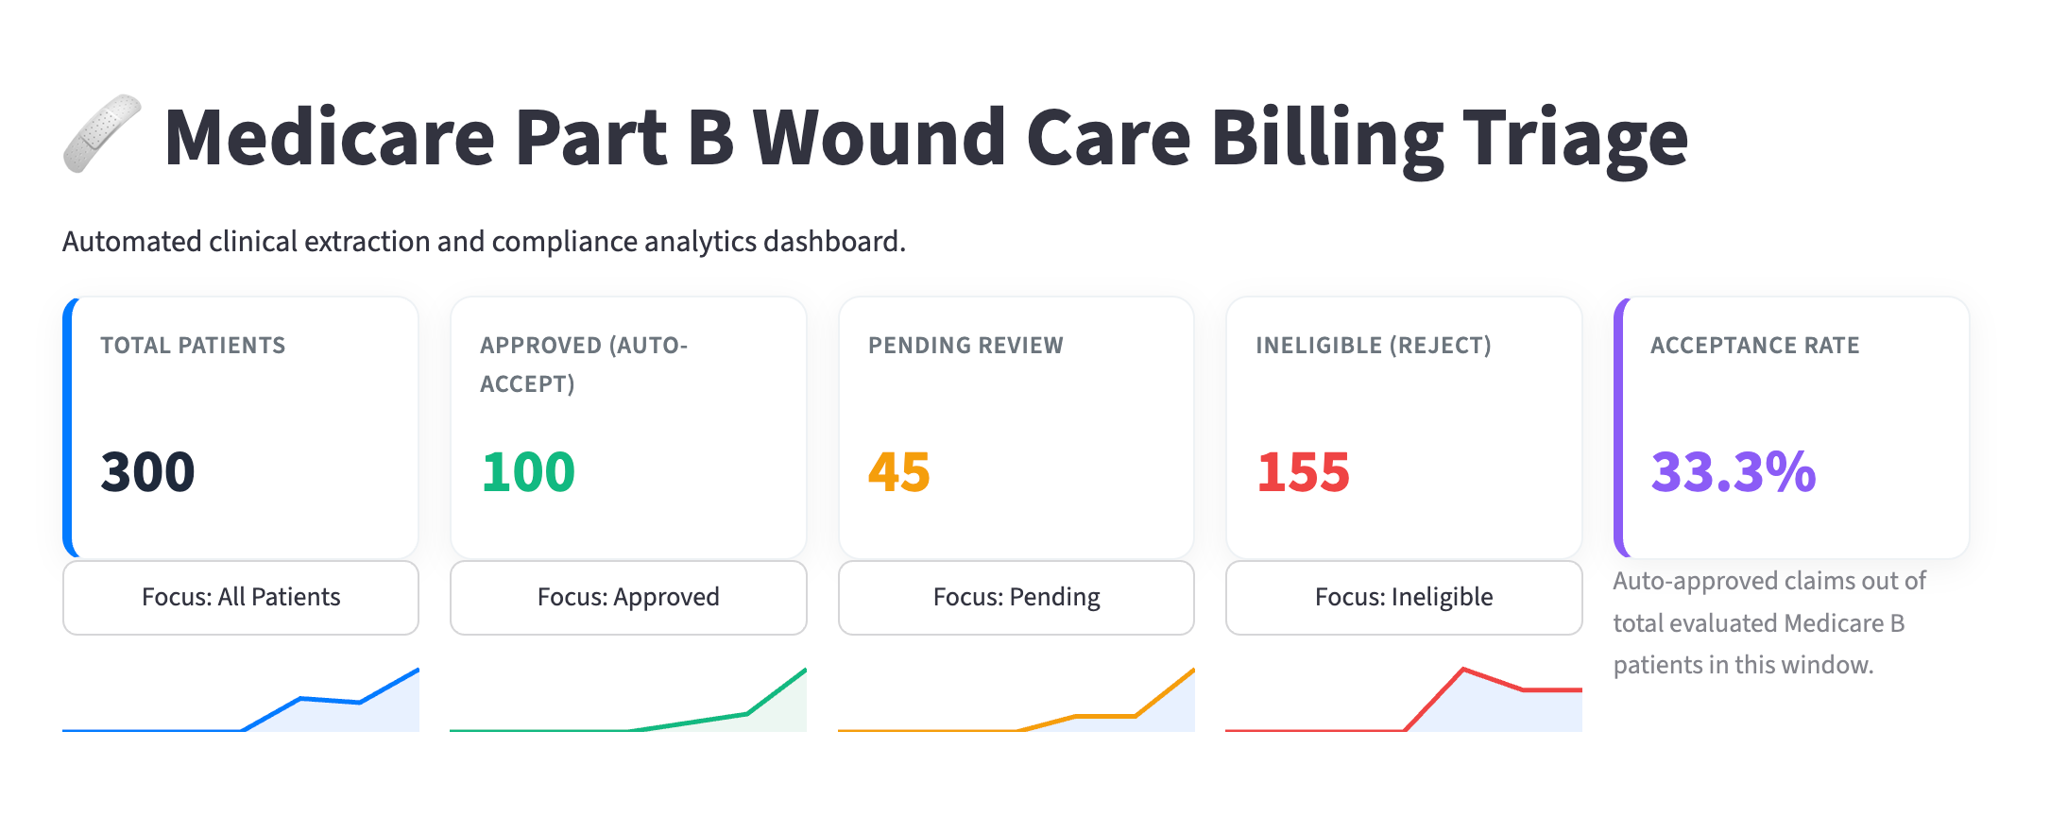
APP.PY · ABIHEALTHCARE.STREAMLIT.APP
Biller Dashboard
ACCEPTANCE RATE
33.3%
Auto-approved out of total MCB patients
300
100
45
155
Total Patients
Approved (Auto-Accept)
Pending Review
Ineligible (Reject)
Live: abihealthcare.streamlit.app · Data: final_triage_output.pkl · Acceptance rate: 33.3% (100/300 MCB patients)

Slide 8
EXAMPLE PATIENTS
Routing Walkthroughs
FA-001
FB-045
FC-088
Facility A
Facility B
Facility C
AUTO ACCEPT
FLAG FOR REVIEW
REJECT
· Stage 3 Pressure Ulcer — sacrum
· Diabetic Foot Ulcer — left heel
· Wound type: Unknown
· 4.2 × 3.1 × 1.5 cm — fully documented
· Measurements: MISSING
· Measurements: could not extract
· Drainage: Moderate
· Drainage: Heavy
· Drainage: undocumented
· Payer: Medicare Part B ✓
· Payer: Medicare Part B ✓
· Payer: Medicare Part A ✗
· Note: SOAP → JSON Parser
· Note: Prose → Gemini 2.5 Pro
· Note: Envive → Gemini 2.5 Pro
All 3 rules pass. Safe to bill.
MCB ✓, single wound ✓, but measurements absent → flag.
Payer ≠ MCB. First check fails. Stop.
300 patients processed · ~60% MCB eligible · pipeline runs end-to-end in a single command

Slide 9
TECHNICAL APPROACH
Key Design Decisions
01
Hybrid Extraction
extract.py
Structured assessments → fast local Python JSON parser (deterministic, free). No assessment → Gemini 2.5 Pro with constrained JSON schema. LLM only where regex fails.
02
Deterministic Routing
rules.py
All routing in rules.py is pure rule-based logic — MCB check, wound count, measurement completeness. No ML. Every decision is auditable and explainable to a biller.
03
Conservative Defaults
rules.py
Ambiguity always resolves to flag_for_review, never auto_accept. Multi-wound notes are flagged, not guessed. A false reject is cheaper than a wrong billing claim.
Pickle caching between stages: raw_patient_data.pkl → extracted_patient_data.pkl → final_triage_output.pkl — re-runs skip completed stages

Slide 10
CTO FEEDBACK · IMPLEMENTED
Keyword Cache Optimization
Problem: Every justification sent full patient context to Gemini 2.5 Pro — high token cost per patient, multiplied across 300 patients.
BEFORE — Full context every call
AFTER — Keyword cache first
→ Patient record (notes + assessments + diagnoses)
→ Extract keywords from each patient's records once
→ Insurance / coverage details
→ Cache: wound type, stage, measurements, drainage, payer
VS
→ Full wound description (all fields)
→ Check cache before any LLM call
→ All sent to Gemini 2.5 Pro → verbose justification
✓ Cache hit → assemble justification from keywords (0 tokens)
⚠ ~800–1200 tokens per patient × 300 patients
~ Cache miss → targeted Gemini call for gap only
Clinical Notes
Assessments
Diagnoses
Coverage
wound type · stage · location · drainage
length · width · depth · wound count
ICD-10 codes · primary dx
payer · MCB status · effective date

Slide 11
OPTIMIZATION RESULT
How the Cache Works
IMPACT
1
Extract Keywords
~70–80%
On first ingest, scan diagnoses, notes, assessments, and coverage. Store as a structured keyword dict per patient_id.
fewer tokens on cache-hit patients
Targeted
2
Cache Check
prompts only for missing fields — not full records
Before generating justification, compare required fields against the patient's keyword cache. All fields present?
Same
justification accuracy — keywords are evidence-based
3a
Cache Hit ✓
3b
Cache Miss ~
Assemble justification from cached keywords. No LLM call. Zero tokens consumed.
Send only the missing fields to Gemini 2.5 Pro. Minimal targeted prompt — not full patient context.

Slide 12
LINKS
What
we built.
abihealthcare.streamlit.app
github.com/VinayKumar2320/ABI-Healthcare
PIPELINE FILES
ingest.py
API fetch + retry + cache
300 patients ingested from live PCC API with retry handling
extract.py
Hybrid extraction: JSON parser + Gemini 2.5 Pro across 4 note formats
JSON parser + Gemini 2.5 Pro NLP
rules.py
3-way routing: AUTO ACCEPT · FLAG REVIEW · REJECT
MCB → count → measurements → decision
Keyword cache: ~70–80% token reduction on justifications
app.py
Streamlit biller dashboard
Live Streamlit dashboard for billers
CTO Optimization · Keyword cache reduces justification token cost ~70–80%

