Slide 1
Review-2 on Air Draw - An Interactive OpenCV Image Creation Project
S. Rohit Jaiswal – 2010030141
K. Sidharth Rao – 2010030443
P. Vinay Kumar – 2010030469
Sai Bhargav – 2010030535
Under the Guidance of
Dr. Sumit Hazra
Associate Professor
Computer Science and Engineering Department
KL Hyderabad Off Campus, Aziz Nagar ,Hyderabad

Slide 2
Overview
Introduction
Objectives of the Project
Proposed Methodology/Architecture/Algorithm/Technique/etc
Implementation Details
Results (If any one objective is completed)
References

Slide 3
Introduction
The fusion of technology and creativity has led to the development of innovative applications that empower users to express themselves in novel ways. One such captivating endeavor is the "Air Draw" project—an ingenious exploration of interactive image creation using OpenCV.
This project seamlessly marries the power of computer vision with user engagement, allowing individuals to paint and craft images through intuitive air gestures and movements.
Traditional artistic tools like pens, brushes, and canvases have undergone a digital metamorphosis, resulting in a canvas that responds to gestures performed in the air.
The "Air Draw" project, built upon the OpenCV framework, not only exemplifies this transformation but also invites users into an interactive realm where their imagination takes the lead.

Slide 4
Objectives of the Project
The primary objective of the "Air Draw" project is to provide an innovative platform for users to create images without the need for physical tools or direct contact.
Secondly, the application seeks to achieve real-time interaction by seamlessly translating detected gestures into smooth, visually coherent drawings on the screen.

Slide 5
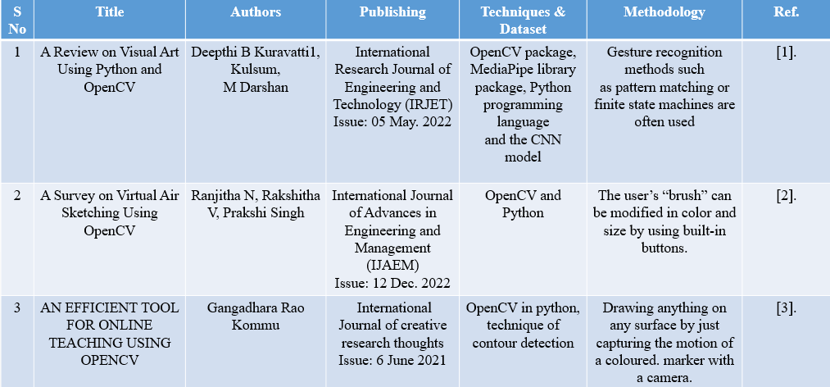
Literature Survey

Slide 6
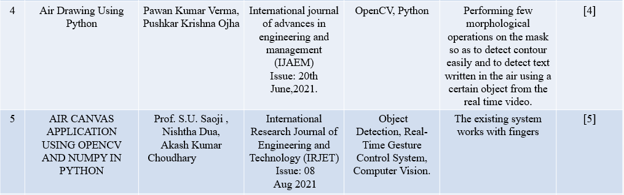

Slide 7
Proposed Methodology
The workflow of the "Air Draw" project is elegantly structured to guide users seamlessly from inception to creation:
User Launch: The project begins as users launch the application, stepping into the realm of digital artistry.
Gesture-based Interface: The gesture-based interface, built upon OpenCV's capabilities, captures users' hand movements and translates them into actions on the virtual canvas.
Canvas Interaction: Users can interact with the canvas through air gestures to draw strokes, change colors, adjust brush sizes, and erase elements.

Slide 8
Image Processing: The OpenCV framework processes the captured gestures, mapping them to corresponding actions on the canvas. This involves hand tracking, stroke rendering, color mixing, and erasing.
Real-time Feedback: The canvas provides real-time feedback, allowing users to witness their creations come to life as they move their hands through the air.
Image Output: The result of the creative process is a digital image that encapsulates the user's artistic expression.
Endless Possibilities: With a spectrum of colors, brush sizes, and gestures, "Air Draw" opens the door to a multitude of artistic possibilities, limited only by the user's imagination.

Slide 9
Implementation Details
This project has primarily been implemented using OpenCV and Lucas-Kanade Optical Flow
OpenCV (Open Source Computer Vision Library) is a versatile open-source computer vision and machine learning software library.
It is widely used in various applications, including image and video processing, object detection, facial recognition, and more.
Lucas-Kanade optical flow is a classic and well-established algorithm for estimating the motion of objects in a sequence of images or video frames.
Named after its creators, Bruce D. Lucas and Takeo Kanade, this method assumes that the motion between consecutive frames is approximately constant within a small local neighborhood.

Slide 10
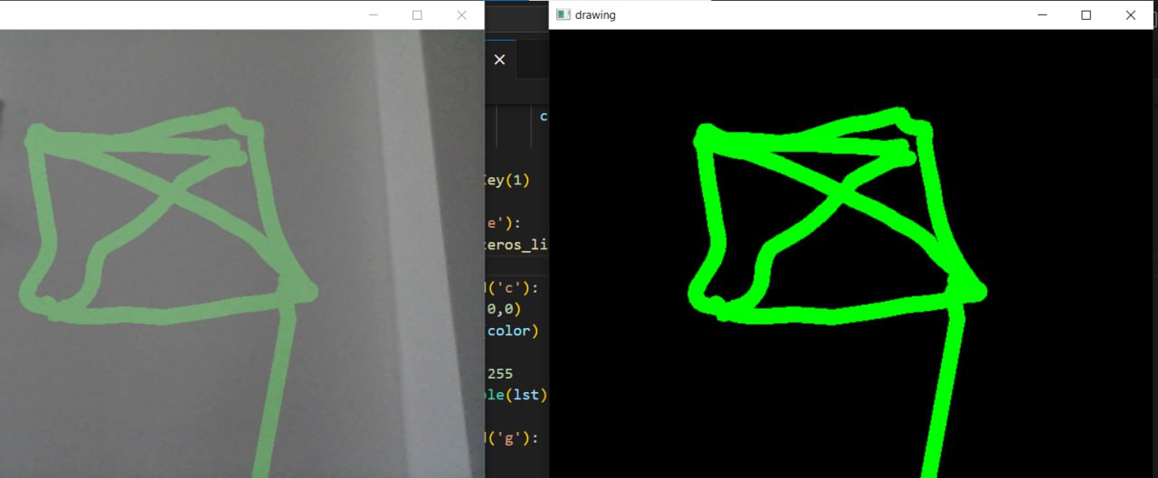
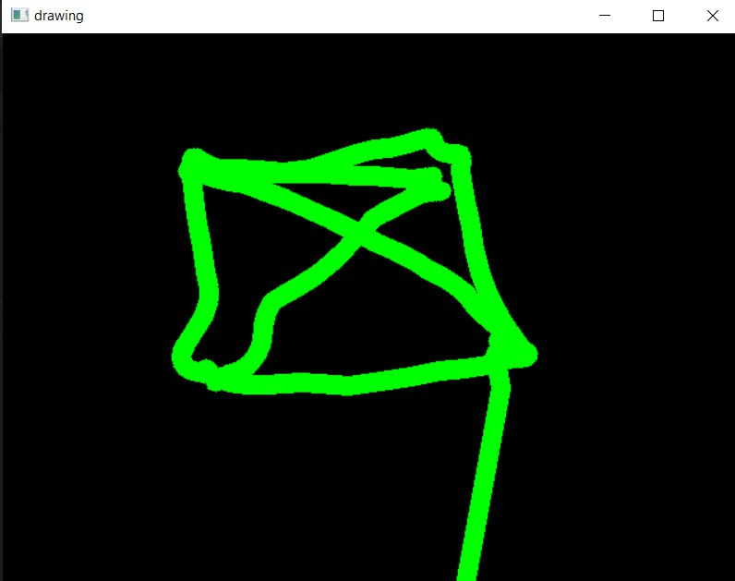
Results

Slide 11
References
https://www.irjet.net/archives/V9/i5/IRJET-V9I528.pdf
Ranjitha, N., V. Rakshitha, Aditi B. Prahalad Prakshi Singh, and Smt Akshitha Katkeri. "A Survey on Virtual Air Sketching Using OpenCV.“
Kommu, G. R. "An efficient tool for online teaching using Opencv." International Journal of Creative Research Thoughts (IJCRT) 9, no. 6 (2021): 225-228.
Verma, Pawan Kumar, and Pushkar Krishna Ojha. "Air Drawing Using Python.“
Saoji, S. U., Nishtha Dua, Akash Kumar Choudhary, and Bharat Phogat. "Air canvas application using Opencv and numpy in python." IRJET 8, no. 08 (2021).
https://www.ijitee.org/wp-content/uploads/papers/v10i8/H92620610821.pdf

Slide 12
Thank you and Any Queries

