Slide 1
Polynomial
Regression
Mathematical Concepts
Vinay Lokre

Slide 2
What is Regression?
It is a technique for investigating the relationship between independent variables and a dependent variable.
Types of regression : Linear Regression
Logistic Regression

Slide 3
Linear Regression :
It is used to predict the value of a variable based on the value of another variable. The variable you want to predict is called the dependent variable. The variable you are using to predict the other variable's value is called the independent variable
Y = mX + b
Y : Dependent or Output Variable.
X : Independent or Feature.
m : estimated slope.
b : estimated intercept.

Slide 4
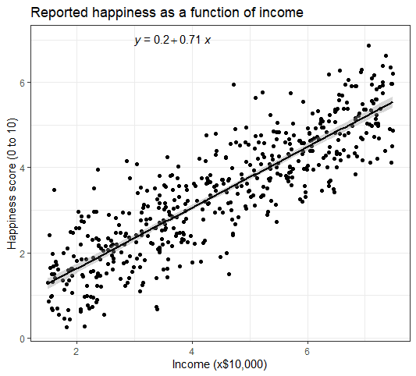
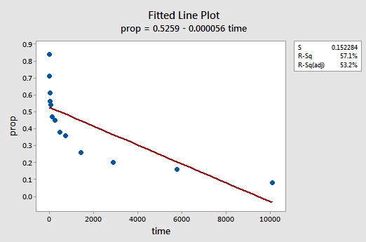
Linear Regression
Non-linear data points

Slide 5
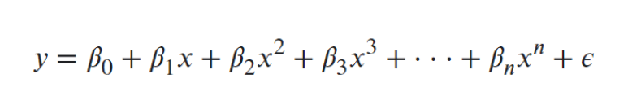
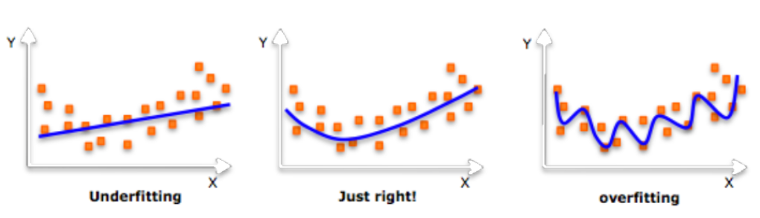
Polynomial Regression :
It is a form of linear regression in which the relationship between the independent variable x and the dependent variable y is modelled as an nth degree polynomial.

Slide 6
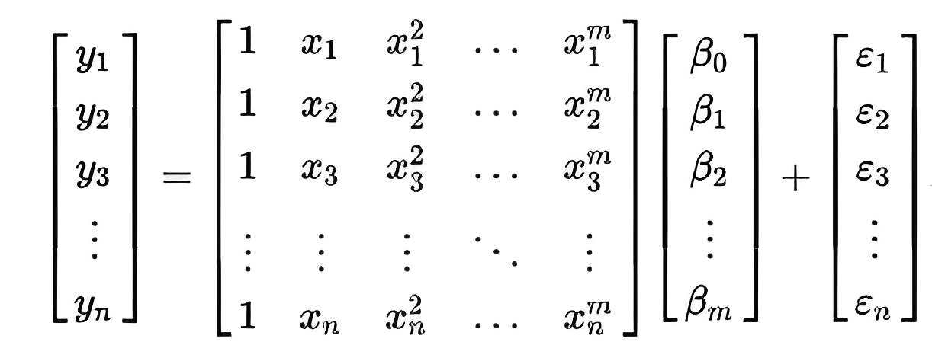
Calculation in matrix form

Slide 7
Cost Function
In polynomial regression, the goal is to fit a polynomial function to the given training data, in order to make predictions on new data points.
The cost function in polynomial regression is typically the mean squared error (MSE) between the predicted outputs and the true outputs. MSE is defined as follows:
MSE ( y, ŷ ) = ( 1/m ) * ∑_{ i=1 } ^ m ( y ^ ( i ) - ŷ ^( i ) )^2
where m is the number of training examples, y^(i) is the true output for the ith example, and ŷ^(i) is the predicted output for the ith example.

Slide 8
Advantages
The biggest advantage of nonlinear regression over many other
techniques is the broad range of functions that can be fit.
Polynomials very flexible, and useful where a model must be developed empirically.
Polynomial fit a wide range of curvature.
Polynomial provide a good approximation of the relationship.
Transformations generally more interpretable, often more easily interpreted in terms of a possible functional relationship.

Slide 9
Disadvantages
Disadvantages include a strong sensitivity to outliers. The presence of one or two outliers in the data can seriously affect the results of a nonlinear analysis.
In addition there are unfortunately fewer model validation tools for the detection of outliers in nonlinear regression than there are for linear regression.

Slide 10
ThanK
YoU

