Slide 1

Vinay Mathew Varghese
RSET IEEE CS Vice-Chair

Slide 2
Git
Git is a free and open source distributed version control system designed to handle everything from small to very large projects with speed and efficiency.

Slide 3
Basic topics I am dealing
Repositories
Basic git operations

Slide 4
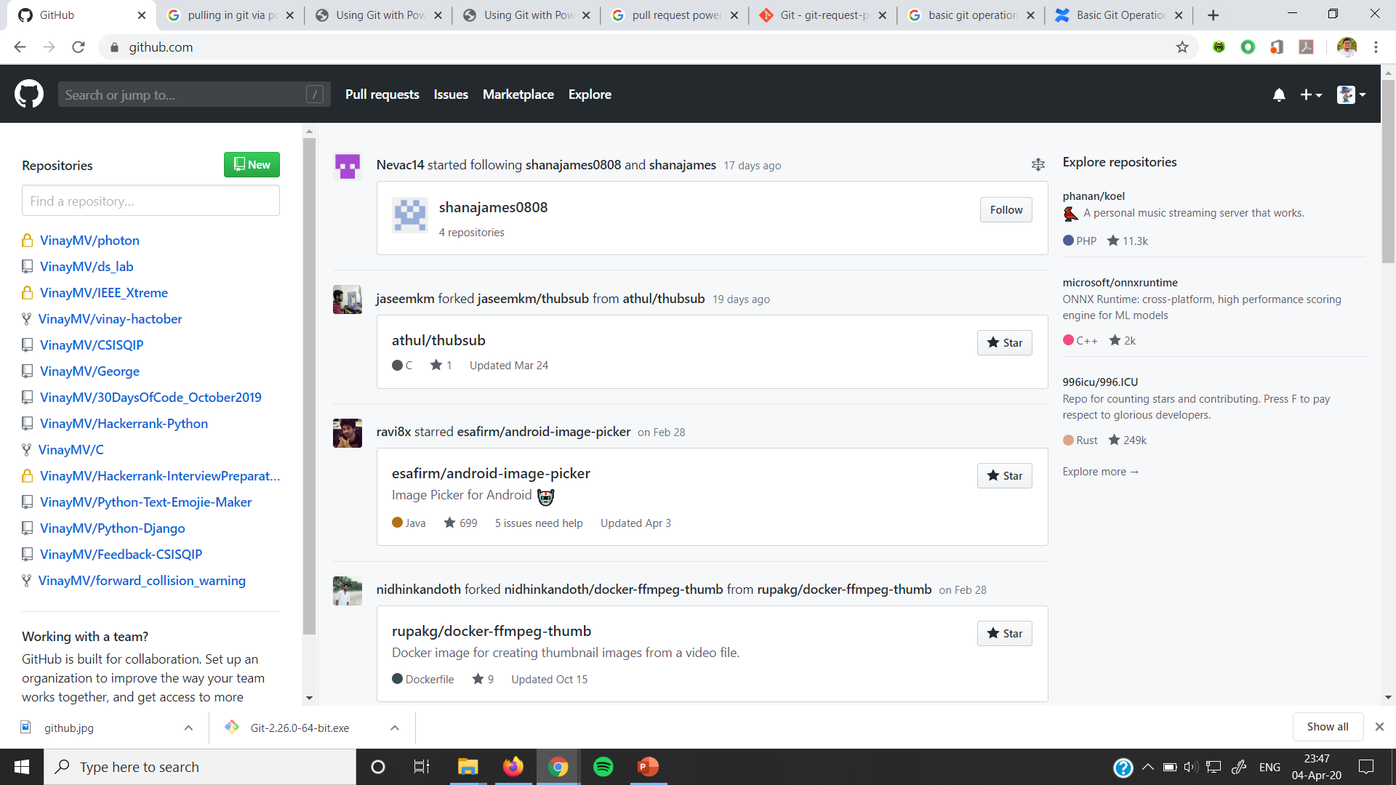
Repositories

Slide 5
Basic git operations
git clone
git status
git add
git commit
git push

Slide 6
Git cloning
Command
git clone “<url>”

Slide 7
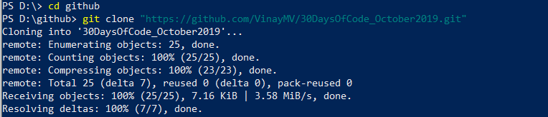
Git clone

Slide 8
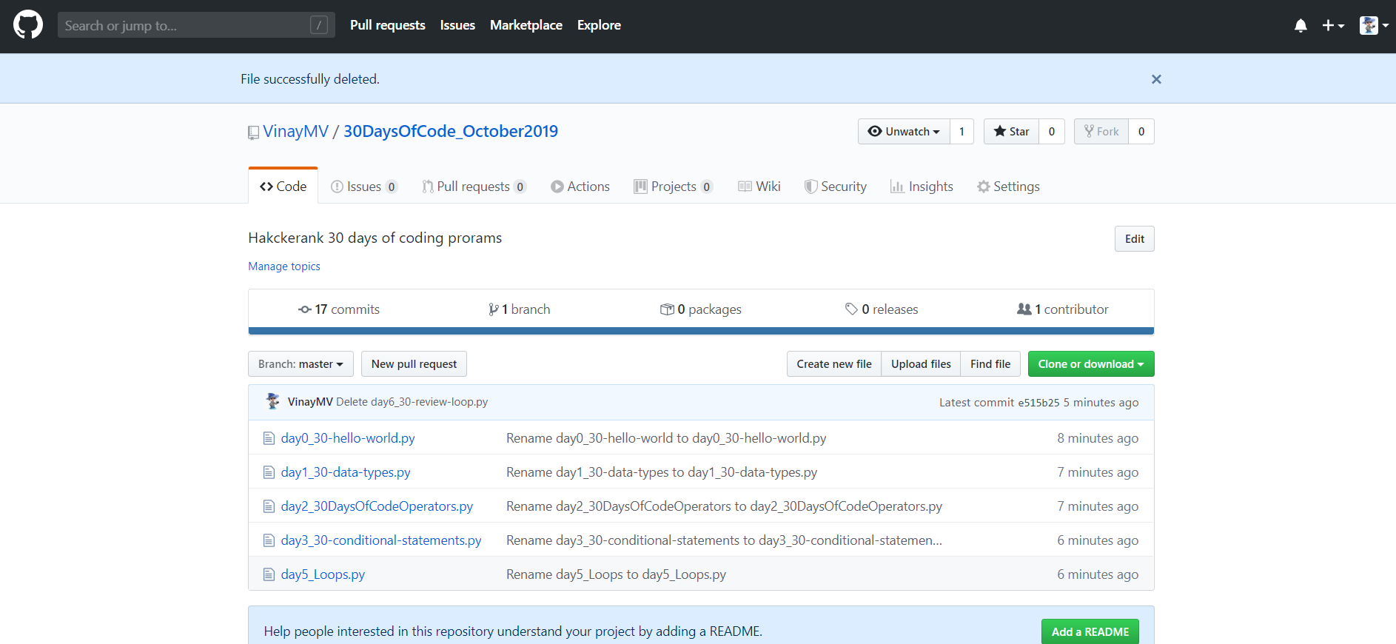
Git status

Slide 9
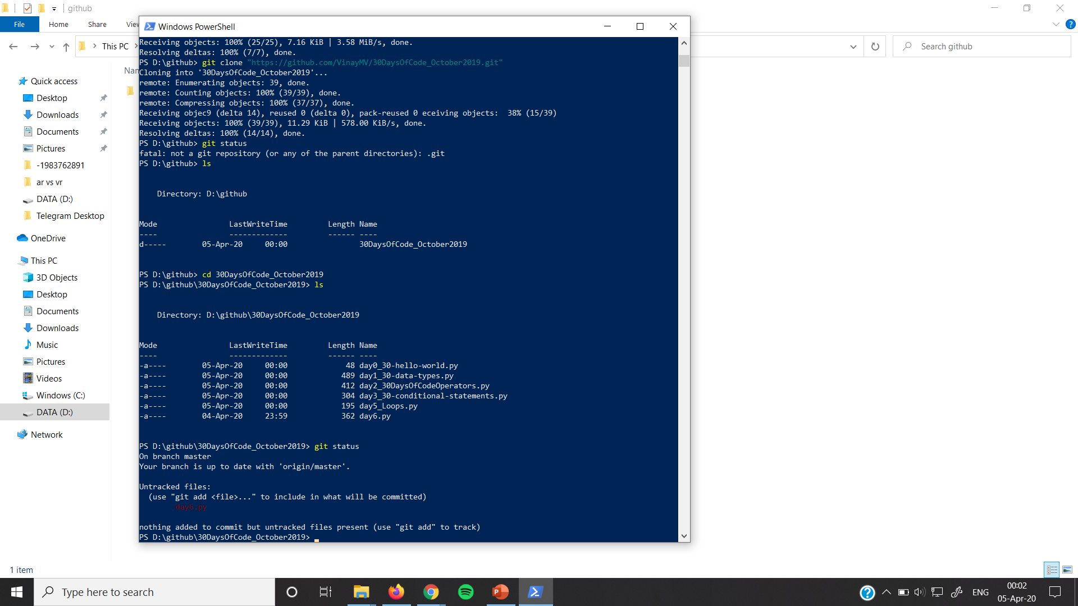
Git status

Slide 10
Git add
Command
git add <file name>

Slide 11
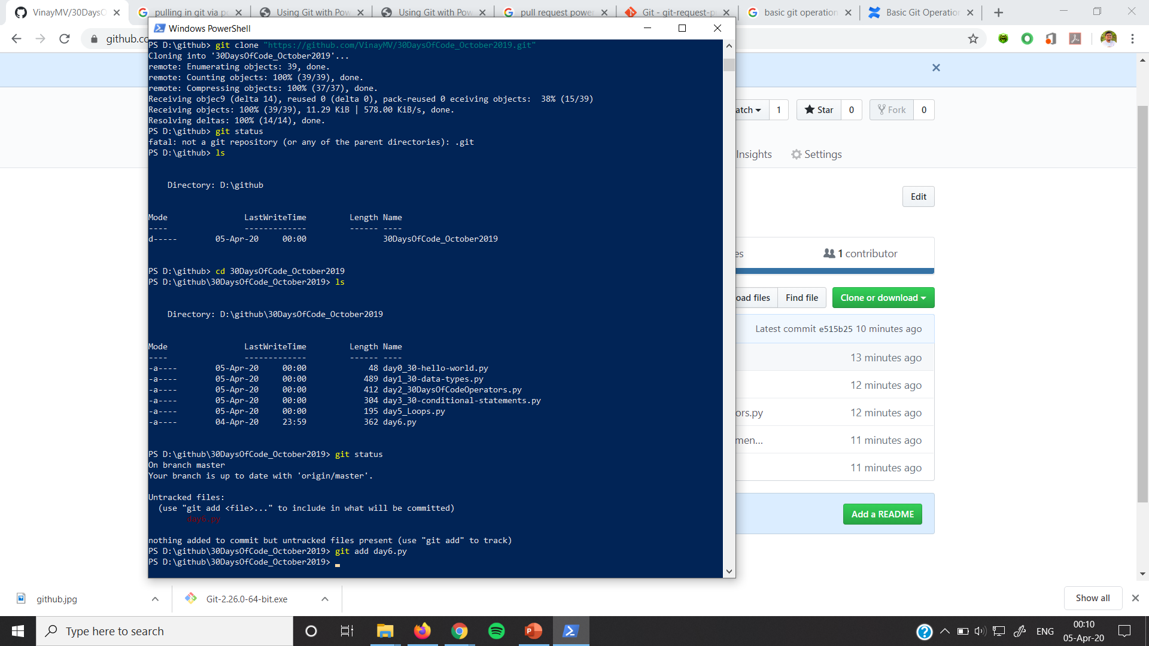
Git add

Slide 12
Git commit
Command
git commit –m “<message>”

Slide 13
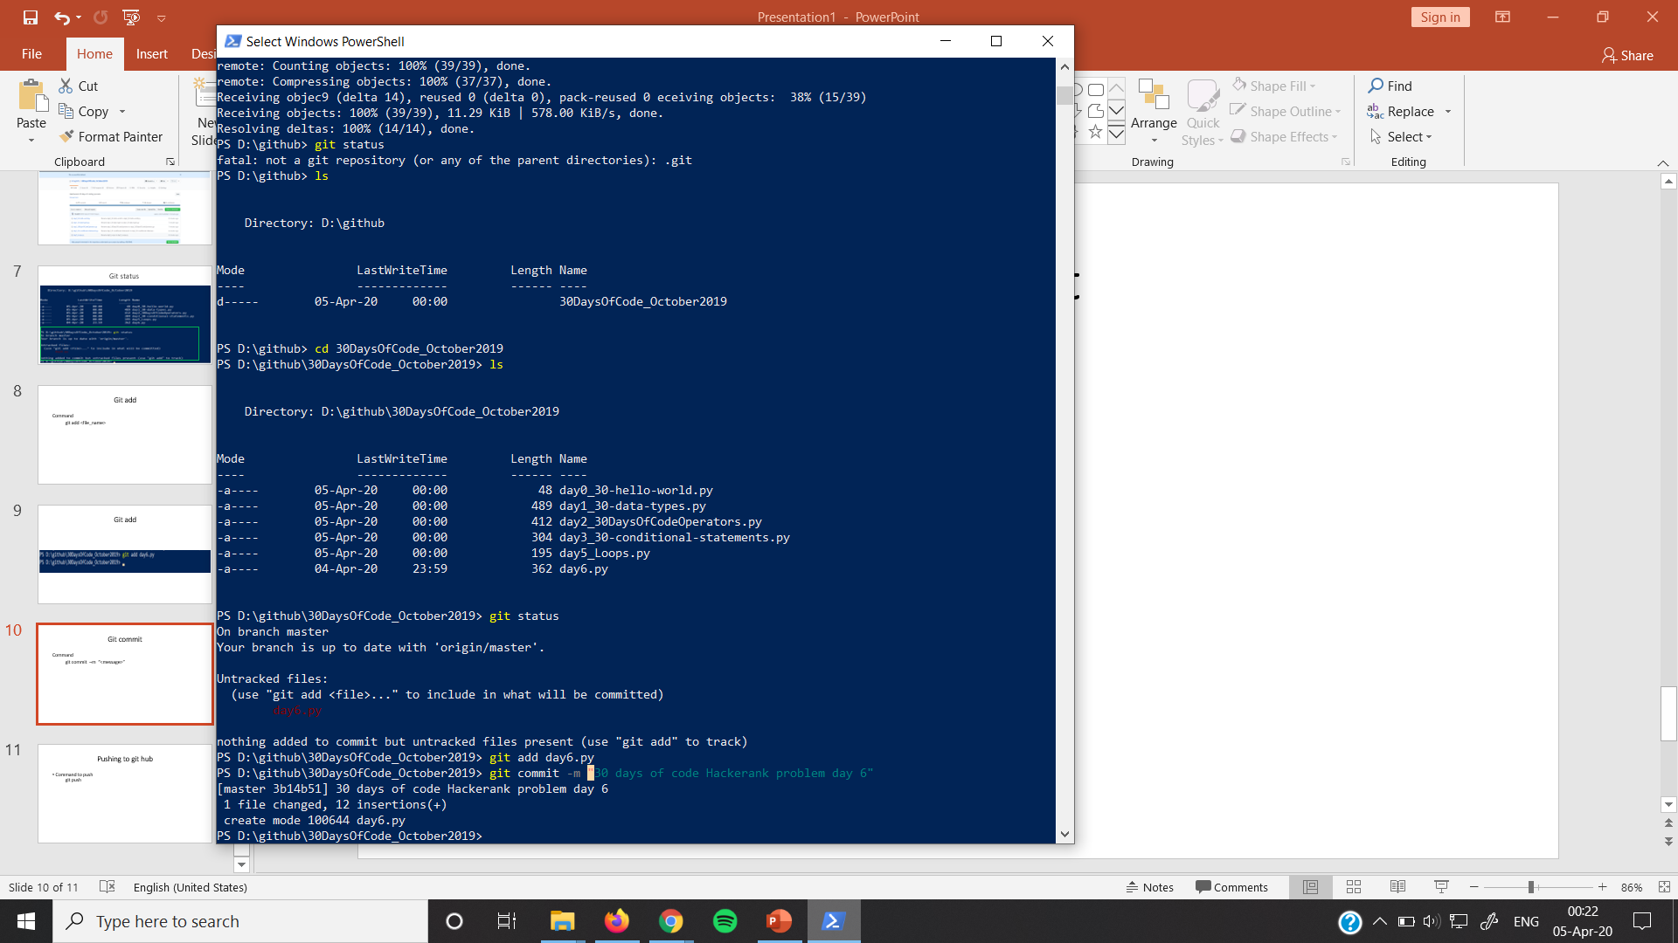
Git commit

Slide 14
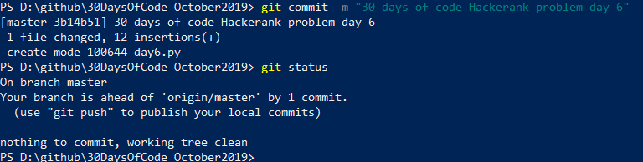
Git commit

Slide 15
Pushing to git hub
Command to push git push

Slide 16
Git push

Slide 17
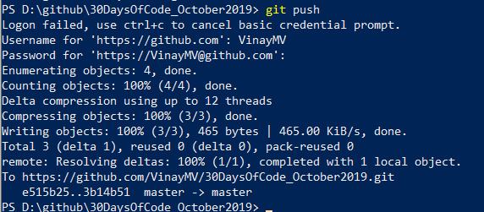
Git push

Slide 18
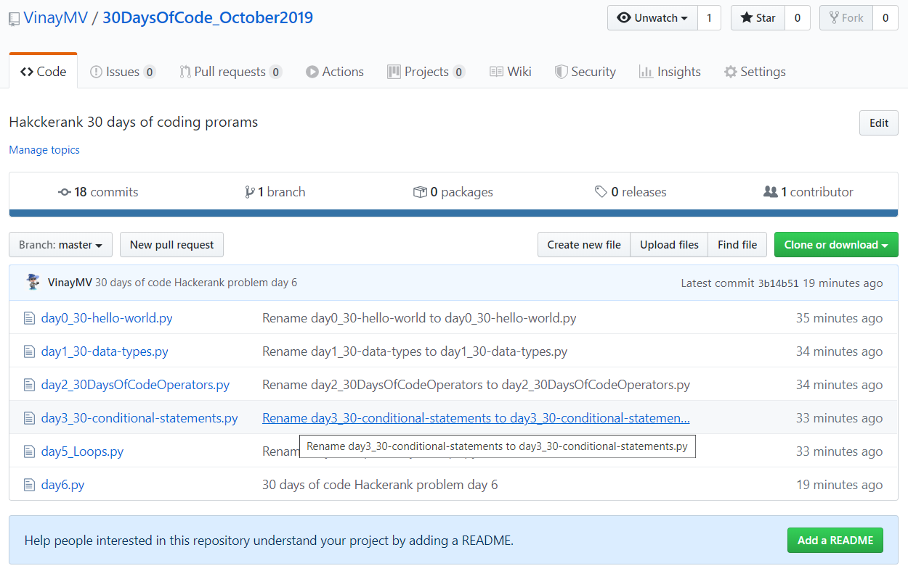
Git push

