Slide 1
HealthCare Prediction on Diabetic Patients using Python
CAPSTONE PROJECT
Presented By:
Vinay Malyala
Raghu Institute of Technology
Data Science

Slide 2
OUTLINE
Problem Statement (Should not include solution)
Proposed System/Solution
System Development Approach (Technology Used)
Algorithm & Deployment
Result
Conclusion
Future Scope
References

Slide 3
Problem Statement
The escalating prevalence of diabetes poses a substantial global health challenge, necessitating innovative solutions to enhance its management and care. Traditional healthcare approaches often struggle to identify individuals at risk of diabetes promptly and tailor interventions based on individual characteristics, resulting in suboptimal outcomes. The overarching problem addressed by this project is the inadequacy of existing healthcare models in efficiently predicting and managing diabetes.
Challenges encompass the absence of robust predictive tools for early detection, insufficient risk stratification methodologies for anticipating complications, and a lack of personalized treatment plans that consider diverse individual factors. Additionally, prevalent class imbalances in diabetic datasets further complicate the accurate training of machine learning models. Addressing these challenges requires a comprehensive and integrated approach, combining advanced analytics, machine learning algorithms, and domain-specific insights.
The project seeks to bridge these gaps by leveraging a comprehensive dataset and advanced analytical techniques to develop accurate predictive models. These models aim to enable early detection, stratify individuals based on complication risks, and personalize treatment plans, thereby addressing the fundamental problem of inadequate diabetes management and care. By doing so, the project aspires to contribute to the evolution of healthcare practices toward more effective, personalized, and preventative approaches for diabetic patients.

Slide 4
Proposed Solution
The healthcare project demonstrates a comprehensive approach to leveraging machine learning for diabetes management. Beginning with meticulous data exploration and preprocessing, the project addresses missing values, outliers, and class imbalance. Exploratory data analysis provides a nuanced understanding of the dataset, evidenced by insightful visualizations such as histograms and KDE plots. Feature engineering and selection aim to enhance model performance, followed by the application of machine learning algorithms, including Decision Trees, k-Nearest Neighbors, and Logistic Regression.
Class imbalance is effectively managed using the Synthetic Minority Over-sampling Technique (SMOTE), promoting balanced training datasets. The models are trained and evaluated to assess their predictive capabilities. The project's overarching objective is to proactively intervene in diabetes care, offering personalized treatment plans and improving healthcare outcomes. Insights derived from the trained models provide a foundation for informed decision-making in patient management. The project not only contributes to predictive analytics but also fosters a data-driven approach towards enhancing the overall quality of healthcare for diabetic patients.

Slide 5
System Approach
Libraries required to build the model:
Data Processing and Analysis:
Pandas: For data manipulation and handling.
NumPy: Essential for numerical computations and array operations.
Seaborn and Matplotlib: Used for data visualization and exploratory data analysis.
Machine Learning and Model Implementation:
Scikit-learn: For implementing classification algorithms such as Logistic Regression, Decision Tree, Random Forest, and KNN.
Linear Regression: Utilizes a linear approach to model the relationship between dependent and independent variables in predictive analysis.
Decision Tree: Constructs a tree-like structure to make decisions based on feature values, facilitating both classification and regression tasks.
Random Forest: Ensemble learning method that builds multiple decision trees and combines their outputs to enhance predictive accuracy and control overfitting.
K-Nearest Neighbors (KNN): Non-parametric algorithm for classification and regression that makes predictions based on the majority class or average of k-nearest data points.

Slide 6
Algorithm & Deployment
For predicting the health care on diabetic patients, the chosen algorithm is a supervised learning classification model, particularly the Random Forest Classifier.
Random Forest is chosen for its capability to handle numerical and categorical data, robustness in capturing complex patterns, and resilience against overfitting. Its ensemble nature and feature importance scores aid in accurate predictions and interpretation.
The input features used by the Random Forest Classifier include:
patient demographics (e.g., age, blood pressure, BMI)
Pregnancies (e.g., patients with more no. of pregnancies prone to diabetes)
Diabetes Pedigree Function
The Random Forest Classifier is trained on health care data. Cross-validation and hyperparameter tuning techniques are employed to optimize model performance and prevent overfitting.

Slide 7
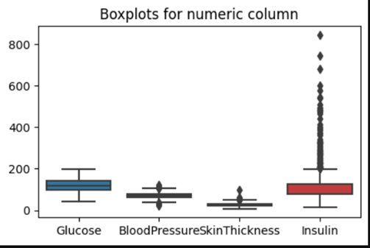
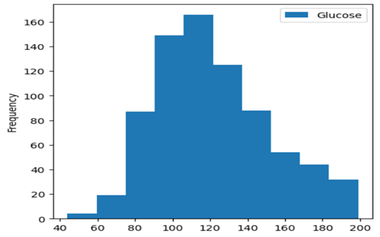
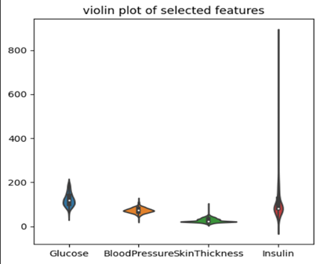
Result
1. Glucose: Median > 200, indicating variability (large IQR), and no outliers.
2. Blood Pressure: Median:72 mmHg (normal range). Smaller IQR, few outliers, none extremely high or low.
3. Insulin: Median: 79 mlU/L. Large IQR, considerable variability, numerous outliers, many extremely high.
4. Overall: Wide range, some outliers. Insulin has many outliers. Median values, except for insulin, within normal range.
The normal range for blood glucose levels is considered to be between 70 and 110 mg/dL. The data in the image appears to be mostly above this range, suggesting that the people represented in the data may have diabetes.
It is normally distributed, with a peak in the middle of the range and with the tails tapering off on either side.
The violin plot shows the distribution of four numerical features: ‘Glucose’, ‘BloodPressure’, ‘SkinThickness’,’Insulin’
The violin shape represents the probability density function (PDF) of each feature and the boxplot embedded within each violin plot shows the median,IQR and outliers.

Slide 8
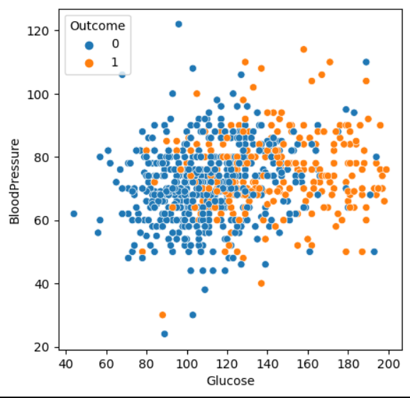
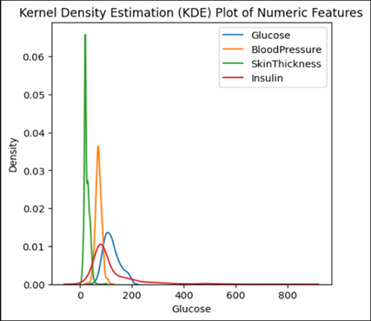
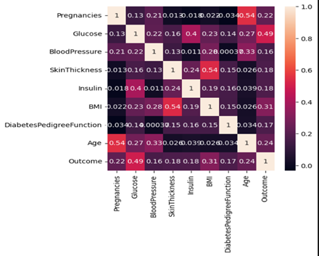
Result
The scatter plot of Glucose against Blood Pressure
If the glucose level increases above 80 then there are high chances of having diabetes.
The image shows a Kernel Density Estimation(KDE) Plot of four numerical features:
Glucose
Blood Pressure
Skin Thickness
Insulin
KDE is a non-parametric method for estimating the probability density of a random variable.
The KDE Plot shows the estimated pdf of each feature which can be used to visualize the distribution of the data.
We can see BloodPressure feature has lowest relation with output column.
So we will remove BloodPressure for training a good model with high accuracy

Slide 9
Conclusion
The healthcare project successfully navigates the complexities of diabetes management through a robust application of machine learning and data-driven strategies. The meticulous data preprocessing, including handling missing values and outliers, establishes a solid foundation for subsequent analyses. The exploratory data analysis offers valuable insights into the distribution of key variables, facilitating informed decision-making.
Feature engineering and selection contribute to model efficiency, and the adoption of machine learning algorithms, such as Decision Trees, k-Nearest Neighbors, and Logistic Regression, showcases a versatile approach to predictive analytics. The project's commitment to addressing class imbalance with the integration of SMOTE ensures a more accurate and representative training process.
Overall, the project aligns with its objectives of proactive intervention and personalized treatment plans for diabetic patients. By leveraging predictive models, healthcare practitioners can make data-driven decisions, leading to improved patient outcomes. The project not only highlights the potential of machine learning in healthcare but also underscores its pivotal role in shaping a more effective and personalized approach to diabetes care.

Slide 10
Future scope
Precision Medicine: Leveraging genetic data and personalized health profiles to tailor treatment plans for individual patients.
Real-time Monitoring and Feedback: Implementing systems for continuous monitoring of patient health metrics and providing real-time feedback to both patients and healthcare providers.
Educational Programs: Creating educational content and programs to raise awareness about diabetes prevention and management.
Deep Learning Integration: Future work can include the integration of deep learning models such as neural networks, which could potentially improve predictive accuracy.

Slide 11
References
Healthcare Predictive Analytics Using Machine Learning and Deep Learning Techniques: A Survey: This survey provides an overview of various machine learning techniques such as linear regression, logistic regression, decision trees, and random forests, and their applications in healthcare predictive analytics. It discusses the strengths and limitations of each method, providing valuable insights for selecting appropriate algorithms for healthcare predictions​ (SpringerOpen)​​ (Home)​.
Applications of Machine Learning Techniques in Healthcare: This research highlights the use of machine learning for diagnosing and predicting diseases. It covers the implementation of algorithms like random forests and support vector machines, focusing on their effectiveness in different healthcare scenarios​ (SpringerLink)​.

Slide 12
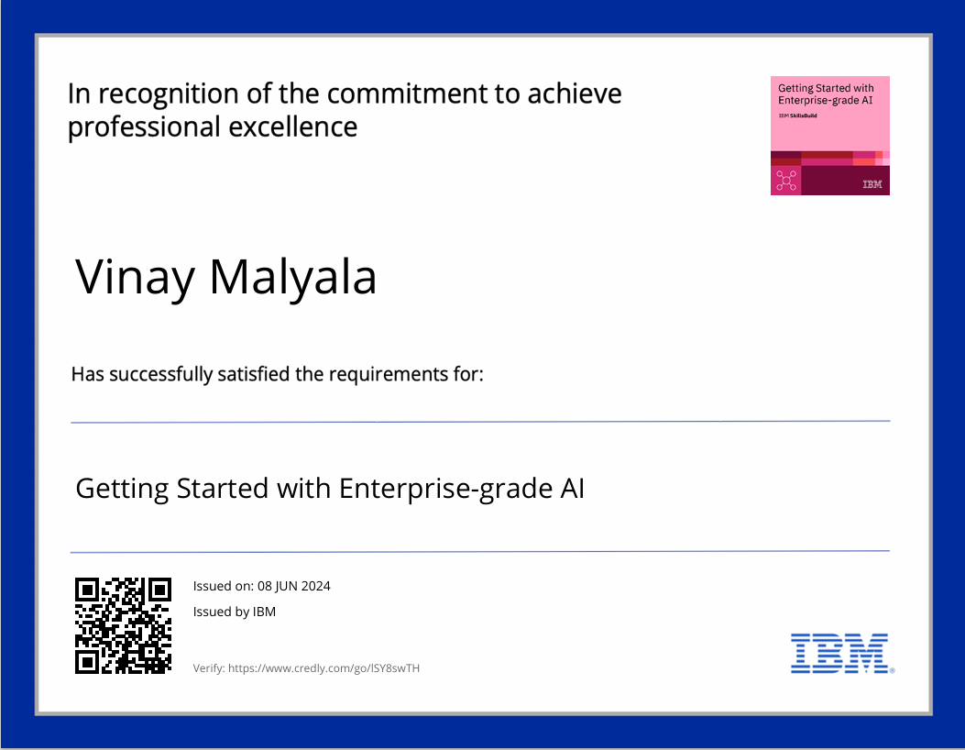
course certificate 1

Slide 13
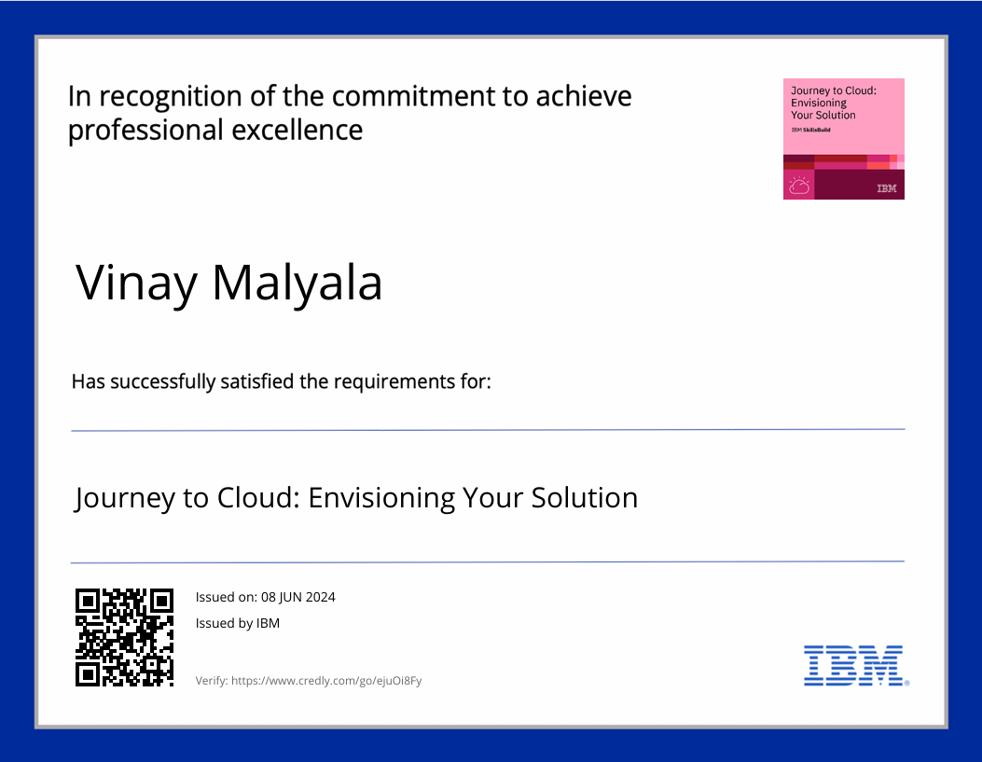
course certificate 2

Slide 14
THANK YOU

