Slide 1
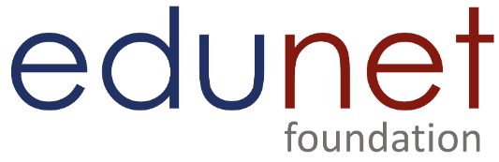


HealthCare Prediction on Diabetic Patients using Python
Program Feedback
Project Short Summary
The HealthCare Prediction on Diabetic Patients using Python is a well-structured project that effectively integrates machine learning techniques to address a significant healthcare challenge. The project demonstrates thorough data preprocessing, robust model implementation, and insightful exploratory data analysis. Future enhancements, such as incorporating deep learning models, integrating with electronic health records, and deploying scalable cloud solutions, could further improve the accuracy and utility of the predictions. Overall, the project is a commendable step towards proactive and personalized diabetes care, leveraging data-driven strategies to improve patient outcomes.
The project "HealthCare Prediction on Diabetic Patients using Python" leverages machine learning and predictive analytics to develop models that can accurately forecast the onset of diabetes. By utilizing comprehensive datasets and advanced data processing techniques, the project aims to enhance early detection, risk stratification, and personalized treatment plans, ultimately improving healthcare outcomes for diabetic patients. This initiative emphasizes the importance of data-driven strategies in transforming diabetes care and management.
Vinay Malyala
213j1a4431@raghuinstech.com
Raghu Institute of Technology
#skillsbuild

Slide 2
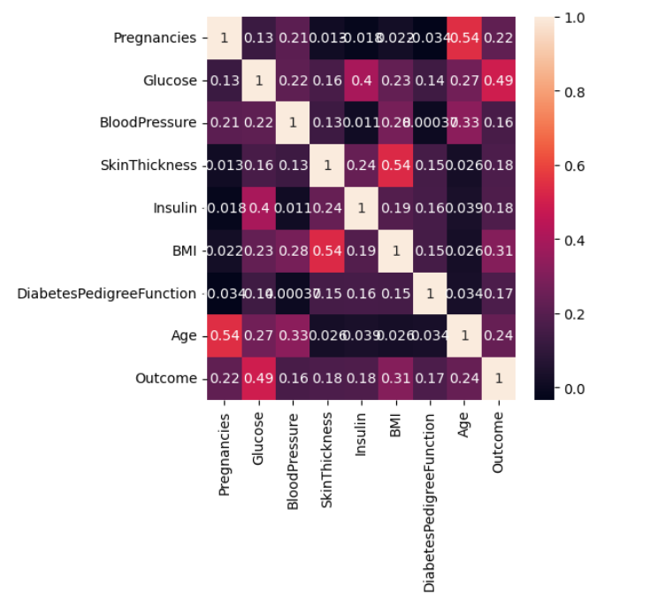
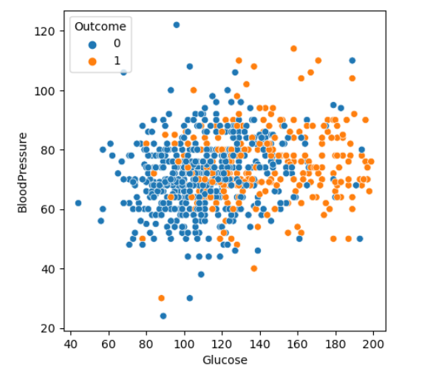
Final project Outcome Screanshort

Slide 3
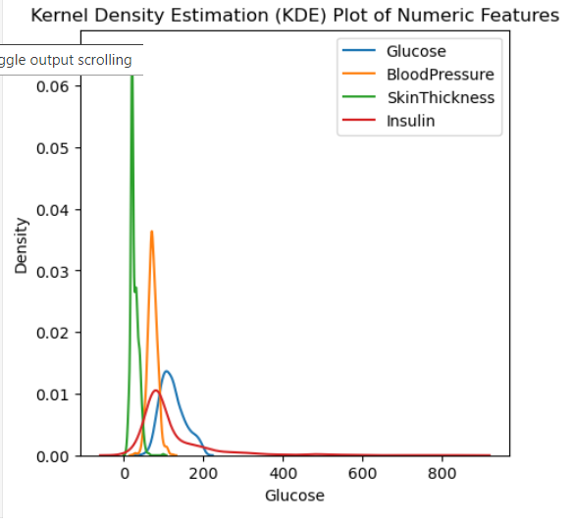
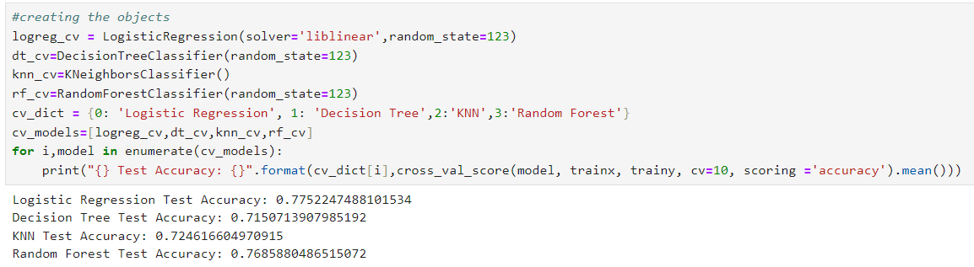
Final project Outcome Screanshort

