Slide 1
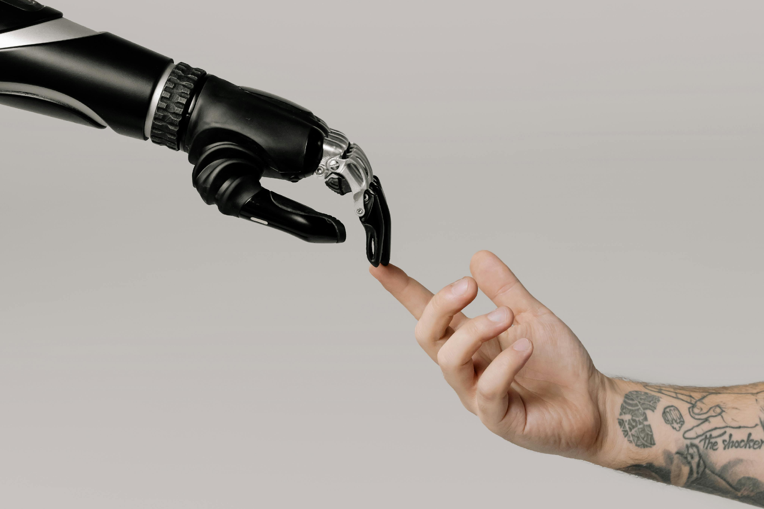
Deep Learning for Enhanced Prosthetic Control
Vinay Naidu
700753987

Slide 2
Motivation
The goal is to improve the way prosthetic limbs are controlled, making them more intuitive and precise. Current prosthetics often don't provide the best control for users. By using deep learning, the study aims to decode motor intent from EMG signals in real-time, resulting in better and more reliable prosthetic control.

Slide 3
Problem Statement
Current prosthetic limbs often don't respond accurately or reliably to user commands. This makes it hard for users to perform everyday tasks. The challenge is to create a system that can better understand and decode what users want their prosthetics to do, allowing for smoother and more precise movements.

Slide 4
Objectives
To compare the performance of deep learning architectures with shallow networks in decoding motor intent from EMG signals.
To evaluate the practical usability of these architectures through real-time, human-in-the-loop experiments.
To identify the most effective deep learning model for enhancing prosthetic control systems.

Slide 5
Contribution
Evaluation of four neural network architectures (FFNN1, FFNN6, TCN, CNN-SE) for real-time prosthetic control.
Demonstrated that deep learning architectures outperform shallow networks in motor intent decoding.
Provided evidence that deep learning approaches offer more reliable and precise prosthetic control, potentially improving the quality of life for amputees.

Slide 6
Results
Deep neural networks outperformed shallow networks.
CNN-SE had the best performance with faster completion times and higher accuracy (from 80.6% to 91.6%).
Deep neural networks provided better motor intent decoding compared to shallow networks.

Slide 7
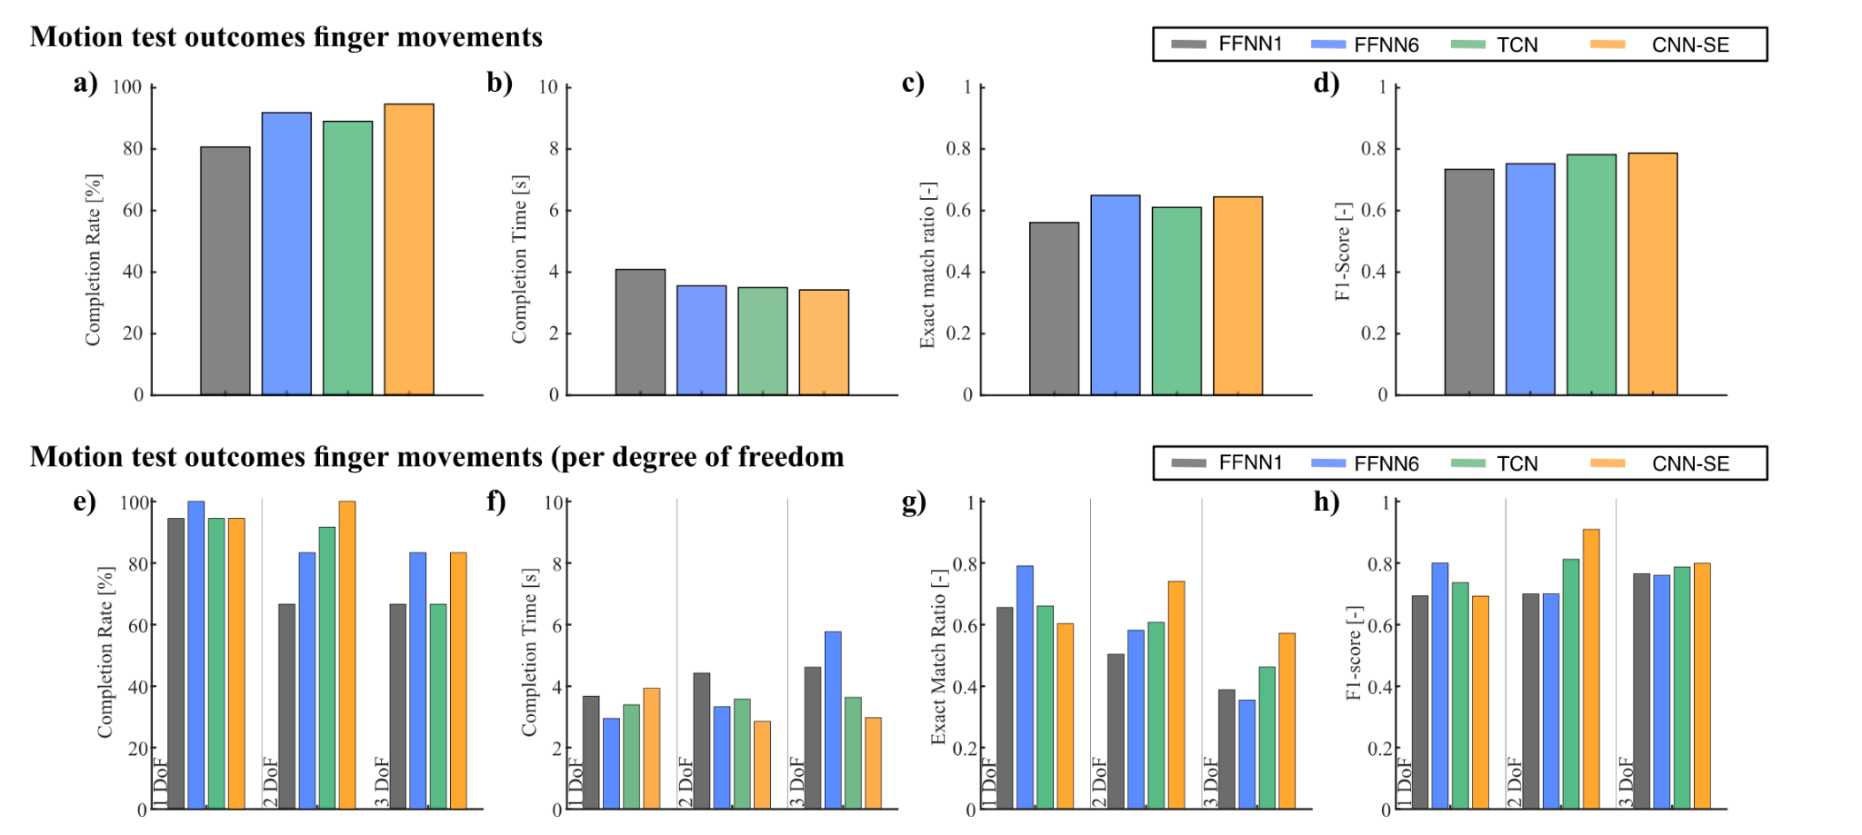

Slide 8
Critical Analysis
Strengths : Significant improvement in motor intent decoding with deep learning architectures.
Real-time, human-in-the-loop experiments provide robust validation of results.
Limitations : High computational complexity and data requirements of deep learning models.
Need for further research to optimize models for real-world scenarios.
Future Work : A broader participant pool to better generalize the findings.
Long-term studies to assess impact on daily life activities.

Slide 9
References
Zbinden, J., Molin, J., & Ortiz-Catalan, M.
Deep Learning for Enhanced Prosthetic Control: Real-Time Motor Intent Decoding for Simultaneous Control of Artificial Limbs.
IEEE Transactions on Neural Systems and Rehabilitation Engineering.

Slide 10
Thank You

