Slide 1
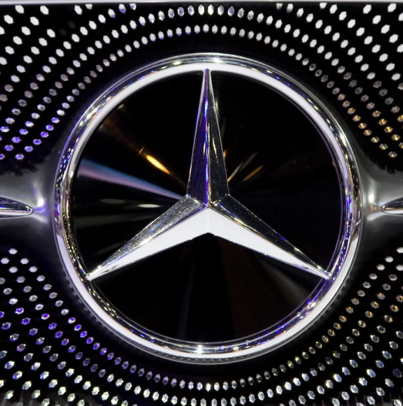
POTENTIAL PATRONS
EMPOWERING ELECTRIC MOBILITY
BY SHARING POTENTIAL
TEAM - AKHIL PRASAD
NAGESH K
PREETHAM MAIYA
VINAY N R
GAUTHAM R REDDY

Slide 2
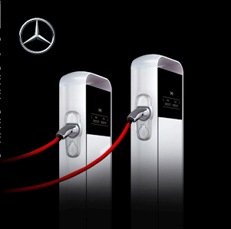
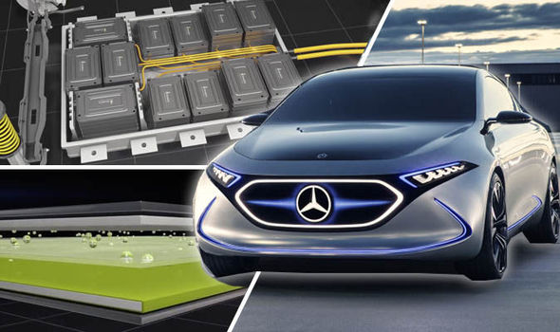
THE CHALLENGE
Fulfilling the EV charge requirement across
diverse scenarios
THE SOLUTION
ENVISION A CHARGE SHARING PARADIGM
AMONG USERS

Slide 3
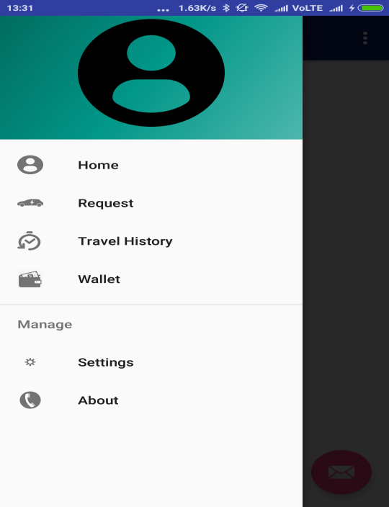
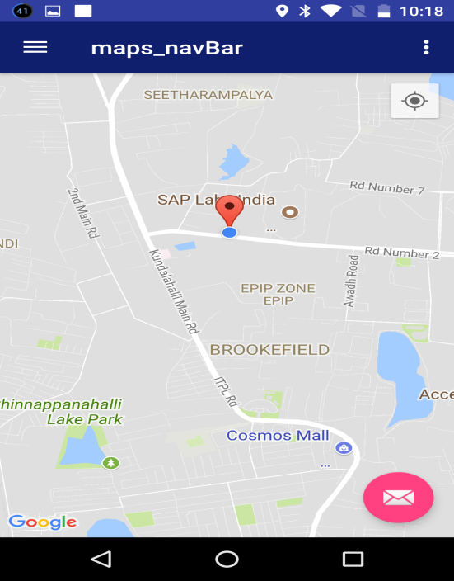
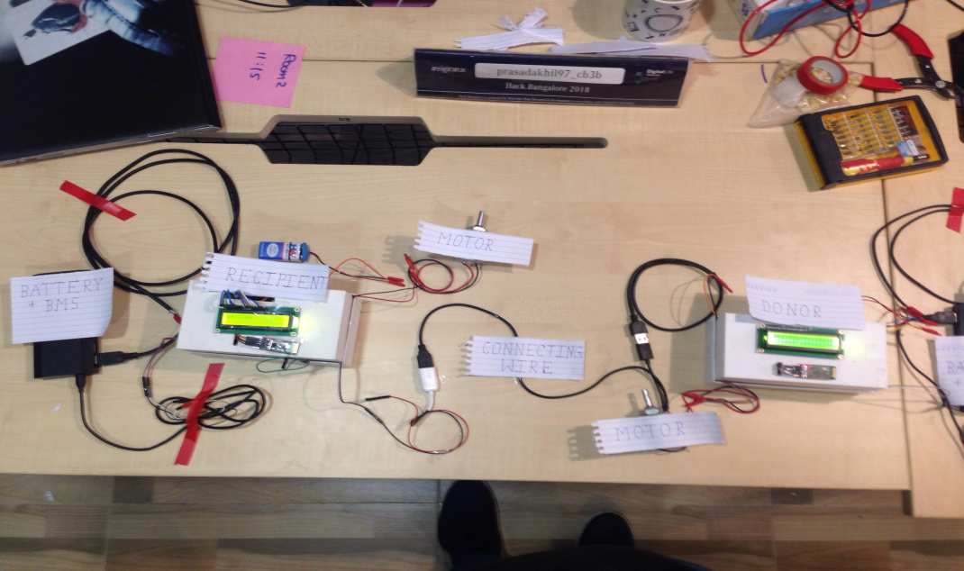
THE IMPLEMENTATION
Android Application for facilitating meet, calculating price and achieve charge transfer
Achieve high efficiency and fast transfer with DC – DC converter and BMS.
Monitor SOC ,current and tap on sweet zone of charge and discharge.

Slide 4
INNOVATION AT DAIMLER
Integrate this solution along with plugshare in Mercedes cars.
The idea applied to EQ vehicle-
battery capacity = 70KWh max charge rate- 120KW
max discharge rate- 300KW
10 mins of charge sharing-
120KW * (1/6) = 20KWh -> 80 miles range extended
Extend this idea by hosting mobile charging trucks.

