Slide 1
MEETING APPOINTMENT SCHEDULER
M VIJAY SIDDHARTH, B16CS014
VINAY NAGALGAONKAR, B16CS017

Slide 2
Key features of the project
Ease of input for User : Throughout the program for almost every input user has to just type a number rather than a complete data like username, date etc.
Calendar : For every user Calendar keeps a track of each and every appointment in a particular time slot in the working hours of a particular date.
Notifications : Redundant notifications are discarded.

Slide 3
They are--
Old Notifications.
If Acceptor is busy.
If Seeker is busy.
Data Management in Calendar : In Calendar old data is erased and new data is initialized automatically. That is, all the data in the calendar before current date is erased and new data is created.
Flexibility in Appointment Type : Seeker can choose the appointment type.
Normal Appointment
Priority Appointment

Slide 4
Exception Handling : Exception Handling is used in each and every function and at every step of input by user so that the program will not crash.
Console : Data displayed on the console is well organised and spacious. System.clear() function is used so that the data on the console is erased frequently.
View Schedule : By selecting View Schedule option, user can see their schedule for four consecutive working days from the current day. User can also see their schedule for four consecutive working days from any further valid date.

Slide 5
Normal Appointment
Priority Appointment
Request Appointment
Cancel Appointment
Appointment Decision
Use Cases
Create Account
Update Schedule
Login
View Profile
View Schedule

Slide 6
Structure of the database
Users_Appointment_Data_Final
User 1’s Username
K1(Seeker’s Appointment Count) :
K1 lines follow.
Each line has these following details--
Username, Appointment Type, Date and Time Slot
K2(Acceptor’s Appointment Count) : Same
K3(Notifications of Incoming Requests) : Same

Slide 7
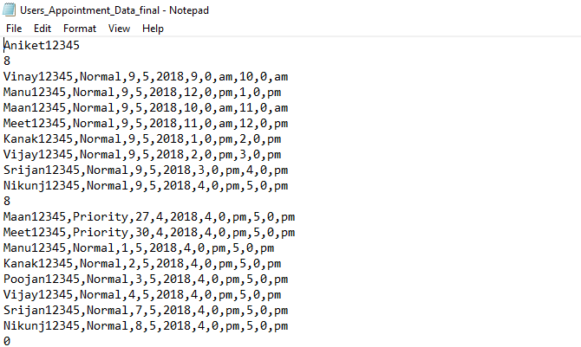

Slide 8
Structure of the Database
Users_Data_Final
User 1’s Name, Username and Password
120 Lines follow.
Each line has these following details--
Date and Appointment Status.

Slide 9
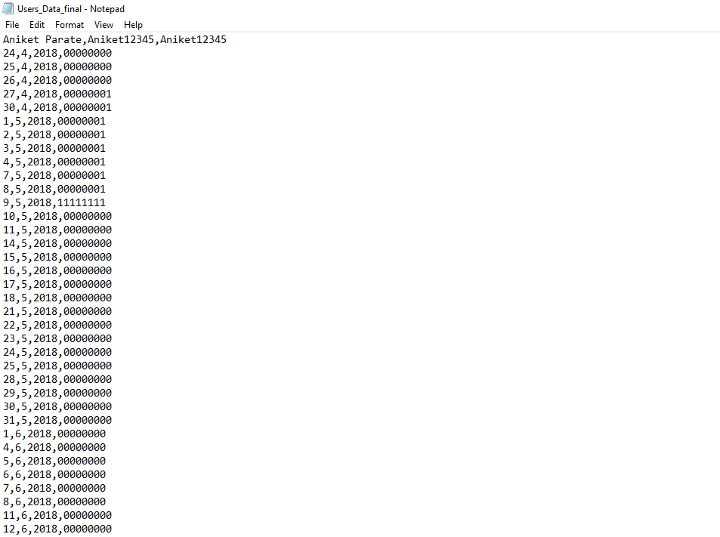

Slide 10
Things that could not be implemented
All the mentioned objectives in the SRS have been fulfilled.

Slide 11
Statistics of unit and system testing
The Test cases have been identified by unit and system testing.
Automated tools were not used.
No test cases were missed.

Slide 12
Student Fee Management System

Slide 13
List of Use cases tested
Register Student
View Student Details
Remove Student
Update Details
Semester Fee Payment
Mess Fee Payment
View Fee Receipt
Change Password

Slide 14
Statistics of the test cases
Number of functions tested = 12
Number of functions working correctly = 10
Number of functions giving error = 2
TakeAdminInput() and TakeStudentInput() functions were giving error for some particular inputs. Error in the sense these functions should not accept those inputs.
Eg. 2abcd when given as input is accepted by both the functions.

Slide 15
Conclusion
All the objectives in the SRS have been fulfilled but some functions have been used in the code that were not mentioned in the SRS.
All the errors mentioned in the Test Report by the Testing Group have been corrected.

Slide 16
Thank you

