Slide 1

SMART AGRICULTURE: PREDICTING SOIL TYPE AND IRRIGATION METHODS WITH MACHINE LEARNING BATCH No : 07 UNDER THE ESTEEMED GUIDANCE OF Ms. P. VASANTHA KUMARI DEPARTMENT OF COMPUTER SCIENCE AND ENGINEERING SRI VENKATESWARA ENGINEERING COLLEGE FOR WOMEN Karakambadi Road, Opp. LIC Training Center, Tirupati-517507
N.VARSHA (219E1A05G2) P.VINAY (219E1A05H1) P.MANASA (219E1A05H0) M.SHIVARAM (219E1A05E2)

Slide 2
SMART AGRICULTURE: PREDICTING SOIL TYPE AND IRRIGATION METHODS WITH MACHINE LEARNING

Slide 3
CONTENTS
ABSTRACT
INTRODUCTION
EXISTING SYSTEM
DRAWBACKS OF EXISTING SYSTEM
PROPOSED SYSTEM
ADVANTAGES OF PROPOSED SYSTEM
ARCHITECTURE
CONCLUSION
FUTURE ENHANCEMENT

Slide 4
ABSTRACT
This project focuses on using machine learning algorithms to predict soil types and optimize irrigation methods, based on key agricultural factors like Nitrogen (N), Phosphorus (P), Potassium (K) values, water availability, and crop type. Accurate predictions of soil composition and irrigation needs are crucial for efficient farming, as they help in resource optimization and sustainable crop production. The system employs advanced machine learning models, particularly Random Forest and XGBoost, to analyze input data and generate precise recommendations. Random Forest, with its ability to handle large datasets and provide feature importance, is utilized to predict soil type, while XGBoost is applied for irrigation method prediction, offering higher accuracy through boosting techniques. These algorithms enable the system to provide real-time, data-driven insights that assist farmers in making informed decisions about irrigation scheduling and soil management. The approach significantly reduces water waste, enhances crop yields, and minimizes environmental impact by ensuring efficient use of resources. By integrating predictive analytics into farming practices, the project fosters the implementation of precision agriculture, ultimately supporting sustainable farming practices and improving the overall agricultural ecosystem.

Slide 5
INTRODUCTION
Smart agriculture integrates technology and data-driven approaches to enhance farming efficiency and sustainability.
Identifying soil types and determining optimal irrigation methods are crucial for improving crop yield and conserving resources.
Machine learning plays a pivotal role in analyzing complex agricultural data and providing actionable insights for farmers.
Key agricultural factors such as Nitrogen (N), Phosphorus (P), Potassium (K) levels, water availability, and crop type significantly influence soil and irrigation requirements.
The project uses Random Forest and XGBoost algorithms, selected for their ability to deliver accurate and reliable predictions.

Slide 6
Random Forest is utilized to predict soil types due to its capability to handle large datasets and highlight feature importance.
XGBoost is applied to predict irrigation methods, leveraging its boosting techniques to achieve higher accuracy.
The system provides farmers with real-time, data-driven recommendations for efficient irrigation scheduling and soil management.
By reducing water wastage and enhancing crop productivity, the project contributes to precision agriculture and resource optimization.
Integrating predictive analytics into farming practices fosters sustainable agriculture, benefiting the environment and the agricultural ecosystem.

Slide 7
EXISTING SYSTEM:
Traditional farming practices often rely on manual observation and historical knowledge to determine soil types and irrigation methods, which can lead to inefficiencies and inaccuracies.
Current systems for soil classification and irrigation scheduling are generally time-consuming and lack real-time adaptability to changing environmental conditions.
Many existing approaches use basic statistical models or rule-based methods that fail to capture the complexity of interactions between soil nutrients, water availability, and crop types.
Farmers often face challenges in accessing advanced tools for precise resource management, leading to over-irrigation, water wastage, and suboptimal crop yields.
The absence of robust predictive systems limits the ability to implement precision agriculture practices, hindering sustainable farming and resource conservation efforts.

Slide 8
DRAWBACKS:
Relies heavily on manual observation, leading to inaccuracies and inefficiencies.
Lacks real-time adaptability to dynamic environmental conditions.
Fails to capture complex interactions between agricultural factors like soil nutrients and water availability.
Results in over-irrigation, water wastage, and suboptimal crop yields due to imprecise resource management.
Limits the adoption of precision agriculture, hindering sustainability and resource optimization.

Slide 9
PROPOSED SYSTEM:
The proposed system leverages machine learning algorithms to accurately predict soil types and recommend optimal irrigation methods based on key agricultural factors.
Random Forest is employed for soil type prediction, utilizing its ability to handle large datasets and provide feature importance for better decision-making.
XGBoost is used for irrigation method prediction, ensuring high accuracy through advanced boosting techniques and efficient processing.
The system offers real-time, data-driven insights, enabling farmers to make informed decisions on resource allocation and irrigation scheduling.
By integrating predictive analytics, the system promotes precision agriculture, reducing water wastage, enhancing crop yields, and supporting sustainable farming practices.

Slide 10
ADVANTAGES:
Provides accurate predictions for soil types and irrigation methods using advanced machine learning algorithms.
Enables real-time, data-driven decision-making for efficient resource management.
Reduces water wastage and enhances crop productivity through optimized irrigation.
Promotes sustainable farming practices by minimizing environmental impact.
Facilitates the adoption of precision agriculture, improving overall agricultural efficiency and sustainability.

Slide 11
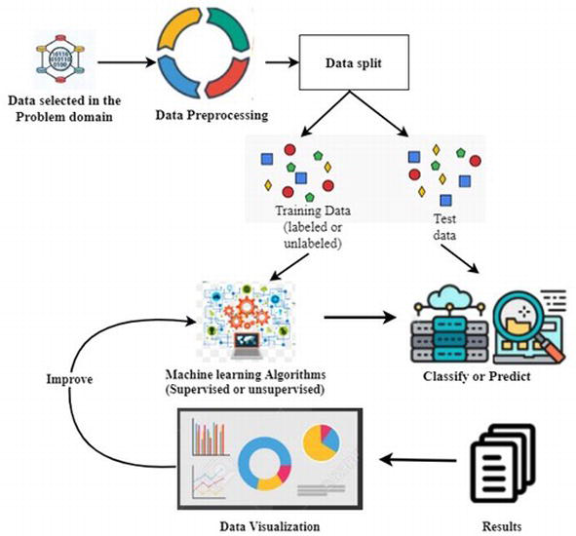
ARCHITECTURE

Slide 12
CONCLUSION
The proposed system revolutionizes agriculture by leveraging machine learning to predict soil types and optimize irrigation methods. By utilizing Random Forest and XGBoost algorithms, it provides accurate, real-time insights that enhance resource efficiency and support sustainable farming. This approach reduces water wastage, boosts crop yields, and minimizes environmental impact, promoting precision agriculture. By integrating predictive analytics into farming practices, the system empowers farmers to make informed decisions, ultimately fostering a more sustainable and efficient agricultural ecosystem for the future.

Slide 13
FUTURE ENHANCEMENT
Future enhancements include integrating IoT devices for real-time data collection, expanding the system to predict additional agricultural factors like pest infestations and crop diseases, and incorporating satellite imagery for large-scale analysis. Advanced deep learning models can also be explored to further improve prediction accuracy and enable fully automated precision farming solutions.

Slide 14
THANK YOU

