Slide 1
Google Cloud-Based Secure File Storage and Sharing System (Enigma)
Amrit Gupta (211000008)
Anirban Bhattacharjee (211000010)
Vinay Kiran Polisetti (211000037)
Date: 21-04-2023
Dr. Kavita Jaiswal
International Institute of Information Technology, Naya Raipur

Slide 2
Abstract
01
04
Data Transfer
Security
Physical Ways
02
05
Encryption
03
06
Sharing
Network Ways
International Institute of Information Technology, Naya Raipur

Slide 3
Introduction & Motivation for Cloud
Scalability
Data Leaks
Easier Accessibility
Maintenance
International Institute of Information Technology, Naya Raipur

Slide 4
Cloud Technology
Google Cloud
1
NextAuth
2
Google Cloud Console
3
Access Tokens
4

Slide 5
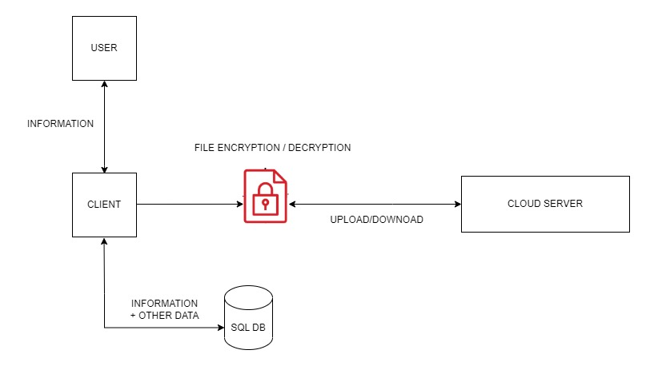
Proposed Architecture
International Institute of Information Technology, Naya Raipur

Slide 6
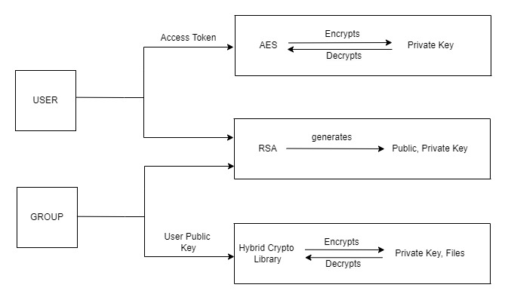
How Cryptography is used?
International Institute of Information Technology, Naya Raipur

Slide 7
Sequence Diagram
International Institute of Information Technology, Naya Raipur

Slide 8
Demonstration
International Institute of Information Technology, Naya Raipur

Slide 9
Results & Future Scope
Website on LocalHost
API for MySQL database
Including other providers
Deploy the website
International Institute of Information Technology, Naya Raipur

Slide 10

Thank You
..
Dr. Shyama Prasad Mukherjee International Institute of Information Technology, Naya Raipur
International Institute of Information Technology, Naya Raipur

