Slide 1
Web-Based Cross-Chain Zero Knowledge Asset Proof
Amrit Gupta (211000008)
Anirban Bhattacharjee (211000010)
Vinay Kiran Polisetti (211000037)
Date: 12-10-2023
Dr. Satyanarayana Vollala
International Institute of Information Technology, Naya Raipur

Slide 2
Content
Abstract
Objectives
Literature Review
Mechanism
Demonstration
Conclusion and Future directions

Slide 3
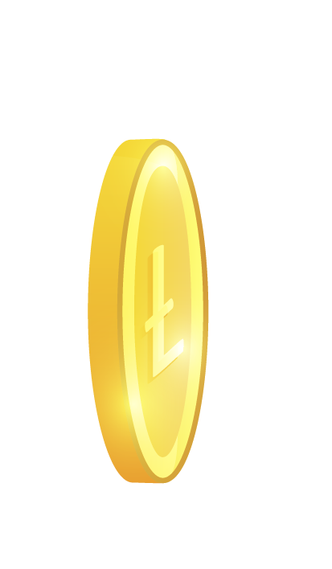
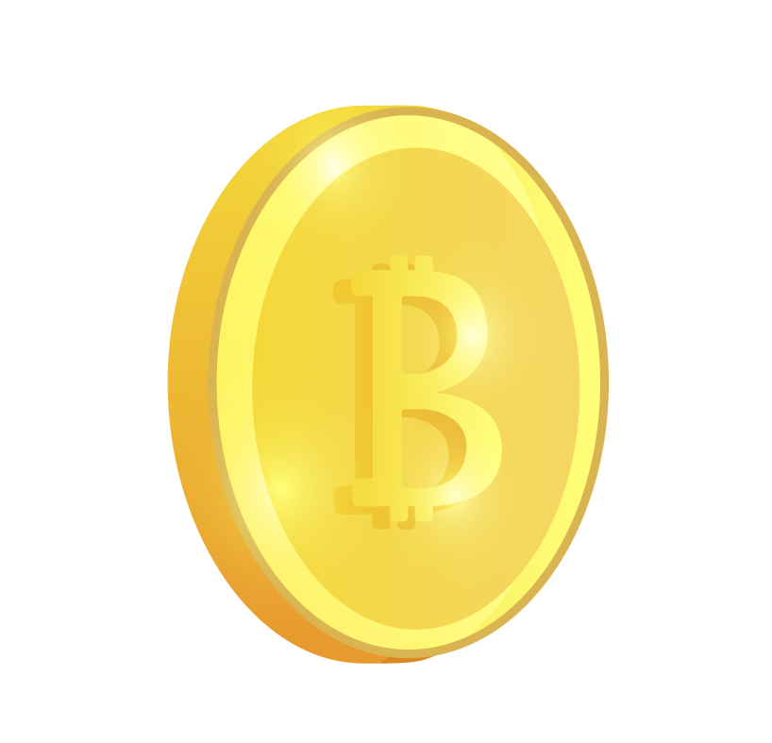
Introduction
01
04
Different Tokens
Web3 World
Multiple Chains
02
05
Interoperability
03
06
Various Advantages
Scattered Funds
Notes:
The world is moving towards web3[1]. Therefore, multiple blockchains are being developed and published[2]. Each blockchain has its own advantages and used various use cases like Ethereum for dapps, bitcoin for investment and polygon for scalability etc..[3]. Each blockchain has its own native currency i.e different tokens[4]. To allow all users to leverage the benefits of each blockchain, many major blockchains has added interoperability support for other chain tokens to exist on them in the form of wrapped tokens[5]. Due to this and the growing number of blockchains has made user’s assets to be scattered over different tokens in different chains[6].

Slide 4
Problem Statement
Wallet Privacy
01
04
A WebApp
02
05
Cross-Chain
ChainLink
03
06
ZKPs
Asset Proof
Notes:
Notes on Animation – Points 1,2,3 are what we want to achieve and points 4,5,6 are what we are thinking to use to achieve them. Therefore, on first click, we will make 1,2,3 visible and after reciting them once as what we wanted to achieve, then display 4,5,6 as the ways to achieve them and then come back and explain point 1, its proposol point 4 after which go to point2, point 5 and then finally point3,point6.
If the wallet address becomes public knowledge with the organization or verifier we need to prove the assets to, they can track our transactions all the time.
We will use a webapp that maintains a particular flow such that the user’s wallet address will not be known to the verifier.
Cross-chain means we want to prove all the assets associated with the prover across all the chains he has assets in.
ChainLink is a set of oracles that provide real world data to on-chain (how we are solving cross-chain using chainlinks will be explained in net worth calculation part, don’t stretch this)
Asset Proof is the case where a user needs to prove all his assets in different wallets and chains are over a certain threshold and we don’t even want to reveal a number to the verifier which describes the user’s assets worth.
6. We will do this with zkps (How will be explained with proof generation part).

Slide 5
Objectives
01
03
ZKPs
Robust WebApp
Witness protection using zkSNARKs
For users to have accounts and a history
02
04
IPFS, Blockchain
Framework
To store and retrieve the proofs securely
To connect all the components and the flow

Slide 6
Literature Review
R.no | Paper | Advantages | Disadvantages
1 | Huang, J., Huang, T., Wei, H., Zhang, J., Yan, H., Wong, D. S., & Hu, H. [1] (2022) | The paper provides a good proposal for building an asset-proof management system for a single organization. | The paper’s proposed architecture isn’t scalable for multiple-chain token management and secondary wallet approvals.
2 | Tabacaru, Robert, et al. [2] (2023) | The paper suggests methods to implement asset proof in a private environment. | The paper’s described framework fails to provide any privacy for the transactions in public use cases.
3 | Konkin, A., Zapechnikov, S. [3] (2023) | The paper tests and recommends the use of zkSNARKs for asset-proof. | The paper mentions the challenges of the implementation at a large-use scale.
4 | Dieye, M., Valiorgue, P., Gelas, J.-P., Diallo, E., Ghodous, P., Biennier, F., & Peyrol, É. [4] (2023) | The paper gives a good framework for handling decentralized identities. | The paper doesn’t mention about the privacy of the assets stored in the account.
Notes:
References to the papers are the first 4 references in the references page.

Slide 7
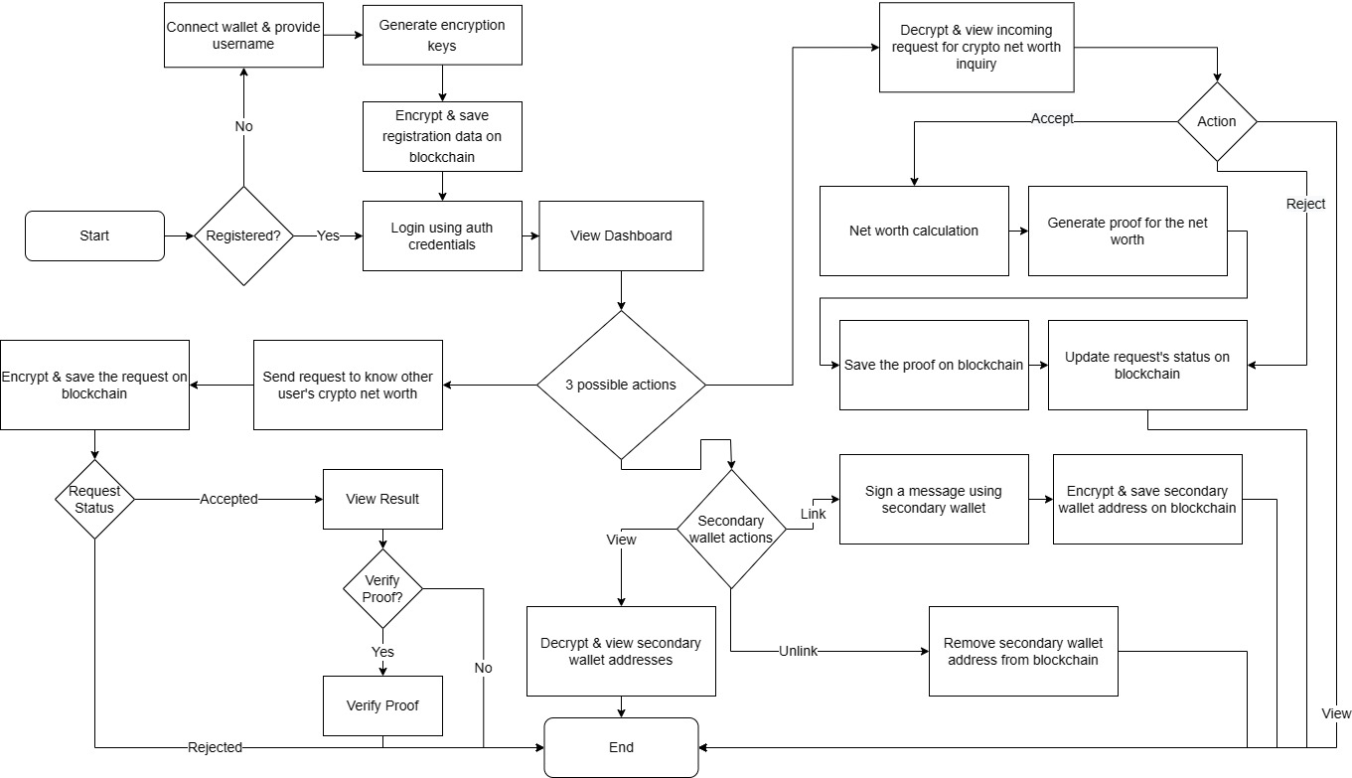
Proposed Architecture
Notes:
Make sure you are not talking about unlink operation of secondary wallets.
“Send request” and “Decrypt and view” actions should not be explained in depth as they will be covered again later through animations. Just give a high level overview.

Slide 8



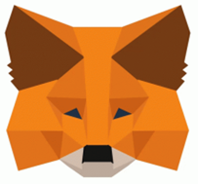

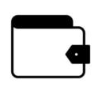
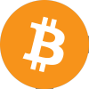



Calculation of Net Worth
Notes:
Click [0] Now we will see the implementation of Net worth calculation in our project.
[1] Lets assume there’s a user named “Bob” who owns a wallet..
[2] which possesses multiple assets over different chains like Ethereum and polygon. Due to the web3 revolution, major blockchain networks have been adding support for other chains native currencies.
[3] Like you can see here, Ethereum supports obviously it’s native currency Ethereum as well as bitcoin in the form of wrapped bitcoin, matic in the form of wrapped matic, usdc in the form of wrapped usdc. Basically, the wrapped tokens try to mimic the value of org tokens on their respective blockchains. To get the total worth of Bob’s assets, we need to add up all the tokens quantity his wallet owns. But, we cant add 1 ether to 1 btc because they are of different units.
[4] That’s where chainlink comes in.
[5] Chainlink is a group of oracles that provide regular trusted real-world data to the blockchains and in this case, they provide exchange rates for different tokens at any given time..
[6] in us dollars. So, now the problem becomes easy, we just need to get all the various tokens quantity that’s possessed by Bob’s wallet, multiply them with the exchange rates, and add them all up.
[7] This process remains the same for some other ones like Alice who has a single wallet and..
[8] even for Bob if he possesses multiple wallets. But to get the token quantities and exchange rates, we need a server on the blockchains to give us that information.
[9][10] For that, we developed a smart contract..
[11] that interacts with both chainlink and token contracts to get the exchange rates and token quantities..
[12] whenever a request is sent to it..
[13] and deployed it on the blockchains to serve the users of our application.

Slide 9
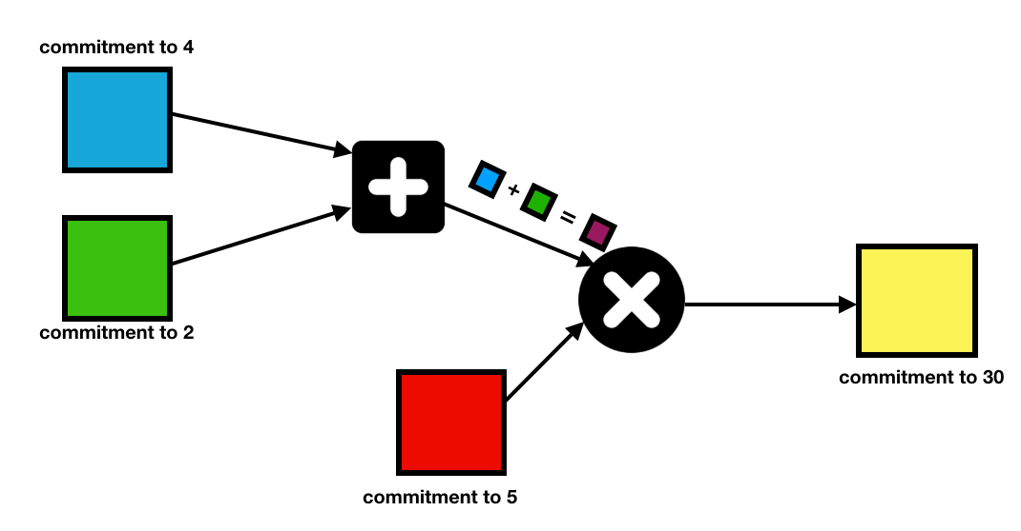





Zero Knowledge Proof Generation
Proof.txt
Groth16 zkSNARK
Verifier Username
Prover Username
Threshold
Threshold
Net Worth
CID
Status=1
Prf=CID
CID
Verified
Status=0
No Proof
Verifier Circuit
Proof.txt
Verifier
Prover
Notes:
Click [0] Now we will see the implementation of proof generation in a zero knowledge way in our project.
[1] Let’s assume there are 2 entities namely verifier and prover. Verifier can be anyone who wants to verify the asset worth of the prover. For example, it might be an educational institution with a policy to check whether the assets of the students who want to join the institute are above a certain threshold.
[2] We will be leveraging the services of Polygon Chain for this task and we will be seeing how shortly.
[3] After a series of steps containing blockchain state reads and decryptions, effectively at the verifier end we will have Verifier address, Prover Addr and threshold.
[4] The proof request’s meta data is created and stored on the blockchain by making a transaction with two extra variables status=0(which indicates that the prover didn’t accept the request yet) and No proof(which indicates there’s no proof attached with this record). If the prover accepts the request to prove his assets worth..
[5] he will request the record from the blockchain and..
[6] extracts the threshold from the record, calculates his/her net worth and uses them..
[7] as a witness for the Groth16 zkSNARK circuit..
[8] to produce the proof in a txt format..
[9] and returns it to the prover. Since, blockchains face scalability and throughput issues, we will store it on..
[10] IPFS instead. IPFS is a decentralized file storing web protocol.
[11] If you give the proof to ipfs..
[12] , it will produce “CID” and..
[13] returns it to the user.
[14] Now, the prover makes a request to edit the contents of the record with status=1(which indicates that the prover did some computation on the record(accepting or rejecting)) and proof=cid (indicates where the proof is stored(if accepted otherwise it will be ‘-’ indicating that the prover has rejected the request)) and..
[15] it will be updated on the network. The verifier will know by now whether or not the prover assets are above/below the threshold. But, still, if he wants to check for himself..
[16] , he requests the record from the blockchain network and..
[17] extracts the CID..
[18] gives it to IPFS and..
[19] gets the proof.txt file back from the hosts.
[20] It gets returned to the user. Now there’s already a verifier circuit (produced by the zksnark) deployed on the chain as a smart contract which when called with the proof.txt file..
[21] returns whether or not the proof is valid or invalid.

Slide 10
Demonstration

Slide 11
Conclusion and Future Directions
Web3 relevant Accessible App.
No witness proof, cross-chain
Add more chains and tokens
Expand Reach to Global
Notes:
First 2 points are conclusion.
Last 2 points are future scope. Expand reach to global means make our web app used by everyone

Slide 12
References
[1] Huang, J., Huang, T., Wei, H., Zhang, J., Yan, H., Wong, D. S., & Hu, H. ZkChain: A privacy-preserving model based on zk-SNARKs and hash chain for efficient transfer of assets. Transactions on Emerging Telecommunications Technologies, e4709. https://doi.org/10.1002/ett.4709
[2] Tabacaru, Robert, et al. "The Challenges of Proving Solvency While Preserving Privacy." Cryptology ePrint Archive, Paper 2023/079 (2023). https://eprint.iacr.org/2023/079.
[3] Konkin, A., Zapechnikov, S. Zero knowledge proof and ZK-SNARK for private blockchains. J Comput Virol Hack Tech 19, 443–449 (2023). https://doi.org/10.1007/s11416-023-00466-1
[4] Dieye, M., Valiorgue, P., Gelas, J.-P., Diallo, E., Ghodous, P., Biennier, F., & Peyrol, É. (2023). A Self-Sovereign Identity Based on Zero-Knowledge Proof and Blockchain. IEEE Access, 11, 49445-49455. DOI: 10.1109/ACCESS.2023.3268768.
[5] J. Groth, "On the size of pairing-based proofs," in Advances in Cryptology—EUROCRYPT 2016: 35th Annual International Conference on the Theory and Applications of Cryptographic Techniques, Proceedings, Part I, T. Iwata and K. Dodis, Eds., Cham: Springer International Publishing, 2016, pp. 186–216.
[6] B. Bünz, B. Fisch, and N. Smart, "Composability proofs for succinct non-interactive arguments of knowledge," in Advances in Cryptology—CRYPTO 2018: 38th Annual International Cryptology Conference, Proceedings, Part II, H. Shacham and A. Boldyreva, Eds., Cham: Springer International Publishing, 2018, pp. 158–189.
[7] V. Bulatov, J. Groth, and R. Ostrovsky, "Non-interactive zero-knowledge proofs for boolean circuits," in Proceedings of the 42nd Annual ACM Symposium on Theory of Computing, STOC 2010, Cambridge, Massachusetts, USA, June 5–8, 2010, R. Ostrovsky, Ed., ACM, 2010, pp. 115–124.
[8] Z. Bootle, J. Groth, and A. O. Narula, "Proofs of knowledge of homomorphic commitments and related applications," in Advances in Cryptology—CRYPTO 2016: 35th Annual International Conference on the Theory and Applications of Cryptographic Techniques, Proceedings, Part II, M. Robshaw and J. Katz, Eds., Cham: Springer International Publishing, 2016, pp. 158–188.
[9] B. Bünz, B. Fisch, and N. Smart, "Bulletproofs: Short and efficient zero-knowledge proofs for range proofs," in Advances in Cryptology—CRYPTO 2018: 38th Annual International Cryptology Conference, Proceedings, Part II, H. Shacham and A. Boldyreva, Eds., Cham: Springer International Publishing, 2018, pp. 315–344.
[10] A. Tomescu and B. Bünz, "Zero-knowledge proofs with hidden provers," in Advances in Cryptology—CRYPTO 2020: 40th Annual International Cryptology Conference, Proceedings, Part I, D. Lieman and M. Mannan, Eds., Cham: Springer International Publishing, 2020, pp. 704–732.
[11] M. Beller, A. Chiesa, I. Eyal, and R. A. Popa, "Proof-based state machines: A cryptographic perspective," in Proceedings of the 2017 ACM SIGSAC Conference on Computer and Communications Security, CCS 2017, Dallas, TX, USA, October 30 - November 3, 2017, B. Coan and D. S. Wallach, Eds., ACM, 2017, pp. 1255–1270.

Slide 13

Thank You
..
Dr. Shyama Prasad Mukherjee International Institute of Information Technology, Naya Raipur

