Slide 1
Play Store Data Analysis
By
Vinay Simha M K
Batch code: ML3-DA23

Slide 2
Objective:
My project involves analyzing Play Store data to identify insights into app success and in-app purchase potential
and to find the opportunities on what basis the app can get generated based on installs, ratings.
Problem statement
What kind of application are available and based on that what kind of application creation is suggested?
Area of focus:
What kind of app/application is frequently created.
On what category the app is getting created.
What is the Minimum android version that is required for installing app.
What is the frequent/average size of the app.
Does the app contain ads or not?
Is the app available at free of cost or required pay?
Does the app contain privacy policy?
Does the app allow In app purchase?
Why the In Purchase is better than buying before installing?

Slide 3
About the dataset:
The dataset contains information about several mobile applications, including App name,
Category, Rating, Rating count, Developer details, Released year, Privacy policy link, Ad-supported etc.
There are 1,50,000+ Unique applications in the dataset.
There are total 48 kind of category in dataset like Action, Adventure, Entertainment etc.
The rating column represents the overall rating of the application.
There are kind of Apps which are free of cost and Paid for installing.
There are Apps which support Ads and Apps that doesn’t support Ads.
There are few Apps containing privacy policy as well.
There are details regarding Develop like Developer ID and Developer E-mail.
There is a column named Content Rating which indicates which age category can install.
There is released year and last updated column as well.

Slide 4
Data Cleaning & Pre-Processing
Importing required libraries
v
Importing Data for cleaning
v
Displaying info of the data
v
Checking for duplicates
v
Checking for null values
v
Dropping null values from selective columns.

Slide 5
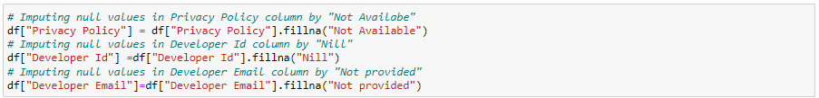
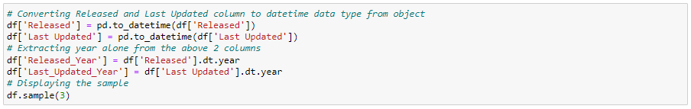
Imputing null values for
selective columns
v
Dropping unnecessary
columns
v
Creating new columns for analysis

Slide 6
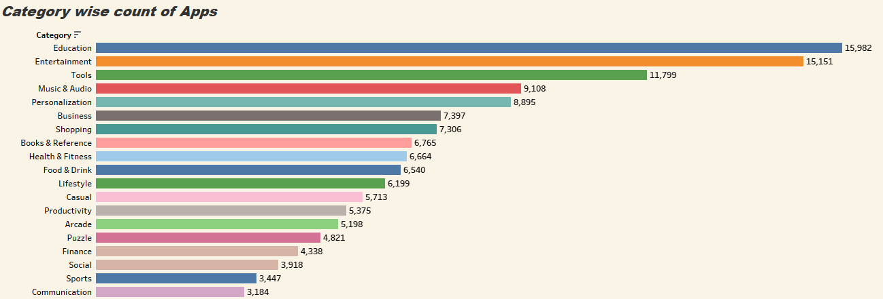
Business questions:
Category based Count of Application:
Interpretation:
Among all the Categories, Education Category consist of higher count of Apps i.e. 15,982

Slide 7
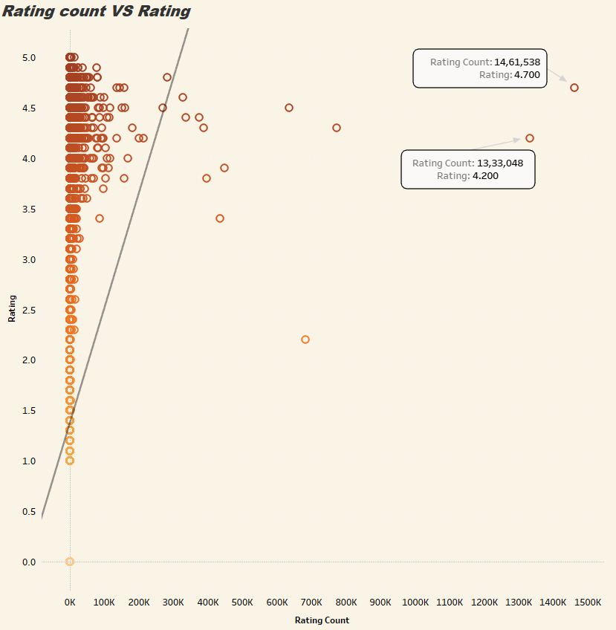
What is the relation between Rating and Rating count?
Interpretation:
The relation is strong positive correlated.
The number of Rating count is increasing
as the Rating id higher.

Slide 8
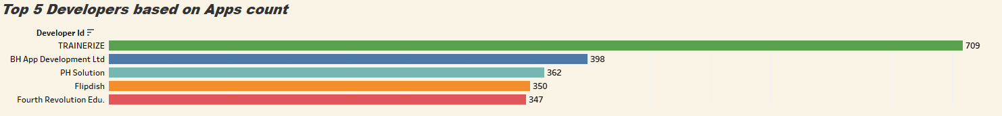
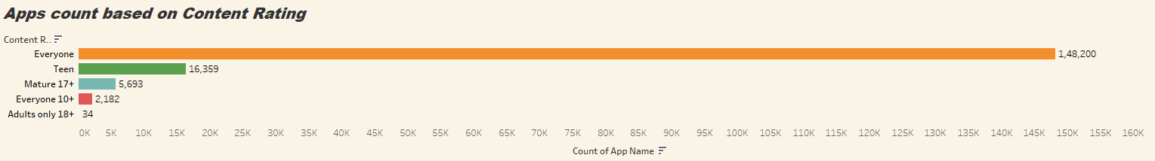
Top Developers based on Applications Developed?
The Developer named “TRAINERIZE” has developed highest number of application i.e. 709
Applications count based on Content Rating.
Interpretation:
The most common type of Application is for Everyone i.e. no age restriction.

Slide 9
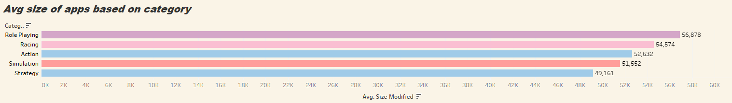
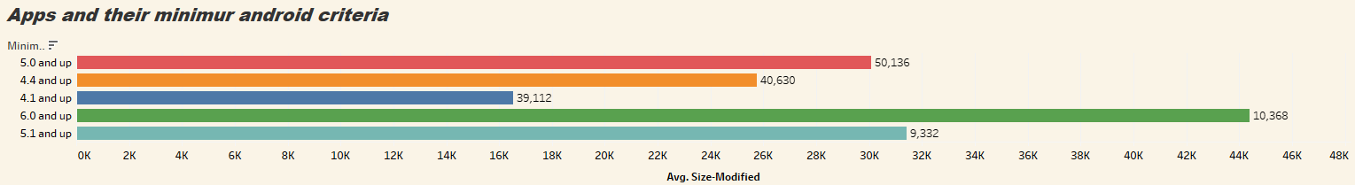
Average Size of Applications based on Category
The Role-Playing category applications have average size of 56,878kb ~ 56.878MB
Minimum android version required to download application
The minimum android version required to install applications is 5.0 and above cause that is the latest version

Slide 10
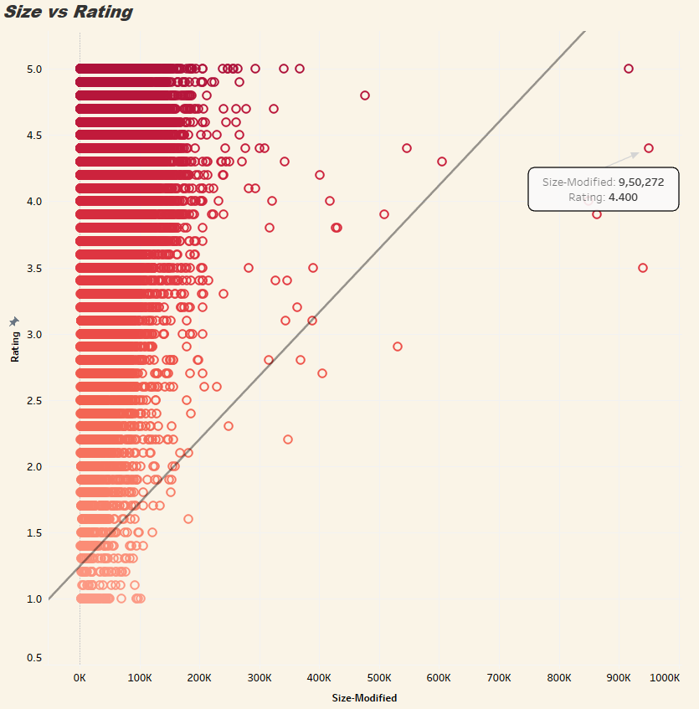
How does the size of Application vary with respect to the Rating?
Interpretation:
The relation is “Strong Positive Co-related”.
Which represents that the size of the Application
Is getting high as the Rating is also high.

Slide 11
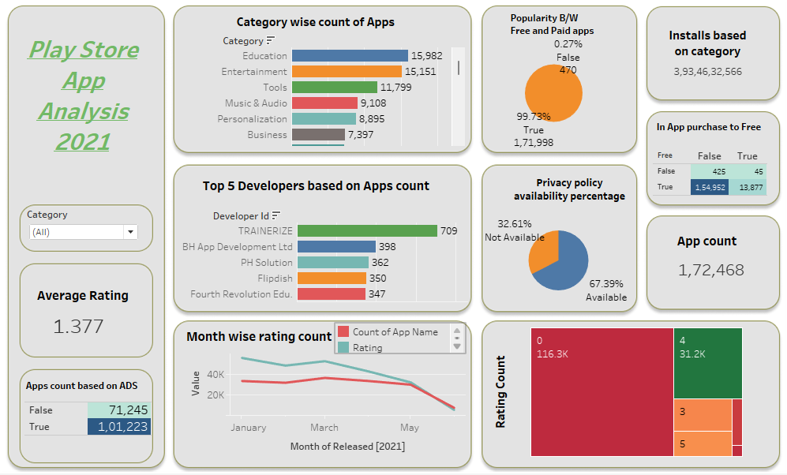
Final Analysis:

Slide 12
Summary
The highest Apps is from Education category followed by Entertainment & Tools
99.73% of total Apps are free of cost for installation.
There are 0.01% which supports editor choice.
The average rating is varying between 0-2 because of around 70% of Rating are 0 or not given rating by user.
70% of Apps does support ADS because in general it’s a kind of source generating.
Among total Apps 67.39% of Apps does have Privacy Policy.
Around 90% of Apps does provide free of cost for installation and doesn’t have In-App purchases.
The maximum rating is in the range of 4-5 if we neglect the non-rating percentage.

Slide 13
Conclusion
The count of Application is higher in Education and Entertainment, based on the idea and interest
of Developer he can develop Application based on Education or Entertainment category.
The app should be from free of cost for installation, because the ratio of applications which are
free of cost is higher than paid.
The app can support ADS cause in general it’s a source of income and the drawback is if the
application contains a lot of ADS, it might lead to have less rating or downfall of install rating.
The frequent size of Apps is between 5-50MB which has a lot of Application count.
The App should be of no age restriction cause those kinds of App count is high.
App should contain Privacy Policy in general so that there won’t be any unnecessary issue in future.
The App should be developed in such a way that, it should support android version of 4.4 and above.
Depending upon the interest in Application the Developed can either go with the decision of In-App
purchase or not. If he goes for In-App Purchase, then it’s going to be another kind of source of Income.

Slide 14
Thank you

