Slide 1
CS 487/587 Database Implementation Spring 2019 Database Benchmarking Project - Part III
Amee Sankhesara
Vinaya D Bhat

Slide 2
Why did we choose Postgres?
PostgreSQL is a comprehensive, sophisticated database system which offers countless features.
It is compatible with various platforms using all major languages and middlewares. It also offers most sophisticated locking mechanism. It supports MVCC (Multi version concurrency control) feature.
PostgreSQL has many configuration parameters in its config file. By tweaking the PostgreSQL config parameters we can improve query performance drastically. So we wanted to learn that how we can get better performance by tweaking the config parameter of PostgreSQL.
PostgreSQL's query optimizer is superior to many others. We wanted to see the working of optimizer closely and see how it processes different queries.

Slide 3
Goals
Learn implementation of join algorithms in PostgresSQL
Index vs Sequential scan
Test performance of different types of aggregations
Memory and execution times
Implementation
System Selected: PostgreSQL Version 10.7
Three tables:
Fifteenhundredktup: 1500000 tuples
Thousandktup: 1000000 tuples
Twothousandktup: 2000000 tuples

Slide 4
Experiment – 1 : Join Algorithms
SQL Query : select * from fifteenhundredktup where unique1 in (select unique1 from thousandktup)
Expected Results: Default: Nested loop join With enable_nestloop = Off, Postgres chooses Merge Join With enable_nestloop = Off, enable_mergejoin = Off , Postgres chooses Hash Join | Results Obtained: Default: Hash Join (Average Execution time: 9.9 s) With enable_hashjoin = Off, Postgres chooses Merge Join (Average Execution time: 19.8 s) With enable_hashjoin = Off, enable_mergejoin = Off, Postgres chooses Nested Loop Join (Average Execution time: 7.47 s)
Important observations:
Since selectivity of the query is greater than 10% ,we expected the optimizer to choose Nested Loop Join and last preferable join would be Hash Join since the table is too large to fit in memory. However, Postgres chooses Hash Join over the other joins because of Multi Batch Hash Join. Even though the table size is large, batches are created of work_mem size and stored on temporary files on disk.
Average execution time of nested loop join is better the other two joins still it is preferred last because Postgres considers the number of tuples the algorithm has to look through. Nested loop join will have to look through 1.5million*1million tuples which is greater than the number of tuples the other algorithms look through.

Slide 5
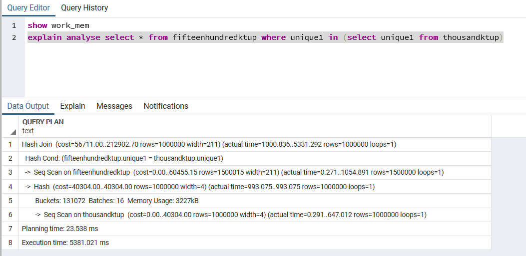
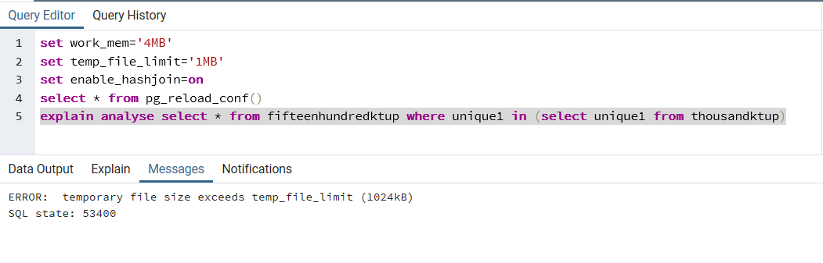
Experiment – 1 :
Varying temp_file_limit on same SQL query
Temp_file_limit parameter: Specifies the maximum amount of disk space that a process can use for temporary files, such as sort and hash temporary files, or the storage file for a held cursor.
Fig(2)
temp_file_limit=1MB
work_mem=‘4MB’ (default)
Enable_hashjoin=on
The query fails since the batch size exceeds the size of temporary file on disk. We expected Postgres to chose then next best join rather than failing. This proves query optimizer does not consider space on disk before choosing the query plan.
If the same query is executed with Enable_hashjoin=off, query will not throw error instead will execute choosing Merge Join.
Fig(1)
temp_file_limit=-1 (default)
work_mem=‘4MB’ (default)
Enable_hashjoin=on
Postgres can use the total amount of disk space available.

Slide 6
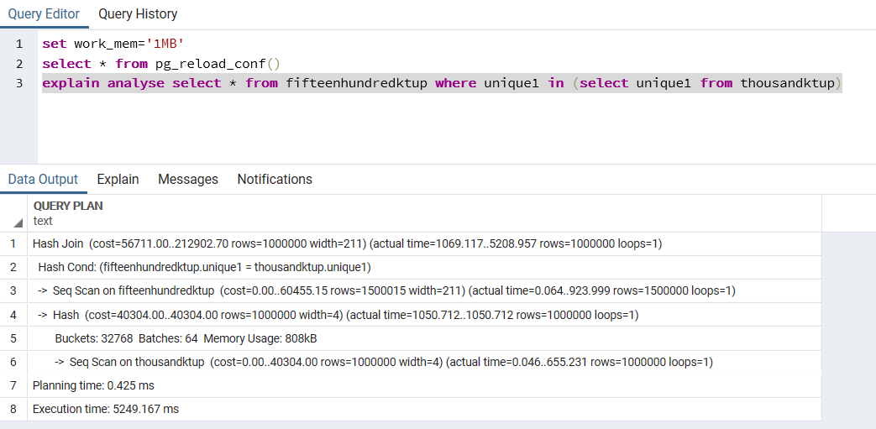

Experiment – 1 :
Varying work_mem on same SQL query
Work_mem parameter: Specifies the amount of memory to be used by internal sort operations and hash tables before writing to temporary disk files.
Important Observation:
With decrease in the amount of working memory the number of batches increase since the size of the batch is same as the amount of working memory. So more number of disk access with increase in number of batches.
Fig(1)
work_mem=‘4MB’ (default)
Batches=16
Fig(2)
work_mem=‘1MB’
Batches: 64
Fig(3)
work_mem=‘500kB’
Batches: 128

Slide 7
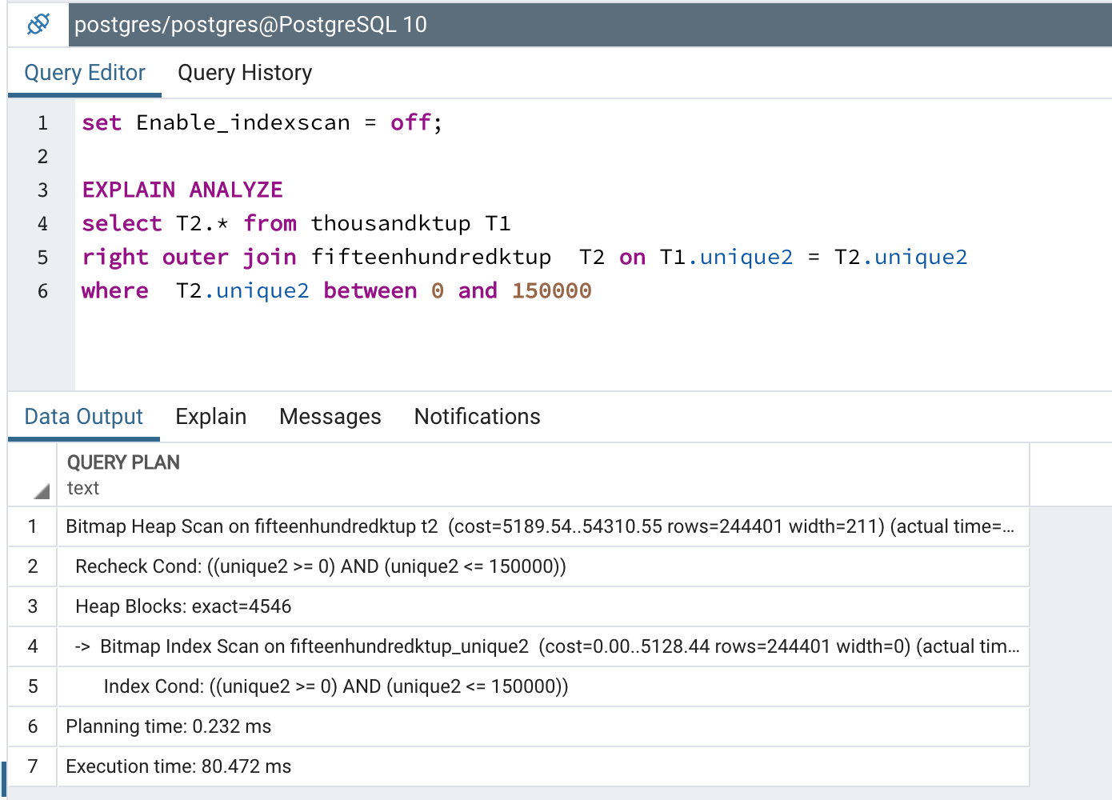
Experiment-2: Index scan and Sequential scan
SQL Query : select * from fifteenhundredktup where stringu1 like 'AAA%' and unique2 between 0 and 120000
Expected Result and Results Obtained: Index Scan (Average Execution Time: 0.797 s ) : Here we are fetching 0 to 120000 number of records from total 1500000 number of records. So, selectivity is less than 10%. Unique2 is primary key of table. So it has clustered index. And selectivity is less than 10% so It will use Index scan for this query according to us. First it will fetch data which has unique2 between 0 and 120000 and then on that data it will apply filter on column stringu1.
If Enable_indexscan = off
Expected Result and Results Obtained: Bitmap Heap Scan (Average Execution Time : 0.574 s ) : According to us when we set parameter Enable_indexscan to Off it will use Bitmap Heap Scan on table. Because selectivity is less than 10% so for sequential scan there is not enough data. So it will use Bitmap heap scan on both table. First it will find portion of data according to where clause then it will perform join operation on the fly and then it will get result from it.

Slide 8
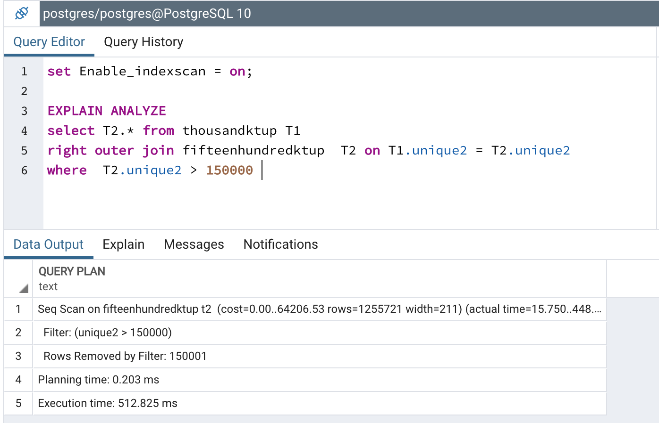
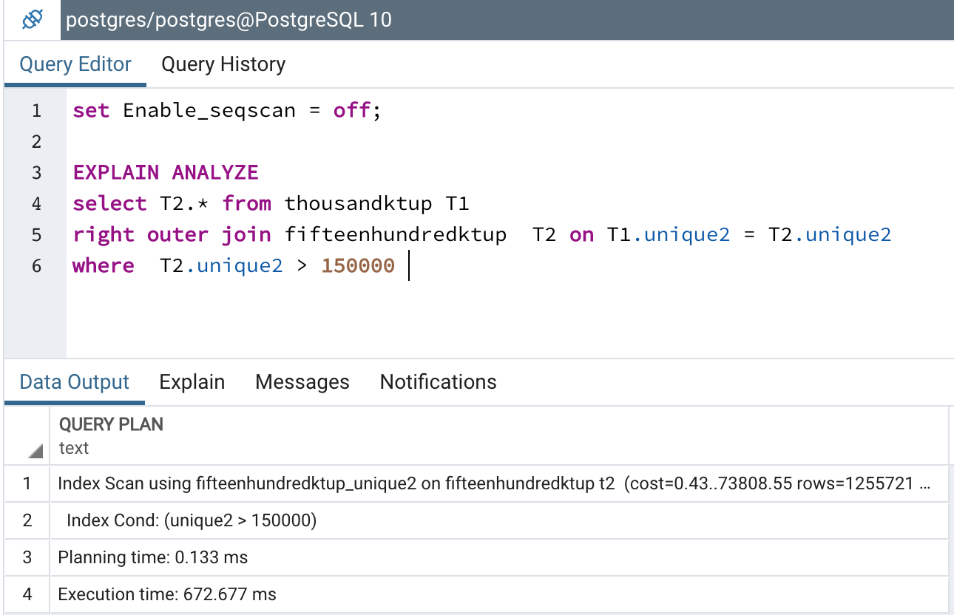
Experiment-2: Index scan and Sequential scan
SQL Query: select * from fifteenhundredktup where stringu1 like 'AAA%' and unique2 > 150000
Expected Result and Results Obtained: Sequential Scan (Average Execution Time: 1.03 s) : Here we are fetching more than 10% records so selectivity is greater than 10%. So it will use sequential scan for this query even though unique2 has clustered index.
If Enable_seqscan = off
Expected Result and Results Obtained: Index Scan ( Average Execution Time: 1.238 s) : According to us when we set parameter Enable_seqscan to Off. It will force to use index scan even though its selectivity is greater than 10%. And it will give worse performance than sequential scan.

Slide 9
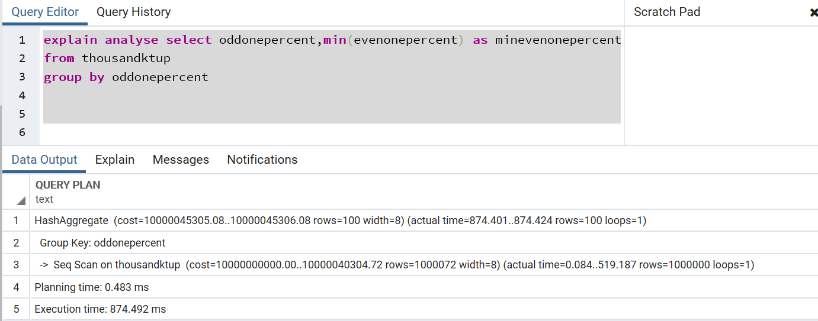
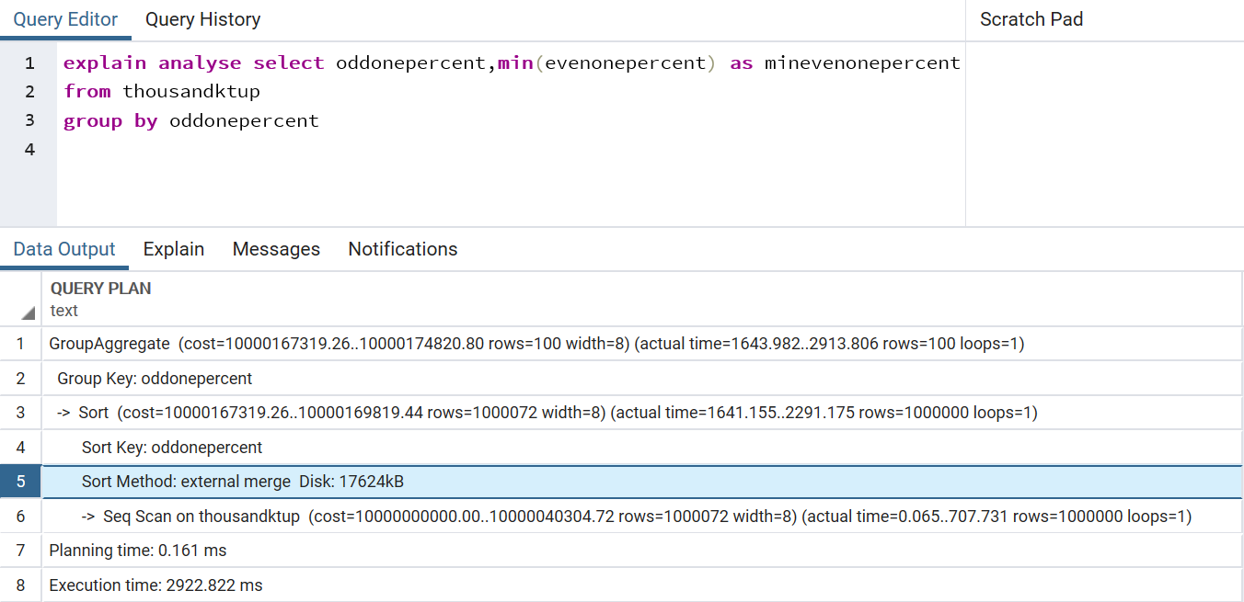
Experiment-3: Aggregations
SQL query: select oddonepercent,min(evenonepercent) as minevenonepercent from thousandktup
group by oddonepercent
Expected Results and Results Obtained were the same. We have first test hash aggregation for that we have just disabled enable_sort parameter and executed above query as hash aggregation do not require sorted input. Then we have test group aggregation for that we have just disabled Enable_hashagg and enabled enable_sort parameter as it requires sorted input. Group aggregation takes more time than hash aggregation as it is performing additional operation sorting operation to sort input. enable_sort = off , enable_hashagg = on, Postgres chooses hash aggregate (Average Execution Time: 0.973 s) enable_sort = on , Enable_hashagg = off ,Postgres chooses group aggregate (with a sort) (Average Execution Time: 1.77 s)

Slide 10
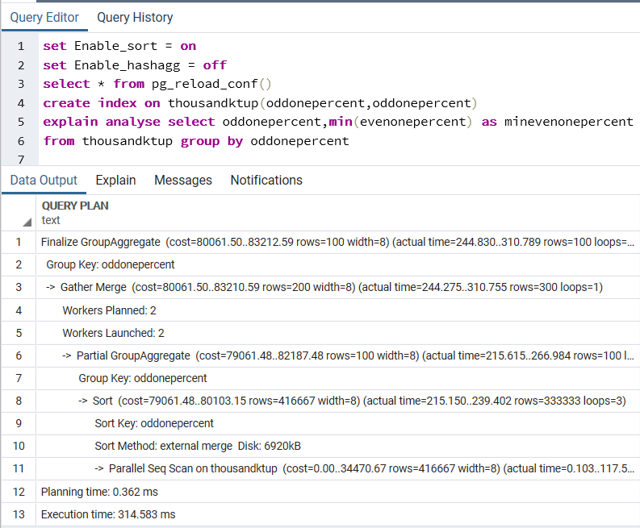
Experiment-3: Aggregations
To optimize the query we have created an index on columns present in the aggregation. So not it is doing parallel seq scan on table rather than seq scan. It will be much faster than previous one. It will also give better performance than hash aggregation due to its cache efficiency. HashAggregate needs to keep the whole hash table in memory at once, GroupAggregate only needs the last group. So it will give better performance than previous two cases.
enable_sort=on, enable_hashagg = off : group aggregate with index only scan
Average Execution Time: 0.35 s which is better than previous two cases.

Slide 11
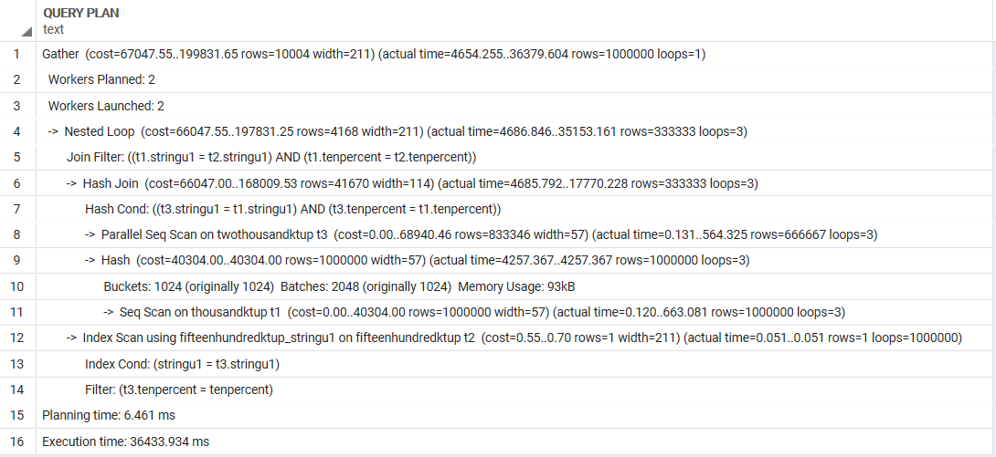
Experiment-4: Memory management and Execution time using work_mem parameter
SQL query : select T2.* from thousandktup T1 inner join fifteenhundredktup T2 on T1.stringu1 = T2.stringu1 and T1.tenpercent = T2.tenpercent inner join twothousandktup T3 on T2.stringu1 = T3.stringu1 and T2.tenpercent = T3.tenpercent
Output rows: 1000000 rows

Slide 12
Experiment-4: Memory management and Execution time using work_mem parameter
Important Observations:
With work_mem=‘100kB’ the average execution time is 43.8 s.
With work_mem=‘4MB’ (default) the average execution time is 33.6 s.
With work_mem=‘128MB’ the average execution time is 27.9 s.
Results Expected and Results Obtained: We can see that with increase in work_mem the average execution times decreases. Because of work_mem size batches done during hash join with increase in work_mem the number of batches will be less. Also, we can see that two workers are working in parallel in this query to optimize the performance since the number of rows returned is very large.

Slide 13
Summary/Conclusion
We have done experiments for query optimization in PostgreSQL by tweaking PostgreSQL config parameters. In the first experiment we have checked different joins. From first experiment we have concluded that even though selectivity of query will be more than 10% still it will use hash join because PostgreSQL is using multi batch join so it will divide data into multiple batches and perform hash join . We have also concluded that PostgreSQL is choosing best query plan based on number of tuples it retrieves not on execution time.
In the second experiment, we have checked different scans used by query (Index scan, Seq scan, Bitmap heap scan). From second experiment we have concluded that for selectivity less than 10% index scan will give good performance and if we disable config parameter for index scan than it will use bitmap heap scan for selectivity less than 10%. It will also give good performance. And in the case of query having selectivity greater than 10% seq scan is better than index scan.
In the third experiment, we have checked hash and group aggregation. From the third experiment we have concluded that hash aggregation do not require sorted input so it gives better performance than group aggregation as group aggregation require sorted input so it will take more time than hash aggregation. But group aggregation with index scan only will give better performance than hash aggregation as it will use parallel seq scan on table.
In the fourth experiment, we have checked memory management and execution time using work_mem parameter. From the fourth experiment, we have concluded that increase in the work_mem will decrease the execution time of query.

Slide 14
Lessons Learned
Starting this project we were very excited to play around with the Postgres Config parameters. In the course of the project, we learnt that Postgres even though being widely used and popular database still has flaws. Like in the first experiment we were expecting Postgres optimizer to roll over to the next best plan instead of crashing. Another feature of Postgres that took us by surprise was its implementation of Multi Batch Hash Join. Even for tables of size 2 million Postgres still chooses Hash Join because of batches getting created of work_mem size. We learnt a lot of configuration parameter and how they affect the query optimizers choice of query plan. Some of the other parameters we came across and got familiar with are max_worker_processes, max_parallel_workers_per_gather, max_parallel_workers, max_parallel_workers, seq_page_cost, random_page_cost, min_parallel_table_scan_size and min_parallel_index_scan_size. In the first part of the project we learnt how to populate data from code execution, second part gave us a better understanding about selectivity, indexes and aggregations. Third part of the project increased our understanding of Postgres system. Given more time we would have conducted more number of experiments with different parameters and modification of same query (like with and without subquery, correlated and uncorrelated query etc). After this project we have a better understanding of Postgres, query optimization and queries.

