Slide 1
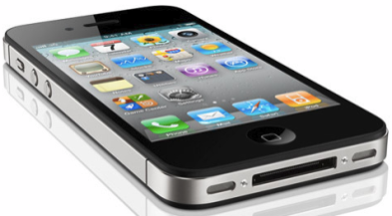




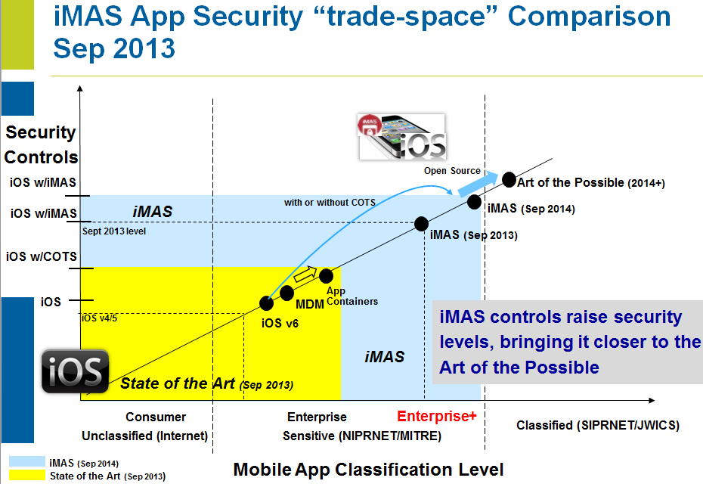
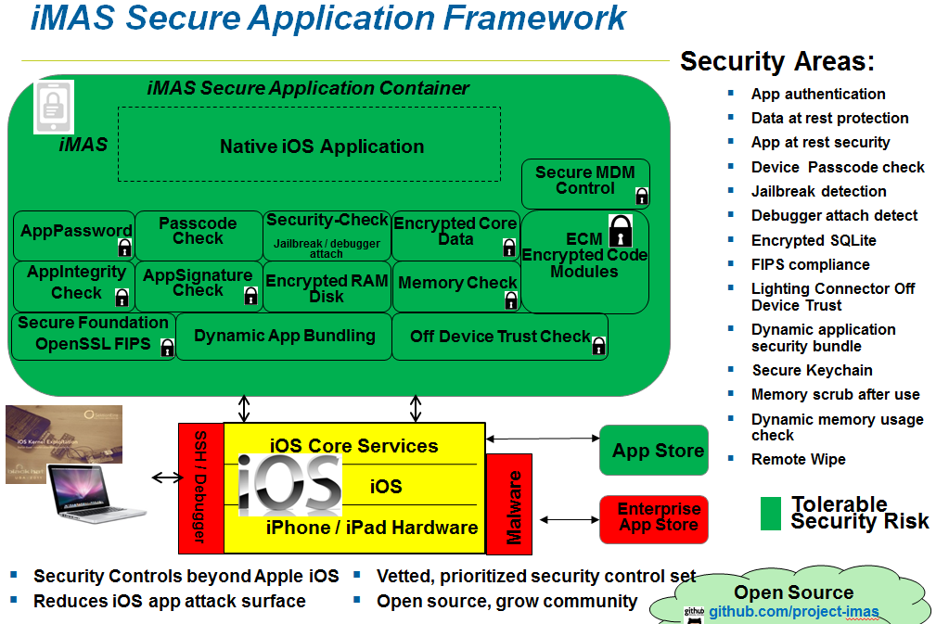
iMAS iOS Mobile Application Security
Gregg Ganley
Gavin Black
Problem
iOS is considered secure, but out of the box security is not enough
Simple device passcodes enable easy compromise of applications and data
Solution
Additional security controls beyond Apple
Reduce iOS app attack surface
Extends security with or without MDM and commercial solutions
Measurable security (DISA Mobile App SRG)
Open source available
project-imas.github.com
Raise iOS app security levels - closer to the Art of the Possible

Slide 2
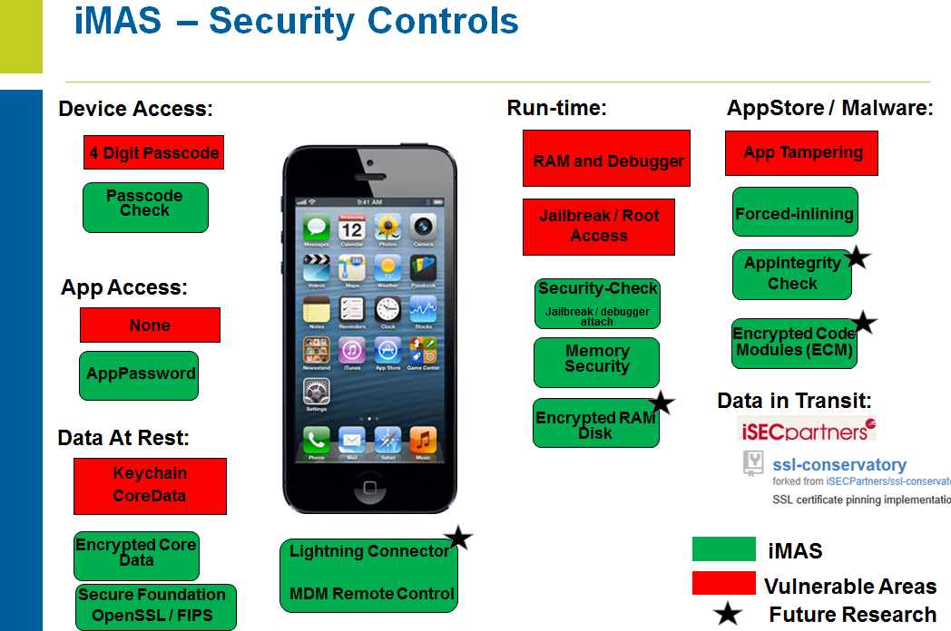
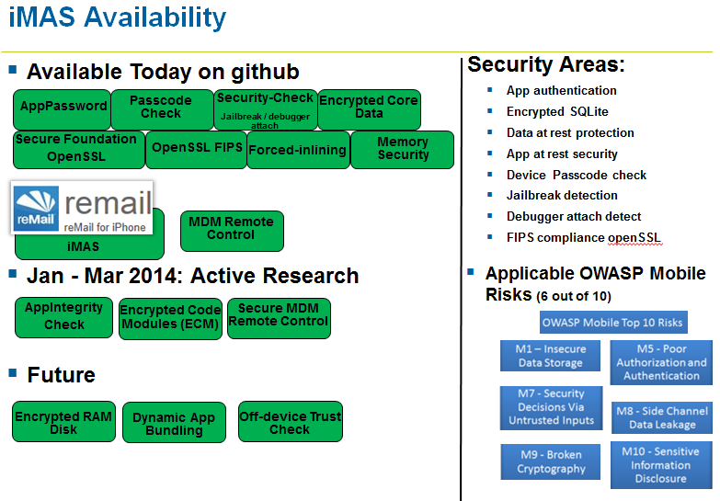

Contact
Github:
project-imas.github.com
POC:
MITRE, Bedford MA
Gregg Ganley
781-271-2739
gganley@mitre.org
Gavin Black
781-271-4771
gblack@mitre.org

