Slide 1



iOS Mobile Application Security (iMAS)
Dec 2012
Principal Investigator:
Gregg Ganley

Slide 2


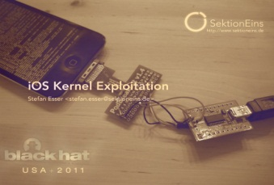


iOS Mobile Application Security (iMAS)
FY13
Gregg Ganley, Caleb Davenport, Shawn Valle
iMAS Secure Application Framework
iMAS
Native iOS Application
Config Profile
App Signing
App Store
Extended App level Passcode
Jailbreak Detect / Disable
RAM / Debugger lib / techniques
Encrypted App Files and keychain
iOS Core Services
SSH / Debugger
iOS
Internet
iPhone / iPad Hardware
Security Controls beyond Apple
Reduces iOS app attack surface
Vetted, prioritized security control set
Extends security with or without MDM and COTS solutions
Throughout project, open source, establish community
Open Source Community
Tolerable Security Risk

Slide 3

iOS Mobile App Security (iMAS) Overview
Elevator pitch – short
“iMAS - iOS secure application framework to reduce iOS application vulnerabilities and information loss”
Elevator pitch – long
iOS meets enterprise security needs of customers, however many experts cite critical vulnerabilities and have demonstrated exploits
iMAS idea – research iOS application protection beyond Apple provided security model across major vulnerability areas
System Passcode, jailbreak, debugger / run-time, flash storage
Research a secure application framework, which includes application container, developer and validation tools to strengthen the security of iOS applications
iMAS security enhanced iOS reference application using defense in-depth techniques
Open source for developer and commercial benefit

Slide 4
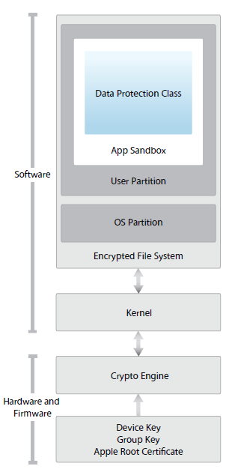
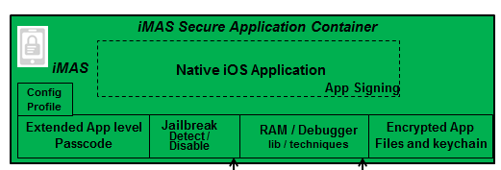
iOS Security Architecture

