Slide 1
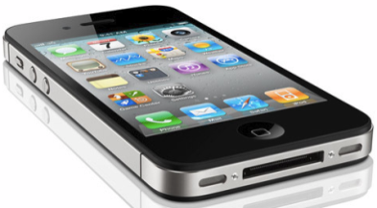




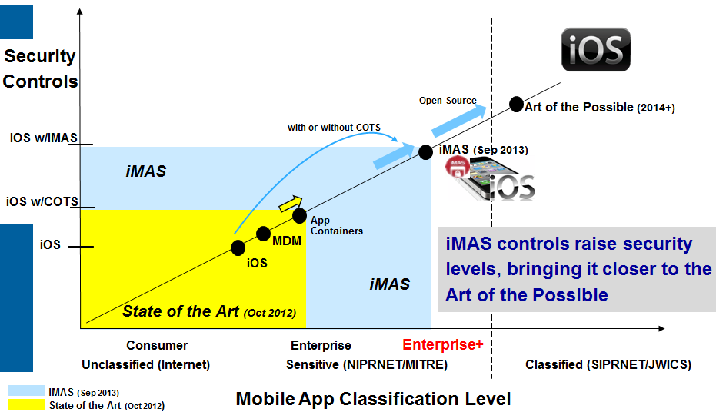
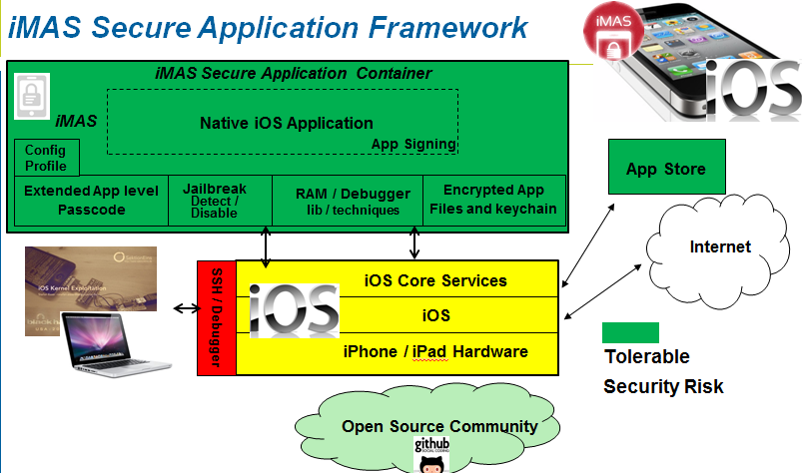
iMAS iOS Mobile Application Security
Gregg Ganley
Shawn Valle
Problem
iOS is considered secure, but out of the box security is not enough
Simple device passcodes enable easy compromise of applications and data
Solution
Additional security controls beyond Apple
Reduce iOS app attack surface
Extends security with or without MDM and COTS solutions
Measurable security (DISA Mobile App SRG)
Open source researched controls, grow community
Raise iOS app security levels, bringing it closer to the Art of the Possible

