Slide 1
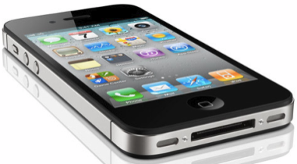


iOS Mobile Application Security (iMAS)
FY13 MITRE Research
April 2013
Principal Investigator:
Gregg Ganley

Slide 2
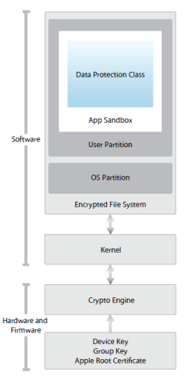
iOS Security Model
Click for more details
iOS four layers
Device - prevents unauthorized access to device
Data - protects data stored on the device
Network - protects data in transit
Application security – protects OS and isolates applications while they are running
iOS security
Reduced attack surface; no Java or Flash support, reduced PDF/.MOV features, stripped down system apps from full Mac OS X
iOS smaller footprint; no shell (/bin/sh), or rm, ls, ps, avail for exploit
Privilege separation; several iOS users (e.g., mobile, _wireless, root is limited)
Code Signing; binaries, libs, and pages in memory must be signed to exec
DEP / ASLR in place; limits exploits to ROP
Sandboxing; limits damage, makes exploitation harder
Security model is comprehensive; has evolved considerably since 2007; malware is difficult to craft and proliferate on iOS
Notes:
http://en.wikipedia.org/wiki/Return-oriented_programming
http://en.wikipedia.org/wiki/Return-to-libc_attack
http://www.infosecwriters.com/text_resources/pdf/return-to-libc.pdf

Slide 3
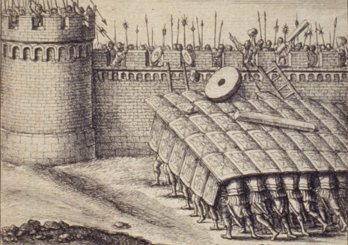
Research Scope
iOS attack surface is multi-faceted
Vulnerability vectors
Malware inserted via
Browser JavaScript engine
Apps downloaded from app store
Lost/stolen device, physical access attacks
Attacker purpose
Steal application data
Eavesdropping on video, microphone, and phone calls
Piggy back into Enterprise networks
iMAS focus - Application data as the target
Enterprise data, tactical operational data, patient health info
Protect against: malware and physical access attacks
Secure Static and Dynamic application controls

Slide 4
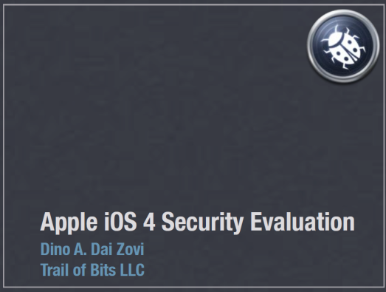
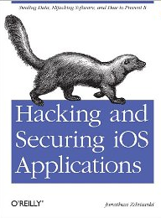
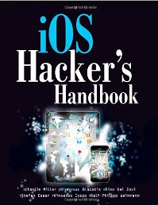
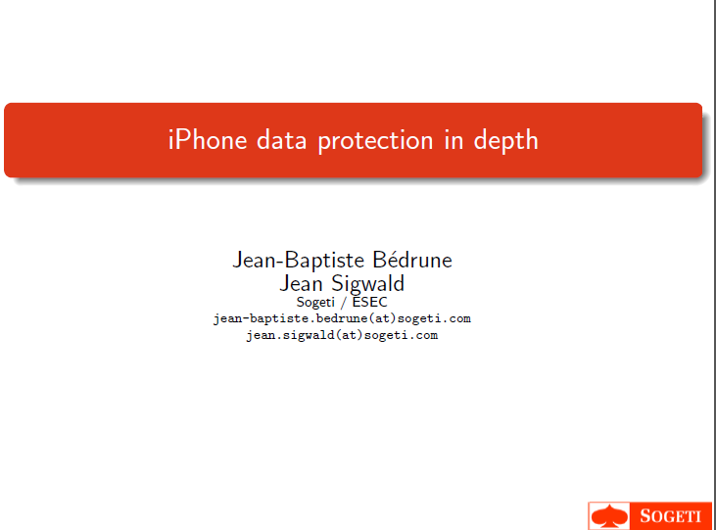
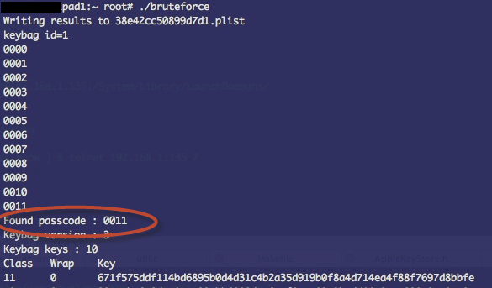
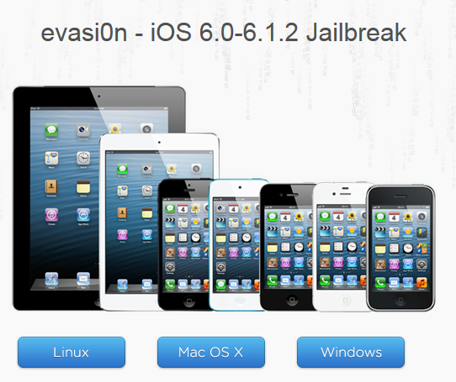
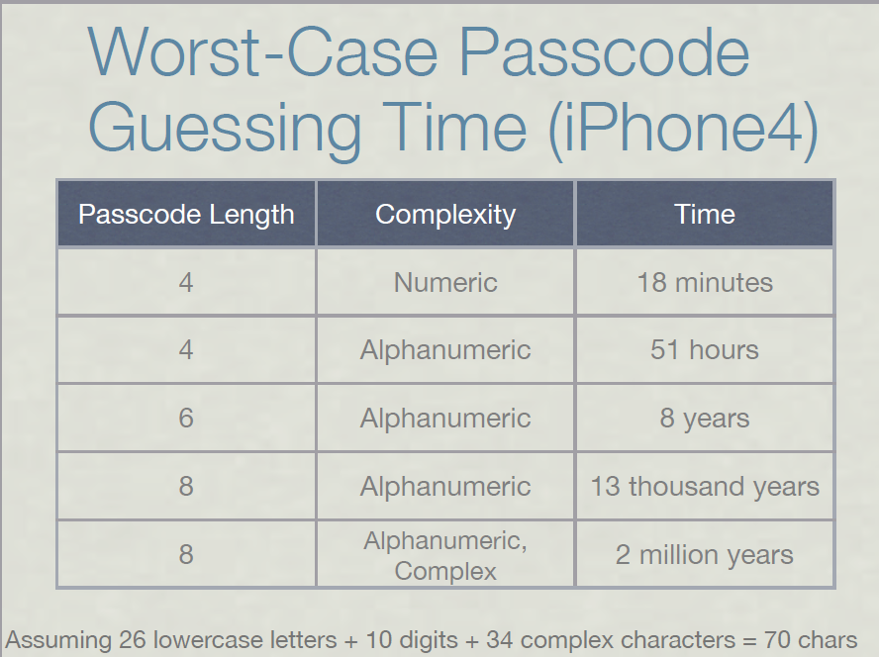
Hacking and Jailbreaking iOS
Attacks and weaknesses are well documented:
Latest Jailbreak: http://evasi0n.com/
Passcode
guessing:

Slide 5
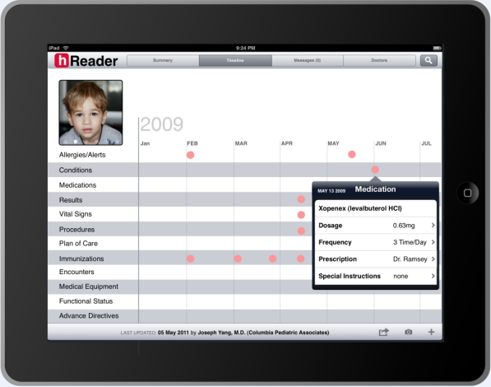
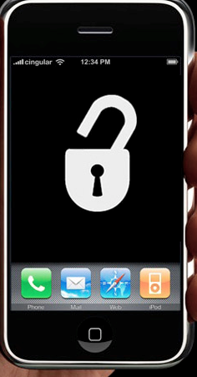
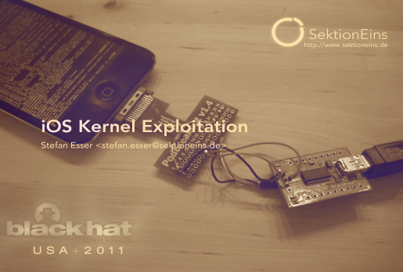

Standard iOS Application Today
4 Digit Passcode
Native iOS Application
App Store
App Signing
System components:
RAM and Debugger
Jailbreak / Root Access
User Auth
App Access
Keychain
Flash Data Storage
iOS Core Services
Internet
SSH / Debugger
iOS
iPhone / iPad Hardware
Vulnerable Areas

Slide 6


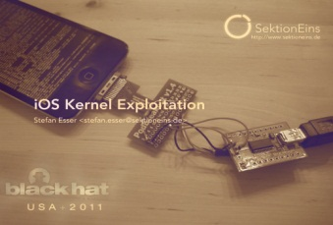


iMAS Secure Application Framework
iMAS Secure Application Container
iMAS
Native iOS Application
Config Profile
App Signing
App Store
Extended App level Passcode
Jailbreak Detect / Disable
RAM / Debugger lib / techniques
Encrypted App Files and keychain
iOS Core Services
SSH / Debugger
iOS
Internet
iPhone / iPad Hardware
Security Controls beyond Apple iOS
Reduces iOS app attack surface
Vetted, prioritized security control set
Extends security with or without MDM and COTS solutions
Open source, grow community
Open Source Community
Tolerable Security Risk

Slide 7


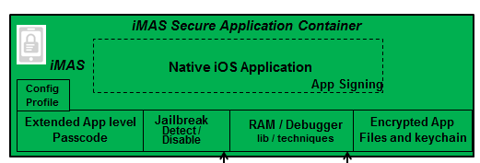
iOS Security Architecture

Slide 8
Mobile Threats
24 threats that are most relevant to the mobile environment
Software-Based Threats
Malware
Exploitation of Vulnerable App
Exploitation of Vulnerable OS
Physical-Based Threats
Loss of Device
Data recovered by unauthorized party
Use of authorized Credentials
Physical Tamper
Supply Chain
Web-Based Threats
Mobile Code
Drive-By-Downloads
Exploitation of Vulnerable Browser
Enterprise-Based Threats
Access to Enterprise Resources
Network-Based Threats
Data/Voice Collection over the air
Bluetooth
WiFi
Cellular
Data/Voice Collection over the network
Manipulation of data-in-transit
Connection to Masqueraded service
Jamming
GPS
Mobile Carrier
WiFi
Flooding
User-Based Threats
Social Engineering
Phishing / Spear Phishing
Theft/Misuse of Services
Malicious Insider
Tracking
Geolocation
Tower/Signal Traingulation
Geotagging
Mining of Call Records / Billing
Usage Patterns
iMAS Applicable

Slide 9




iMAS App Security “trade-space” Comparison Goal: Sep 2013
Change over time
(arrow size = rate of change)
Security Controls
Open Source
Art of the Possible (2014+)
iOS w/iMAS
with or without COTS
iMAS (Sep 2013)
iMAS
iOS w/COTS
MDM
App
Containers
iOS
iMAS controls raise security levels, bringing it closer to the Art of the Possible
iOS
iMAS
State of the Art (Oct 2012)
Consumer
Enterprise
Enterprise+
Unclassified (Internet)
Sensitive (NIPRNET/MITRE)
Classified (SIPRNET/JWICS)
iMAS (Sep 2013)
Mobile App Classification Level
State of the Art (Oct 2012)

Slide 10


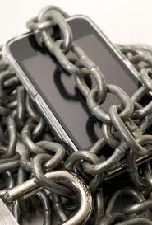
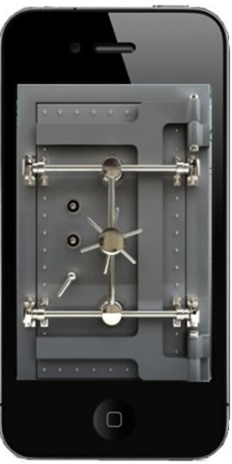
iMAS Deliverables
iMAS secure application framework, application container with validation tools
Ready for immediate developer use
iMAS security enhanced iOS reference application using defense in-depth techniques
Demonstrations of various vulnerabilities countered with iMAS secure app framework
Documented security control techniques in briefings and a white paper
Open Source iMAS and establish a community

Slide 11
iOS Application Security Audit

Slide 12

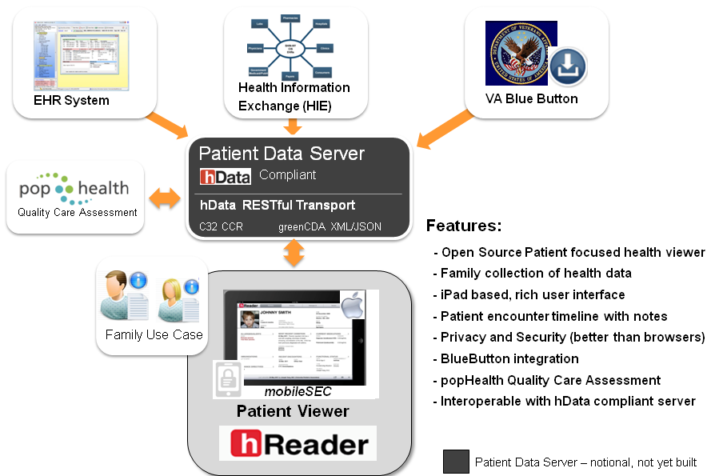
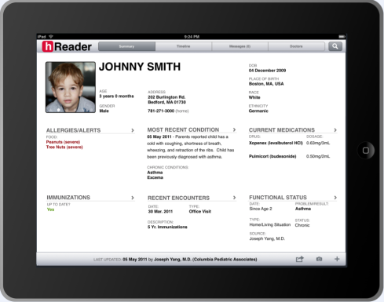
FY12
MITRE Internal Research - MIP
mobile Patient Health Reader

Slide 13
Audit Summary
hReader team targeting Open Source space for hReader application
hReader would be used mostly offline
Application security needs to be bolstered
Production hReader app would be contain sensitive patient health information
hReader requested a red-team to security audit the application
Test app contains “synthetic” patient data; NOT real patient data
A DISA App security STIG checklist was used to measure the security compliance
Iterative process over several months
First pass, many areas were found to be exposed
Third pass, considerably more secure

Slide 14
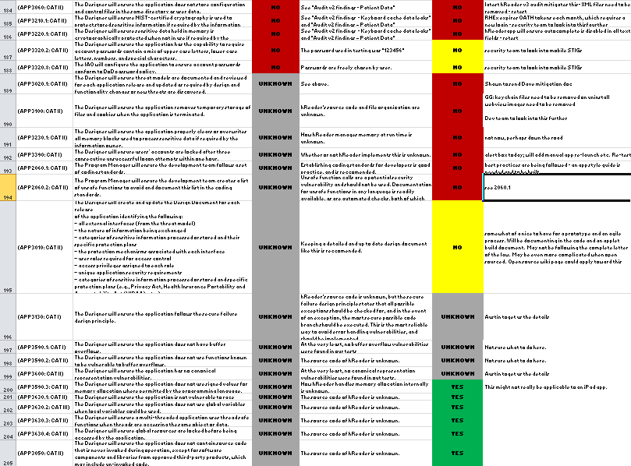
STIG Compliance Security Technical Implementation Guide
DISA / DoD Application STIG
255 total criteria
78 Applicable to hReader as a mobile prototype
Initial assessment
27 pass (16%), 10 fail, 129 unsure (166 Total), 89 NA
After several audits
72 pass (90%), 8 fail (80 total), 175 NA
hReader application security compliance increased to 90% criteria met – about a 5X increase from original design
* STIG – A specification that defines the configuration standards for DOD IA and IA-enabled devices/systems

Slide 15
Audit Takeaways
iOS, vendor supplied security is good, but has limitations
Securing beyond “out of box” security controls is critical
Adding controls is an iterative process
Develop Security controls => audit => forensics
Very custom mitigation techniques – due to lack of industry best practices
DoD STIGs offer guidance for securing applications and can be used as a benchmark of security coverage
Security compliance almost 90% of STIG categories
hReader development was very effective at locking down App
5X more compliant than Apple provided SDK, hence more secure
repeat

Slide 16
Technical Approach iMAS Secure Application Framework
Research and collect list of iOS vulnerabilities and prioritize
Review and vet list with security SMEs and CVE
Align iMAS components with vulnerabilities list
Research iMAS components, solutions, verification tools and techniques
Static security controls, followed by Dynamic run-time controls
Integrate into iMAS secure app container
Demonstrating the whole is greater than the individual components
Build reference app and red-team audit (“final exam”)
Open Source and establish a community
When ready and iMAS baseline is demonstrable

Slide 17

Research Plan
Q1
Static security defense research
iMAS secure application framework, application container with validation tools
App level passcode, keychain, DAR
Open Source iMAS and establish a community
hReader Third Party Audit
DISA Mobile App SRG and CWE analysis
Continue static controls, start dynamic control research
MOCSI integration efforts
Public Release Material
Deeper research and bolster iMAS secure framework
Encrypted Code Modules (ECM) investigation
More Controls (App integrity check, signature check, encrypted RAM disk, run-time memory check)
Share research with MITRE Sponsors and Security community
iMAS security enhanced iOS reference application (reMail)
Build reference app and red-team ( “THE FINAL EXAM” )
Documented security control techniques in briefings
Q2
Q3
Q4

Slide 18
Progress FY13 first-half
Q1
Open source software
Created github organization and added latest software
FIRST iOS security framework of its kind
iMAS Framework Components / Controls
Passcode “isSet” detection and configuration profile
App Password refactor
SecureFoundation
OpenSSL crypto library and primitives
Security Check
Encrypted Core Data
Encrypted iOS persistence layer using FOSS SQLCipher
hReader integration
Third Party Audit
hReader Third Party Audit viaForensics and Veracode
DoD SRG/STIG, CAPEC and CWE measurement techniques
Proposing a new CAPEC attack pattern to cover an iOS vulnerability
Q2

Slide 19
FY13 Additional Controls
App Integrity check research
Leverage ECM to wrap “app checksum” algorithm ensuring trust
App Signature check research
Confirm app is signed by original author
Encrypted RAM disk research
Research bundling a FOSS TrueCrypt RAM disk with an app; allows for rapid data destruction on app exit
Run-time memory check research
Application program address validation checks at run-time
Scrub memory on app exit
Encrypted Code Modules (ECM) investigation
Encrypt critical portions of code as a run-time loadable library
Invulnerable to static attack vector
Mitigates run-time attack when coupled with security check control

Slide 20
Questions?
iOS Mobile Application Security (iMAS)
FY13 MIP Research
Gregg Ganley

Slide 21
Backup

Slide 22
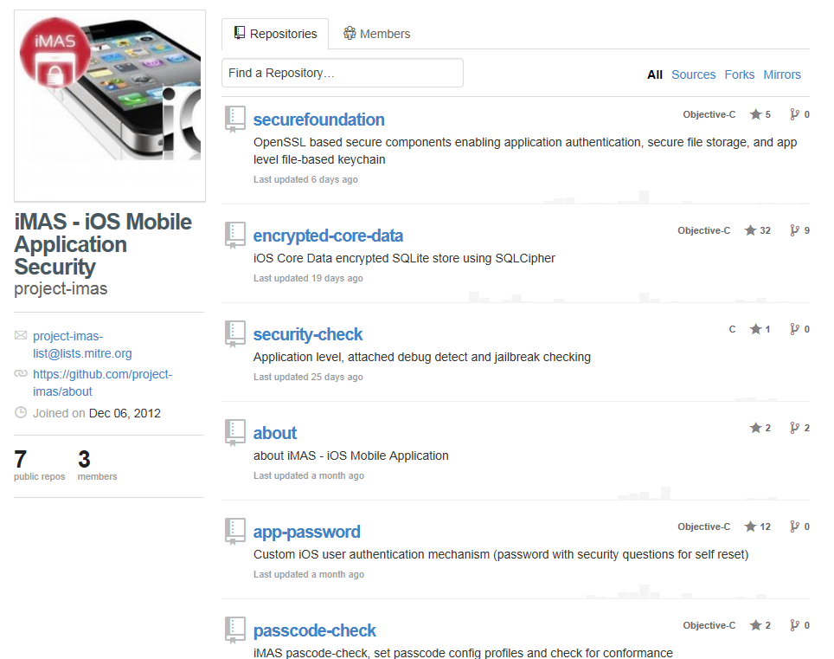
github.com/project-imas site Five iMAS security controls available

Slide 23



Technical Approach iMAS Static Components
Q1
System passcode “isSet?” detection
If not set, an application could use to disallow install or use
How: use NSDataWrite or kSecAttrAccessibleWhenUnlocked libs to determine
Configuration profile
Enhanced, application level passcode
Additional encryption specific to application, use to encrypt all app data, store portion off device, KDF with Common Crypto Lib
Basic:
Min. 6 digit rotating keyboard, user self-service reset with questions
Advanced:
Key Derivation Function (KDF) based with Common Crypto Lib encryption, split-key off device capable, password strength feedback, multiple apps use, timeout adjustable, app data wipe on fail
iMAS and SQL Cipher
Research a simple “drop-in” component for instant secure DB

Slide 24

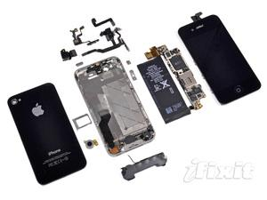
Technical Approach iMAS Static Components (cont.)
Q1
Jailbreak detection
Employ process fork check, known JB files
(cydia), altered fstab etc.
App will have choice uninstall, degraded mode
Building blocks
Crypto Library
Replaces libcrypto with openSSL
C-code based
Keychain data encryption
Read / write native keychain securely
SSKeychain shim
DoD STIG, CAPEC and CWE
Research techniques to measure and quantify app security level

Slide 25
iOS Mobile App Security (iMAS) The Story
Elevator pitch – short
iMAS – iOS application defense
iMAS – iOS secure application framework to reduce iOS application vulnerabilities and information loss
Elevator pitch – long
iOS meets enterprise security needs of customers, however many experts cite critical vulnerabilities and have demonstrated exploits
iMAS idea – research iOS application protection beyond Apple provided security model across major vulnerability areas
System Passcode, jailbreak, debugger / run-time, flash storage
Research a secure application framework, which includes application container, developer and validation tools to strengthen the security of iOS applications
iMAS security enhanced iOS reference application using defense in-depth techniques
Open source for developer and commercial benefit

