Slide 1

Project on:
Azure Synapse Analytics
Capstone Project:
Vinayak Dixit

Slide 2
Content
Introduction.
Creating Synapse workspace
Synapse Workspace
Ingest data into studio
Source link
Formatting data
Giving path where our data will be stored
Here data is stored
Querying the data(SQL)
Visualizing the data
Creating spark pool
Opening notebook for Pyspark code
Querying and visualizing data (Pyspark)

Slide 3
Introduction
I have given a link which contains the data about Bikes.
It have the Columns as Follows:
ProductID
ProductName
Category List Price.
I ingested the data on Azure Synapse Analytics Workspace to analyze it.

Slide 4
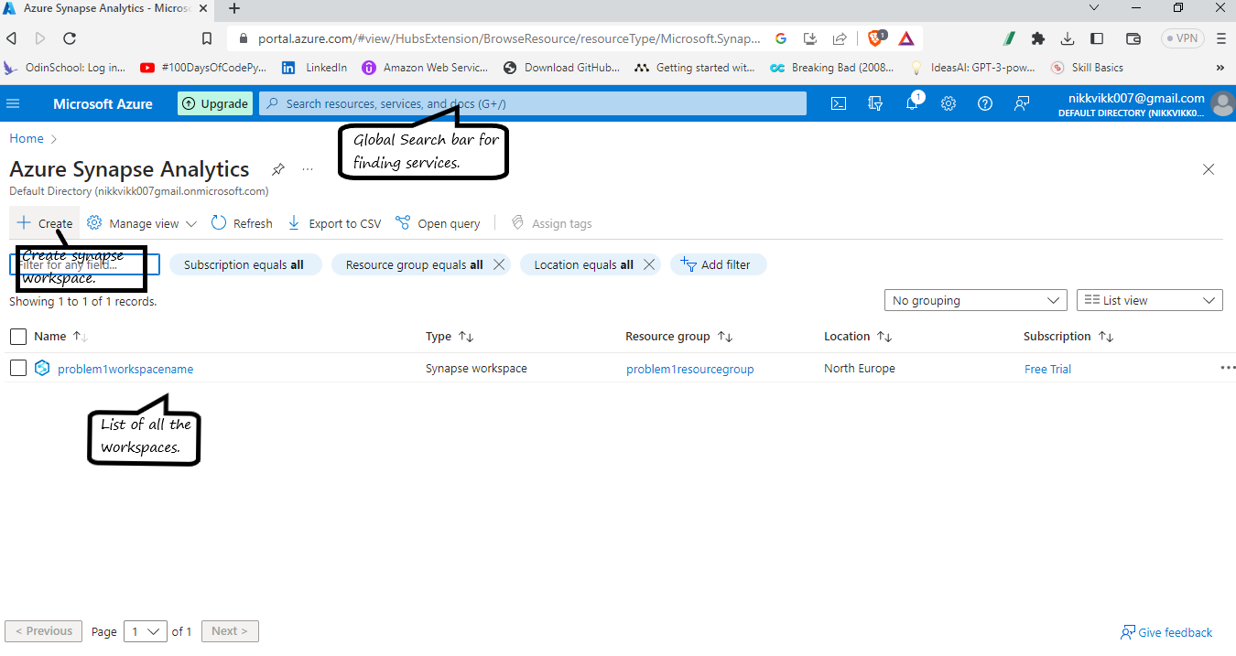
Creating Synapse Workspace

Slide 5
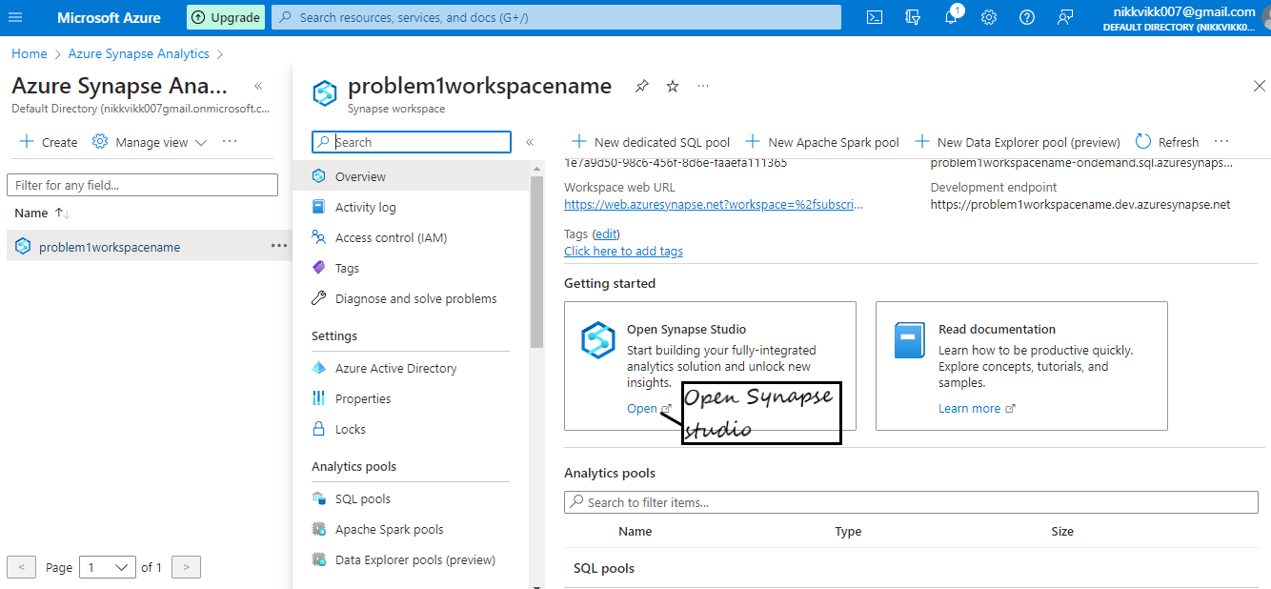
After Creating synapse workspace.
Opening Synapse studio.

Slide 6
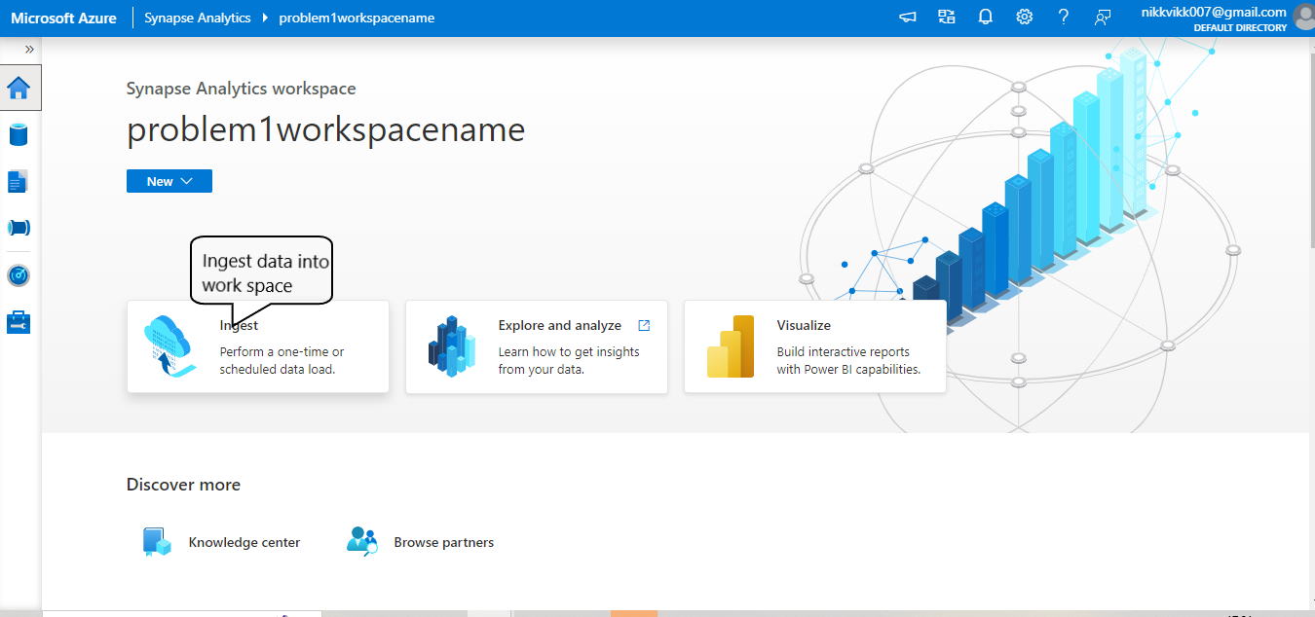
Ingesting a data into workspace.
Running a pipeline once.

Slide 7
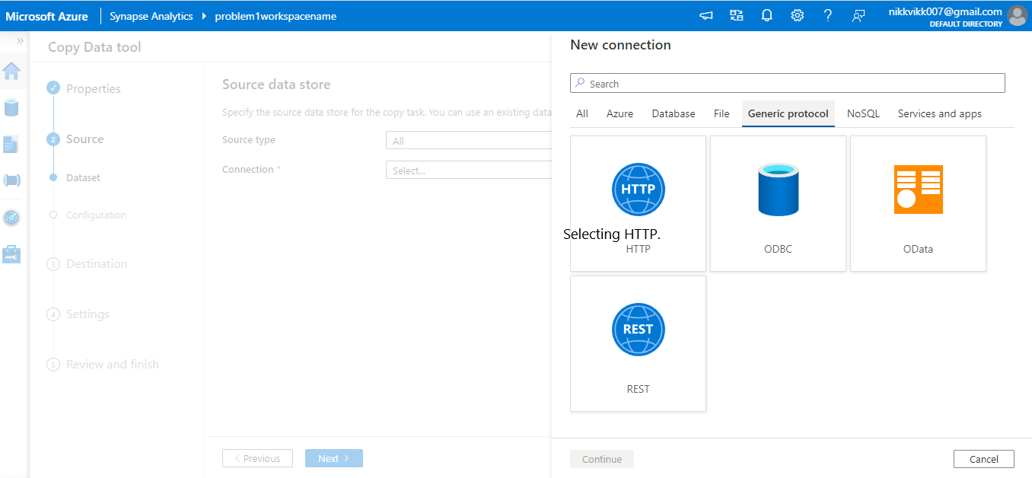
For Source data store I have to use HTTP option.

Slide 8
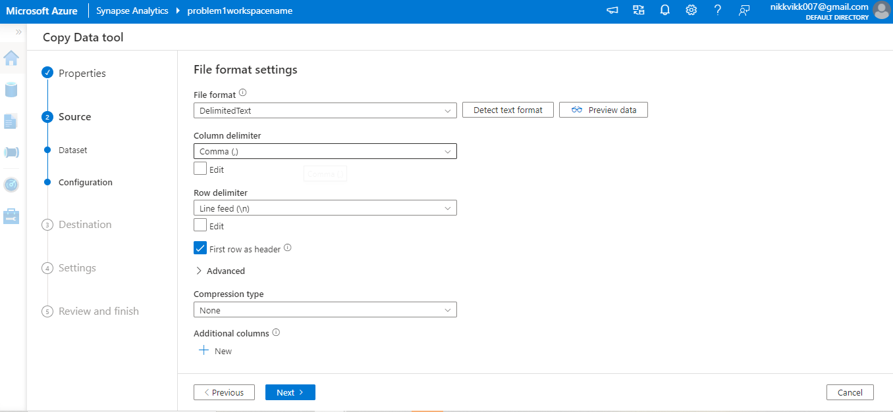
Formatting the content as required.

Slide 9
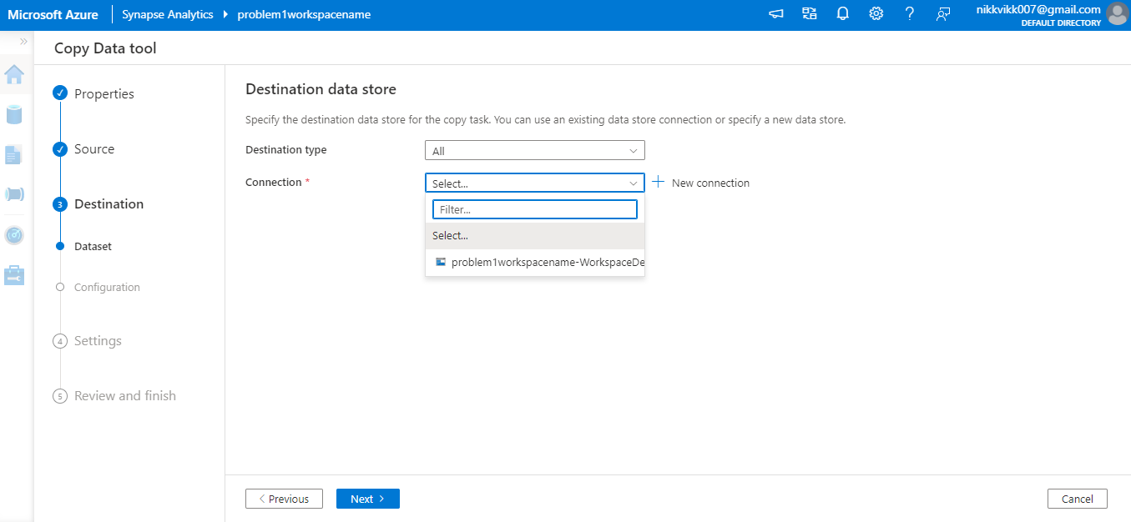
Giving a path where our data will be stored.

Slide 10
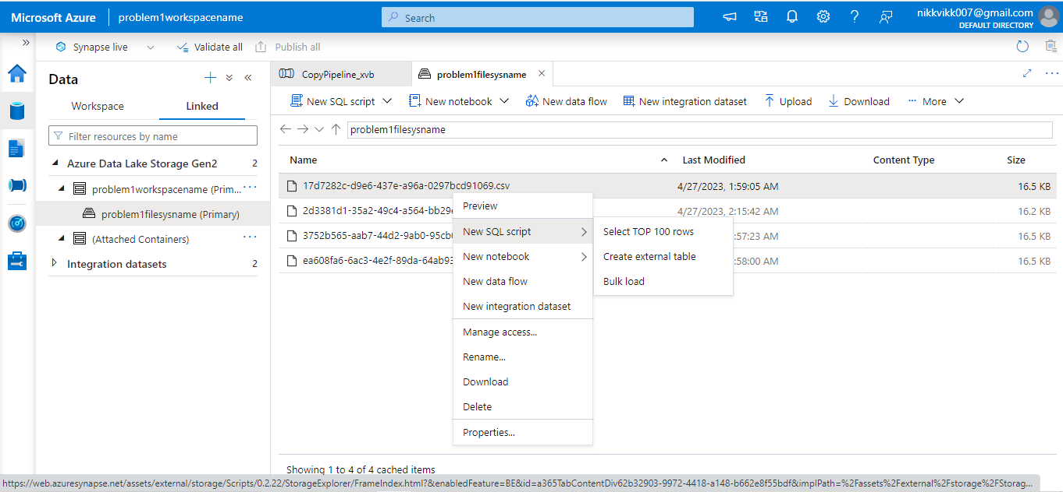
Data will be stored.

Slide 11
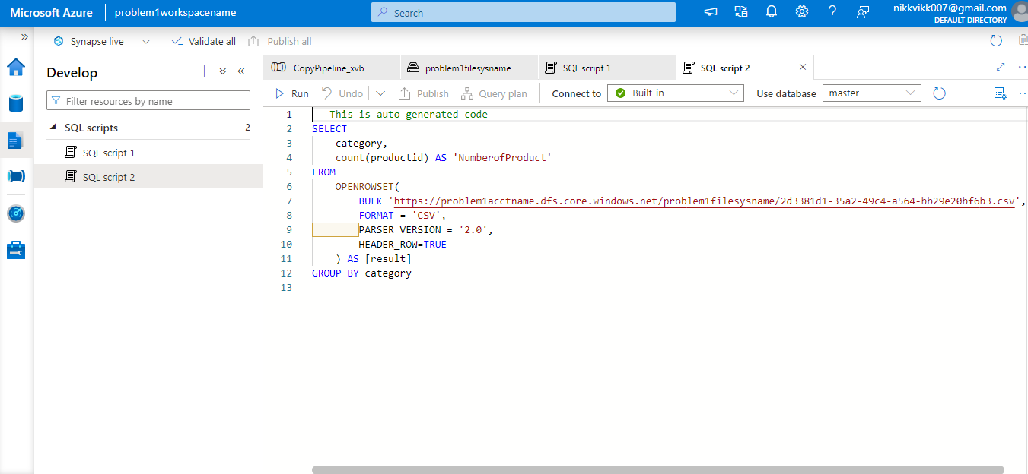
Querying the data as:
Group by Category and Number of product per category.

Slide 12
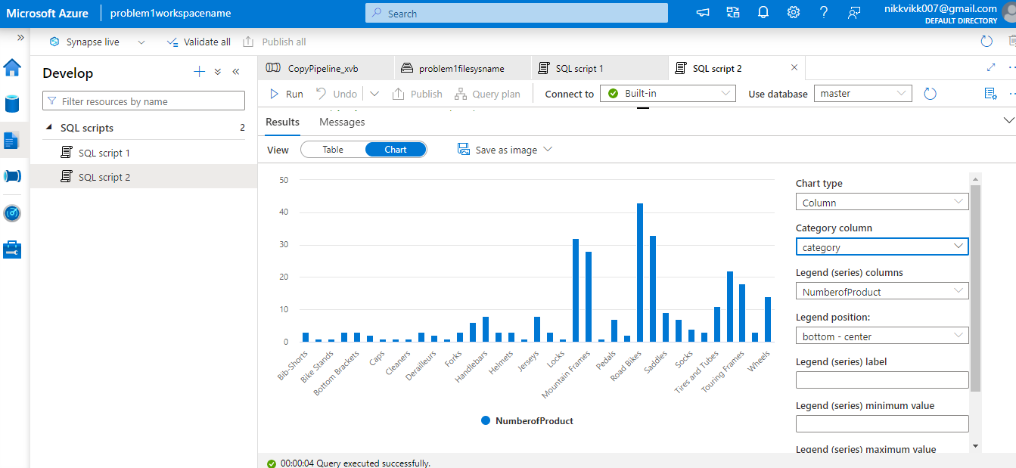
Visualizing the Output.

Slide 13
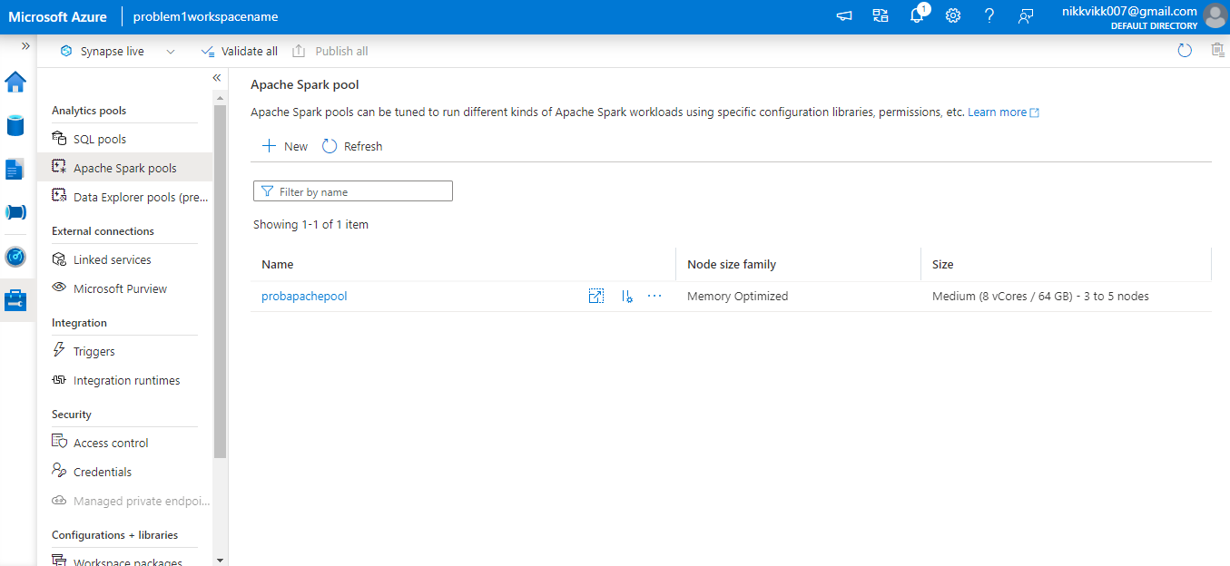
Creating a spark pool for analyzing the data

Slide 14
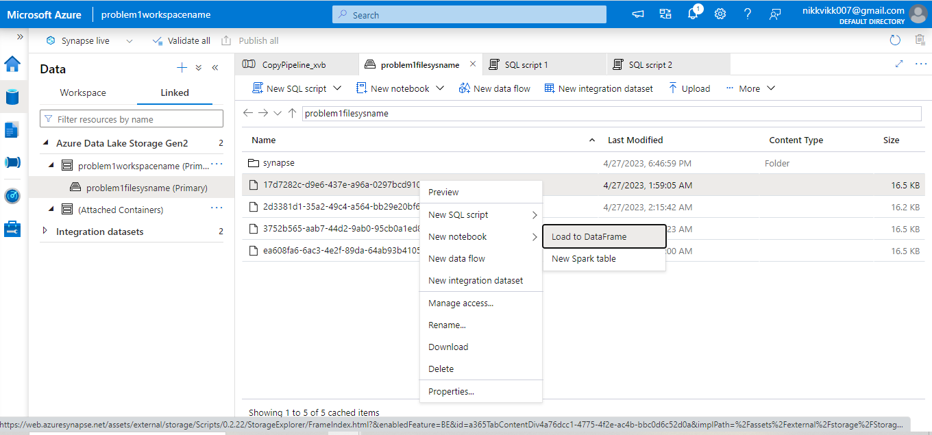
Loading the data for Pyspark.

Slide 15
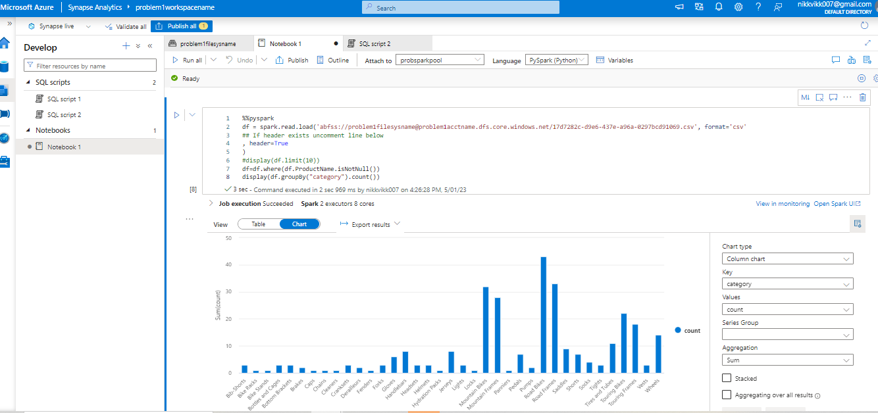
Querying the data as: Group by Category and Number of product per category.

Slide 16
THANK
YOU

