Slide 1

EXECUTIVE PRESENTATION
Autonomous Agent Architecture
Foundations of Self-Directing Intelligence
Prepared for Zenith Studio • Zenith Engine

Slide 2
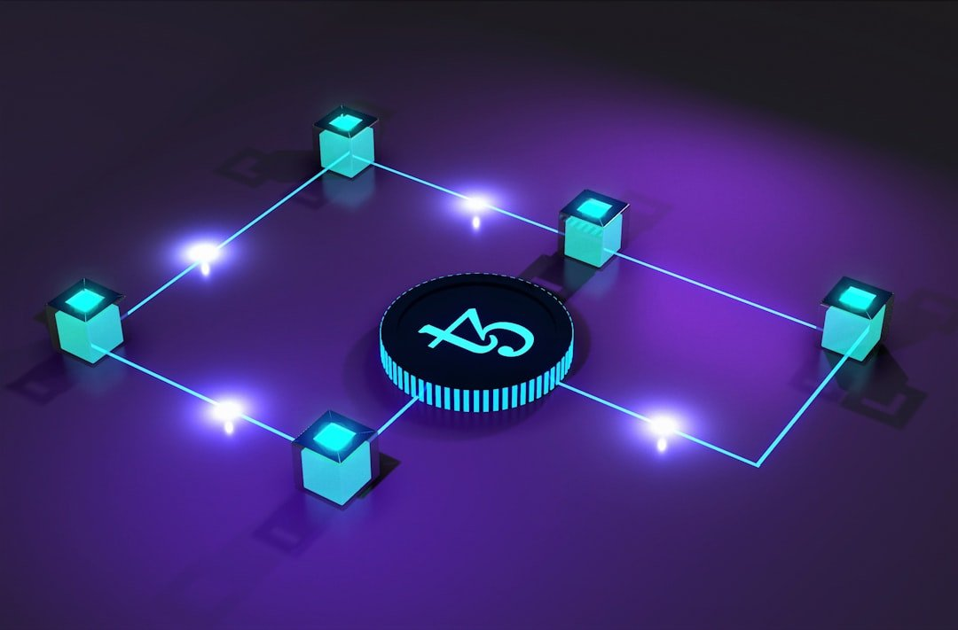
Autonomous Agent Architecture
Overview
• Key presentation takeaway point.
Notes:
Key takeaway for Autonomous Agent Architecture: Deliver with concise, confident executive presence.

Slide 3

Strategic Context & Opportunity
Market dynamics and foundational objectives
• Addressing critical industry shifts
• Capitalizing on high-growth segments
• Eliminating systemic friction
Notes:
Key takeaway for Strategic Context & Opportunity: Deliver with concise, confident executive presence.

Slide 4
Core Architecture & Capabilities
Precision Execution
• High-performance pipeline
• Sub-second response SLAs
Scalable Integration
• Zero-friction onboarding
• Enterprise security compliant
Continuous Optimization
• Real-time telemetry
• Automated feedback loops
Notes:
Key takeaway for Core Architecture & Capabilities: Deliver with concise, confident executive presence.

Slide 5

Performance & Impact Metrics
99.99%
3.5x
-45%
100%
Reliability SLA
Mission-critical uptime
Throughput Velocity
Accelerated cycle times
Operational Overhead
Cost reduction
Data Integrity
ACID compliance
Notes:
Key takeaway for Performance & Impact Metrics: Deliver with concise, confident executive presence.

Slide 6
Modern vs Legacy Paradigm
Legacy Infrastructure
Zenith Modern Engine
• Siloed, manual processes
• Static, rigid report templates
• Fragmented data silos
• Autonomous, integrated agent workflow
• Kinetic, interactive 3D presentations
• Unified graph memory architecture
Notes:
Key takeaway for Modern vs Legacy Paradigm: Deliver with concise, confident executive presence.

Slide 7

Execution Roadmap & Next Horizons
1
2
3
Phase 1: Foundation
Core engine rollout and baseline validation
Phase 2: Scale
Ecosystem integration and multi-team onboarding
Phase 3: Autonomy
Autonomous optimization and real-time synthesis
Notes:
Key takeaway for Execution Roadmap & Next Horizons: Deliver with concise, confident executive presence.

