Slide 1
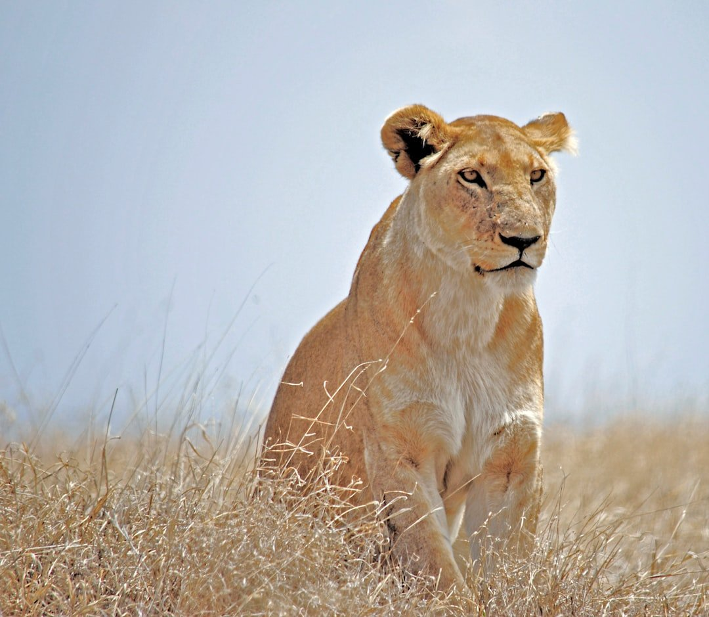
EXECUTIVE PRESENTATION
Lions: Monarchs of the Savanna
Ecology, Social Dynamics, and Conservation of Panthera leo
Prepared for Aditya • Zenith Engine

Slide 2
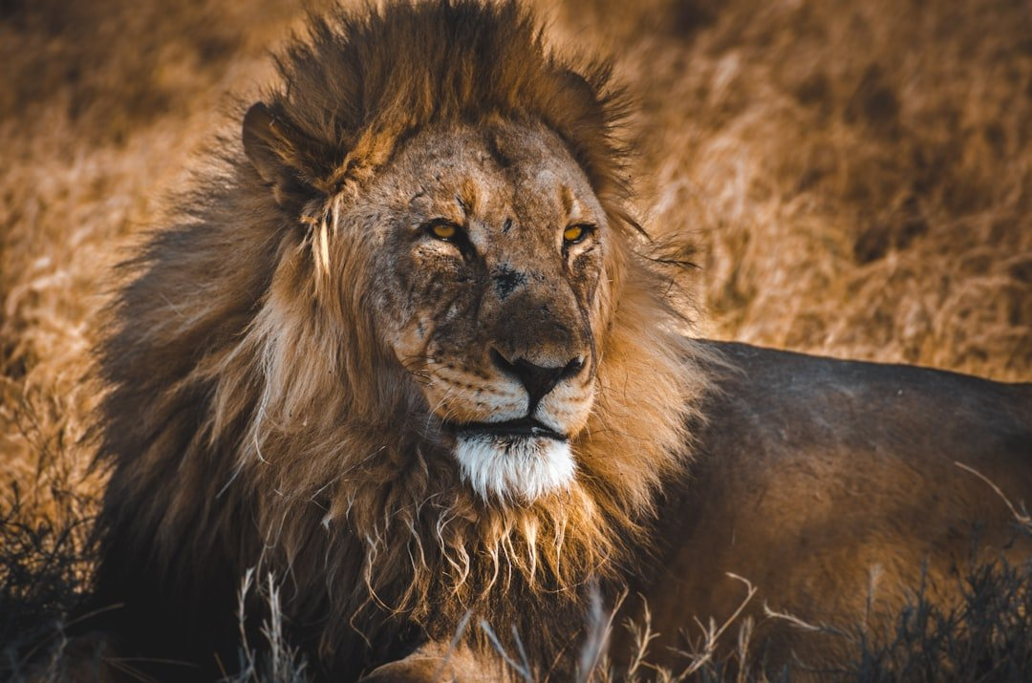
Panthera leo: The King of Beasts
Visual Highlight
• Scientific Name: Panthera leo
• Apex predator of sub-Saharan Africa and small relict population in India
• Symbol of strength, courage, and majesty across human civilization

Slide 3
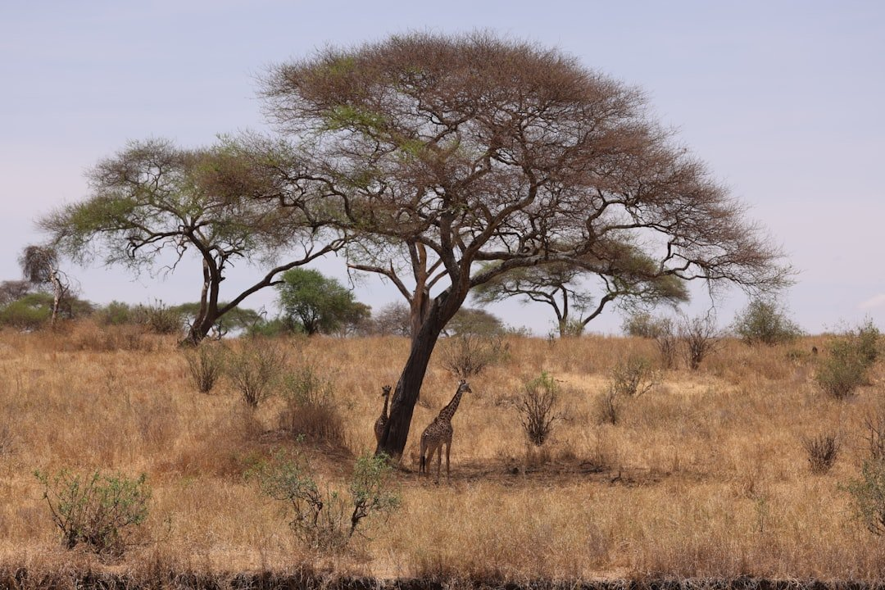
Social Architecture: The Lion Pride
Visual Highlight
• Only truly social cat species in the world
• Core unit: A pride consisting of 1-4 related adult males, multiple related females, and dependent cubs
• Female alliance: Females remain in their natal pride for life, cooperating on hunting and cub-rearing
• Coalition dynamics: Males form coalitions to conquer and defend prides from rival nomads

Slide 4
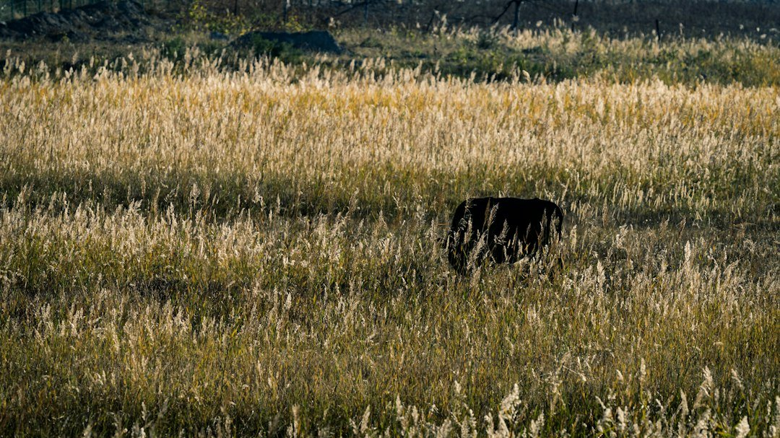
Hunting Ecology & Tactics
Hunting Ecology & Tactics
• Cooperative ambush predators specializing in medium to large ungulates (zebras, wildebeest, buffalo)
• Division of labor: Lionesses perform 85-90% of hunting through coordinated tactical flanking
• Night hunters: Superior rod-rich vision grants optimal nocturnal hunting advantage
• Apex status: Direct competition with hyenas, leopards, and wild dogs for territory and kills

Slide 5
Physiological Mastery & Adaptations
Data Insights & Metrics
• Exceptional sexual dimorphism: Males possess dense manes signaling hormonal vigor and genetic fitness
• Auditory power: Roars carry up to 5 miles (8 km) across the savanna to signal territory boundaries
• Athletic power: Capable of short bursts up to 50 mph (80 km/h) and leaps over 36 feet (11 meters)

Slide 6
Subspecies Diversity & Conservation Crisis
Subspecies & Taxonomy
Conservation Status

Slide 7
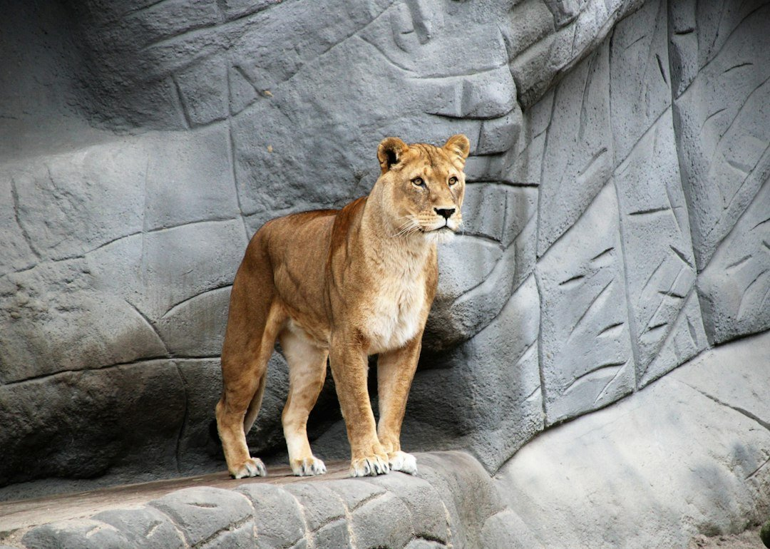
Status & Preservation
Visual Highlight
• Panthera leo leo (Barbary / Asian lion populations)
• Panthera leo melanochaita (Southern and East African lions)
• Drastic population collapse: Down to ~20,000–25,000 wild individuals across Africa
• Primary threats: Habitat fragmentation, human-wildlife conflict, and prey depletion

Slide 8
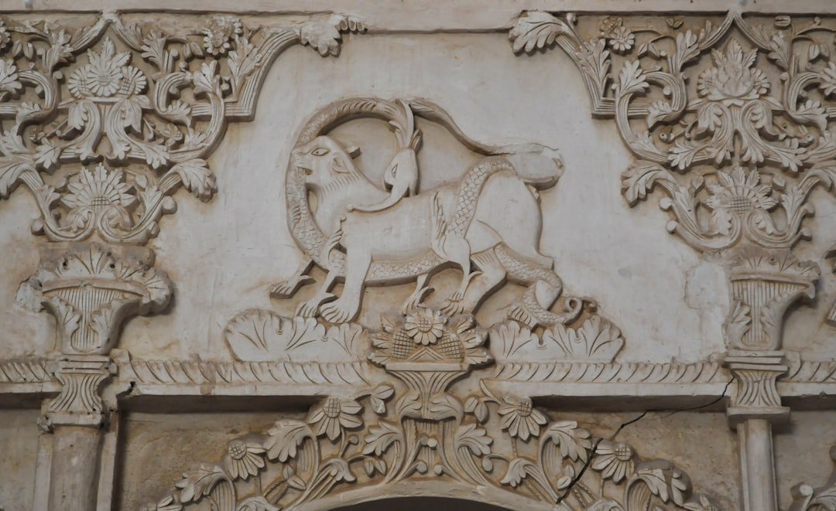
Historical Symbolism & Cultural Legacy
Visual Highlight
• Mesopotamian & Egyptian iconography: Associated with solar deities, royalty, and divine protection
• Heraldry & Architecture: Widespread emblem of sovereignty across European and Asian dynasties
• Cultural duality: Revered simultaneously as a symbol of noble justice and untamed terror

Slide 9
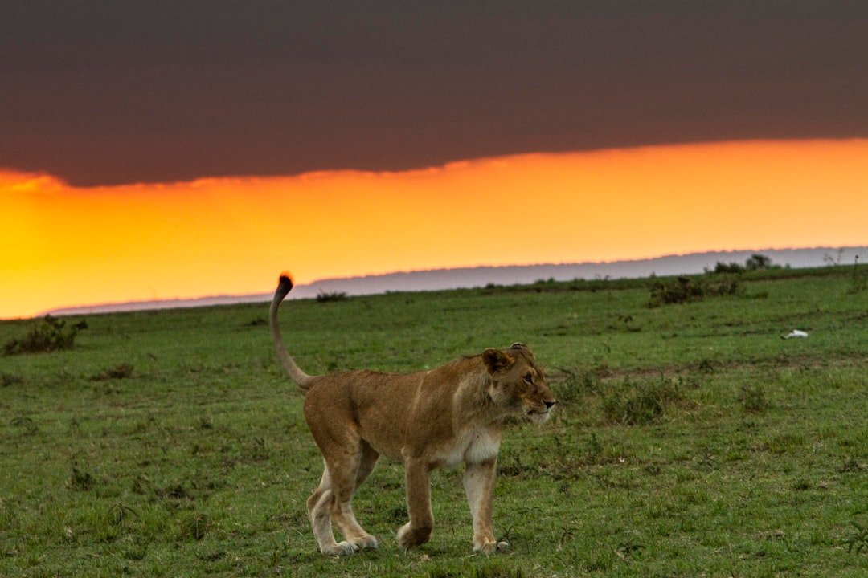
The Sovereign Future of Panthera leo
Visual Highlight
• Prides ensure generational survival through cooperative defensive strategies
• Conservation requires urgent landscape connectivity and anti-poaching measures
• Preserving the king of beasts secures entire savanna ecosystems

