Slide 1
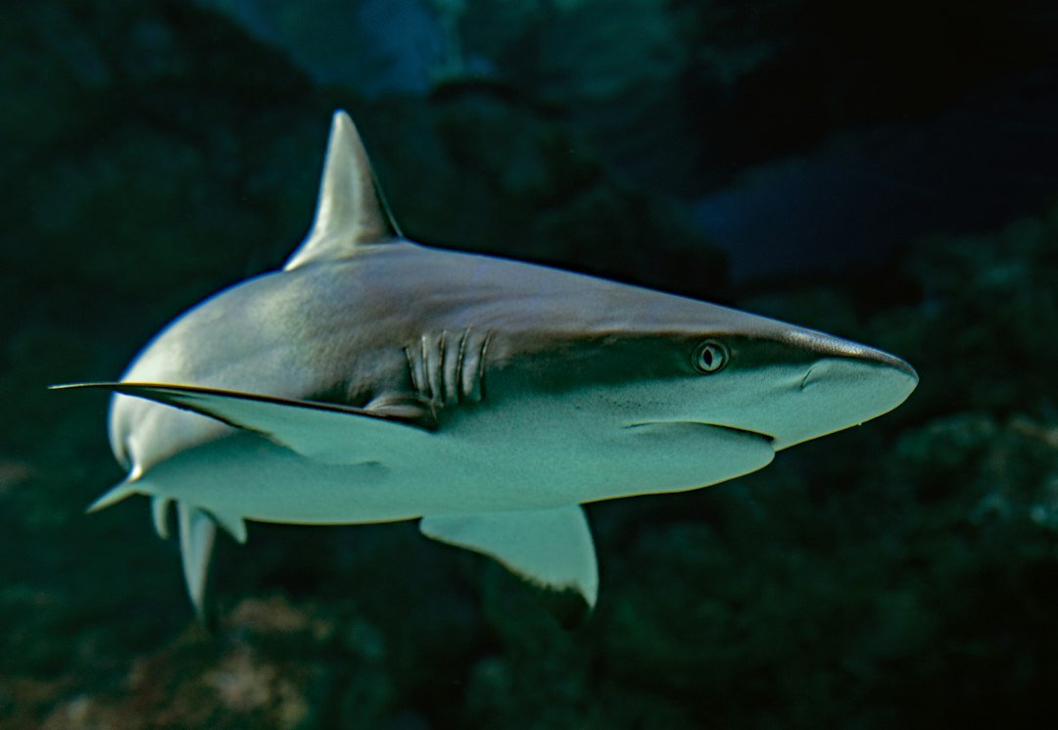
EXECUTIVE PRESENTATION
Sharks: Apex Predators of the Ocean
Masters of the Deep Ocean
Prepared for Zenith Studio • Zenith Engine

Slide 2

Introduction to Sharks
Ancient lineage and biological mastery
• Ancient lineage: over 400 million years old, predating trees and dinosaurs.
• Cartilaginous skeleton: lightweight and flexible, made of cartilage instead of bone.
• Diverse species: over 500 species ranging from the dwarf lanternshark to the massive whale shark.
Notes:
Key takeaway for Introduction to Sharks: Deliver with concise, confident executive presence.

Slide 3
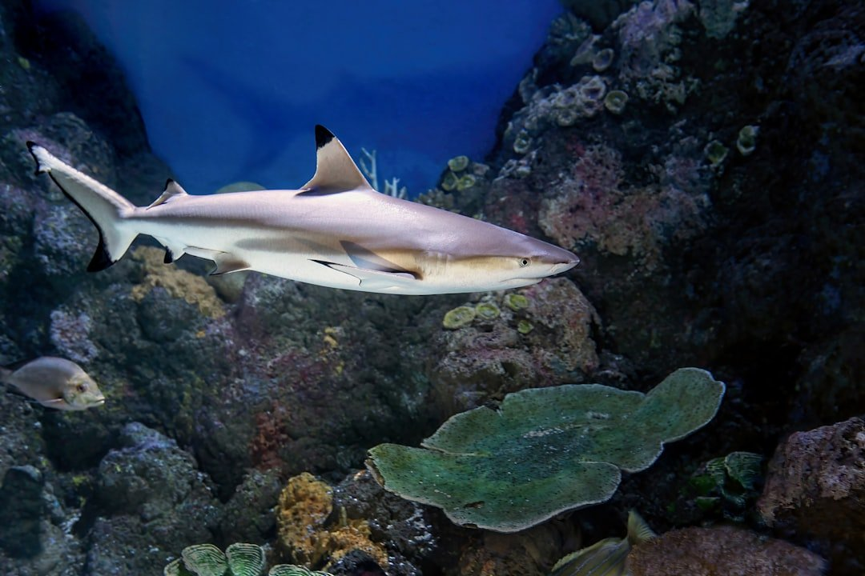
Apex Predators of the Marine Web
Pillars of ocean health
• Ecological balance: regulate prey populations and maintain healthy coral reefs and seagrass beds.
• Top-down control: prevent overgrazing by herbivores, preserving ocean carbon sinks.
• Keystone species: their presence indicates a thriving, resilient marine ecosystem.
Notes:
Key takeaway for Apex Predators of the Marine Web: Deliver with concise, confident executive presence.

Slide 4
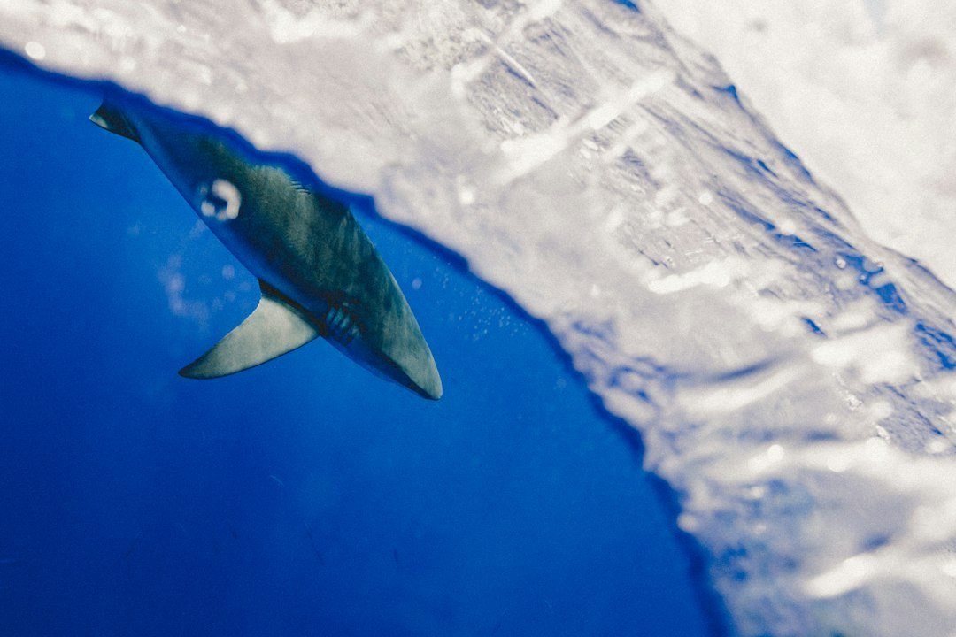
Senses and Superpowers
Evolutionary adaptations
• Ampullae of Lorenzini: specialized organs sensing weak electrical fields of prey.
• Incredible smell: can detect a single drop of blood in millions of gallons of water.
• Lateral line system: detects minute pressure changes and vibrations in the water column.
Notes:
Key takeaway for Senses and Superpowers: Deliver with concise, confident executive presence.

Slide 5

Conservation and Threats
100M+
500+
400M
Annual Mortalities
Estimated sharks killed yearly
Species Assessed
Diverse marine predators
Evolutionary Years
Predating dinosaurs
Notes:
Key takeaway for Conservation and Threats: Deliver with concise, confident executive presence.

