Slide 1

EXECUTIVE PRESENTATION
Synthesizer Sound Design & Analog Architecture
A Deep Dive into Subtractive Synthesis and Hardware Architecture
Prepared for Aditya • Zenith Engine

Slide 2
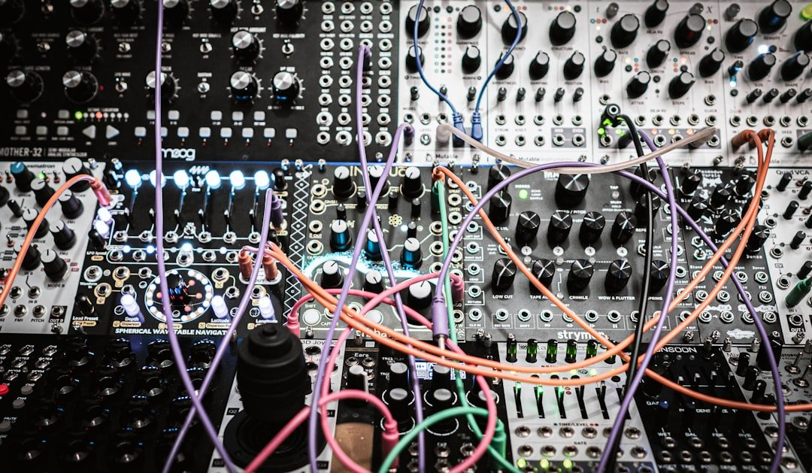
Voltage-Controlled Oscillators (VCOs)
The Acoustic Genesis of Electronic Sound
• Generate rich raw waveforms: Sawtooth, Square, Triangle, and Sine
• Control harmonic richness and core timbre at the source
• Super-saw and unison stacks for massive supersized leads
Notes:
Oscillators are the acoustic foundation of analog synthesis, generating raw harmonically rich or pure waveforms.

Slide 3
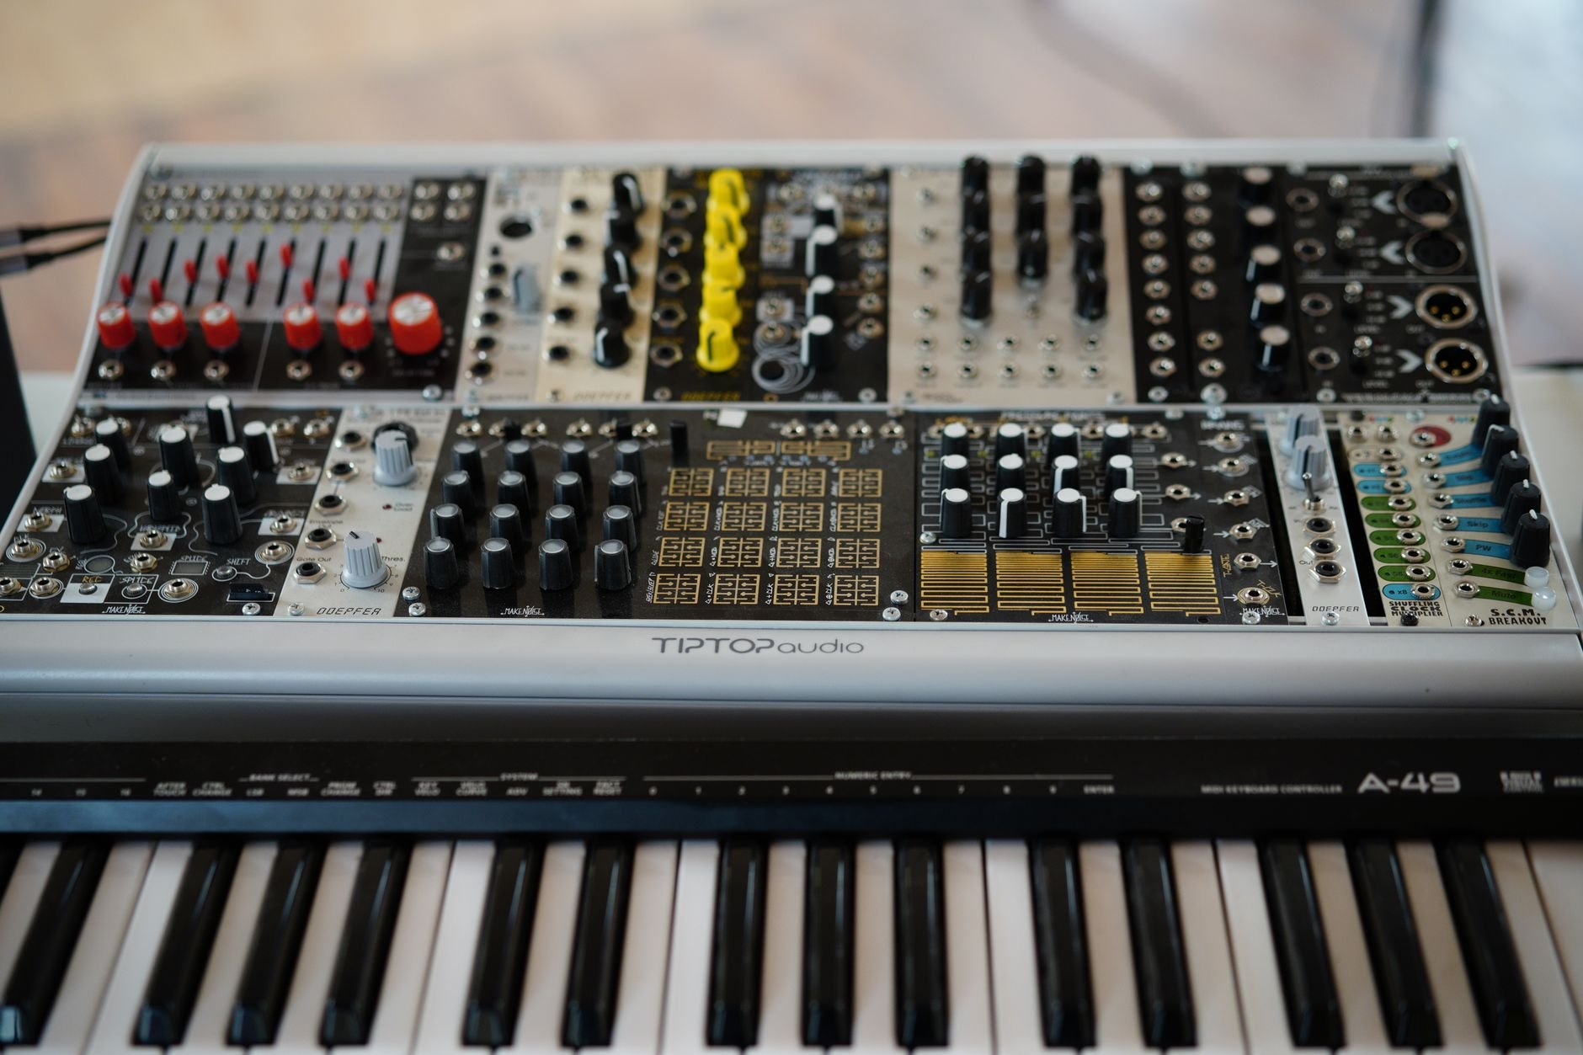
Voltage-Controlled Filters (VCFs)
Sculpting the Harmonic Spectrum
• Low-pass, high-pass, band-pass, and notch filter topologies
• Cutoff frequency shapes overall spectral brightness
• Resonance (Q) boosts frequencies around the cutoff for self-oscillation warmth
Notes:
Filters sculpt the harmonic spectrum by attenuating unwanted frequencies, giving analog gear its characteristic warmth.

Slide 4
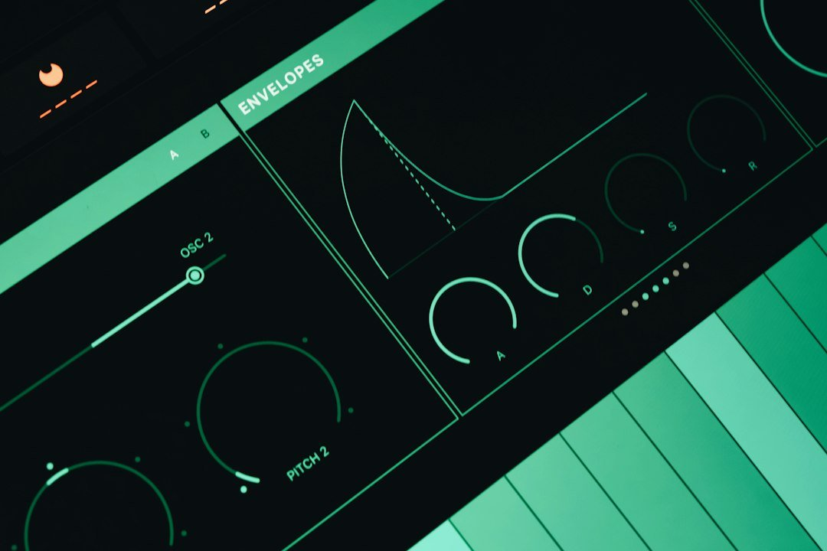
Envelopes & ADSR Architecture
Shaping Volume and Timbre Over Time
Notes:
ADSR envelopes control how synthesizer parameters evolve over time in response to note triggers.

Slide 5
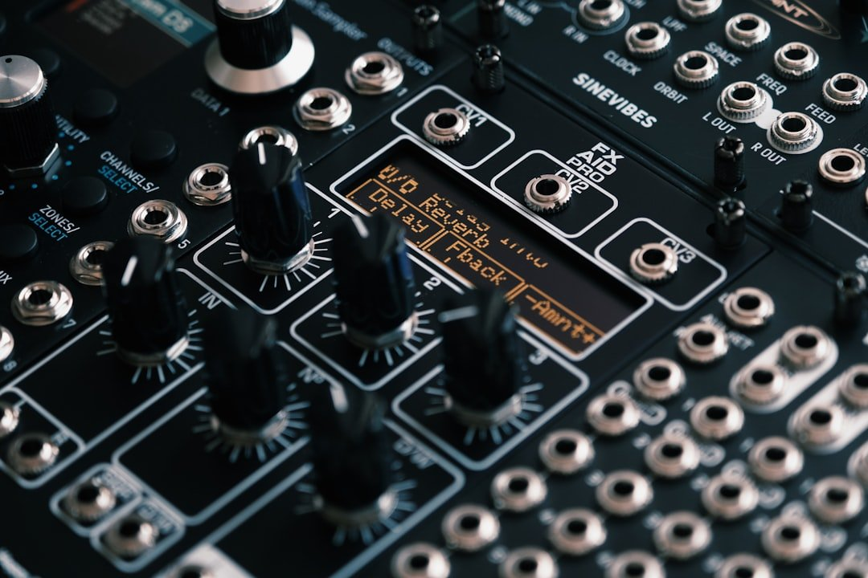
Low-Frequency Oscillators (LFOs)
Injecting Motion and Rhythmic Life
• Low-Frequency Oscillators operate below human hearing (0.1 Hz to 20 Hz)
• Modulate pitch (vibrato), filter cutoff (wah), or amplitude (tremolo)
• Free-running or tempo-synced modulation sources for rhythmic movement
Notes:
LFOs inject life and motion into static patches by rhythmically modulating synth parameters.

Slide 6

Patching & Modular Routing
CV / Audio
3.5mm / Banana
Infinite
Signal Routing
Voltage Control vs. Sound
Interconnectivity
Modular Patch Cables
Creative Freedom
Unrestricted Signal Paths
Notes:
Key takeaway for Patching & Modular Routing: Deliver with concise, confident executive presence.

