Slide 1
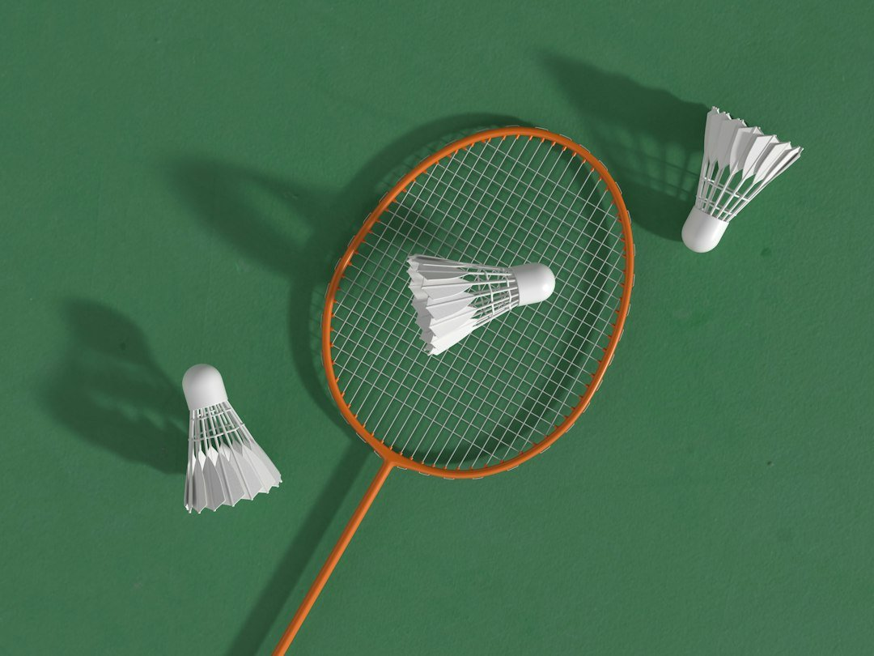
EXECUTIVE PRESENTATION
The Badminton Shuttlecock: Design and Dynamics
Prepared for Zenith Executive Studio • Zenith Engine

Slide 2

Introduction to the Shuttlecock
Visual Highlight
• Evolution of the Shuttlecock
• Feather vs. Synthetic
• Aerodynamic Profile
• Key Characteristics

Slide 3
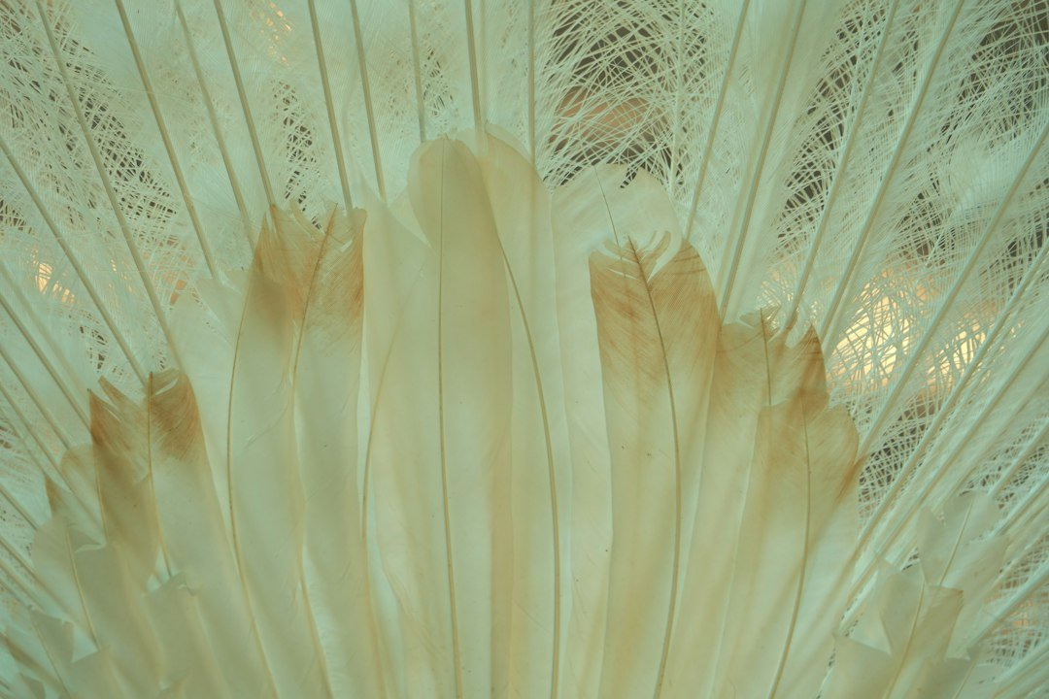
Anatomy of a Feather Shuttlecock
Anatomy of a Feather Shuttlecock
• Premium Goose/Duck Feathers
• Precision Cork Base
• Handcrafted Stability
• Flight Performance Standards

Slide 4
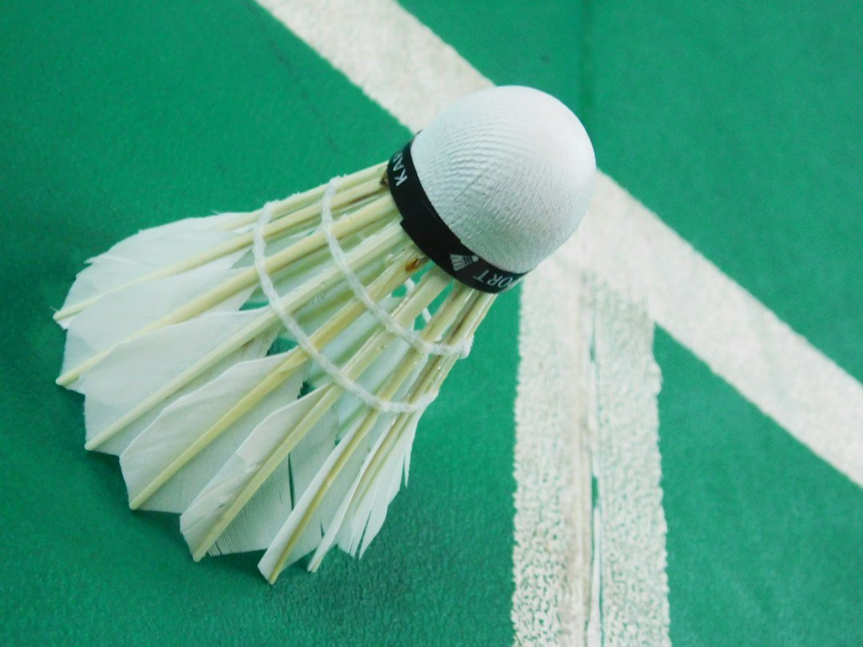
The Synthetic Alternative
Visual Highlight
• Nylon Durability
• Consistent Flight Trajectory
• Cost-Effectiveness for Practice
• Modern Material Innovations

Slide 5
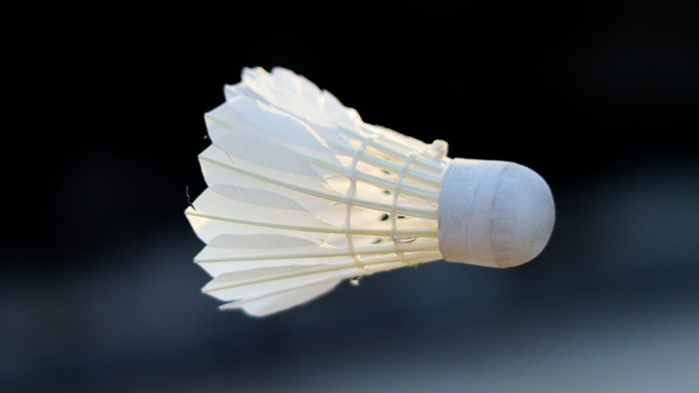
Aerodynamics & Flight Speed
100%
24/7
< 1s
Operational Efficiency
Automated workflow
Continuous Monitoring
Real-time alerts
Execution Latency
Instant feedback

