Slide 1
Week 1
Training AIS- C# Programs

Slide 2
C# Programs
The following Programs have been executed-
1. Insertion Sort
2. Stack- Generic
3. Queue- Generic
4. Binary Search Tree
5. Merge Sort
6. Breadth First Search
7. Depth First Search

Slide 3
Insertion Sort
This is a sorting technique which takes O(n*n) time complexity in worst case. In this each element is compared with element before it in the array and swapped if the criteria is sufficed.
The programs allows the user to decide whether he/she wants to sort the integer array in ascending or descending order.
Try catch is used to validate the inputs.
The code is available on github. The output is as follows-

Slide 4
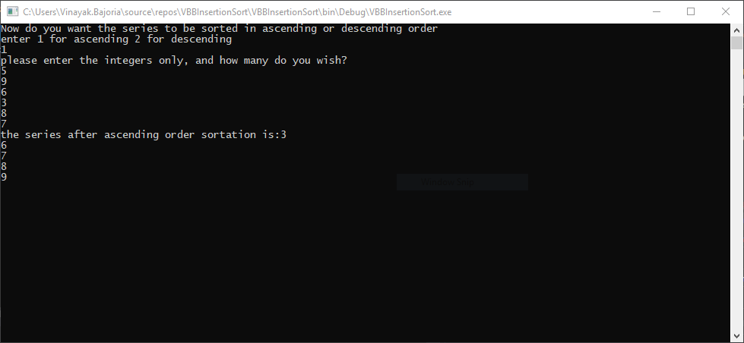
Insertion sort- ascending order

Slide 5
Stack-Generic
A Stack is list in which the new element is added at the top of stack and the deletion also happens at the top of stack. The following is a Generic implementation of Stack with pop and push operations available.

Slide 6
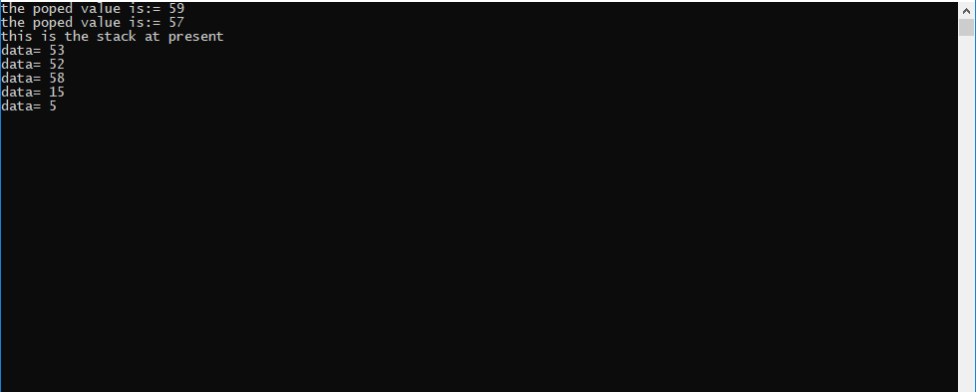
Stack-Generic Result

Slide 7
Queue-Generic
A Queue is list in which the insertion of the new element takes place at the end of list and the deletion takes place from the starting of the element. For insertion Enqueue is used and for Deletion Dequeue is used.

Slide 8
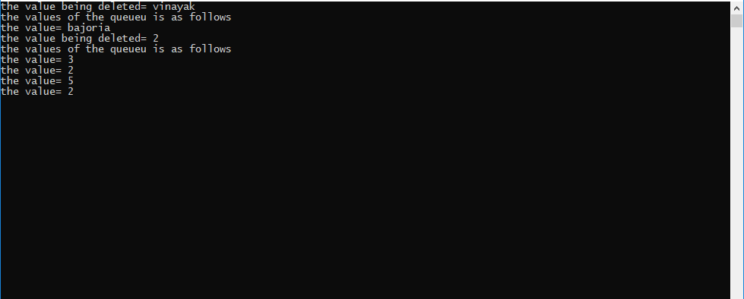
Queue- Generic implementation

Slide 9
Binary Search Tree
A binary Search tree works in O(logn) time when a search is to be performed. The following code allows to create the tree and traverse in three possible orders-
Preorder, Postorder and Inorder traversals.

Slide 10
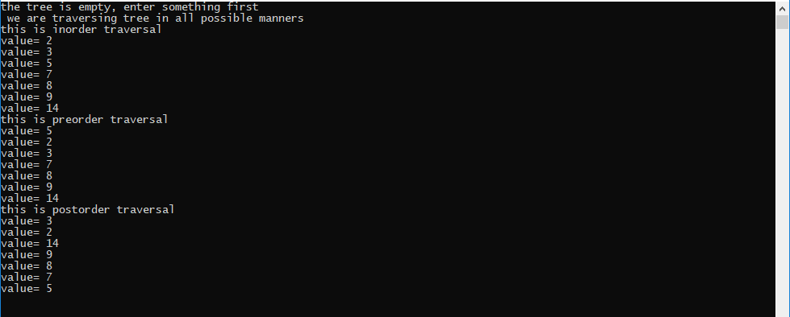
BST result

Slide 11
Merge Sort
The following sorting technique is based on the Divide and Conquer approach. The D&C divides the array till single elements are formed and then start merging them in ascending/descending order.

Slide 12
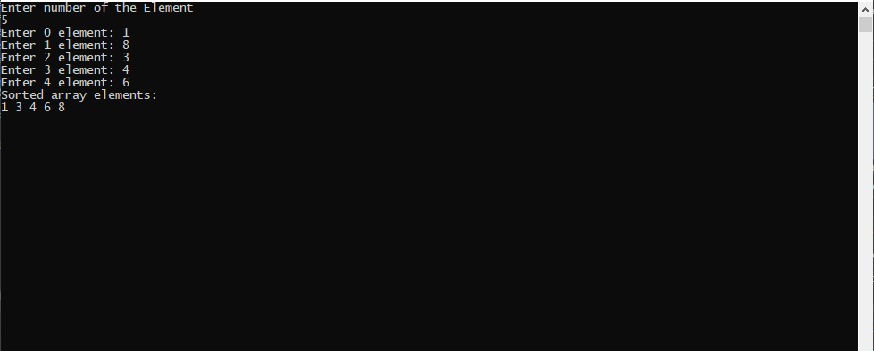
Merge Sort

Slide 13
Breath First Search
BFS is a search technique implemented in Trees and Graphs. They search/traverse the tree’s every level in left to right manner. The following implementation is in the Tree code itself as a BFS() function

Slide 14
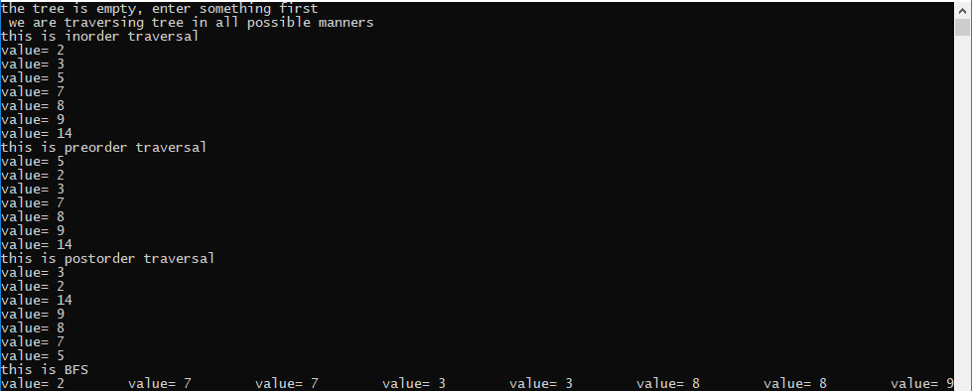
BFS result

Slide 15
Depth First Search
DFS uses a stack to traverse a tree/graph. It is slightly faster than BFS and also has lower space complexity.

Slide 16
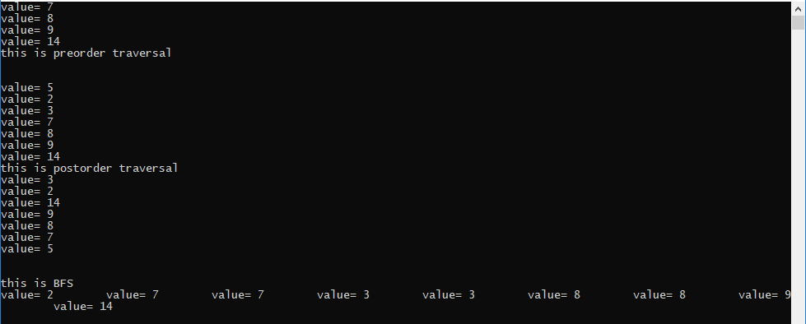
DFS result

Slide 17
Thank you

