Slide 1

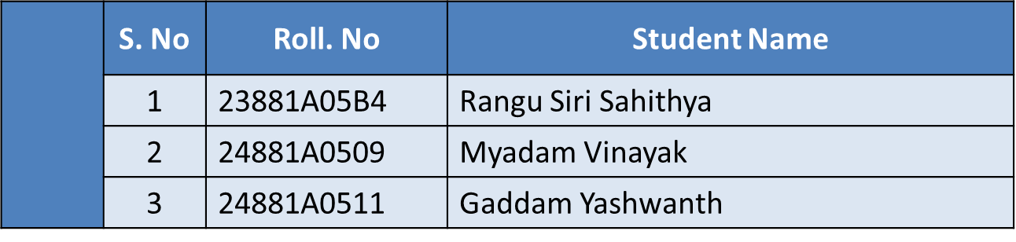
(AUTONOMOUS)
Affiliated to JNTUH, Approved by AICTE, Accredited by NAAC with A++ Grade, ISO 9001:2015 Certified
Kacharam, Shamshabad, Hyderabad – 501218, Telangana, India
Department of Computer Science and Engineering
Title: ResumeXAI - An Framework for Semantic Resume Analysis
BATCH ID : 23MPCS-B17
PHASE-I REVIEW-I
Guide Details
Mr. S. Surendhar
Assistant Professor
Department of CSE

Slide 2
Project Work Phase-I Review-1 Outlines
Main idea of the Project
Existing System Vs Proposed
Proposed Project Objectives
Proposed Project Outcomes
Process Model
Architectural Diagram
Software and Hardware Requirements
Summary of First Review
All the Best
DEPARTMENT OF CSE PROJECT WORK PHASE-I REVIEW-I

Slide 3
Main idea of the Project
Problem
Many resumes are rejected by ATS before recruiters review them.
Existing resume analyzers only provide an ATS score with little explanation.
Users cannot identify why their resumes perform poorly.
Proposed Solution
Develop an AI-powered Resume Analyzer that uses:
Large Language Models (LLMs)
Retrieval-Augmented Generation (RAG)
Natural Language Processing (NLP)
Explainable AI (XAI)
to analyze resumes, compare them with job descriptions, generate ATS scores, and visually explain the results.
DEPARTMENT OF CSE PROJECT WORK REVIEW

Slide 4
Existing System Vs Proposed
Existing System | Proposed System
Keyword-based ATS scoring | Semantic understanding using LLMs
Limited resume parsing | Intelligent information extraction
Basic recommendations | Personalized improvement suggestions
No explanation for scores | Explainable AI visualizations
Static ATS score | Interactive dashboards & heatmaps
Limited recruiter support | Resume-job matching & recruiter comparison
DEPARTMENT OF CSE PROJECT WORK REVIEW

Slide 5
Proposed Project Objectives
Objectives
Develop an AI-powered resume analyzer using NLP and LLMs.
Parse resumes in PDF and DOCX formats.
Compare resumes with job descriptions.
Calculate ATS compatibility score.
Identify missing skills and keyword gaps.
Generate personalized improvement suggestions.
Provide Explainable AI visualizations.
Assist recruiters in candidate screening.
DEPARTMENT OF CSE PROJECT WORK REVIEW

Slide 6
Proposed Project Outcomes
Expected Outcomes
Automated ATS-based resume evaluation.
Accurate resume-job matching.
Personalized AI recommendations.
Transparent ATS score explanation.
Better hiring decisions.
Improved resume quality.
Faster recruiter screening.
Enhanced trust using Explainable AI.
DEPARTMENT OF CSE PROJECT WORK REVIEW

Slide 7
Process Model
DEPARTMENT OF CSE PROJECT WORK REVIEW

Slide 8
Architectural Diagram
DEPARTMENT OF CSE PROJECT WORK REVIEW

Slide 9
Software & Hardware Requirements
Software Requirements
Python
FastAPI
React.js
PostgreSQL
pgvector
LangChain
OpenAI/Gemini LLM
VS Code
Git & GitHub
Docker (Optional)
DEPARTMENT OF CSE PROJECT WORK REVIEW

Slide 10
Software & Hardware Requirements
Hardware Requirements
Intel Core i5/i7 Processor
8 GB RAM (Minimum)
256 GB SSD
Internet Connection
Windows/Linux
DEPARTMENT OF CSE PROJECT WORK REVIEW

Slide 11
Summary of First Review
Work Completed
✔ Literature Survey
✔ Problem Statement
✔ Objectives
✔ System Design
✔ Technology Selection
✔ Architecture Design
✔ Process Flow
✔ Research Gap Identification
DEPARTMENT OF CSE PROJECT WORK REVIEW

Slide 12
Thank You
DEPARTMENT OF CSE PROJECT WORK REVIEW

