Slide 1
ADVANCED MACHINE LEARNING · RESEARCH PAPER PROJECT 23
Induction of Decision Trees
ID3 from scratch on 7 real datasets: information gain, depth control and noise
J. R. Quinlan (1986), Machine Learning 1(1): 81–106 · doi:10.1007/BF00116251
GROUP
Vinayak Singh (22MA25005) · Debjit Mondal (22MA25009) · Keya Battu (22MA25006) · Gurkirat Singh (22MA25015)
Nikhil Nagar (22MA25001) · Mayank Fenin (22MA25002) · Atharv Sable (21MA20001)
Code and data: github.com/Vinayak069/id3-decision-trees
MA30235 / MA60215 · Department of Mathematics, IIT Kharagpur · November 2026

Slide 2
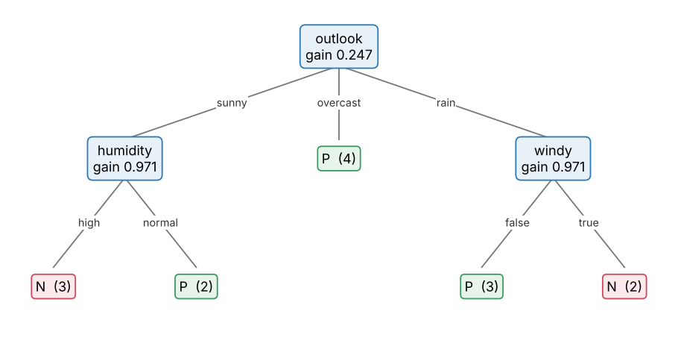
THE PROBLEM
Learn a small tree that classifies objects from their attributes
outlook | temperature | humidity | windy | class
sunny | hot | high | false | N
sunny | hot | high | true | N
overcast | hot | high | false | P
rain | mild | high | false | P
rain | cool | normal | false | P
rain | cool | normal | true | N
overcast | cool | normal | true | P
sunny | mild | high | false | N
sunny | cool | normal | false | P
rain | mild | normal | false | P
sunny | mild | normal | true | P
overcast | mild | high | true | P
overcast | hot | normal | false | P
rain | mild | high | true | N
• Induction task: given objects described by categorical attributes and a class, build a rule that classifies unseen objects.
• Top-down divide and conquer: pick a test, split the objects, recurse until every subset is one class.
• Occam's razor: among trees that fit, prefer the simplest. ID3 gets there greedily, without searching all trees.
Table 1 of the paper: 14 Saturday mornings, P = suitable, N = not.
Quinlan (1986), Induction of Decision Trees · ID3 from scratch
2 / 8

Slide 3
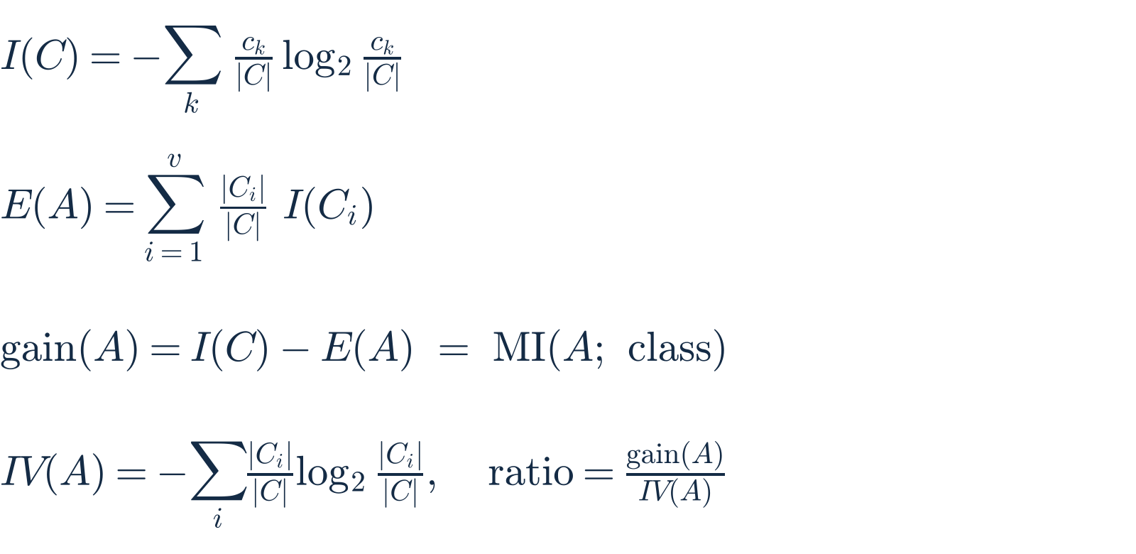
THE KEY EQUATION
ID3 splits on the attribute that carries most information about the class
Attribute | gain (ours) | gain (paper) | IV | gain ratio | χ² p-value
outlook | 0.247 | 0.246 | 1.577 | 0.156 | 0.170
temperature | 0.029 | 0.029 | 1.557 | 0.019 | 0.752
humidity | 0.152 | 0.151 | 1.000 | 0.152 | 0.094
windy | 0.048 | 0.048 | 0.985 | 0.049 | 0.334
• I(9, 5) = 0.940 bits; outlook wins with 0.247 bits, so it becomes the root. Our values match the paper to its rounding.
• Gain is mutual information (paper footnote 3): ID3 asks which test most reduces uncertainty about the class.
• Bias: gain rewards attributes with many values. The gain ratio divides by IV(A) (Section 7): outlook 0.156 vs humidity 0.152.
Worked root split: E(outlook) = 5/14 · 0.971 + 4/14 · 0 + 5/14 · 0.971 = 0.694
gain(outlook) = 0.940 − 0.694 = 0.246 bits (0.2467 unrounded)
Quinlan (1986), Induction of Decision Trees · ID3 from scratch
3 / 8

Slide 4
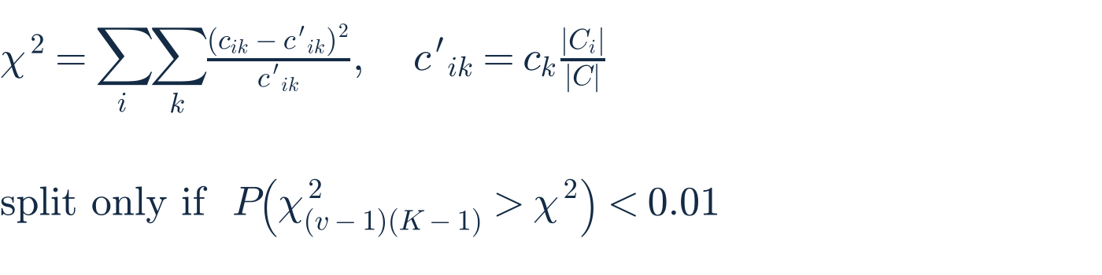
METHOD
We implemented every mechanism in the paper, then tested it
Section 4 · Tree + window
Section 5 · Noise
Section 6 · Unknown values
• Recursive split on max gain; each attribute used once per path
• Empty branch → majority class of parent
• Windowing: grow on a sample, add misclassified objects, repeat
• Impure leaves are labelled with the majority class
• χ² test of independence: no split unless irrelevance is rejected (α = 1 % in the paper; we sweep α)
• Gain: spread unknowns over values ∝ |Cᵢ|, then discard them
• Classify: a token goes down every branch with weight ratioᵢ; class votes are summed
Section 7 · Extensions
Our additions
• Gain ratio among attributes with ≥ average gain
• Binary subset tests A ∈ S (ASSISTANT)
• Continuous attributes: threshold at midpoints
• max_depth for the depth study; K ≥ 2 classes
• 15 unit tests of the paper's claims
• Corrected paired t-test (Nadeau–Bengio)
Pure Python / NumPy, about 500 lines (id3.py). sklearn is used only for the CART baseline.
Quinlan (1986), Induction of Decision Trees · ID3 from scratch
4 / 8

Slide 5
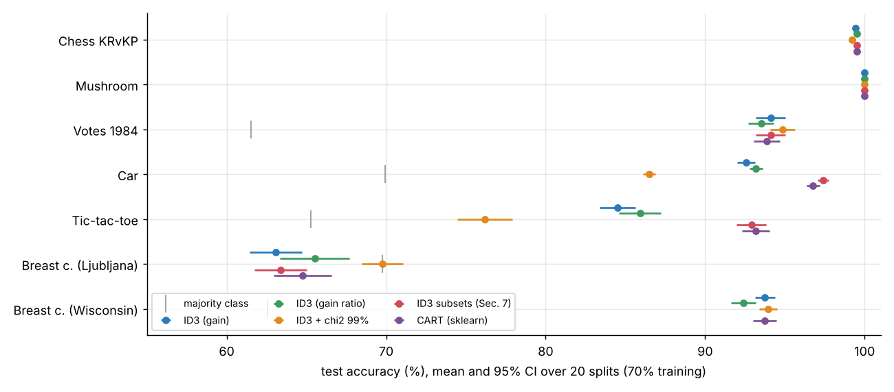
REAL DATA AND BENCHMARK
On 7 real datasets ID3 with subset tests matches CART
Dataset | Objects | Attrs | Classes | '?' values
Chess KRvKP | 3 196 | 36 | 2 | 0
Mushroom | 8 124 | 22 | 2 | 2480
Votes 1984 | 435 | 16 | 2 | 392
Car Evaluation | 1 728 | 6 | 4 | 0
Tic-tac-toe | 958 | 9 | 2 | 0
Breast c. Ljubljana | 286 | 9 | 2 | 9
Breast c. Wisconsin | 569 | 30 | 2 | 0
Sim: known tree | 2 000 | 10 | 2 | 0
Sim + id_code | 600 | 11 | 2 | 0
UCI data (GitHub mirrors) + scikit-learn; simulated sets only for sanity checks.
• Fragmentation is ID3's weak spot: on Car and Tic-tac-toe, multi-way ID3 trails CART by 4–9 points. The paper's own binary subset tests close the gap (+4.8 and +8.4 points, 20/20 and 20/20 wins, p < 0.001).
• Clean concepts (chess, mushroom): all variants reach 99.4–100 %; differences are not significant.
• Noisy medical data (Ljubljana): the χ² test gains 6.7 points over the full tree (p = 0.04) with 8 nodes instead of 224, but only reaches the majority-class rate: the attributes carry little signal.
Quinlan (1986), Induction of Decision Trees · ID3 from scratch
5 / 8

Slide 6
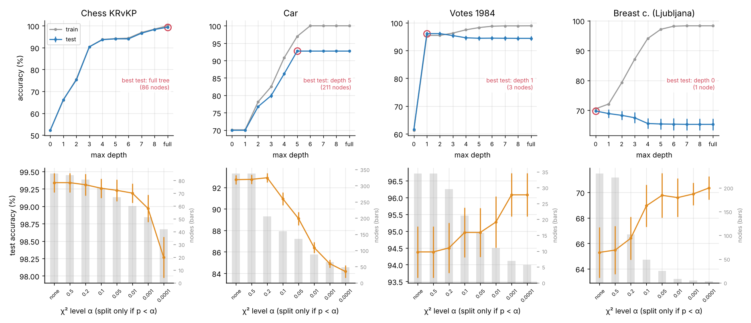
EXPERIMENT 1 · DEPTH AND Χ² LEVEL
Depth control: shallow trees win on noisy data, full trees on clean data
How to read it
• Top: max_depth 0 … 8 and the full tree (train grey, test blue)
• Bottom: χ² level α from 'none' to 0.0001; bars = tree size
• 20 stratified 70/30 splits, 95 % CI
• Ljubljana: best at depth 0, the majority class (69.8 %); the full tree has 231 nodes and 65.3 %
• Clean concepts: chess and car need deep trees (chess depth 3: 90.4 %, full: 99.3 %); a strict χ² test costs car 8.6 points.
• Noisy concepts: votes is best at depth 1, one question about physician-fee-freeze (96.1 % vs 94.4 %, 3 nodes vs 34). Training accuracy keeps rising while test accuracy falls: overfitting.
Quinlan (1986), Induction of Decision Trees · ID3 from scratch
6 / 8

Slide 7
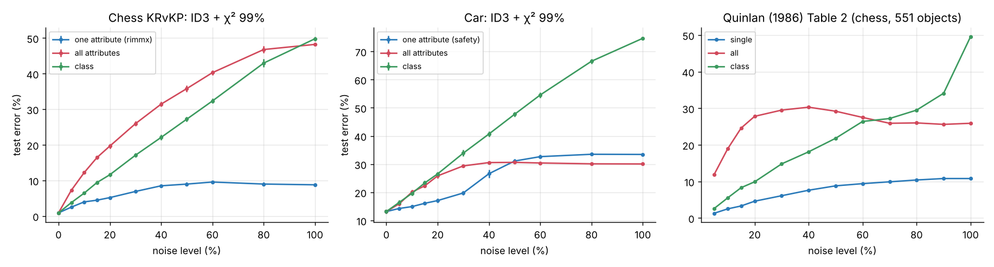
EXPERIMENT 2 · NOISY INPUTS
Noise on real data reproduces the shapes of the paper's Table 2
• Class noise grows almost linearly to random guessing: chess 49.8 % at 100 %, the paper 49.6 %.
• Noise in all attributes on car levels off at the majority-class error (30.1 %) once χ² finds nothing relevant, as in the paper.
• One attribute (the root attribute) saturates: chess rises only to 8.8 %, the paper 10.8 %.
Why χ² matters (Section 5)
• Probabilistic leaf errs 2pn/(p+n)²; majority leaf n/(p+n), smaller when p > n
• Ablation on chess with 20 % class noise: without χ² 1160 nodes and 20.5 % error; with χ² 53 nodes and 11.6 %
Quinlan (1986), Induction of Decision Trees · ID3 from scratch
7 / 8

Slide 8
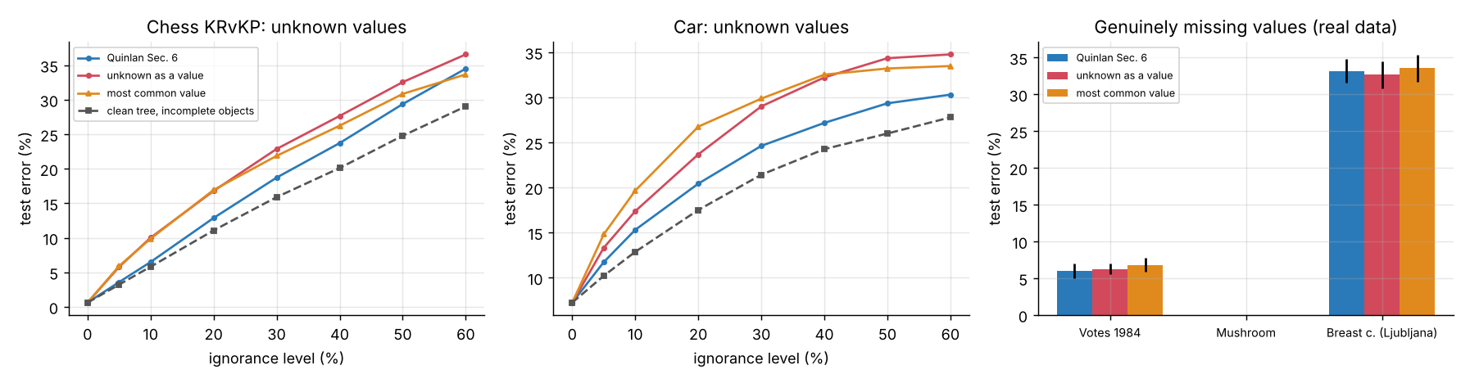
EXPERIMENT 3 AND CONCLUSIONS
Unknown values, gain bias and what we learned
• Unknowns: at 30 % ignorance on car, Quinlan's rule errs 24.6 % vs 29.0 % ('?' as a value) and 29.9 % (mode). On genuinely missing data the three tie.
• Gain bias: an irrelevant 150-valued id_code enters the gain tree (171 nodes, 95.5 %); the gain ratio never uses it (13 nodes, 100 %).
• Windowing: 304 of 2 237 chess objects gave a tree with zero training errors.
Conclusions
• Code reproduces the paper's numbers and recovers a known tree
• Depth limits / χ² help noisy data, hurt clean data
• Subset tests fix multi-way fragmentation
• github.com/Vinayak069/id3-decision-trees
Quinlan (1986), Induction of Decision Trees · ID3 from scratch
8 / 8

