Slide 1
Software Quality Assurance Fundamentals
Prepared by D.A.Sarwate DATE: 02/02/2026

Slide 2
Definition of Quality
Quality is the degree to which a product meets customer requirements
It ensures the product is fit for use
In software, quality means:
Correct functionality
Reliability
Efficiency
User satisfaction

Slide 3
Quality Assurance (QA)
QA is a process-oriented approach
Focuses on preventing defects
Ensures proper standards, methods, and processes are followed
Applied throughout the Software Development Life Cycle (SDLC)
Examples:
Process audits
Reviews
Standard definition

Slide 4
Quality Control (QC)
QC is a product-oriented approach
Focuses on identifying and correcting defects
Ensures the final product meets quality standards
Mainly involves testing activities
Examples:
Software testing
Bug detection
Code inspection

Slide 5
Difference between QA and QC
uality Assurance (QA) | Quality Control (QC)
Focus on process | Focus on product
Prevents defects | Detects defects
Proactive approach | Reactive approach
Process-oriented | Product-oriented
Done during development | Done after development

Slide 6
Software Quality Assurance (SQA) Challenges
Changing customer requirements
Tight project deadlines
Limited resources and tools
Complex software systems
Poor documentation
Integration issues
Rapid technological changes

Slide 7
Software Quality Assurance Challenges
Software Quality Assurance ensures high-quality software
SQA faces many challenges due to:
Rapid technology changes
Complex systems
High customer expectations
Changing Requirements
Time Constraints
Limited Resources
Increasing Software Complexity
Rapid Technological Changes

Slide 8
Software Quality Assurance, SQA Planning &Standards (ISO 9000)
Software quality is essential for customer satisfaction
Software Quality Assurance (SQA) ensures quality throughout development
SQA focuses on process improvement and defect prevention

Slide 9
Objective of Software Quality Assurance (SQA)
Ensure high-quality software
Prevent defects early
Improve development processes
Reduce maintenance cost
Increase customer satisfaction

Slide 10
Software Quality Assurance (SQA)
SQA is a systematic approach to ensure software quality
Ensures compliance with standards and procedures
Applied across the Software Development Life Cycle (SDLC)
Objectives of SQA
Ensure high-quality software
Prevent defects early
Improve development processes
Reduce maintenance cost
Increase customer satisfaction

Slide 11
SQA Activities
Quality planning
Process definition and documentation
Reviews and audits
Software testing
Metrics collection and analysis
SQA Planning
SQA Plan defines how quality will be managed
Prepared at the start of the project
Serves as a guideline for quality-related activities

Slide 12
Contents of an SQA Plan
Quality objectives and standards
Organizational roles and responsibilities
Review and audit schedules
Testing strategies and tools
Quality metrics and reporting
SQA Standards
Standards provide guidelines for quality assurance
Help maintain consistency and reliability
Common standards:
ISO 9000
IEEE standards
CMMI

Slide 13
ISO 9000 Standard
ISO 9000 is an international quality management standard
Focuses on process quality
Applicable to software and other industries
Principles of ISO 9000
Customer focus
Leadership
Process approach
Continuous improvement
Evidence-based decision making

Slide 14
Benefits of ISO 9000
Improved software quality
Reduced errors and rework
Better customer satisfaction
Global recognition
Improved organizational efficiency

Slide 16
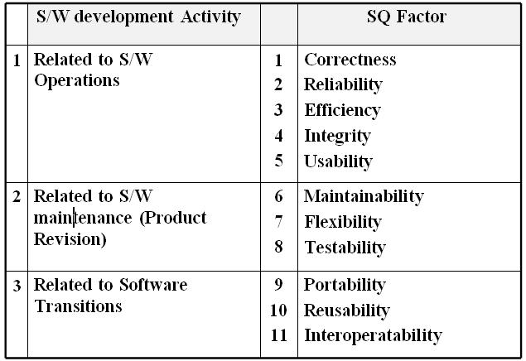
1.5 Software Quality factors:-

Slide 17
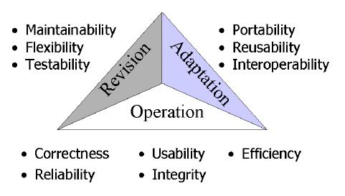

Slide 18
Software Reliability & Reliability Measurement Factors:-
Reliability metrics are used to quantitatively expressed the reliability of the software product. The option of which metric is to be used depends upon the type of system to which it applies & the requirements of the application domain.

Slide 19
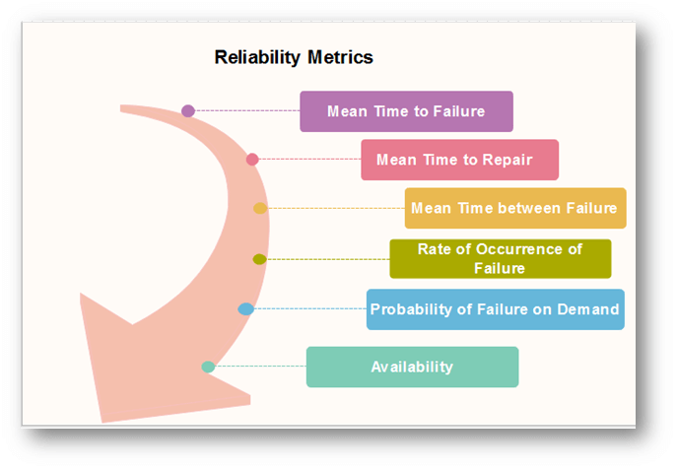

Slide 20
Mean Time to Failure (MTTF):-
MTTF is described as the time interval between the two successive failures. An MTTF of 200 mean that one failure can be expected each 200-time units. The time units are entirely dependent on the system & it can even be stated in the number of transactions. MTTF is consistent for systems with large transactions.
For example, It is suitable for computer-aided design systems where a designer will work on a design for several hours as well as for Word-processor systems.
To measure MTTF, we can evidence the failure data for n failures. Let the failures appear at the time instants t₁,t₂.....t_{n}.

Slide 21
Mean Time to Repair (MTTR) :-
Once failure occurs, some-time is required to fix the error. MTTR measures the average time it takes to track the errors causing the failure and to fix them.
Mean Time Between Failure (MTBR) :-
We can merge MTTF & MTTR metrics to get the MTBF metric.
MTBF = MTTF + MTTR
Thus, an MTBF of 300 denoted that once the failure appears, the next failure is expected to appear only after 300 hours. In this method, the time measurements are real-time & not the execution time as in MTTF.

Slide 22
Rate of occurrence of failure (ROCOF):-
It is the number of failures appearing in a unit time interval. The number of unexpected events over a specific time of operation. ROCOF is the frequency of occurrence with which unexpected role is likely to appear. A ROCOF of 0.02 mean that two failures are likely to occur in each 100 operational time unit steps. It is also called the failure intensity metric.

Slide 23
Probability of Failure on Demand (POFOD):-
POFOD is described as the probability that the system will fail when a service is requested. It is the number of system deficiency given several systems inputs.
POFOD is the possibility that the system will fail when a service request is made.
A POFOD of 0.1 means that one out of ten service requests may fail.POFOD is an essential measure for safety-critical systems. POFOD is relevant for protection systems where services are demanded occasionally.

Slide 24
Availability (AVAIL)
Availability is the probability that the system is applicable for use at a given time. It takes into account the repair time & the restart time for the system. An availability of 0.995 means that in every 1000 time units, the system is feasible to be available for 995 of these. The percentage of time that a system is applicable for use, taking into account planned and unplanned downtime. If a system is down an average of four hours out of 100 hours of operation, its AVAIL is 96%.

Slide 25
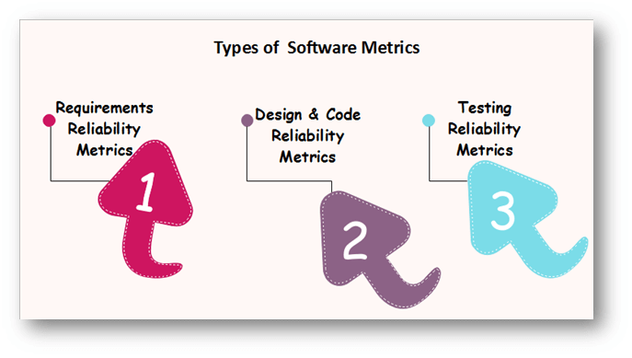

Slide 26
Reliability Measures:
What is reliability?
It is the probability of running a computer program without any failure in a specified environment for a specified time period.
Failure means nonconformance to software requirements (as per software quality & reliability terms)
A simple measure of reliability is MTBF Mean Time Between Failure, where

Slide 27
MTBF = MTTF + MTTR
MTTF: Mean Time To Failure, MTTR: Mean Time To Repair
Reliability is the most costly performance characteristic to assess & most difficult to guarantee.
Software reliability is closely related with software availability.
Availability is the percentage that a program is operating according to requirements at a given point of time.
Software Reliability is the probability of a failure free operation over a specified time in a given environment for a specific purpose.
Software Availability is the probability, that a system, at a point of time will be operational & able to deliver the requested services.

Slide 28
Reliability can be improved by :
1. Fault avoidance
2. Fault Detection & Removal
3. Fault Tolerance

Slide 29
