Slide 1
MCA-I (Semester- II) Subject :- Software Testing & Quality Assurance (Subject Code:- IT-22) Chapter: 3] Static & Dynamic Testing
Prof. Anuradha Hajare

Slide 2
3.1. Static Techniques – Review
3.1.1 Review Process (Informal & Formal)
Static Testing is a software testing technique which is used to check defects in software application without executing the code. Static testing is done to avoid errors at an early stage of development as it is easier to identify the errors and solve the errors.

Slide 3
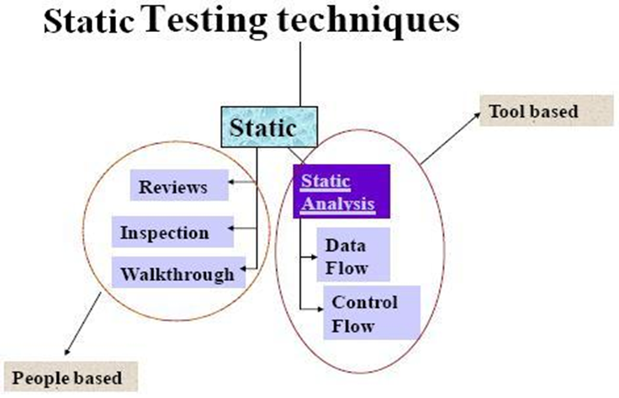

Slide 4
A review in a Static Testing is a process or meeting conducted to find the potential defects in the design of any program. Another significance of review is that all the team members get to know about the progress of the project and sometimes the diversity of thoughts may result in excellent suggestions.

Slide 5
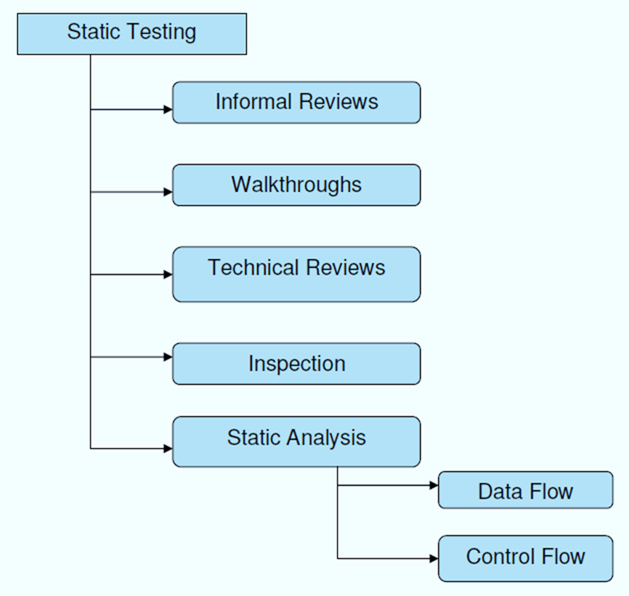

Slide 6
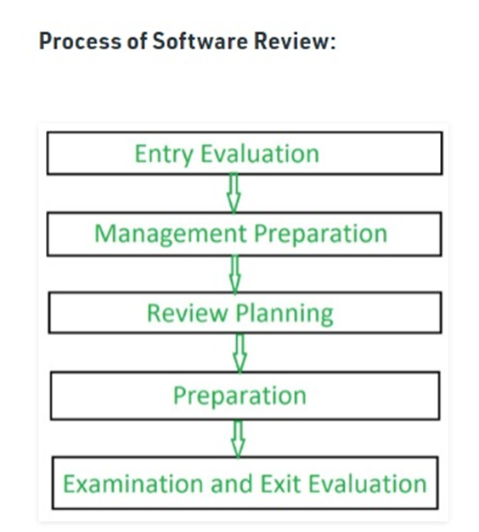

Slide 7
Formal Review:
A type of peer review, "formal review" follows a formal process and has a specific formal agenda. It has a well structured and regulated process, which is usually implemented at the end of each life cycle. During this process, a formal review panel or board considers the necessary steps for the next life cycle.
Features of Formal Review:
This evaluates conformance to specification and various standards.
Conducted by a group of 3 or more individuals.
The review team petitions the management of technical leadership to act on the suggested recommendations.

Slide 8
Formal review consists steps, which are:
Planning.
Kick-off.
Preparation.
Review meeting.
Rework.
- Follow up

Slide 9
Informal Review:
Unlike Formal Reviews, Informal reviews are applied multiple times during the early stages of software development process. The major difference between the formal and informal reviews is that the former follows a formal agenda, whereas the latter is conducted as per the need of the team and follows an informal agenda. Though time saving, this process is not documented and does not require any entry criteria or large group of members.

Slide 10
Features of Informal Review:
Conducted by a group of 2-7 members, which includes the designer an any other interested party.
Here the team identifies errors & issues as well as examine alternatives.
It is a forum for learning.
All the changes are made by the software designer.
These changes are verified by other project controls.
The role of informal review is to keep the author informed and to improve the quality of the product

Slide 11
Informal reviews | Formal reviews
It is a type of review that typically occurs spontaneously among teams. | It is a type of review that is done by a team of software testers or the reviewer’s team.
It is generally done by Software developers or engineers. | It is done by the Reviewers and they are responsible for this all review.
Here, no report is created as it is informal. | Here, a report is created as it is formal.

Slide 12
What is Technical review?
A Technical review is a static white-box testing technique which is conducted to spot the defects early in the life cycle that cannot be detected by black box testing techniques.
A software technical review is examined by a team of qualified software engineers for the suitability of the software product. This process can also be defined as a critical evaluation of an object in the software. Through the software technical review process, we can identify the errors or defects in the software product in the early phase itself.

Slide 13
What is Peer Review?
A peer review, a review technique, which is a static white-box testing which are conducted to spot the defects early in the life cycle that cannot be detected by black box testing techniques.
Peer review is the process of assessing the technical content and quality of the product and it is usually conducted by the author of the work product along with some other developers

Slide 14
3.1.4 Walkthrough
Walkthrough is a method of conducting informal group/individual review. In a walkthrough, author describes and explain work product in a informal meeting to his peers or supervisor to get feedback. Here, validity of the proposed solution for work product is checked.
It is cheaper to make changes when design is on the paper rather than at time of conversion. Walkthrough is a static method of quality assurance. Walkthrough are informal meetings but with purpose.
in which a designer or programmer leads members of the development team and other interested parties through a software product, and the participants ask questions and make comments about possible errors, violation of development standards, and other problems.

Slide 15
Walkthrough Participants:
Author - The Author of the document under review.
Presenter - The presenter usually develops the agenda for the walkthrough and presents the output being reviewed.
Moderator - The moderator facilitates the walkthrough session, ensures the walkthrough agenda is followed, and encourages all the reviewers to participate.
Reviewers - The reviewers evaluate the document under test to determine if it is technically accurate.
Scribe - The scribe is the recorder of the structured walkthrough outcomes who records the issues identified and any other technical comments, suggestions, and unresolved questions

Slide 16
3.1.5 Inspection
An inspection is defined as formal, rigorous, in depth group review designed to identify problems as close to their point of origin as possible. Inspections improve reliability, availability, and maintainability of software product.
Anything readable that is produced during the software development can be inspected. Inspections can be combined with structured, systematic testing to provide a powerful tool for creating defect-free programs.

Slide 17
Stages in the inspections process :
Planning : Inspection is planned by moderator.
Overview meeting : Author describes background of work product.
Preparation : Each inspector examines work product to identify possible defects.
Inspection meeting : During this meeting, reader reads through work product, part by part and inspectors points out the defects for every part.
Rework : Author makes changes to work product according to action plans from the inspection meeting.
Follow-up : Changes made by author are checked to make sure that everything is correct.

Slide 18
3.2.2 Control-Flow Analysis (CFA)
It is a static-code-analysis technique for determining the control flow of a program. The control flow is expressed as a control-flow graph (CFG).
Control flow testing is a testing technique that comes under white box testing. The aim of this technique is to determine the execution order of statements or instructions of the program through a control structure. The control structure of a program is used to develop a test case for the program. In this technique, a particular part of a large program is selected by the tester to set the testing path. It is mostly used in unit testing. Test cases represented by the control graph of the program.

Slide 19
Notations used for Control Flow Graph
Node
Edge
Decision Node
Junction node

Slide 20
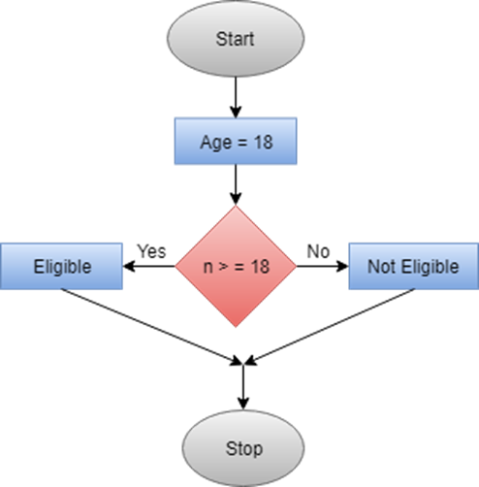

Slide 21
Control Flow Graph is a graphical representation of control flow or computation that is done during the execution of the program.
Control flow graphs are mostly used in static analysis as well as compiler applications, as they can accurately represent the flow inside of a program unit.

Slide 22
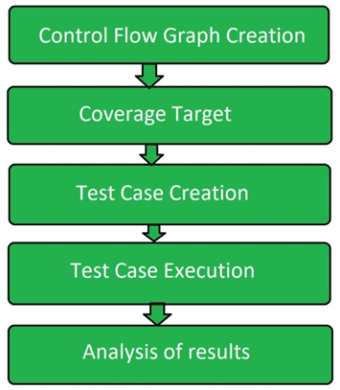

Slide 23
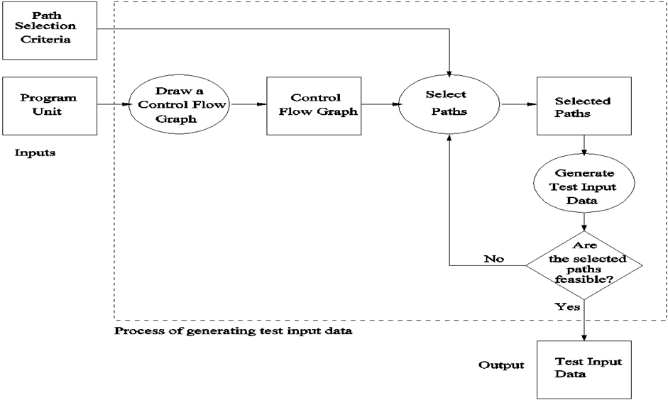

Slide 24
Static Analysis by Tools (Automated Static Analysis)
Static analysis tools refer to a wide array of tools that examine source code, executable, or even documentation, to find problems before they happen; without actually running the code. These tools vary greatly in scope and purpose, ranging from compiler-level checks for logical errors, to code styling enforcement, to cloud-based suites of tools that cover everything from documentation formatting to code complexity analysis.

Slide 25
Static code Analysis Tools
AdaControl :-
A tool to control occurrences of various entities or programming patterns in Ada code, used for checking coding standards, enforcement of safety related rules, and support for various manual inspections. Features automatic fixing of violations.
Apache Yetus :-
A collection of build and release tools. Included is the 'precommit' module that is used to execute full and partial/patch CI builds that provides static analysis of code via other tools as part of a configurable report. Built-in support may be extended with plug-ins.It is supported by Java & Python
Astree :-
Finds all potential runtime errors and data races by abstract interpretation, can prove their absence, and can prove functional assertions; tailored towards safety-critical C code
Code Peer
An advanced static analysis tool that detects potential run-time logic errors in Ada programs.
Code Scene:-
Behavioral analysis of code. Helps identify, prioritize, and manage technical debt. Measures organizational aspects of developer teams. Automated pull request integrations. It is supported by various programming languages as C,C++ ,C#, Java

Slide 26
In software testing, test design techniques are methods used to create effective test cases, aiming to maximize coverage and efficiency. Some common techniques include black-box methods like boundary value analysis and equivalence partitioning, white-box methods, as well as exploratory testing and experience-based approaches.

Slide 27
Black-Box Techniques (Focus n functionality, without looking at the code):
Boundary Value Analysis:
Tests values at the edges of input or output ranges (e.g., minimum, maximum, just above/below these limits) to identify potential vulnerabilities.
Equivalence Partitioning:
Divides input data into groups (equivalence classes) based on their expected behavior, then selects representative values from each class to test.
Decision Table Testing:
Used when multiple input conditions result in different outputs; it systematically tests all possible combinations.

Slide 28
White-Box Techniques (Focus on the code's structure and logic):
Path Testing: Tests different paths through the code to ensure that all branches are executed and that the program logic works correctly.
Statement Coverage: Ensures that every line of code is executed at least once during testing.
Decision Coverage: Ensures that every decision point in the code (e.g., if, while) is evaluated for both true and false cases.

Slide 29
Cyclomatic Complexity
Cyclomatic complexity, developed by Thomas McCabe, is a metric that measures the complexity of a program by counting its decision points. It measures the number of unique paths through the code, indicating how complex the logic is. Lower complexity suggests simpler, more manageable code, reducing the chances of errors and making it easier to maintain and modify. Essentially, it helps assess the code’s readability and risk associated with changes.

Slide 30
Formula for Calculating Cyclomatic Complexity
Mathematically, for a structured program, the directed graph inside the control flow is the edge joining two basic blocks of the program as control may pass from first to second. So, cyclomatic complexity M would be defined as,

Slide 31
M = E – N + 2P
where
E = the number of edges in the control flow graph N = the number of nodes in the control flow graph P = the number of connected components

Slide 32
Data flow based Testing
Data flow testing is a white-box testing technique that examines the flow of data in a program. It focuses on the points where variables are defined and used and aims to identify and eliminate potential anomalies that could disrupt the flow of data, leading to program malfunctions or erroneous outputs.
Data flow testing operates on two distinct levels: static and dynamic.
Static data flow testing involves analyzing the source code without executing the program. It constructs a control flow graph, which represents the various paths of execution through the code. This graph is then analyzed to identify potential data flow anomalies, such as:
Definition-Use Anomalies: A variable is defined but never used, or vice versa.
Redundant Definitions: A variable is defined multiple times before being used.
Uninitialized Use: A variable is used before it has been assigned a value.

Slide 33
Dynamic data flow testing, on the other hand, involves executing the program and monitoring the actual flow of data values through variables. It can detect anomalies related to:
Data Corruption: A variable’s value is modified unexpectedly, leading to incorrect program behavior.
Memory Leaks: Unnecessary memory allocations are not properly released, causing memory consumption to grow uncontrollably.
Invalid Data Manipulation: Data is manipulated in an unintended manner, resulting in erroneous calculations or outputs.

Slide 34
Mutation Testing
Mutation testing, also known as code mutation testing, is a form of white box testing in which testers change specific components of an application's source code to ensure a software test suite can detect the changes. Changes introduced to the software are intended to cause errors in the program. Mutation testing is designed to ensure the quality of a software testing tool, not the applications it analyzes.

Slide 35
Types of mutation testing
There are three main types of mutation testing:
Statement mutation. Statements are deleted or replaced with a different statement. For example, the statement "A=10 by B=5" is replaced with "A=5 by B=15."
Value mutation. Values are changed to find errors. For example, "A= 15" is changed to "A= 10" or "A=25."
Decision mutation. Arithmetic or logical operators are changed to detect errors. For example, "(A<B)" is changed to "(A>B)."

Slide 36
Advantages and disadvantages
Code mutation provides the following advantages:
Helps to ensure the identification of weak tests or code.
Offers a high level of error detection.
Increases the use of object-oriented frameworks and unit tests if an organization uses them.
Offers more mutation testing tools due to the increased frameworks and unit tests.
Helps organizations determine the usefulness of their testing tool through the use of scoring.

Slide 37
Disadvantages of code mutation include the following:
Isn't practical without the use of an automation tool.
Can be time-consuming and costly due to the large number of mutants being tested.

Slide 38
Test Design Techniques-Experience based technique
Experience-based testing techniques- In software testing rely on the tester's skills, intuition, and past experiences to uncover potential issues and design tests, rather than strictly following predefined test cases or detailed requirements. These techniques are particularly useful when specifications are inadequate or time is limited.

Slide 39
Types of Experience-Based Techniques
Error Guessing:
Testers use their experience and intuition to identify areas where the software might be prone to errors or weaknesses.
Exploratory Testing:
Testers explore the software, focusing on learning about its strengths and weaknesses, and designing tests on the fly, without extensive planning or documentation.

Slide 40
END

