Slide 1
Unit-2
Advanced Java Concepts

Slide 2
1 Introduction to Collection Framework
The Collection in Java is a framework that provides an architecture to store and manipulate the group of objects.
Java Collections can achieve all the operations that you perform on a data such as searching, sorting, insertion, manipulation, and deletion.
Java Collection means a single unit of objects. Java Collection framework provides many interfaces (Set, List, Queue, Deque) and classes (ArrayList, Vector, LinkedList, PriorityQueue, HashSet, LinkedHashSet, TreeSet).

Slide 3
What is Collection in Java?
A Collection represents a single unit of objects, i.e., a group.
What is a framework in Java?
A framework provides a ready-made structure of classes and interfaces for building software applications efficiently. It simplifies adding new features by offering reusable components that perform similar tasks, eliminating the need to create a framework from scratch for each new project.
It provides readymade architecture.
It represents a set of classes and interfaces.
It is optional.

Slide 4
What is Collection framework
The Collection framework represents a unified architecture for storing and manipulating a group of objects. It enhances code efficiency and readability by offering various data structures, including arrays, linked lists, trees, and hash tables, tailored to different programming needs. It has:
Interfaces and its implementations, i.e., classes
Algorithm

Slide 5
Why Collection Framework?
Before the Collection Framework was introduced in JDK 1.2, Java's approach to collections was using Arrays, Vectors, and Hash tables lacked a common interface. This meant each type of collection had its own set of methods, syntax, and constructors, with no standardization or correlation between them.

Slide 6
Advantages of the Java Collection Framework
The Java Collections Framework offers significant advantages that enhance development practices, code quality, and application performance:
Reusability: The framework provides a comprehensive set of common classes and utility methods applicable across various types of collections. This feature promotes code reusability, sparing developers the need to write duplicate code for common operations.
Quality: Leveraging the Java Collections Framework elevates the quality of programs. The components within the framework have been extensively tested and are widely used by a vast community of developers, ensuring reliability and stability in your applications.
Speed: Developers often report an increase in development speed when using the Collections Framework. It allows them to concentrate on the core business logic of their applications rather than on implementing generic collection functionalities, thus speeding up the development process.
Maintenance: The open-source nature of the Java Collections Framework, coupled with readily available API documentation, facilitates easier code maintenance. Code written using the framework can be easily understood and taken over by other developers, ensuring continuity and ease of maintenance.
Reduces Effort to Design New APIs: An additional benefit is the reduced necessity for API designers and implementers to create new collection mechanisms for each new API. They can instead rely on the standard collection interfaces provided by the framework, streamlining the API development process and ensuring consistency across Java applications.

Slide 7
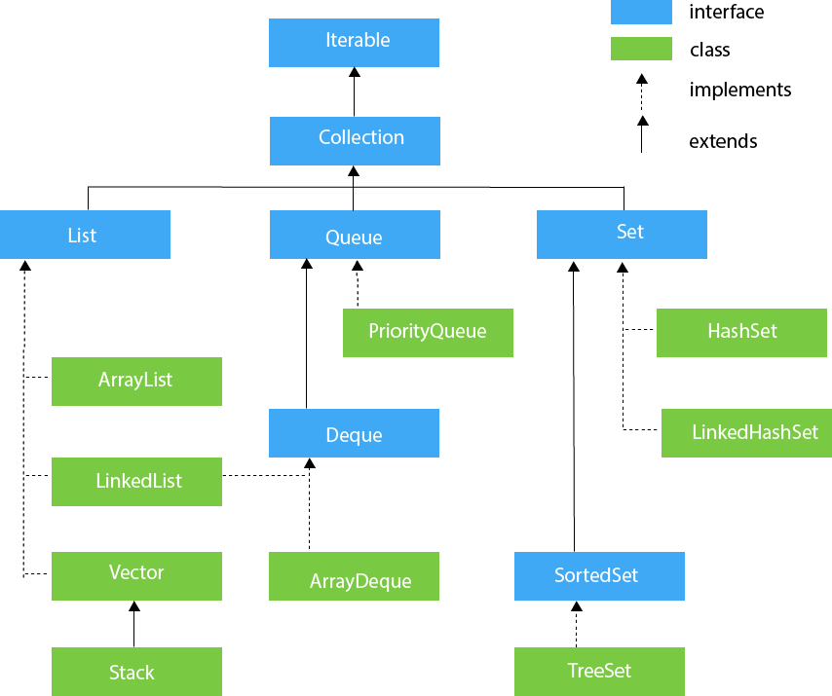

Slide 8
List Interface
List interface is the child interface of Collection interface. It inhibits a list type data structure in which we can store the ordered collection of objects. It can have duplicate values.
List interface is implemented by the classes ArrayList, LinkedList, Vector, and Stack.
To instantiate the List interface, we must use:
List <data-type> list1= new ArrayList();
List <data-type> list2 = new LinkedList();
List <data-type> list3 = new Vector();
List <data-type> list4 = new Stack();
There are various methods in List interface that can be used to insert, delete, and access the elements from the list.
The classes that implement the List interface are given below.

Slide 9
ArrayList
The ArrayList class implements the List interface. It uses a dynamic array to store the duplicate element of different data types. The ArrayList class maintains the insertion order and is non-synchronized. The elements stored in the ArrayList class can be randomly accessed. Consider the following example.
Filename: TestJavaCollection1.java
import java.util.*;
class TestJavaCollection1{
public static void main(String args[]){
ArrayList<String> list=new ArrayList<String>();//Creating arraylist
list.add("Ravi");//Adding object in arraylist
list.add("Vijay");
list.add("Ravi");
list.add("Ajay");
//Traversing list through Iterator
Iterator itr=list.iterator();
while(itr.hasNext()){
System.out.println(itr.next());
}
}
}
Output:
Ravi Vijay Ravi Ajay

Slide 10
LinkedList
LinkedList implements the Collection interface. It uses a doubly linked list internally to store the elements. It can store the duplicate elements. It maintains the insertion order and is not synchronized. In LinkedList, the manipulation is fast because no shifting is required.
import java.util.*;
public class TestJavaCollection2{
public static void main(String args[]){
LinkedList<String> al=new LinkedList<String>();
al.add("Ravi");
al.add("Vijay");
al.add("Ravi");
al.add("Ajay");
Iterator<String> itr=al.iterator();
while(itr.hasNext()){
System.out.println(itr.next());
}
}
}
Output:
Ravi
Vijay
Ravi
Ajay

Slide 11
Vector
Vector uses a dynamic array to store the data elements. It is similar to ArrayList. However, it is synchronized and contains many methods that are not the part of Collection framework.
Consider the following example.
Filename: TestJavaCollection3.java
import java.util.*;
public class TestJavaCollection3{
public static void main(String args[]){
Vector<String> v=new Vector<String>();
v.add("Ayush");
v.add("Amit");
v.add("Ashish");
v.add("Garima");
Iterator<String> itr=v.iterator();
while(itr.hasNext()){
System.out.println(itr.next());
}
}
}
Output:
Ayush
Amit
Ashish
Garima

Slide 12
Stack
The stack is the subclass of Vector. It implements the last-in-first-out data structure, i.e., Stack. The stack contains all of the methods of Vector class and also provides its methods like boolean push(), boolean peek(), boolean push(object o), which defines its properties.
import java.util.*;
public class TestJavaCollection4{
public static void main(String args[]){
Stack<String> stack = new Stack<String>();
stack.push("Ayush");
stack.push("Garvit");
stack.push("Amit");
stack.push("Ashish");
stack.push("Garima");
stack.pop();
Iterator<String> itr=stack.iterator();
while(itr.hasNext()){
System.out.println(itr.next());
}
}
}
Output:
Ayush
Garvit
Amit
Ashish

Slide 13
Queue Interface
Queue interface maintains the first-in-first-out order. It can be defined as an ordered list that is used to hold the elements which are about to be processed. There are various classes like PriorityQueue, Deque, and ArrayDeque which implements the Queue interface.
Queue interface can be instantiated as:
Queue<String> q1 = new PriorityQueue();
Queue<String> q2 = new ArrayDeque();
There are various classes that implement the Queue interface, some of them are given below.
PriorityQueue
The PriorityQueue class implements the Queue interface. It holds the elements or objects which are to be processed by their priorities. PriorityQueue doesn't allow null values to be stored in the queue.

Slide 14
Deque Interface-
Deque interface extends the Queue interface. In Deque, we can remove and add the elements from both the side. Deque stands for a double-ended queue which enables us to perform the operations at both the ends.
Deque can be instantiated as:
Deque d = new ArrayDeque();
ArrayDeque-
ArrayDeque class implements the Deque interface. It facilitates us to use the Deque. Unlike queue, we can add or delete the elements from both the ends.
ArrayDeque is faster than ArrayList and Stack and has no capacity restrictions.

Slide 15
Set Interface
Set Interface in Java is present in java.util package. It extends the Collection interface. It represents the unordered set of elements which doesn't allow us to store the duplicate items. We can store at most one null value in Set. Set is implemented by HashSet, LinkedHashSet, and TreeSet.
Set can be instantiated as:
Set<data-type> s1 = new HashSet<data-type>();
Set<data-type> s2 = new LinkedHashSet<data-type>();
Set<data-type> s3 = new TreeSet<data-type>();

Slide 16
HashSet
HashSet class implements Set Interface. It represents the collection that uses a hash table for storage. Hashing is used to store the elements in the HashSet. It contains unique items.
Consider the following example.
Filename: TestJavaCollection7.java
import java.util.*;
public class TestJavaCollection7{
public static void main(String args[]){
//Creating HashSet and adding elements
HashSet<String> set=new HashSet<String>();
set.add("Ravi");
set.add("Vijay");
set.add("Ravi");
set.add("Ajay");
//Traversing elements
Iterator<String> itr=set.iterator();
while(itr.hasNext()){
System.out.println(itr.next());
}
}
}
Output:
Vijay
Ravi
Ajay

Slide 17
LinkedHashSet
LinkedHashSet class represents the LinkedList implementation of Set Interface. It extends the HashSet class and implements Set interface. Like HashSet, It also contains unique elements. It maintains the insertion order and permits null elements.
import java.util.*;
public class TestJavaCollection8{
public static void main(String args[]){
LinkedHashSet<String> set=new LinkedHashSet<String>();
set.add("Ravi");
set.add("Vijay");
set.add("Ravi");
set.add("Ajay");
Iterator<String> itr=set.iterator();
while(itr.hasNext()){
System.out.println(itr.next());
}
}
}
Output:
Ravi
Vijay
Ajay

Slide 18
SortedSet Interface
SortedSet is the alternate of Set interface that provides a total ordering on its elements. The elements of the SortedSet are arranged in the increasing (ascending) order. The SortedSet provides the additional methods that inhibit the natural ordering of the elements.
The SortedSet can be instantiated as:
SortedSet<data-type> set = new TreeSet();

Slide 19
TreeSet
Java TreeSet class implements the Set interface that uses a tree for storage. Like HashSet, TreeSet also contains unique elements. However, the access and retrieval time of TreeSet is quite fast. The elements in TreeSet stored in ascending order.
import java.util.*;
public class TestJavaCollection9{
public static void main(String args[]){
//Creating and adding elements
TreeSet<String> set=new TreeSet<String>();
set.add("Ravi");
set.add("Vijay");
set.add("Ravi");
set.add("Ajay");
//traversing elements
Iterator<String> itr=set.iterator();
while(itr.hasNext()){
System.out.println(itr.next());
}
}
}
Output:
Ajay
Ravi
Vijay

Slide 20
Map Interface
The Map interface in Java is part of the Java Collections Framework. It represents a mapping between a set of keys and their corresponding values. A Map cannot contain duplicate keys; each key can map to at most one value. The Map interface is used to store key-value pairs, where each key is unique, and it provides an efficient way to retrieve, update, and manipulate data based on keys.
Syntax:
Map<T, T> hm = new HashMap<>();
Map<T, T> tm = new TreeMap<>();

Slide 21
HashMap
HashMap in Java is a key-value data structure offering efficient data access via keys using hashing. Hashing converts large strings or other objects into smaller, consistent values for quick indexing and searching. HashMap implements the Map interface and is used for managing large datasets efficiently. Additionally, HashSet uses HashMap internally to store elements uniquely, demonstrating the utility of hashing in Java's collections framework for fast data retrieval and management.

Slide 22
import java.util.HashMap;
import java.util.Map;
public class HashMapExample {
public static void main(String[] args) {
// Creating a HashMap
Map<String, Integer> map = new HashMap<>();
// Adding key-value pairs to the HashMap
map.put("Alice", 10);
map.put("Bob", 20);
map.put("Charlie", 30);
// Retrieving a value
System.out.println("Value for 'Alice': " + map.get("Alice"));
// Iterating over key-value pairs
for (Map.Entry<String, Integer> entry : map.entrySet()) {
String key = entry.getKey();
Integer value = entry.getValue();
System.out.println(key + ": " + value);
}

Slide 23
// Removing a key-value pair
map.remove("Charlie");
// Checking the presence of a key
if (map.containsKey("Bob")) {
System.out.println("Map contains key 'Bob'.");
}
}
}
Output:
Value for 'Alice': 10Bob: 20
Alice: 10
Charlie: 30
Map contains key 'Bob'.

