Slide 1

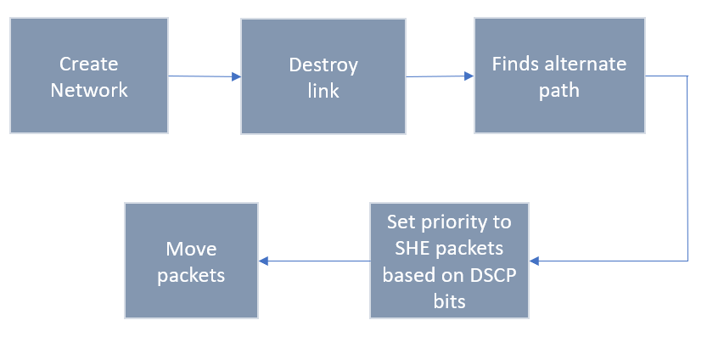
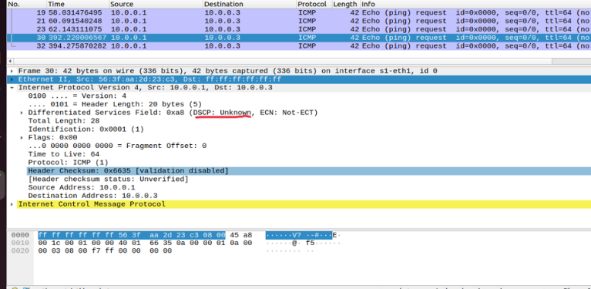
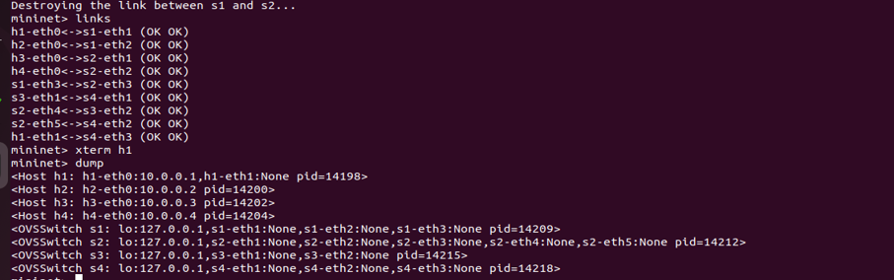
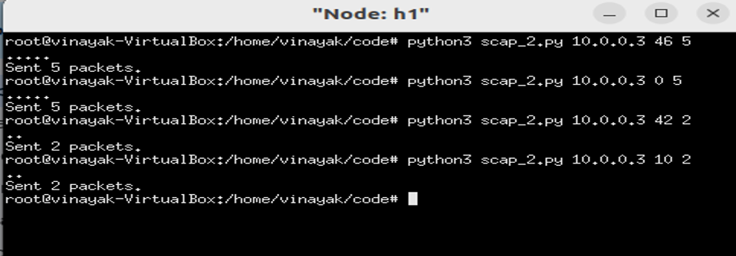
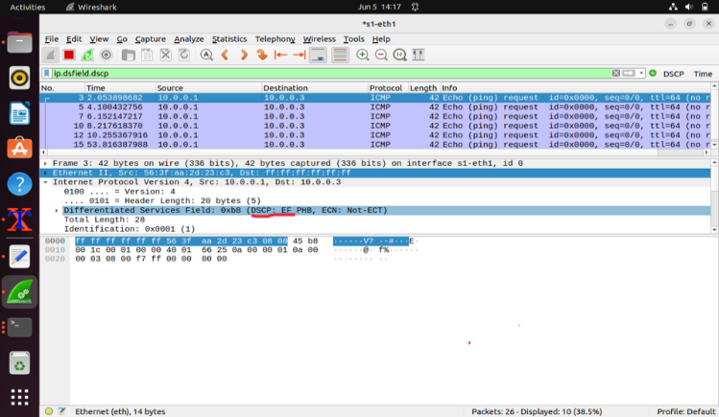
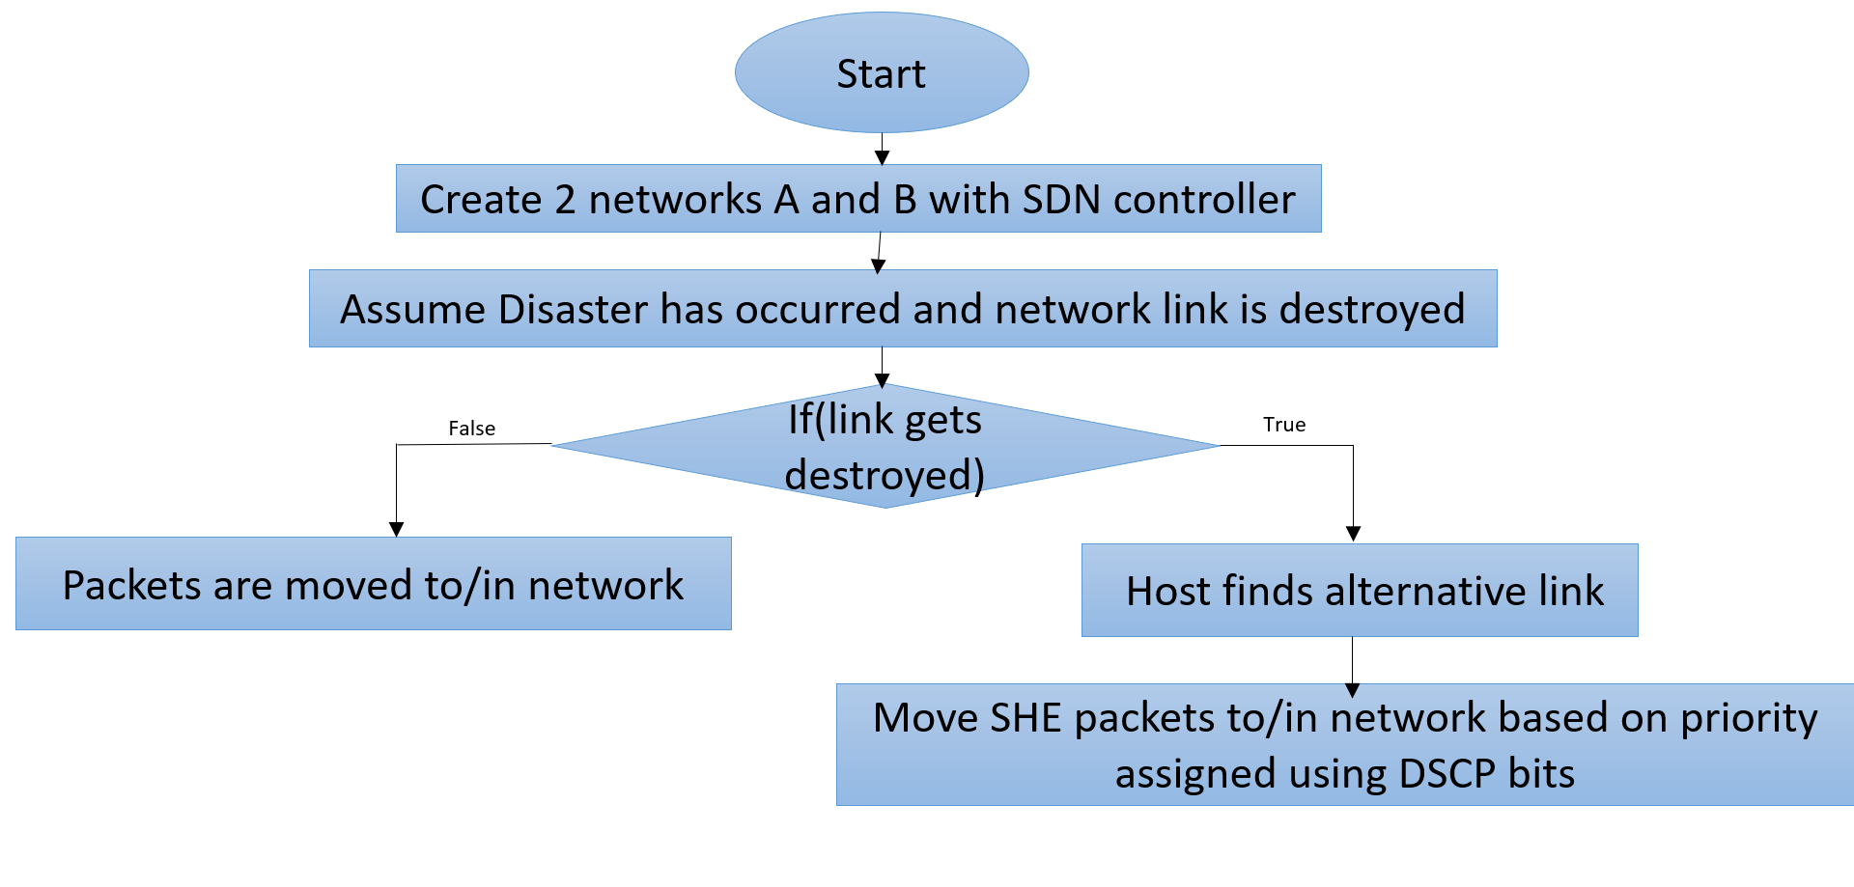
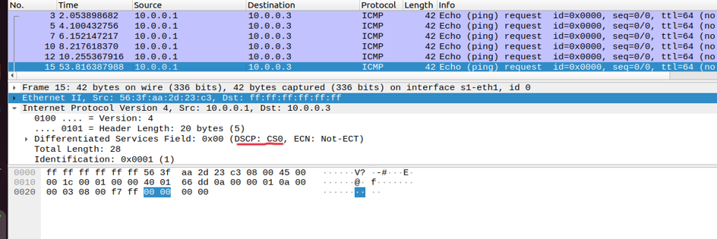
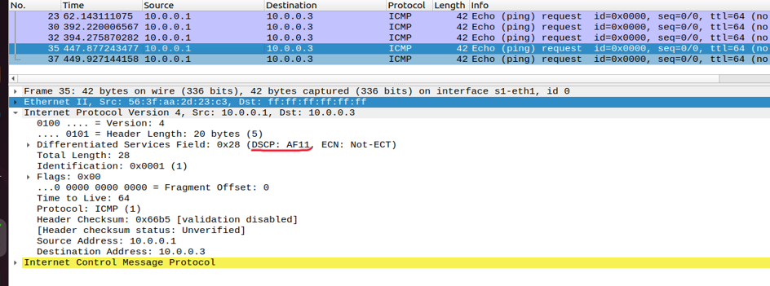
Prioritizing SHE packets for Emergency Response
Aishwarya K, Babusingh R, Rahul S, Vinayak B
Guide: Prof. Kiran M R
School of Electronics and Communication Engineering
zzz
Problem statement
Proposed Framework
Results and Discussion
Addressing the challenge of maintaining resilient networking infrastructure during disasters to ensure uninterrupted communication and data exchange for effective emergency response.
Ensure the prioritized transfer of Security, Health, and Emergency (SHE) packets over the communication network. .
To provide uninterrupted communication and data exchange for effective emergency response..
To develop an easy-to-use communication network that works even when things are really tough.
Our project uniquely prioritizes Safety, Health, and Emergency (SHE) packets using DSCP bits in an SDN-controlled network for disaster management. By simulating network failures in Mininet, we demonstrated SHE packets' rerouting from a compromised Network A to Network B via alternative paths. This ensures continuous, reliable emergency response, a novel approach not explored in existing literature.
Yaseen, F.A., Alkhalidi, N.A. and Al-Raweshidy, H.S., 2022. She networks: Security, health, and emergency networks traffic priority management based on ml and sdn. IEEE Access, 10, pp.92249-92258.
Ali, K., Nguyen, H.X., Vien, Q.T. and Shah, P., 2015, March. Disaster management communication networks: Challenges and architecture design. In 2015 IEEE International Conference on Pervasive Computing and Communication Workshops (PerCom Workshops) (pp. 537-542). IEEE.
Paul, S.P. and Vetrithangam, D., 2022, November. A Comprehensive Analysis on Issues and Challenges of Wireless Sensor Network Communication in Commercial Applications. In 2022 International Conference on Computing, Communication, and Intelligent Systems (ICCCIS) (pp. 377-382). IEEE.
Yu, C., Lan, J., Xie, J. and Hu, Y., 2018. QoS-aware traffic classification architecture using machine learning and deep packet inspection in SDNs. Procedia computer science, 131, pp.1209-1216.
Faezi, S. and Shirmarz, A., 2023. A comprehensive survey on machine learning using in software defined networks (SDN). Human-Centric Intelligent Systems, 3(3), pp.312-343
Objectives
Contributions
The flowchart above shows the complete data flow of the system .
Algorithm:
Start
Create two networks named A and B with SDN controller.
Destroy any end device's connection with switch.(Disaster has occured).
Immediate response is required. Packets are to network based on priority assigned by DSCP bits.
If no link is destroyed. Packets move as usual.
End
Conclusions
Literature survey
In conclusion, giving priority to Security, Health, and Emergency (SHE) packets in our communication networks is very important for keeping people safe and managing disasters better. By using Software-Defined Networking (SDN), we can make sure that important messages from emergency services get through quickly, improving response times during crises like natural disasters and accidents. This means help can reach people faster, saving lives and reducing harm. It also helps communities become stronger and ensures that those most in need get timely assistance. Overall, prioritizing SHE packets with the help of SDN is a key step in making our emergency response systems more effective and protecting everyone in our communities. The output is simulated in Mininet software.
References
https://www.cisco.com/c/en/us/td/docs/switches/datacenter/nexus1000/sw/4_0/qos/configuration/guide/nexus1000v_qos/qos_6dscp_val.pdf
https://www.ietf.org/proceedings/96/slides/slides-96-maprg-6.pdf
https://bura.brunel.ac.uk/bitstream/2438/25119/4/FullText.pdf
https://www.geeksforgeeks.org/mininet-emulator-in-software-defined-networks/
Minor Project-2023-24

