Slide 1

Prioritizing SHE Packets for Emergency Response
TEAM-03
Guide: Prof.Kiran.M.R
NAME | USN | ROLL NO
Aishwarya B Kalatippi | 01FE21BEI016 | 115
Babusingh Rajput | 01FE21BEI018 | 117
Rahul B Sajjan | 01FE21BEI024 | 121
Vinayak Suresh Bhajantri | 01FE21BEI028 | 125

Slide 2
Contents
Problem Statement
Literature Survey
Block Diagram
Flowchart
Implementation

Slide 3
PROBLEM STATEMENT
"Addressing the challenge of maintaining resilient networking infrastructure during disasters to ensure uninterrupted communication and data exchange for emergency response."

Slide 4
LITERATURE SURVEY
Paper Name | Contributions | Methodology | Gaps | Year
SDN-based ML Traffic Prioritisation for SHE Data | Enhances emergency response efficiency by reducing packet loss and queue time for SHE data. | Combines SDN for control and flexibility with ML for classifying SHE data packets by analyzing traffic header bits. | Needs better real-time response and accuracy in emergency situations. | 2022
Reliable Network Architecture with Cloud Computing | Quick ICT service deployment with minimal redundancy, suitable for underdeveloped nations. | Utilizes cloud computing and a tiered architecture for quick deployment and efficient resource use. | Requires real-world validation and detailed cost analysis. | 2015
Wireless Sensor Communication Challenges | Provides recommendations to address network lifetime, energy use, and cost-efficiency in wireless sensor networks. | Analyzes common problems and suggests solutions through detailed comparisons of current approaches. | Needs practical implementation of solutions and further research on security and bandwidth. | 2022
QoS-aware Traffic Classification in SDNs | High accuracy traffic classification using DPI and ML for adaptive QoS traffic engineering. | Uses DPI, semi-supervised ML, dynamic flow database, and periodic retraining of classifiers. | Further research needed on scalability, real-time performance, and handling encrypted traffic. | 2018
Survey of Traffic Classification in SDNs | Reviews and highlights the importance of advanced traffic classification techniques for SDN. | Surveys frameworks, feature extraction, and classification algorithms, including DPI. | Needs focus on real-time classification and improved techniques for handling encrypted traffic. | 2023

Slide 5
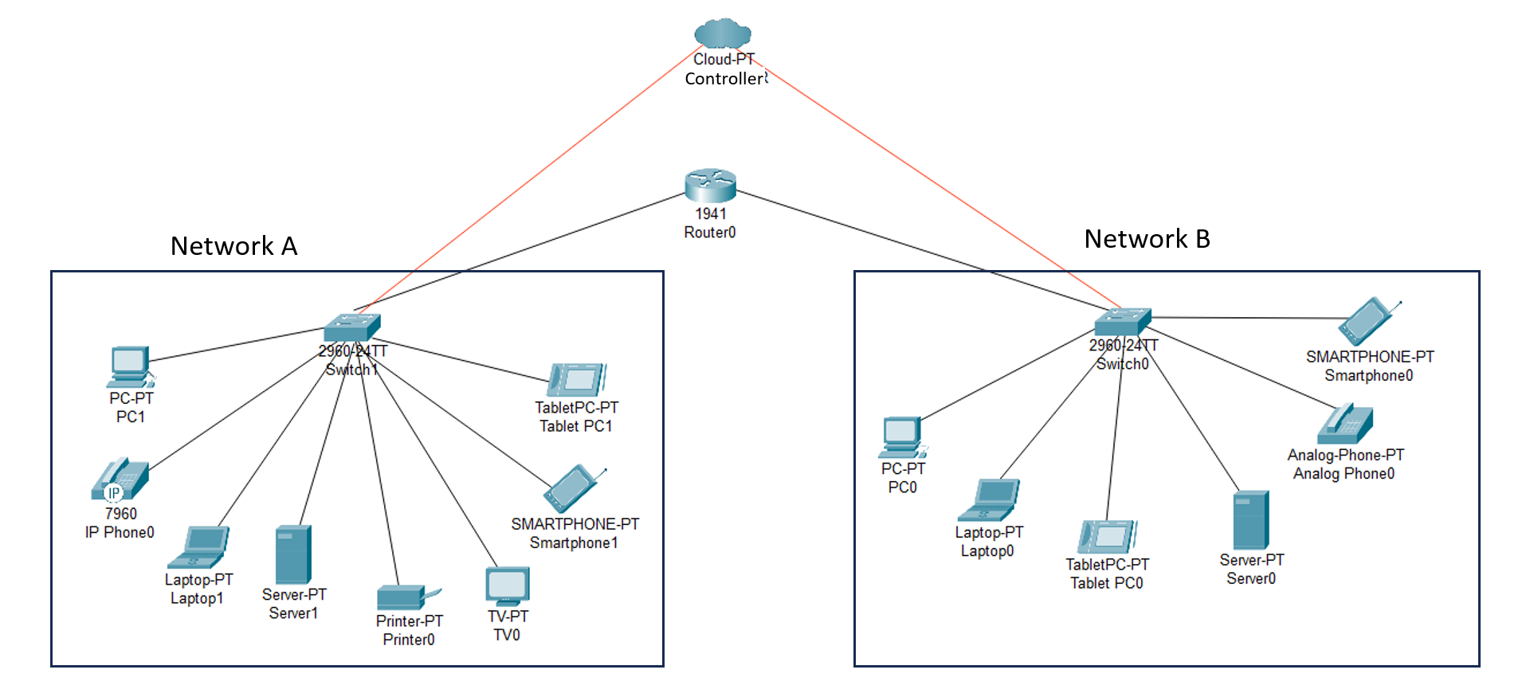
BLOCK DIAGRAM

Slide 6
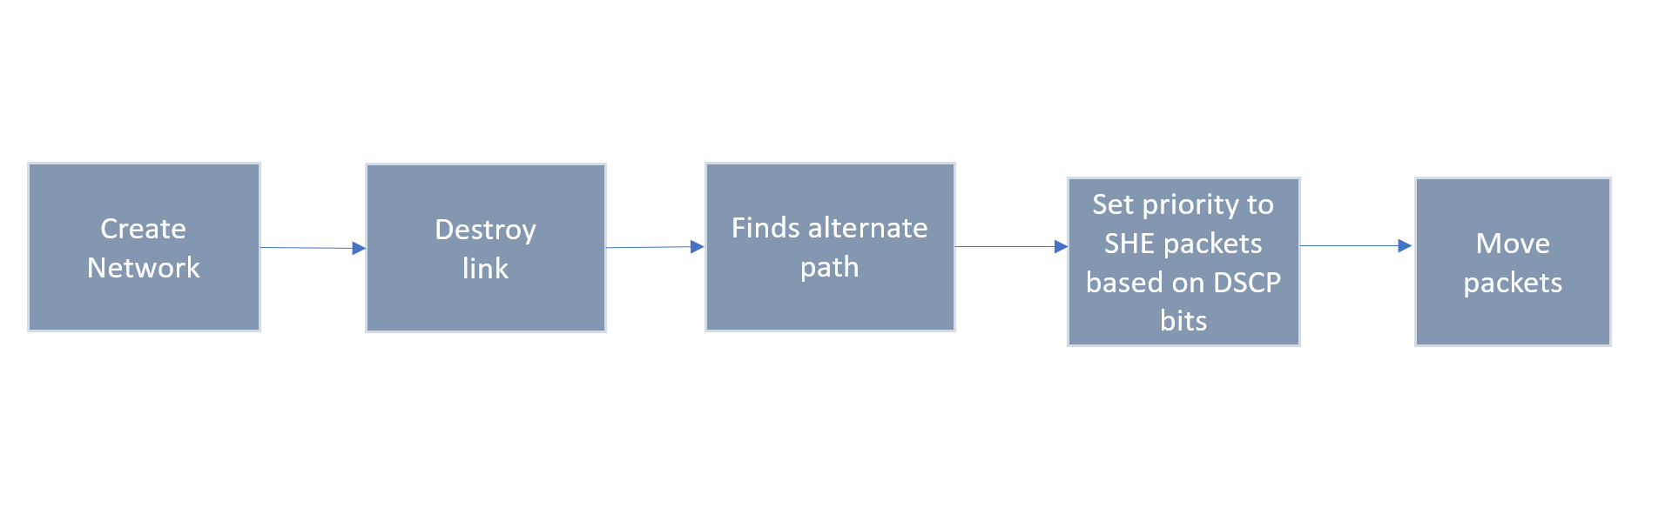
BLOCK DIAGRAM

Slide 7
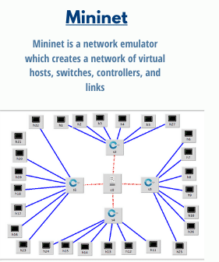
SOFTWARE

Slide 8
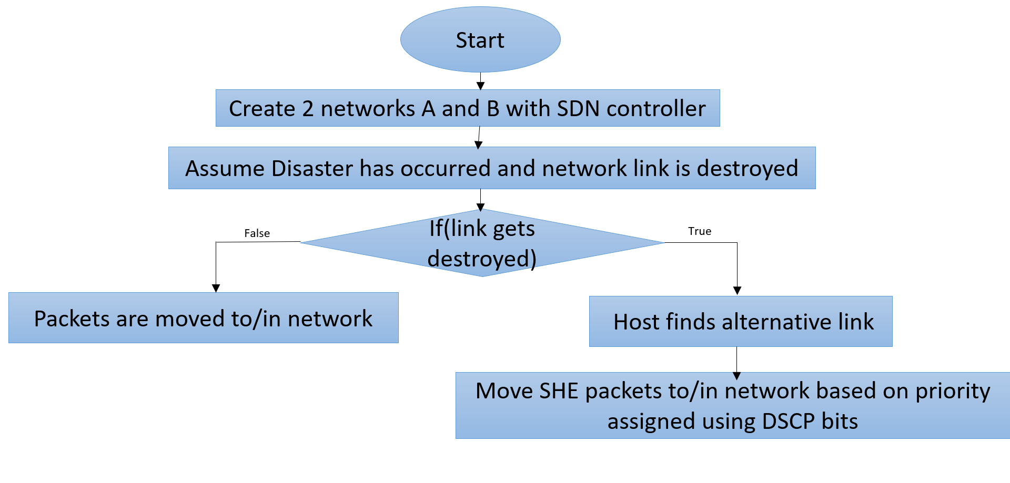
BLOCK DIAGRAM

Slide 9
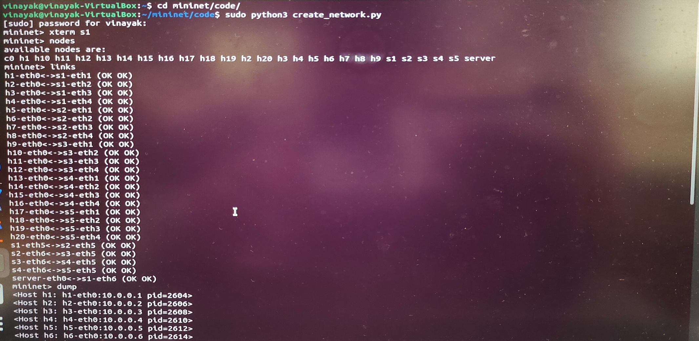
IMPLEMENTATION

Slide 10
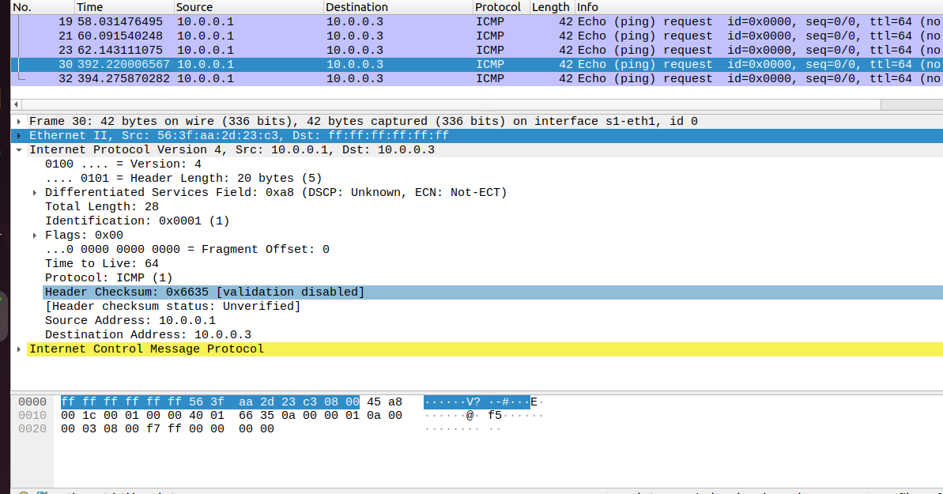
IMPLEMENTATION

Slide 11
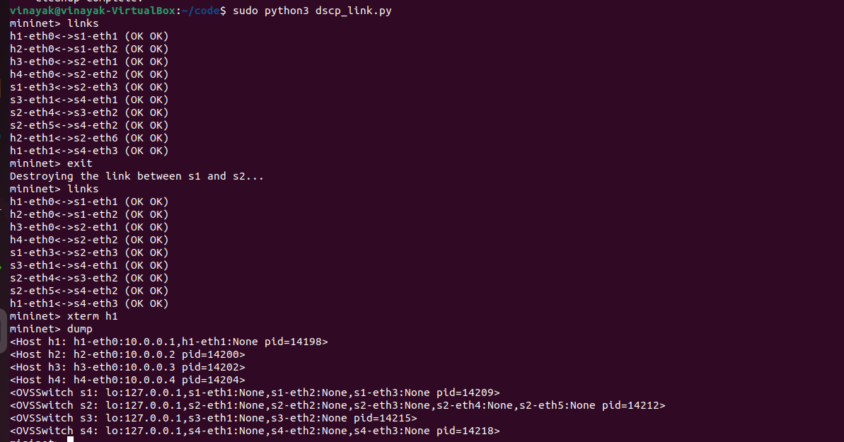
IMPLEMENTATION

Slide 12
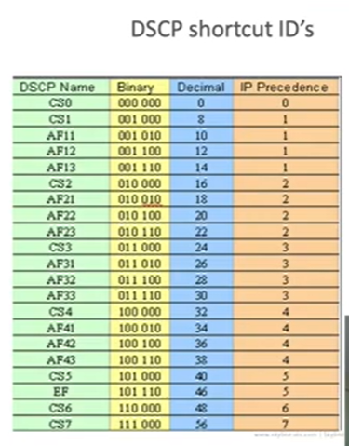
IMPLEMENTATION

Slide 13
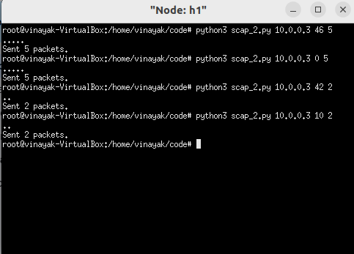
IMPLEMENTATION

Slide 14
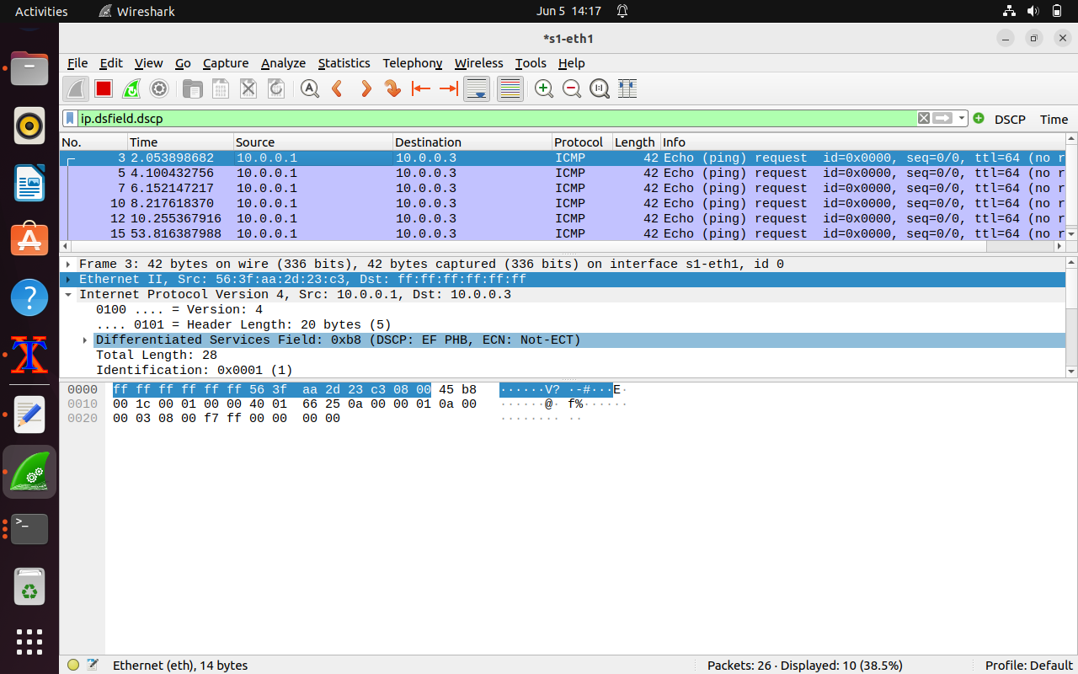
IMPLEMENTATION

Slide 15
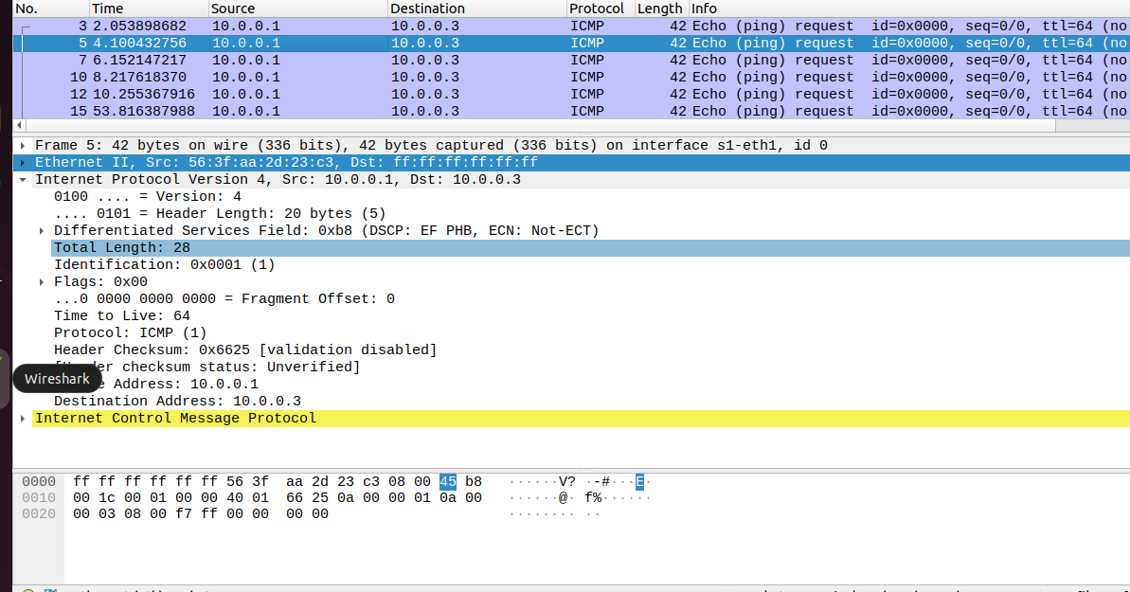
IMPLEMENTATION

Slide 16
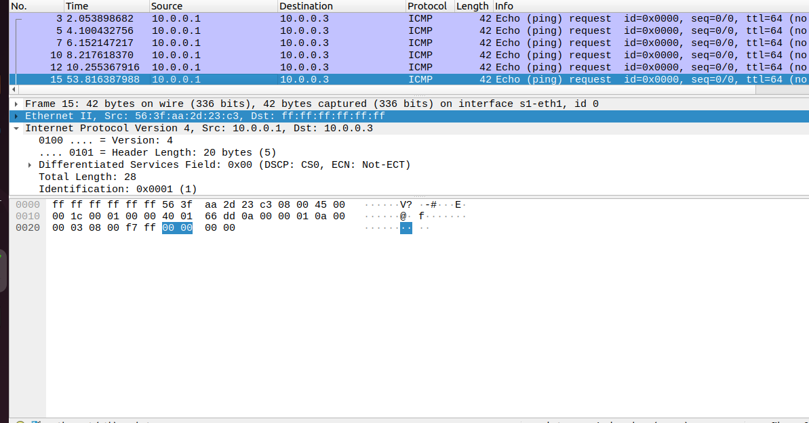
IMPLEMENTATION

Slide 17
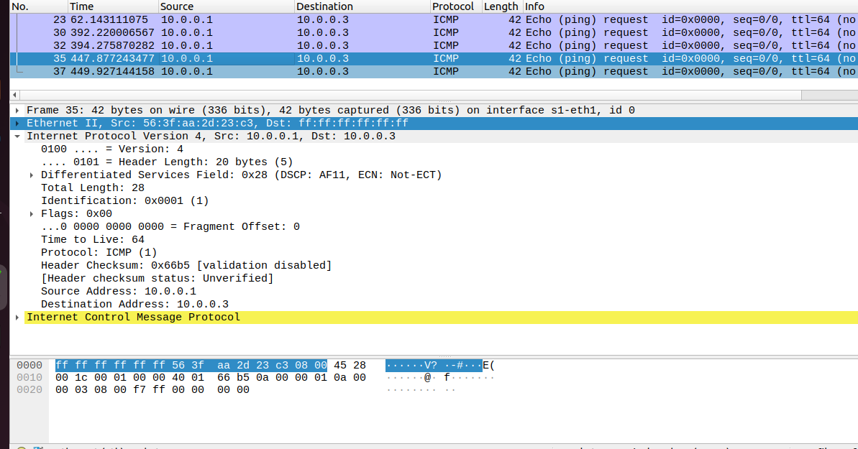
IMPLEMENTATION

Slide 18
THANK YOU

