Slide 1
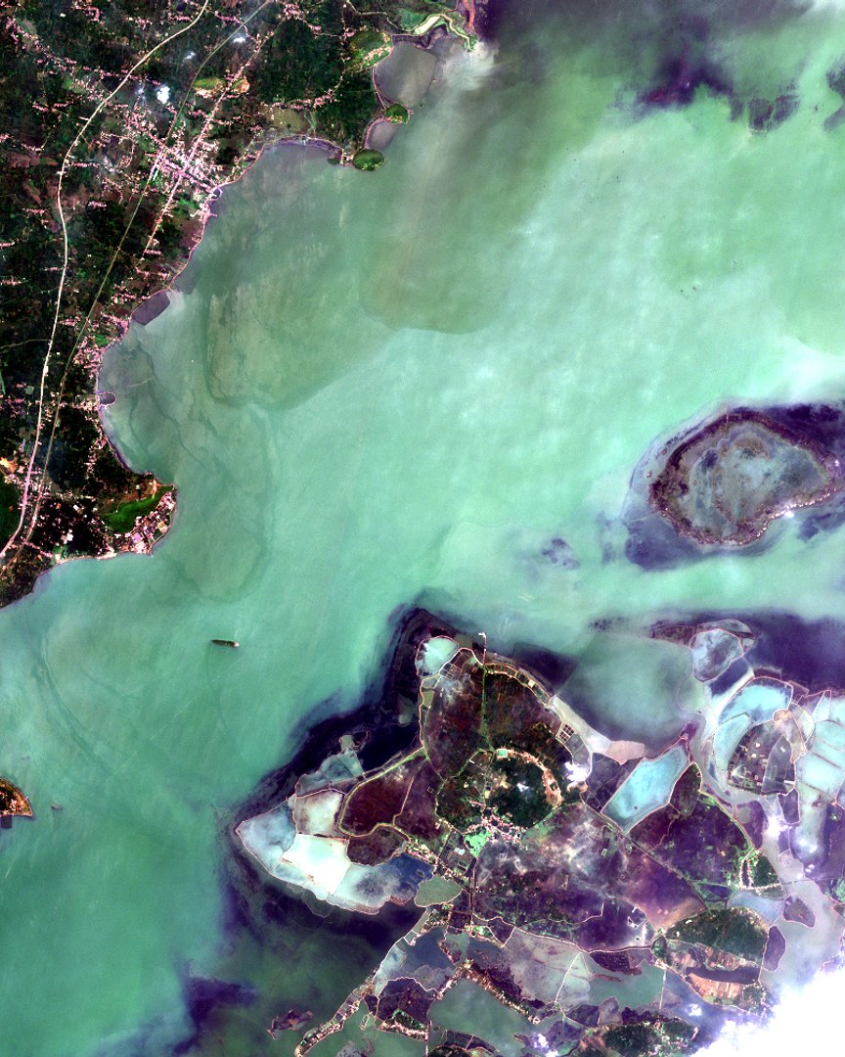
SatQuery AI
SIH 2026 · PROBLEM STATEMENT SIH26167
Natural-language question answering over satellite imagery
PRESENTED BY
[Team name] · [Member names]
[Institution] · Guide: [Guide name] · [Date]
LIVE SYSTEM
satquery-ai-s55c.onrender.com
Chilika Lake · Sentinel-2 via SatQuery
Notes:
Introduce the team and the problem statement number. The image is a real Sentinel-2 scene of Chilika Lake that SatQuery found and downloaded by itself when asked about the lake. SatQuery AI lets anyone ask a question about a place in plain language and get a verified satellite analysis back; it is live at the address shown.

Slide 2
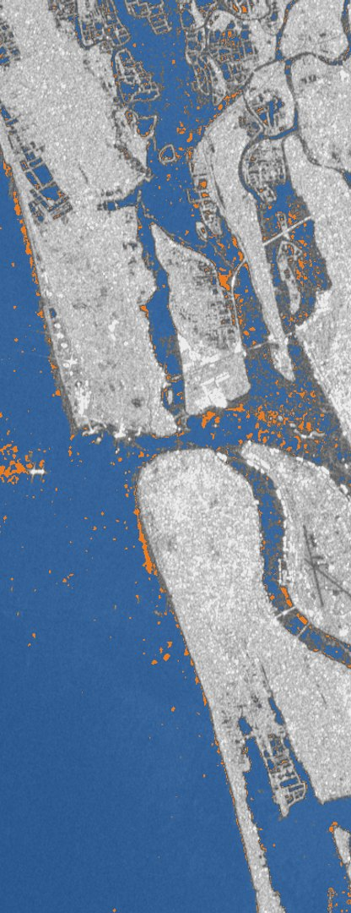
Contents
02 · TABLE OF CONTENTS
03
Introduction
10
Tools and Technologies
04
Problem Statement
11
Implementation
05
Objectives
12
Results and Discussion
06
Existing System
13
Limitations and Future Scope
07
Proposed System
14
Conclusion
08
Methodology
15
References
09
System Design / Architecture
16
Thank You
Notes:
The presentation follows the standard project format: context and problem first, then the proposed system and how it was built, then measured results, limits and the conclusion. The strip on the right is SatQuery’s flood map of Kochi.

Slide 3
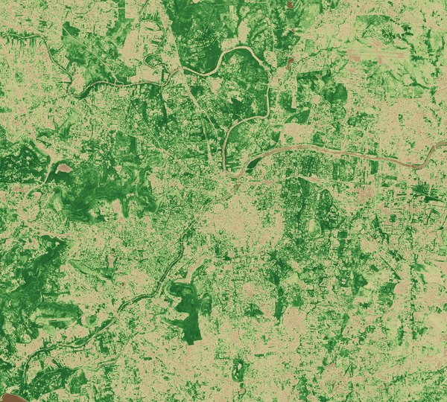



From open imagery to clear answers
03 · INTRODUCTION
The Sentinel satellites image all of India every few days, free of charge. Turning those images into an answer still takes a specialist.
Ask
In English or Hindi, naming a place and a period
Fetch
Sentinel-2 or Sentinel-1 scenes, found automatically
Answer
Map, findings, confidence and an execution trace
Vegetation health (NDVI) around Pune, computed by SatQuery from Sentinel-2
Notes:
Satellite data from the European Copernicus programme is open and frequent, but using it needs expertise: choosing a sensor, bands, an index and a threshold. SatQuery AI removes that barrier. The map is a real output: asked “How healthy is the vegetation around Pune?”, SatQuery fetched a Sentinel-2 scene and computed NDVI, a mean of 0.388. Green is dense vegetation; beige is built-up or bare land.

Slide 4




Barriers to answering satellite questions
04 · PROBLEM STATEMENT
SIH26167 · SMART INDIA HACKATHON 2026
Enable users to ask questions about satellite imagery in natural language and receive accurate, explainable answers.
Expertise barrier
Data access
Choosing sensor, bands, index and threshold needs an analyst.
Finding a cloud-free scene for a place and date is slow, manual work.
Unverified AI answers
Many data types
Language models can give confident but wrong readings of an image.
Optical, radar and before/after pairs each need different methods.
Notes:
Replace the boxed sentence with the official wording of SIH26167 if it is required. The four barriers explain why simply attaching a chatbot to satellite images is not enough: the answer must come from measurement, on the right data, with evidence.

Slide 5



Six project objectives
05 · OBJECTIVES
01
02
03
Understand questions in English and Hindi
Fetch the right satellite imagery automatically
Run only tools from a controlled registry
04
05
06
Validate the imagery before any analysis runs
Fine-tune and measure a remote-sensing vision-language model
Return grounded answers with evidence
Notes:
Each objective maps to a part of the architecture: understanding, acquisition, the tool registry, validation, the fine-tuned vision-language model, and the grounded answer. All six are implemented and tested.

Slide 6

Current approaches and their gaps
06 · EXISTING SYSTEM
Approach | Plain-language questions | Finds imagery itself | Measured analysis | Shows its evidence
Desktop GIS workflows | No | Manual | Yes | Manual
General AI chatbots | Yes | No | No | No
Research VQA models | Fixed types | No | No | No
SatQuery AI | Yes | Yes | Yes | Yes
Gap: no existing approach combines plain-language questions with measured, verifiable analysis.
Notes:
Desktop GIS gives correct numbers but needs an expert for every step, including searching for and downloading scenes. General-purpose chatbots accept plain questions but only look at a picture; they do not compute indices or report how reliable they are. Research models for remote-sensing VQA, trained on benchmarks such as RSVQA, answer fixed question types on prepared tiles. SatQuery AI combines the strengths of all three.

Slide 7




A verified, plain-language analysis system
07 · PROPOSED SYSTEM
“The model proposes; deterministic code decides.”
Only registered tools can run, and every input is validated before anything executes.
Plain-language input
Automatic imagery
English or Hindi; a place name or a map selection is enough.
Sentinel-2 and Sentinel-1 from Microsoft Planetary Computer.
Hybrid analysis
Grounded answers
Deterministic engines measure; a fine-tuned VLM describes.
Map, findings, confidence breakdown and execution trace.
Notes:
The key design decision is the separation of roles. The language model helps read the question, but it cannot run arbitrary code: tools come from a controlled registry, and a deterministic validator checks the imagery first. A reasoning error therefore becomes a precise refusal, never a confident wrong map.

Slide 8
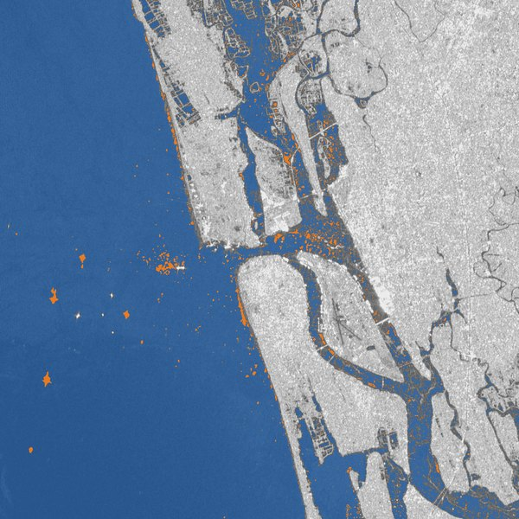
From question to grounded answer
08 · METHODOLOGY
1
2
3
4
5
6
Understand
Fetch
Validate
Select
Execute
Integrate
LLM or offline rules extract task, place, dates and sensor
Geocode the place; pick the clearest Sentinel scenes
Check bands, dates and coverage before anything runs
Choose a registered tool and its engine
Indices, SAR thresholds, change, fusion or VQA
Narrate findings, score confidence, attach map and trace
WORKED EXAMPLE
“Find areas affected by flooding in Kochi in August 2024”
Sentinel-1 radar, flood scene against a dry-season reference → 0.9% newly flooded (orange); 48.2% permanent water kept separate (blue)
Notes:
Every request passes through the same six steps. Understanding can use a hosted model or offline keyword rules, so the system still works without an AI key. Validation happens before execution, so an impossible request, such as NDVI on a radar image, is refused with a reason. In the worked example, radar sees through monsoon cloud; flooding is measured as new water compared with April, so rivers and the sea are not counted as flood.

Slide 9
Six-stage hybrid architecture
09 · SYSTEM DESIGN / ARCHITECTURE
Stage 1
Multimodal input
Optical, radar, image pairs, or scenes fetched by place
Stage 4A
Vision-language core
Fine-tuned Qwen2-VL: VQA, captions, change-VQA
Stage 5
Validation and evidence
Input checks, confidence, measured accuracy, trace
Stage 3
Agentic orchestrator
Plans steps and routes to a registered engine
Stage 2
Query understanding
LLM or rules: task, place, time, metric, sensor
Stage 4B
Deterministic engines
Indices, SAR flood, change, land cover, fusion
Stage 6
Grounded answer
Answer, map, findings and supporting evidence
Notes:
Stage 1 accepts a single optical or radar image, an optical and radar pair, a before and after pair, or no image at all, in which case imagery is fetched for the named place. Stage 2 reads the question. Stage 3 plans and routes. Stage 4 has two engines: 4A, the vision-language model, in orange, and 4B, the deterministic remote-sensing tools, in blue; change-VQA uses both, measuring first and describing second. Stage 5 validates and scores confidence, and Stage 6 returns the answer with its evidence.

Slide 10



Technology stack
10 · TOOLS AND TECHNOLOGIES USED
Backend and analysis
Frontend
Language and vision models
Python 3.13, FastAPI, rasterio (GDAL), NumPy
React, TypeScript, Vite, Leaflet with OpenStreetMap tiles
Groq: gpt-oss-120b, Qwen3.8-27B; fine-tuned Qwen2-VL-2B (LoRA)
Training and serving
Imagery and places
Infrastructure
Kaggle T4 GPU, Hugging Face Transformers, PEFT, bitsandbytes 4-bit
Planetary Computer: Sentinel-2 L2A, Sentinel-1 RTC; Nominatim, Photon
Docker, GitHub Actions CI, Render hosting, Supabase accounts
Notes:
Everything used is free or open source. The deterministic analysis is plain Python on top of rasterio and NumPy. Hosted models run on Groq’s free tier; our own fine-tuned model was trained on a free Kaggle GPU and runs on a 4 GB laptop GPU in 4-bit precision. Imagery needs no account: Planetary Computer serves Sentinel data openly.

Slide 11
How the system was built, in six phases
11 · IMPLEMENTATION
1
PHASE 1
4
PHASE 4
Pipeline and registry
Automatic imagery
Designed a staged FastAPI pipeline in which only tools from a controlled registry may run.
Added geocoding, Planetary Computer search, cloud checks and band-only downloads.
2
PHASE 2
5
PHASE 5
Deterministic engines
Fine-tuning
Wrote the index, SAR flood, change and fusion tools on rasterio and NumPy, each with tests.
Trained Qwen2-VL-2B with LoRA on RSVQA-LR on a free Kaggle T4; served it in 4-bit.
3
PHASE 3
6
PHASE 6
Language and vision
Workspace and deployment
Connected Groq models for understanding and VQA, with offline rules as a fallback.
Built the React workspace, packaged it in Docker, tested it in CI and hosted it on Render.
Notes:
We built the system in six phases. First the backbone: a staged pipeline and a controlled tool registry. Second, the deterministic remote-sensing tools, tested on two raster back ends. Third, the hosted language and vision models, with offline rules so the system works without an AI key. Fourth, automatic imagery, so users never have to upload files. Fifth, our own fine-tuned model, trained on a free Kaggle GPU. Sixth, the web workspace, Docker packaging, continuous integration and public deployment on Render.

Slide 12
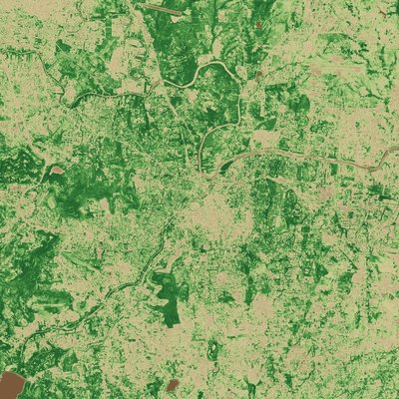
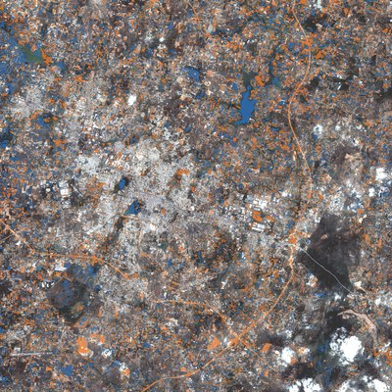
Measured accuracy and live analyses
12 · RESULTS AND DISCUSSION
90.4%
fine-tuned accuracy, up from 58.4%
Kochi: 0.9% newly flooded
Pune: mean NDVI 0.388
Hosur: 9.4% loss, 7.6% gain
In 4-bit on a 4 GB GTX 1650 laptop GPU: 89.0% on 100 of the questions.
Notes:
Fine-tuning raised accuracy on the same 500 RSVQA-LR test questions from 58.4 to 90.4 percent; presence questions improved the most, from 47.3 to 94.0 percent. Training took about 55 minutes on one free Kaggle T4 GPU. Compressed to 4-bit, the model still scored 89.0 percent on 100 of the questions on an ordinary laptop GPU. The three maps are real answers from the system: Kochi flooding in August 2024 measured against a dry-season reference; vegetation health around Pune; and vegetation change around Hosur between 2019 and 2025, loss in orange and gain in blue.

Slide 13
Current limits and future work
13 · LIMITATIONS AND FUTURE SCOPE
Limitations
Future scope
Vision features share a free quota of about 95 image questions a day.
The fine-tuned model needs a GPU; the free host uses a hosted model.
One fetch covers at most 20 km; larger areas are cut, not tiled.
Fine-tuned on RSVQA-LR only; counting questions excluded.
Not yet tested on real Cartosat-2S or RISAT products.
ISRO imagery through Bhoonidhi: Cartosat, RISAT, Resourcesat.
Scale fine-tuning to RSVQAxBEN (BigEarthNet) on a paid GPU.
Tile large areas and add Landsat imagery.
Host the fine-tuned model on a GPU server.
More Indian languages beyond English and Hindi.
Notes:
The limits are mostly about budget, not design. A paid model quota, a GPU server and a paid training budget remove the first, second and fourth. BigEarthNet’s VQA edition has about 15 million questions, too large for a free Kaggle session. ISRO products need a Bhoonidhi account; the radar code already handles RISAT compact-polarisation bands.

Slide 14
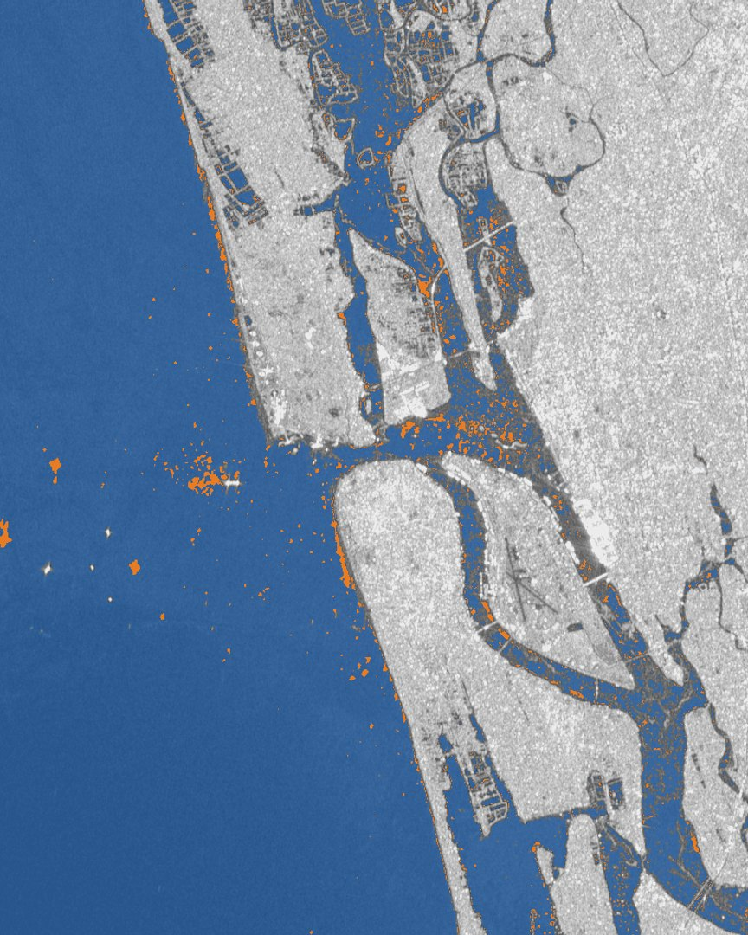


A plain-language question becomes a verified satellite analysis
14 · CONCLUSION
Accessible
English or Hindi; imagery found and fetched automatically
Trustworthy
Only registered tools run; every input is validated and traced
Measured
Fine-tuned model at 90.4%; live for public use
Kochi floods, August 2024 · SatQuery
Notes:
To conclude: SatQuery AI makes satellite analysis available to people who are not remote-sensing experts, without giving up rigour. Answers come from validated, deterministic tools where measurement is possible and from a fine-tuned, benchmarked vision model where description is needed, and every answer shows its evidence. The image is SatQuery’s own flood map of Kochi.

Slide 15
References
15 · REFERENCES
[1] S. Lobry, D. Marcos, J. Murray and D. Tuia, “RSVQA: Visual Question Answering for Remote Sensing Data,” IEEE Trans. Geosci. Remote Sens., vol. 58, no. 12, pp. 8555–8566, 2020.
[2] P. Wang et al., “Qwen2-VL: Enhancing Vision-Language Model’s Perception of the World at Any Resolution,” arXiv:2409.12191, 2024.
[3] E. J. Hu et al., “LoRA: Low-Rank Adaptation of Large Language Models,” in Proc. ICLR, 2022.
[4] J. W. Rouse et al., “Monitoring Vegetation Systems in the Great Plains with ERTS,” NASA SP-351, pp. 309–317, 1974.
[5] S. K. McFeeters, “The Use of the Normalized Difference Water Index (NDWI) in the Delineation of Open Water Features,” Int. J. Remote Sens., vol. 17, no. 7, pp. 1425–1432, 1996.
[6] Y. Zha, J. Gao and S. Ni, “Use of Normalized Difference Built-up Index in Automatically Mapping Urban Areas from TM Imagery,” Int. J. Remote Sens., vol. 24, no. 3, pp. 583–594, 2003.
[7] N. Otsu, “A Threshold Selection Method from Gray-Level Histograms,” IEEE Trans. Syst., Man, Cybern., vol. 9, no. 1, pp. 62–66, 1979.
[8] J. Cohen, “A Coefficient of Agreement for Nominal Scales,” Educ. Psychol. Meas., vol. 20, no. 1, pp. 37–46, 1960.
[9] European Space Agency, Copernicus Sentinel-1 and Sentinel-2 missions, sentinels.copernicus.eu.
[10] Microsoft Planetary Computer STAC API; OpenStreetMap contributors, Nominatim geocoding service.
Notes:
[1] is the benchmark used for fine-tuning and evaluation. [2] and [3] are the base model and the fine-tuning method. [4] to [6] define the spectral indices NDVI, NDWI and NDBI. [7] is the automatic threshold used for radar water mapping, and [8] measures agreement between optical and radar water maps in the fusion tool.

Slide 16
Thank you
SATQUERY AI · SIH 2026
Questions and discussion
LIVE SYSTEM
satquery-ai-s55c.onrender.com
SOURCE CODE
github.com/VinayakGupta-1/SatQuery-AI
TEAM
[Team name]
Notes:
Thank the panel and invite questions. If time allows, open the live system and ask a question such as “Find areas affected by flooding in Kochi in August 2024”. The first request after a quiet period can take about a minute while the free server wakes up, so open it a few minutes before presenting.

