Slide 1
PROJECT TITLE
CAPSTONE PROJECT
Presented By: Vinayak
Student Name : Vinayak
College Name & Department : Shaheed Bhagat Singh State University

Slide 2
OUTLINE
Problem Statement
Technology used
Wow factor
End users
Result
Conclusion
Git-hub Link
Future scope

Slide 3
Problem Statement
Data security is a major concern in the digital age. Unauthorized access to sensitive files and text communication can lead to privacy breaches. This project provides a secure way to encrypt and decrypt files and text using AES encryption

Slide 4
Technology used
Programming Language: Python
GUI: Tkinter
Encryption Library: PyCryptodome (AES Encryption)
File Handling: OS & FileDialog

Slide 5
Wow factors
Supports encryption & decryption for all file formats
Secure AES-256 encryption ensures strong protection
Interactive GUI-based tool for user-friendly operation
Text encryption feature alongside file encryption

Slide 6
End users
Individuals: Personal file protection
Organizations: Secure document storage
Cybersecurity Professionals: Testing and encryption practice

Slide 7
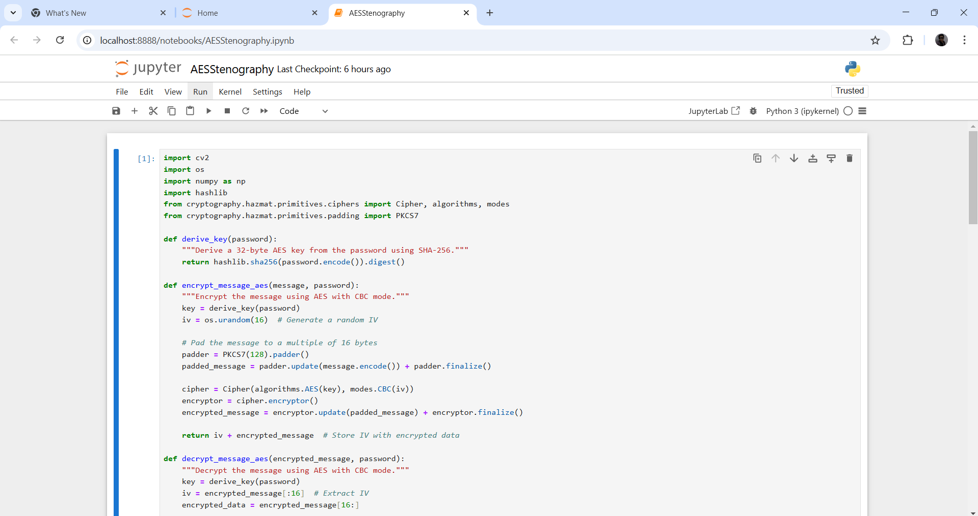

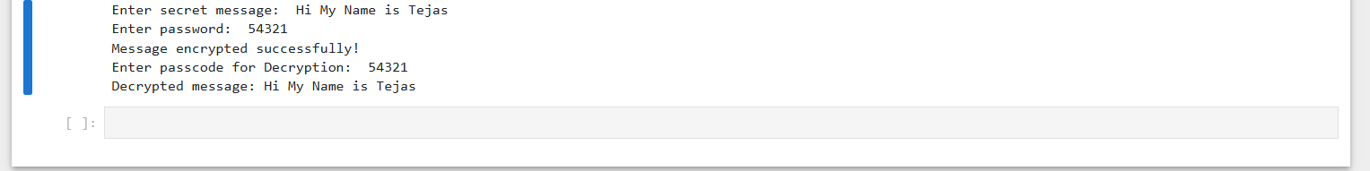
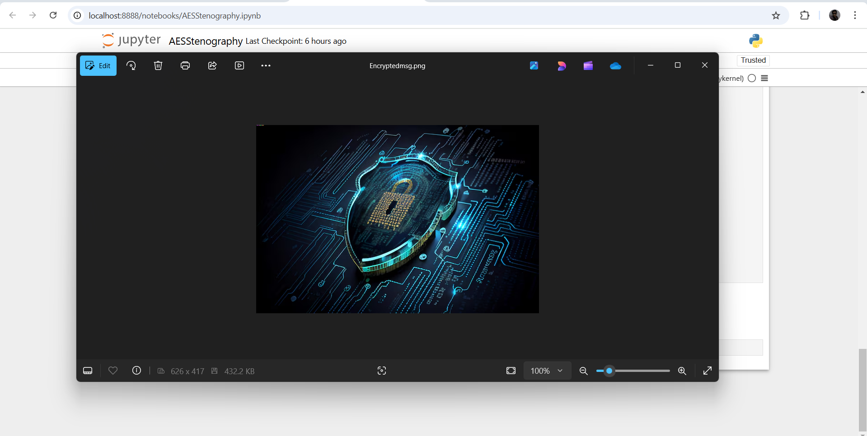
Results
Figure 1: Source code.
Figure 3: Input image Mypic.png

Slide 8
Conclusion
This project effectively addresses the problem of unauthorized access to sensitive files and texts. By using AES encryption, it provides a robust security solution that is easy to use with a graphical interface.

Slide 9
GitHub Link
https://github.com/VinayakGupta15/SecureText

Slide 10
THANK YOU

