Slide 1
BookRec
Introduction:
A college project that my friend and I developed to revolutionize the way people discover books. Although it's still in its early stages, this project represents our shared passion and dedication.
Inspiration
Two college students, both avid readers, often discussed their favorite books and the challenge of finding the next great read. These conversations led to the creation of BookRec. We wanted to build a solution that would make book discovery as enjoyable and effortless as having a conversation with a fellow book lover.
WebApp project by Stefano Bortolatto and Vinayak Kumar

Slide 2
BookRec
The Story of BookRec:
BookRec was born out of brainstorming sessions in our library. As literature enthusiasts with a knack for technology, we decided to combine our skills to create something special. Our goal was to design a website that could provide personalized book recommendations, making use of both our literary knowledge and technical abilities.
Development Journey:
Initial Concept: We started by researching existing book recommendation systems to understand their strengths and weaknesses. Our primary objective was to create a platform that offered personalized suggestions based on individual tastes and preferences.
WebApp project by Stefano Bortolatto and Vinayak Kumar

Slide 3




BookRec
What is BookRec?
BookRec is a web application based on Java Servlet, which lets users register to the website and search for books, authors and other users
How was it built?
It was built using mostly Java technology (Java Servlets and DAOs), HTML (dynamic content provided by JSP pages), CSS and some JavaScript.
WebApp project by Stefano Bortolatto and Vinayak Kumar

Slide 4
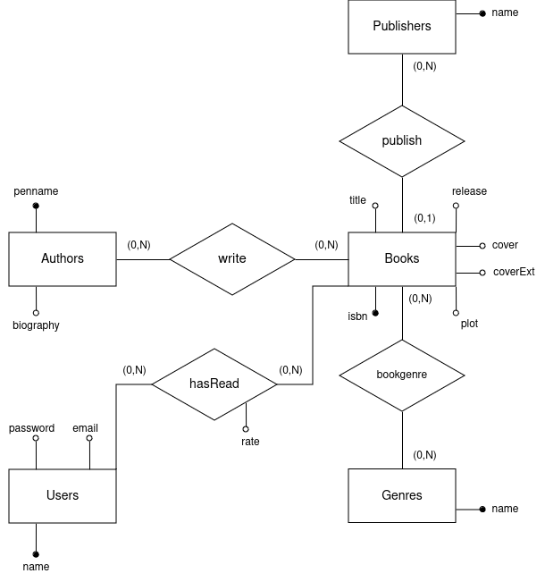

BookRec
What about the database?
The database used for this project is a simple relational database implemented with PostgreSQL.
It’s based on 3 main entities:
Books
Authors
Users
Around this entities, other tables are built to add extra functionalities (what publisher has released the book, which are the authors of this book, what genres a book is, ...)
ER schema of the actual database
WebApp project by Stefano Bortolatto and Vinayak Kumar

Slide 5
BookRec
Following some example of the workflow of the web application
WebApp project by Stefano Bortolatto and Vinayak Kumar

Slide 6




BookRec
User registration workflow:
HTTP request
INSERT INTO Users <data>
signup.jsp
CreateUserServlet
CreateUserDAO
Exception or outpuParam
HTTP response
Query result
WebApp project by Stefano Bortolatto and Vinayak Kumar

Slide 7
BookRec
Searching for users workflow:
HTTP request
SELECT * FROM Users WHERE name=<data>
Search-user-form.jsp
SearchUserServlet
SearchUserDAO
Exception or outpuParam
Query result
Search-user-result.jsp
* for the search of books, another servlet is used to display image covers on the page
WebApp project by Stefano Bortolatto and Vinayak Kumar

Slide 8
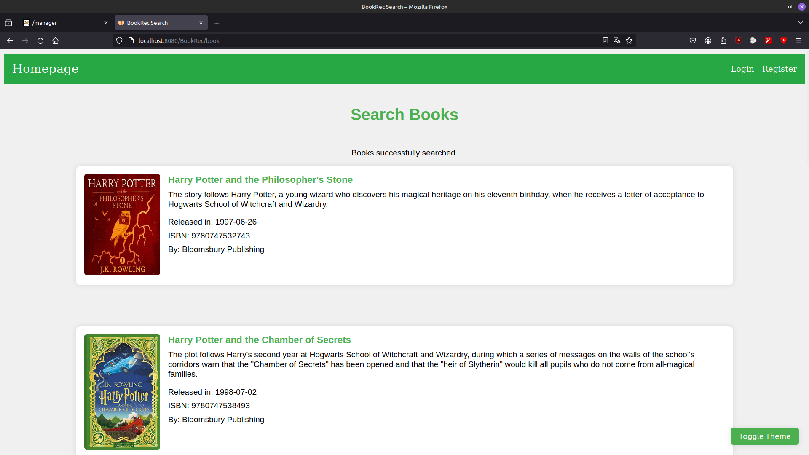
BookRec
What about the design of the web pages?
We used mostly CSS, in order to obtain simple yet clear page for both results and form.
Following, some example of how CSS affects come of the pages in our website...
WebApp project by Stefano Bortolatto and Vinayak Kumar

Slide 9
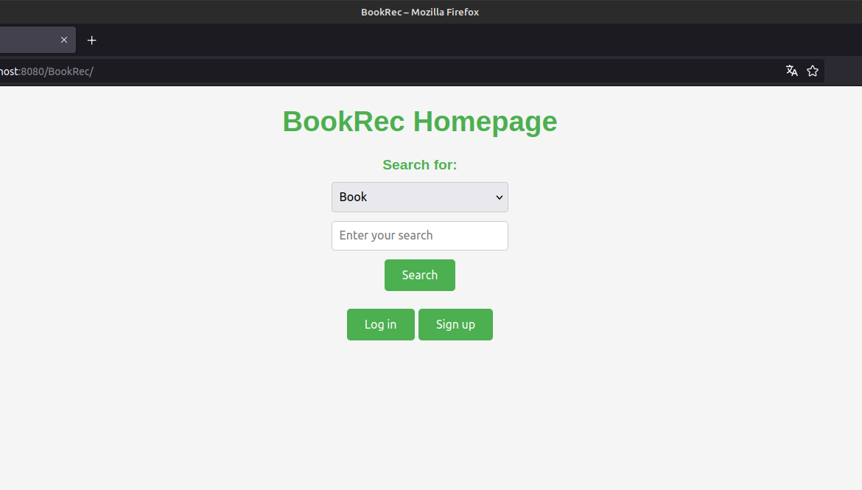
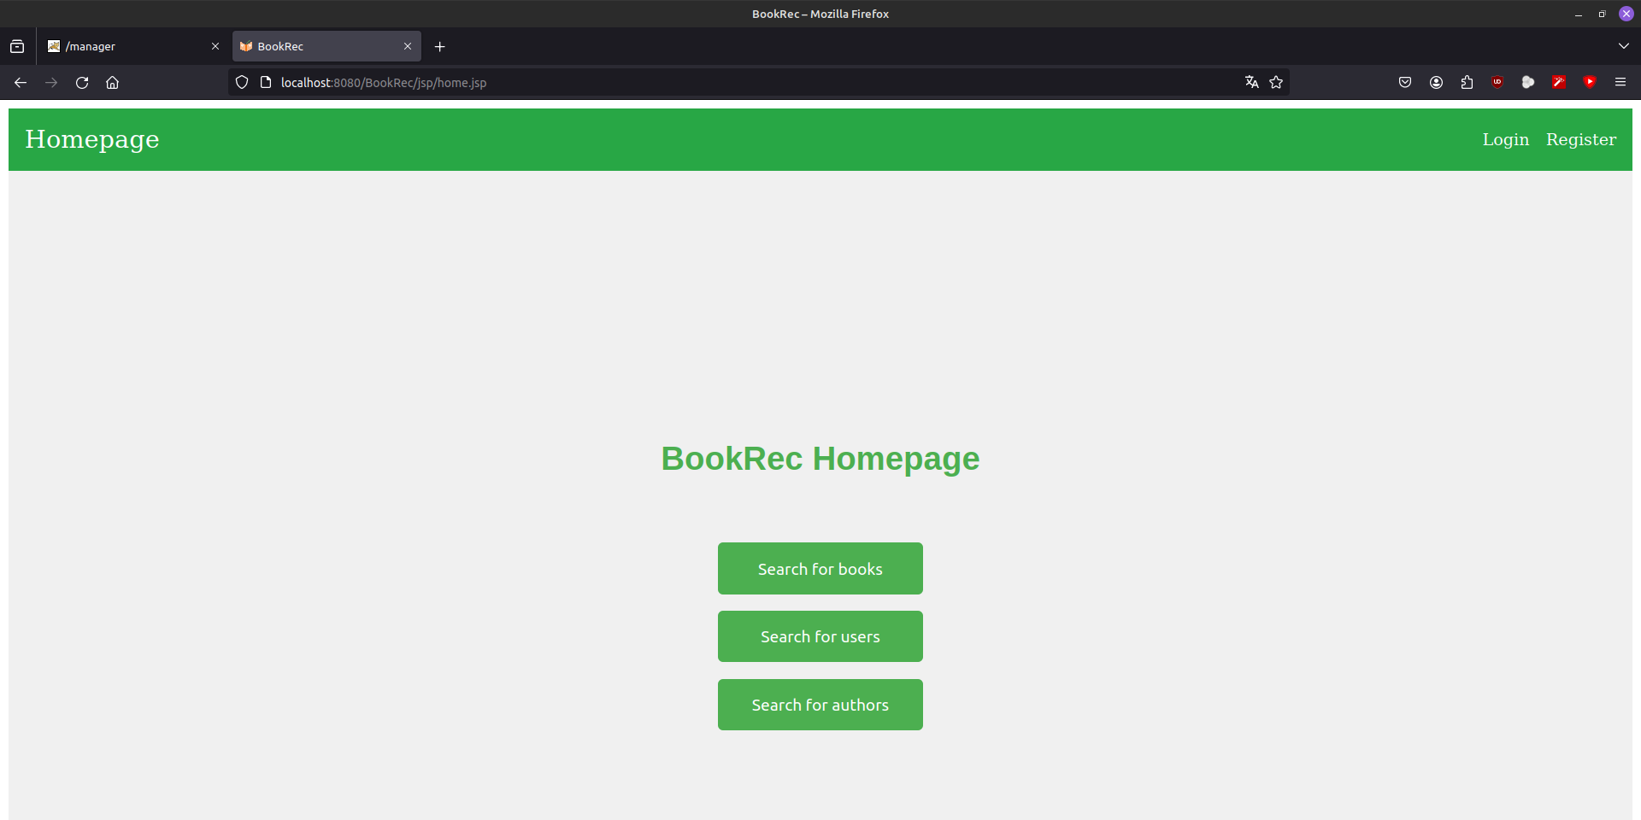
BookRec
Differences in homepage
Without CSS
With CSS
WebApp project by Stefano Bortolatto and Vinayak Kumar

Slide 10
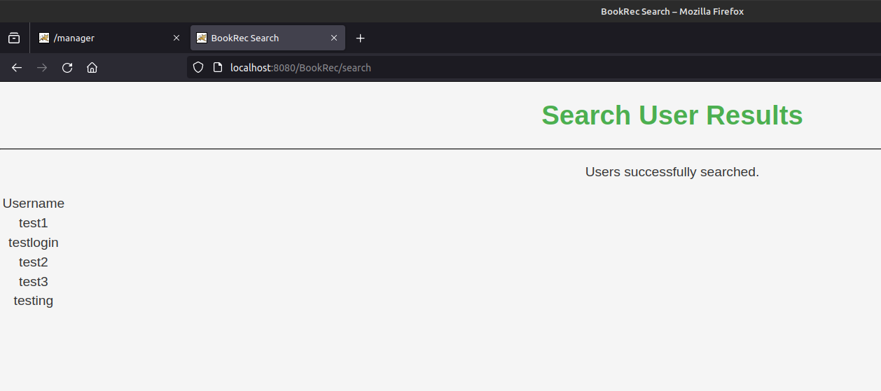
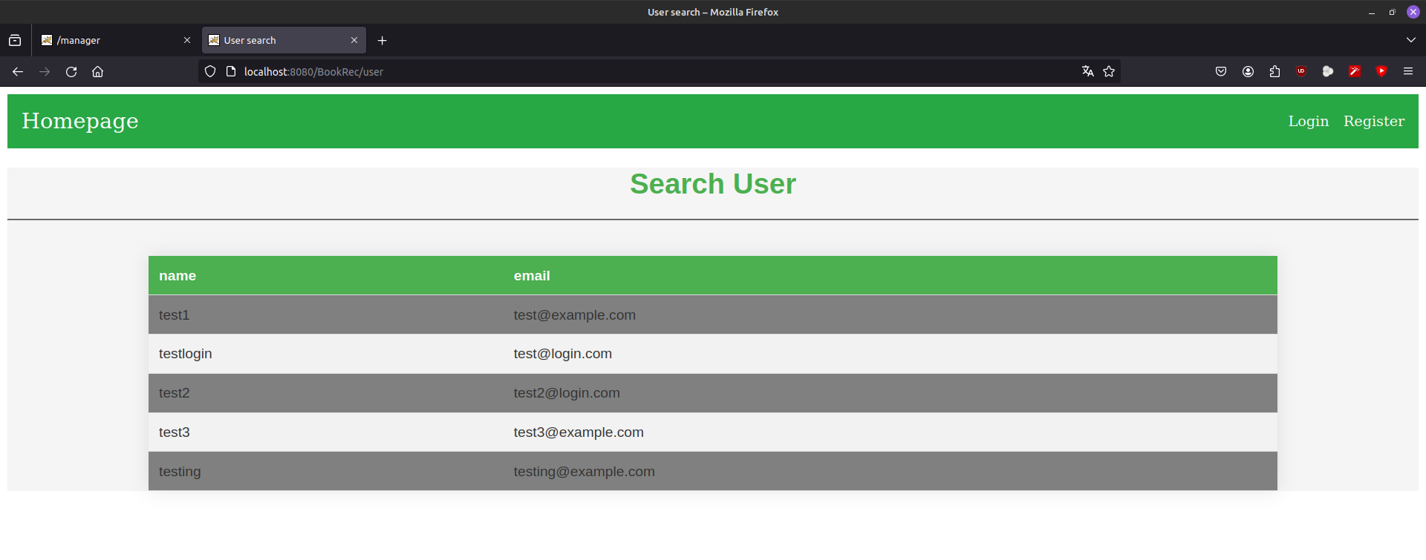
BookRec
Differences in user search results
Without CSS:
No centering
No alternate color
No tabulation
With CSS:
Results are centered
Correctly displayed in table form
Alternate color for each line
WebApp project by Stefano Bortolatto and Vinayak Kumar

Slide 11
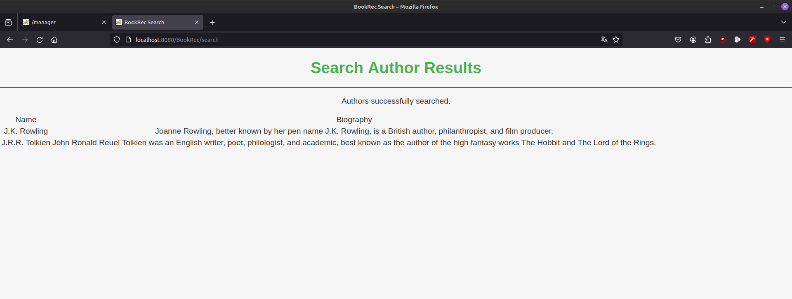
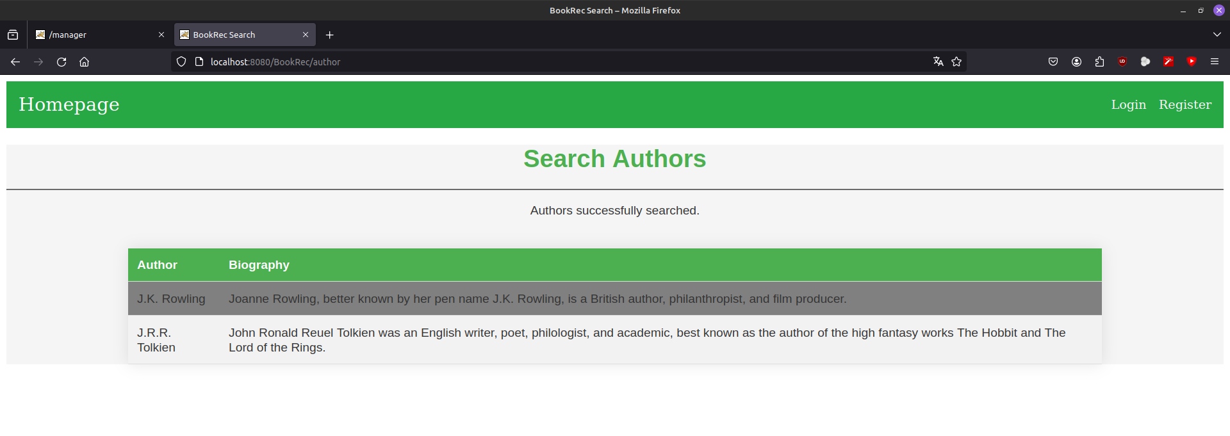
BookRec
Differences in authors search results
Without CSS:
No centering
No alternate color
Basic tabulation
With CSS:
Centered results are
More readable table
Alternate color for each line
WebApp project by Stefano Bortolatto and Vinayak Kumar

Slide 12
BookRec
The Future of BookRec:
Though BookRec remains a college project for now, the journey has been incredibly rewarding. We've built a strong foundation and gained valuable experience in project management, collaboration, and innovative thinking. We hope to continue developing BookRec beyond our college years, transforming our prototype into a fully operational platform.
WebApp project by Stefano Bortolatto and Vinayak Kumar

