Slide 1

Employee Turnover Prediction based on Survival Analysis

Slide 2
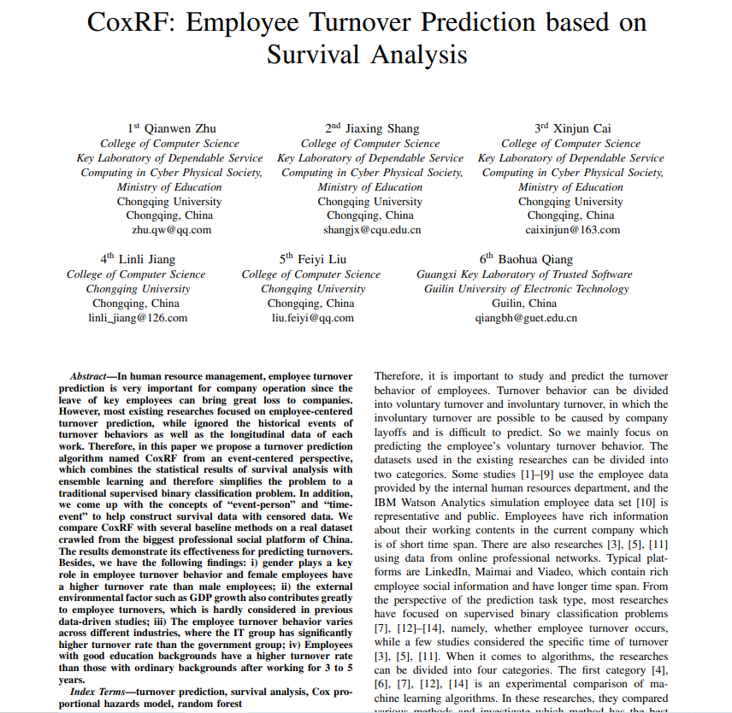
Research Paper:
Employee Turnover Prediction based on Survival Analysis
Published in:
2019

Slide 3
INTRODUCTION
Employee Attrition : Reduction in staff members
Reasons why employees leave : Being Overworked, Little
Opportunities, Lack of Growth, etc
Types : Voluntary and Involuntary

Slide 4

PROBLEM STATEMENT
The success of any service organization depends largely on the employees, the employees areconsidered as the backbone of HCG Hospital.

The attrition rate of the company is25%.So this study focused on why the Attrition occurs andthe possible ways to reduce it.

The study was mainly undertaken to identify the level of employee’s attitude, the
dissatisfaction factors they face in the organization and for what reason they prefer to changetheir job. Once the lev
els of Employee’s attitude are identified, it would be possible for the
management to take necessary action to reduce attrition level. Since they are considered asbackbone of the organization, their progression will lead to the success of the organization forthe long run.

This study can be helpful in knowing, why the employees prefer to change their job and whichfactors make employee dissatisfy.

Since the study is critical issue, it is needed by the originations in order to assess the overallinterest and the feelings of the employees towards their nature of job and organization.

This study can be helpful to the management to improve its core weaknesses by the suggestionsand recommendations prescribed in the project.

This study
can serve as a basis for measuring the organization’s overall performance in terms of
employee satisfaction.

The need of this study can be recognized when the result of the related study need suggestionsand recommendations to the similar situation.
Cost Implications
Overall Business performance
Turnover can be difficult to control

Slide 5

OBJECTIVES
To predict employee turnover
To identify which factors affect the most on employee turnover

Slide 6
DATA DESCRIPTION
Data consists of 1,470 employees and 35 variables
Users information mainly consist of four parts:
Demographic information
2) Current job information
Work experience information
Educational experience information

Slide 7
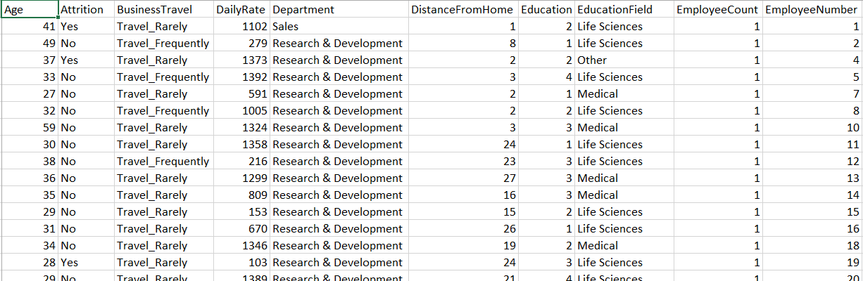
DATA SNIPPET

Slide 8
EXPLORATORY
DATA ANALYSIS

Slide 9
ATTRITION RATE
Attrition

Slide 10
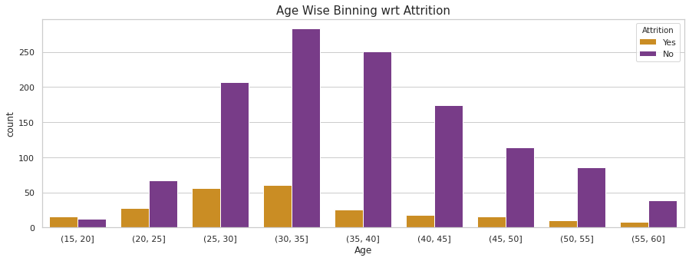
AGE WISE ANALYSIS

Slide 11
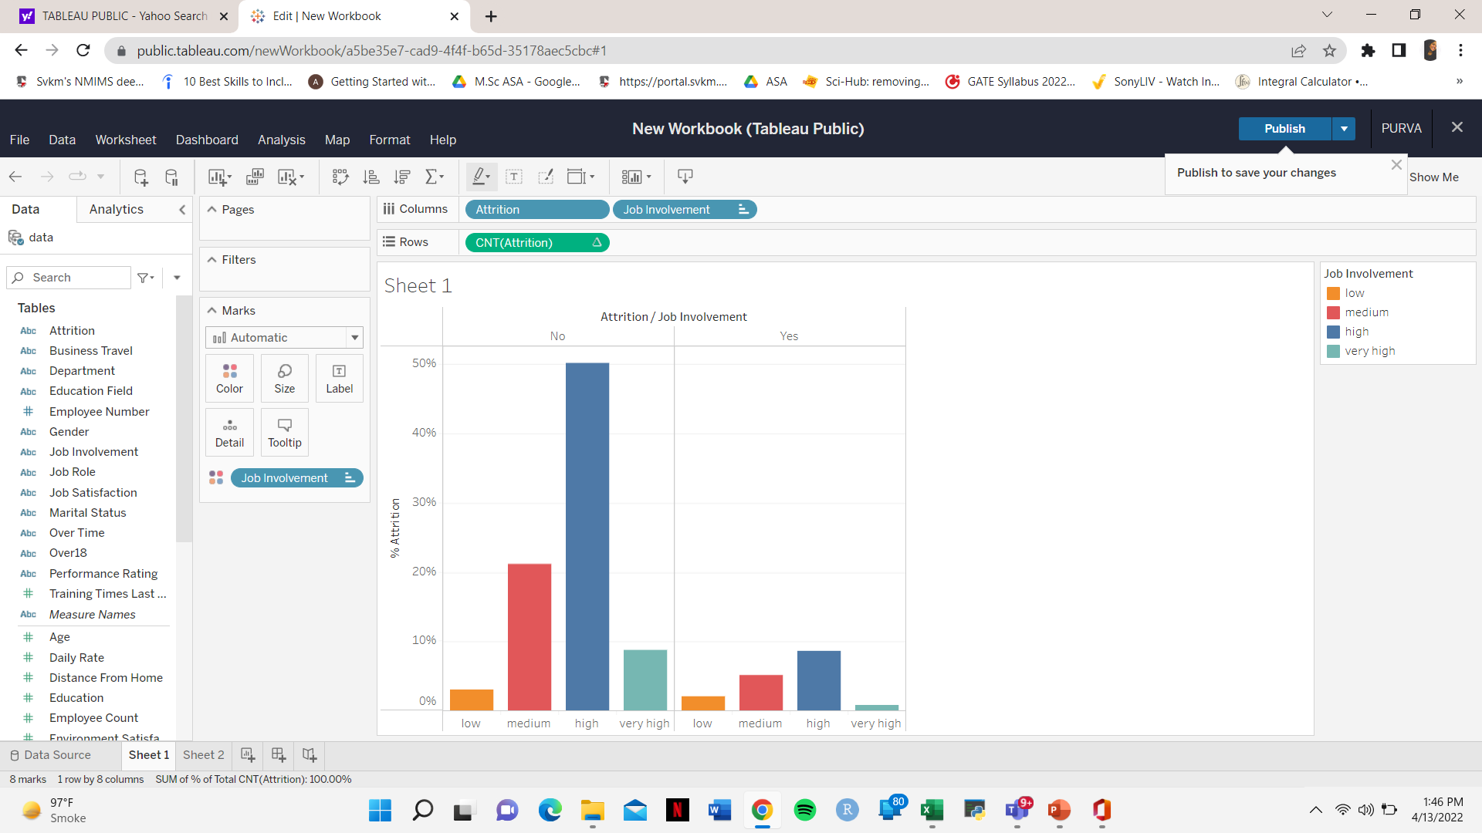
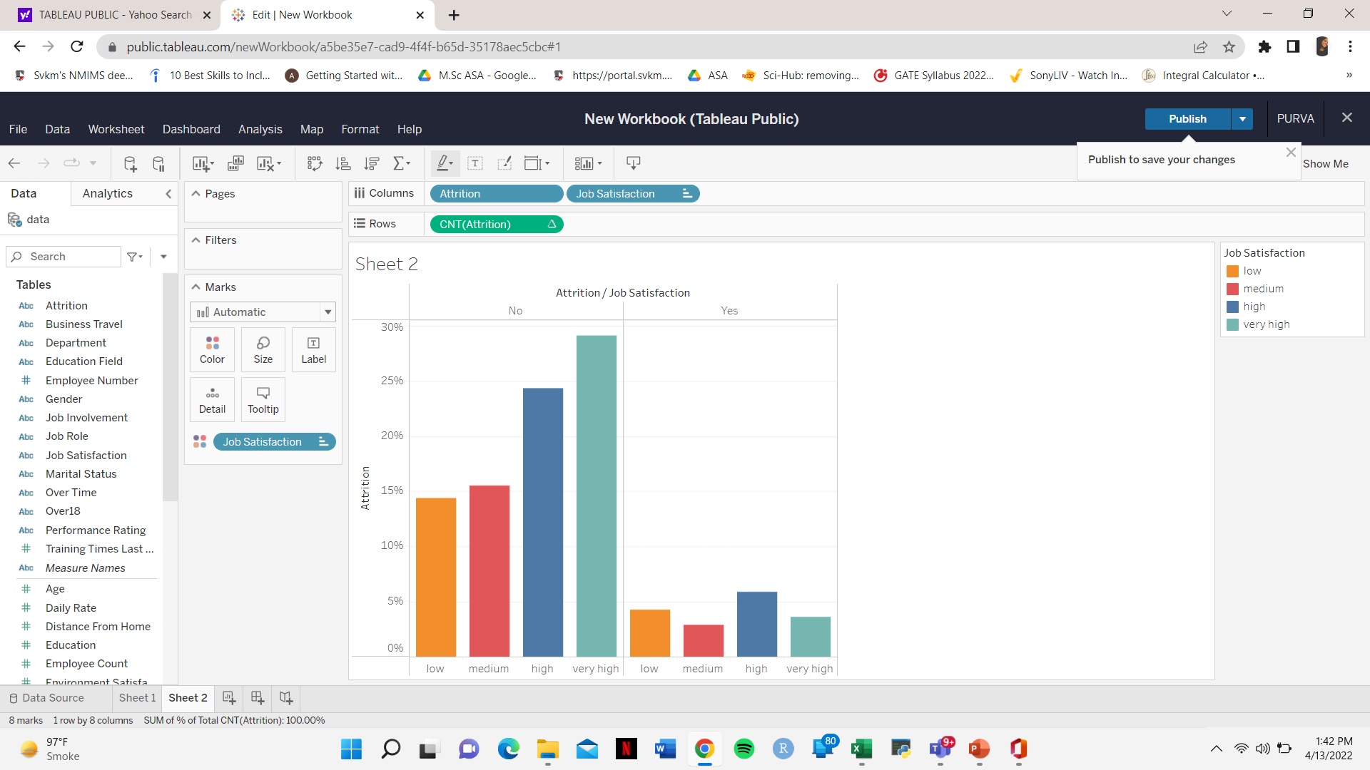
JOB INVOLVEMENT AND JOB SATISFACTION
Job Involvement
Job Satisfaction

Slide 12
Concepts
Survival Analysis
Machine Learning
Survival Function
Logistic Regression
Hazard Function
Random Survival
Forest
Kaplan Meier Estimate of S(t)
Cox-PH Model

Slide 13
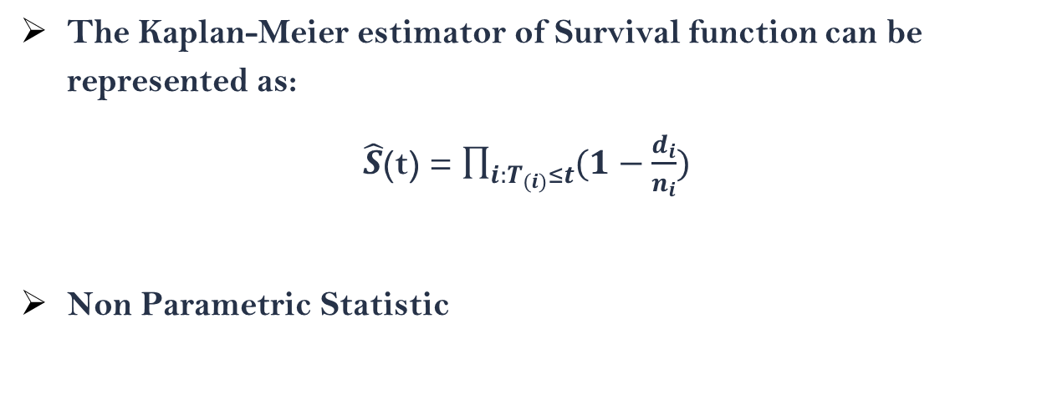
Kaplan Meier Estimate of S(t) - 1958
The Kaplan-Meier estimator of Survival function can be represented as:
$\hat{S}$(t) = $\prod_{i:T_{(i)}≤t}{(1−\frac{d_{i}}{n_{i}}})$
Non Parametric Statistic

Slide 14
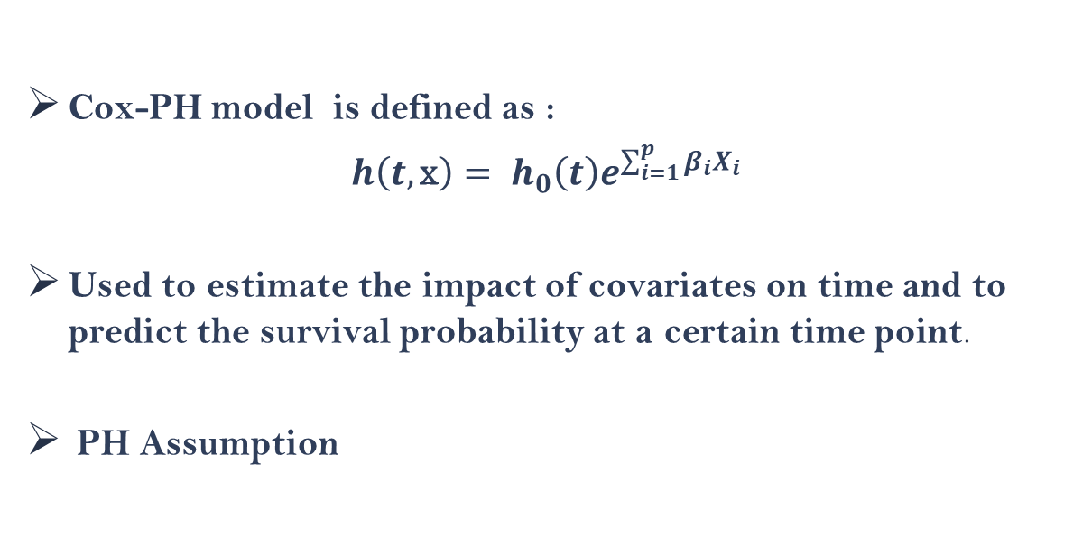
Cox-PH Model (David Cox - 1972)
Cox-PH model is defined as :
$h\left(t,\text{x}\right)= h_{0}\left(t\right)e^{\sum_{i=1}^{p}{β_{i}X_{i}}}$
Used to estimate the impact of covariates on time and to predict the survival probability at a certain time point.
PH Assumption

Slide 15
Survival Random Forest
A Random Forest method for the analysis of right-censored survival data
Combines the well known classification method Random Forest with Survival Analysis
Identifies which features are important
Predicts the Survival probability at a given time point

Slide 16
MACHINE LEARNING ALGORITHMS

Slide 17
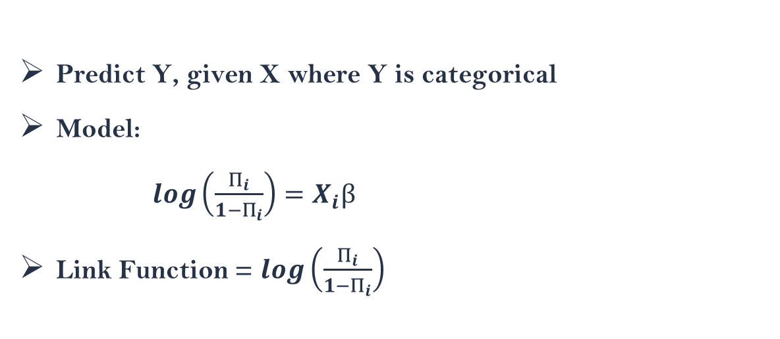
Logistic Regression (Joseph Berkson)
Predict Y, given X where Y is categorical
Model:
$log\left(\frac{Π_{i}}{1−Π_{i}}\right)=X_{i}β$
Link Function = $log\left(\frac{Π_{i}}{1−Π_{i}}\right)$

Slide 18
Analysis

Slide 19
Work flow of Data Analysis
Data Preparation
Testing Models
1
3
Comparing Model Accuracy
2
4
Applying ML algorithms and Survival Analysis

Slide 20
Logistic Regression
Model Building : glm() Function with Binomial Family
Testing the Model : Confusion Matrix
There are 15 significant variables with alpha = 0.05 and the AIC = 674.29
Ref Pred | 0 | 1
0 | 359 | 10
1 | 47 | 29
Accuracy of the model is 87.19%

Slide 21
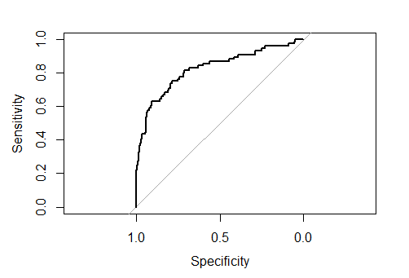
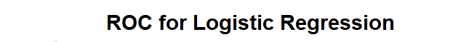
Receiver Operator Characteristic (ROC):
ROC Curve is plotted using roc function pROC package
Optimal cutoff value = 0.5
Area under the curve: 0.8248

Slide 22
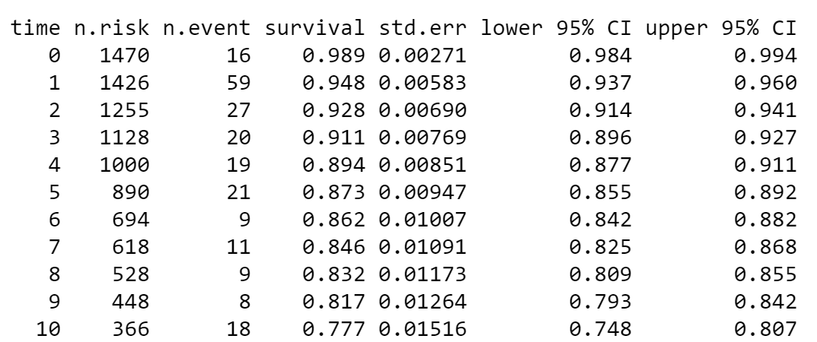
K-M Estimates of S(t)

Slide 23
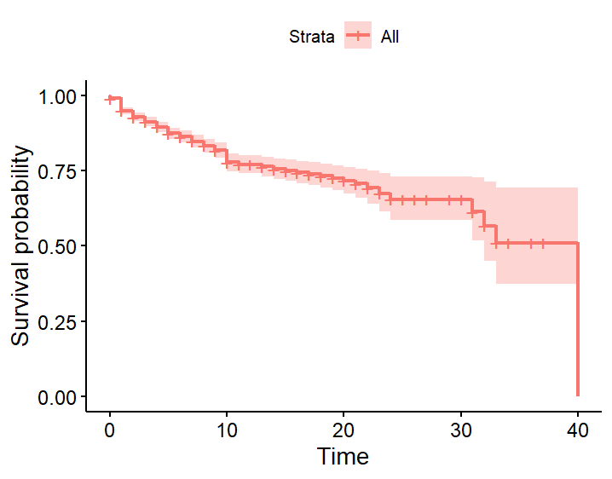
Survival Curve

Slide 24
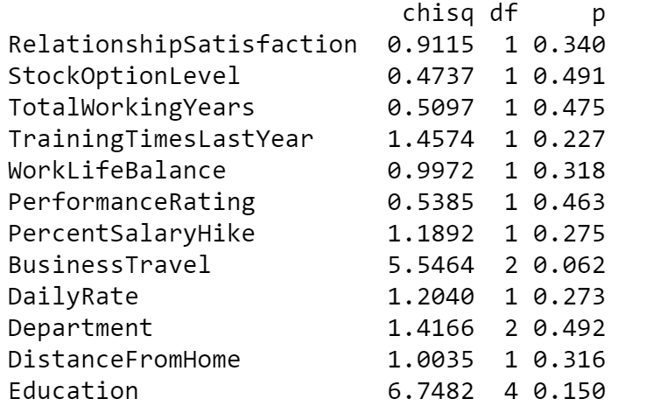
Cox-PH
Assumption Checking and Model Building:
We fit the Cox-PH model using coxph() and we test the PH Assumption

Slide 25
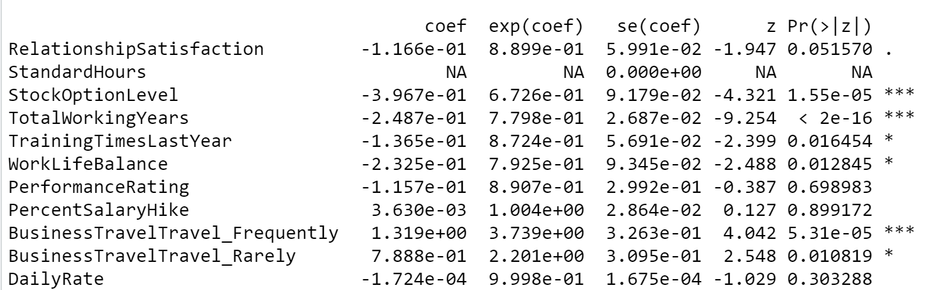
HOURLY DISTRIBUTION OF DAILY RAINFALL: SANTACRUZ (LP III)
Summary of the fitted model

Slide 26
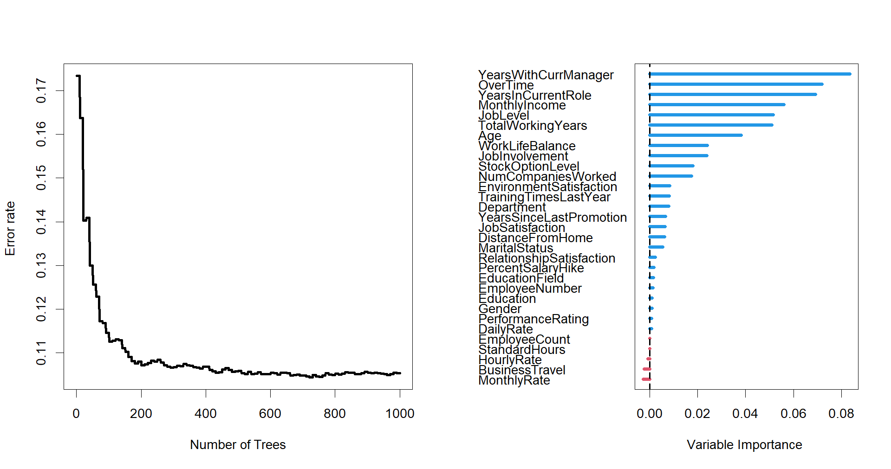
Random Survival Forest (RSF)
Model Building: Fit the RSF model using rfsrc() function regressing the
Survival Object on the remaining variables

Slide 27
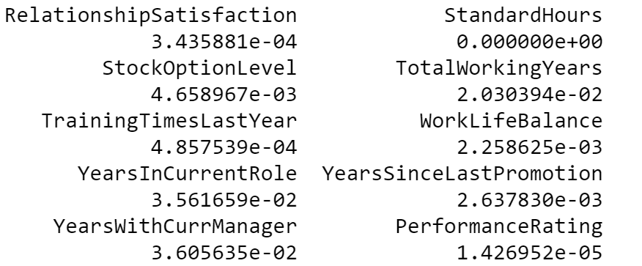
By using vimp() we calculate the variable importance of variables individually

Slide 28
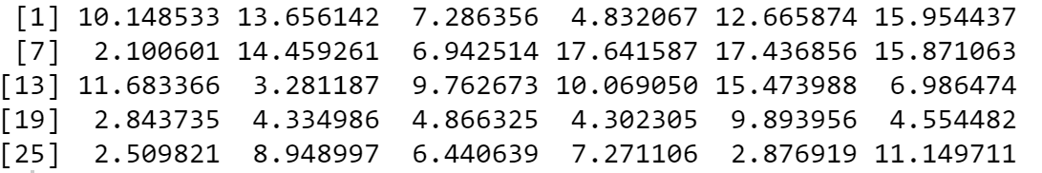
Prediction: Predict the Survival times using the pred() function
Accuracy of the model is 91.64%
Predicted Survival times:

Slide 29
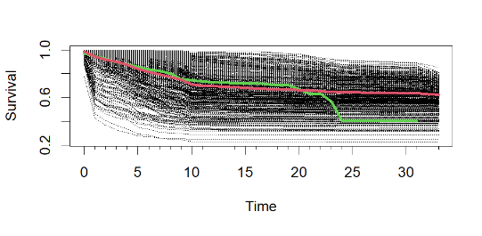
Forest estimated survival function for each individual:

Slide 30
RECOMMENDATIONS
Plan and allocate projects
Hire Polite Managers
Hire Young Employees and not aged people
High Job Involvement
Reasonable deadlines , perks
Work Life Balance
Provide good amount of Stocks
Gather information on industry benchmarks

Slide 31
Future Scope
Help organizations to find ways to prevent attrition or to plan in advance the hiring of new candidate
Project extends to companies in all industries
Use SVM, XGBoost

Slide 32
REFERENCES
CoxRF: Employee Turnover Prediction based on Survival Analysis
Link: https://www.semanticscholar.org/paper/CoxRF%3A-Employee-TurnoverPrediction-Based-on-Zhu-Shang/bb798dc641d058472544b90497a81a4756f611e
Lifetime Data : Statistical Models and Methods
(By J.V. Deshpande , S.G. Purohit)

Slide 33
Thank You!

