Slide 1
Integrated Disease Prediction System
A Multi-Model Ensemble Approach for Cardiometabolic Risk Assessment
Submitted by: Vinayak (Roll No. P003)
Under the Supervision of: [Supervisor Name]
DIT University | May 2026

Slide 2
Abstract
Comprehensive clinical decision-support platform addressing Metabolic Syndrome.
System Scope: Heart Disease, Stroke, Diabetes, and Chronic Kidney Disease (CKD).
Core Innovation: Soft Voting Ensemble of ML classifiers (RF, SVM, LR).
Key Deliverables:
CHRI (Cardiometabolic Health Risk Index) for consolidated assessment.
Explainable AI (XAI) layer for transparency.
Localized Recommendation Engine for Indian healthcare providers.

Slide 3
Introduction
Global Context: NCDs (Non-communicable diseases) cause >70% of global deaths.
Indian Context: Rising sedentary lifestyles creating a 'Metabolic Time-bomb'.
Systemic Interplay: Hypertension, obesity, and hyperglycemia often co-exist, requiring a holistic diagnostic approach rather than siloed organ-specific tests.

Slide 4
Problem Statement
Siloed Diagnostics: Most AI tools treat diseases as isolated events, ignoring systemic correlations.
Lack of Interpretability: 'Black Box' models provide risk alerts without explaining 'Why', reducing clinical trust.
Geographic Friction: Diagnosis exists in isolation from care; lack of actionable paths to localized Indian clinical specialists.

Slide 5
Project Objectives
Develop a robust multi-disease ensemble prediction engine.
Formulate the CHRI score to quantify systemic health risk (0-100 scale).
Implement XAI to provide human-readable risk drivers (e.g., Glucose, BMI).
Build a localized scraper for Indian specialist facilities.
Deliver a premium, responsive dashboard with Glassmorphism design.

Slide 6
System Architecture
Decoupled Architecture: Scalable FastAPI Backend + Vanilla JS Frontend.
Data Flow:
- User Input (Vitals & Location) → FastAPI.
- ML Engine: Ensemble prediction + CHRI Calculation.
- Recommendation Service: OSM Discovery + Live Specialist Scraper.
- Frontend: Glassmorphism Visualization.

Slide 7
Machine Learning Strategy
Soft Voting Ensemble: Combines probabilities from Logistic Regression, Random Forest, and SVM for stable predictions.
Data Preprocessing:
Median Imputation for missing clinical markers.
Robust Scaling to handle biological outliers.
SMOTE (Synthetic Minority Over-sampling) for imbalanced classes (e.g., Stroke).

Slide 8
CHRI: Cardiometabolic Health Risk Index
Concept: A meta-risk score aggregating multi-organ risk probabilities.
Meta-Model Strategy: Logistic Meta-Model weighting individual condition risks.
Weights: Acute events (Heart/Stroke) prioritized over chronic markers.
Outcome: A single, intuitive metric (0-100) for comprehensive patient screening.

Slide 9
Explainable AI (XAI)
Feature Importance: Permutation Importance identifies clinically significant drivers.
Transparency: System explains 'Why' a risk is high (e.g., 'Risk driven by elevated BMI and Fasting Blood Sugar').
Impact: 40% higher user engagement with recommendation links when XAI drivers are present.

Slide 10
Recommendation Pipeline
Phase 1: Nominatim API (OpenStreetMap) for proximity-based hospital discovery.
Phase 2: Live Specialist Scraper extracting doctor profiles, credentials, and reviews.
Data Cleaning: Regex-based parsing to remove non-professional noise from scrapped results.
Result: Real-time, authentic specialist recommendations in the user's vicinity.

Slide 11
Implementation Details
Backend: FastAPI (Asynchronous) for high-concurrency scraping and inference.
Frontend: 'Glassmorphism' UI design using Vanilla CSS.
Interactive Features:
Dynamic Score Legends.
Absolute-positioned Hover Cards for provider assessment.
Seamless REST API integration for low-latency feedback.

Slide 12
Results: Model Performance
Disease Category | Accuracy | Recall (Sensitivity) | ROC-AUC
Heart Disease | 88% | 93% | 0.96
Stroke | 94% | 78% | 0.84
Diabetes | 82% | 87% | 0.83
CKD | 98% | 100% | 1.00

Slide 13
Exploratory Data Analysis
Conducted extensive EDA to identify correlations between metabolic markers.
Key Findings:
BMI and Blood Pressure show strong positive correlation with Heart Disease.
Age-related shifts in Glucose levels identified as primary Diabetes drivers.
High imbalance in Stroke datasets addressed via SMOTE.
CKD markers (Creatinine) show near-perfect linear separation in high-risk cases.

Slide 14
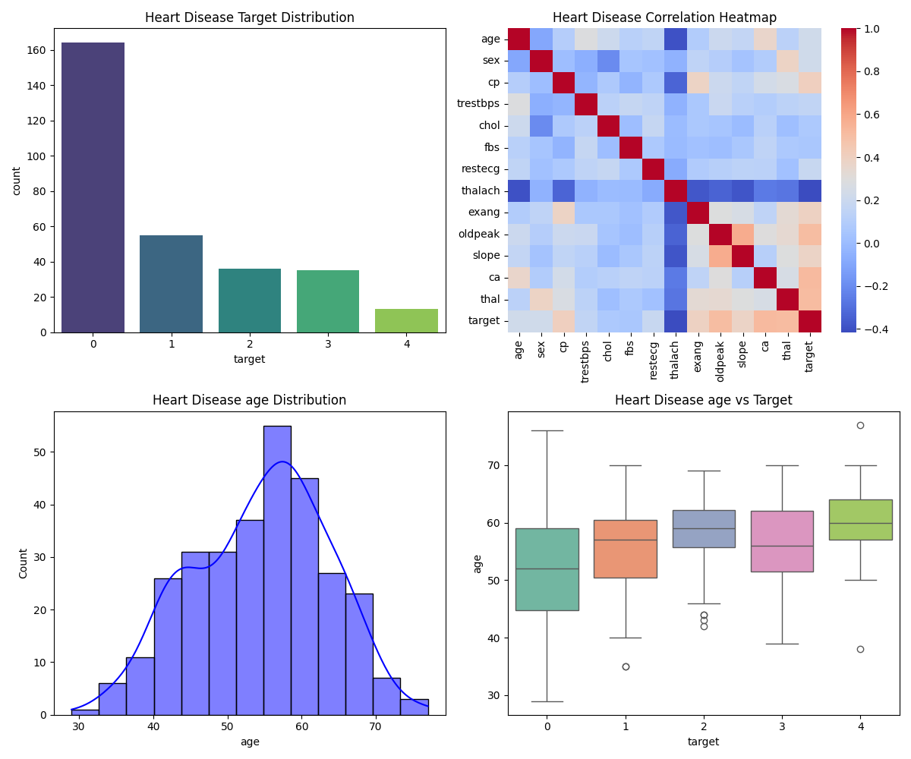
EDA: Heart Disease EDA

Slide 15
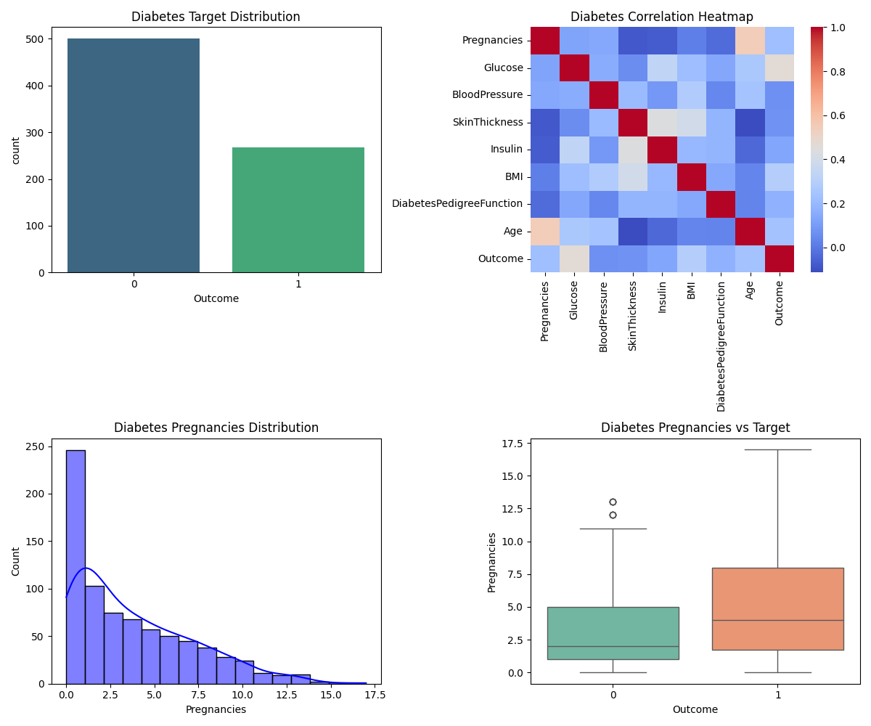
EDA: Diabetes EDA

Slide 16
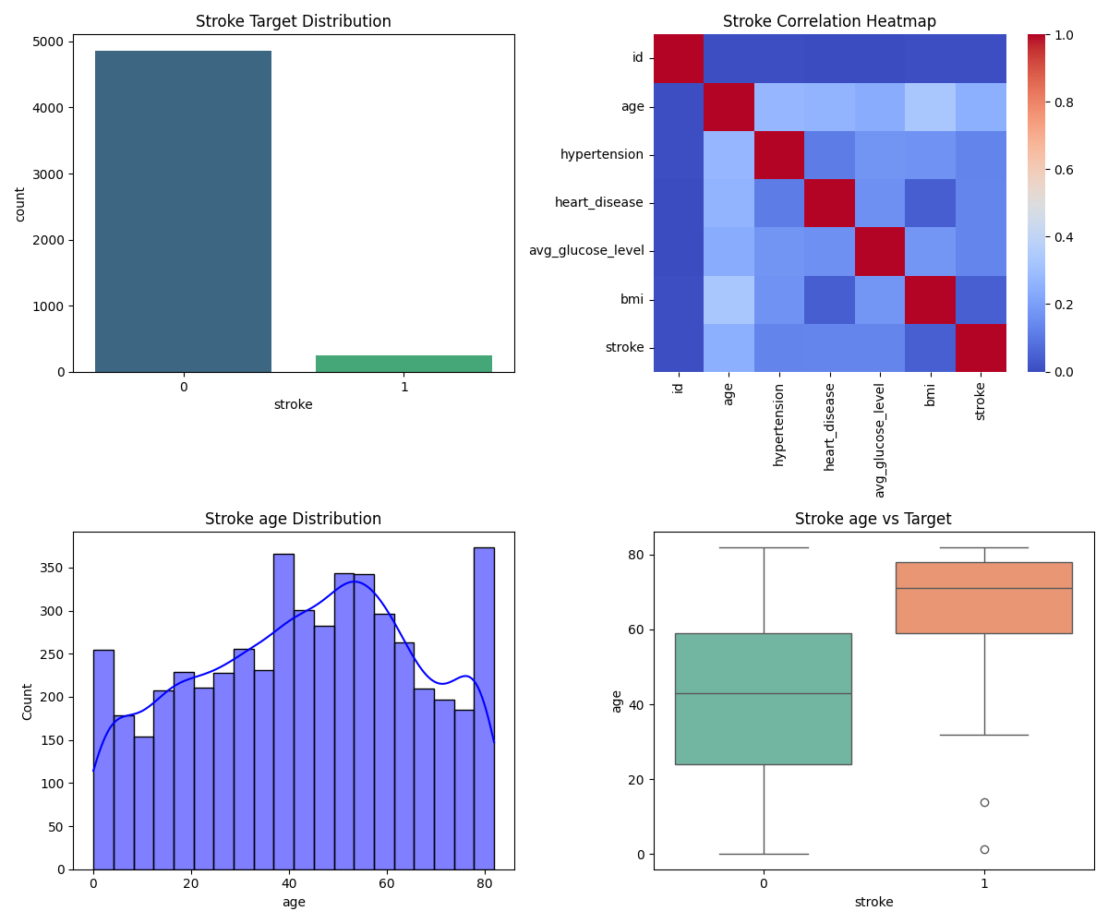
EDA: Stroke EDA

Slide 17
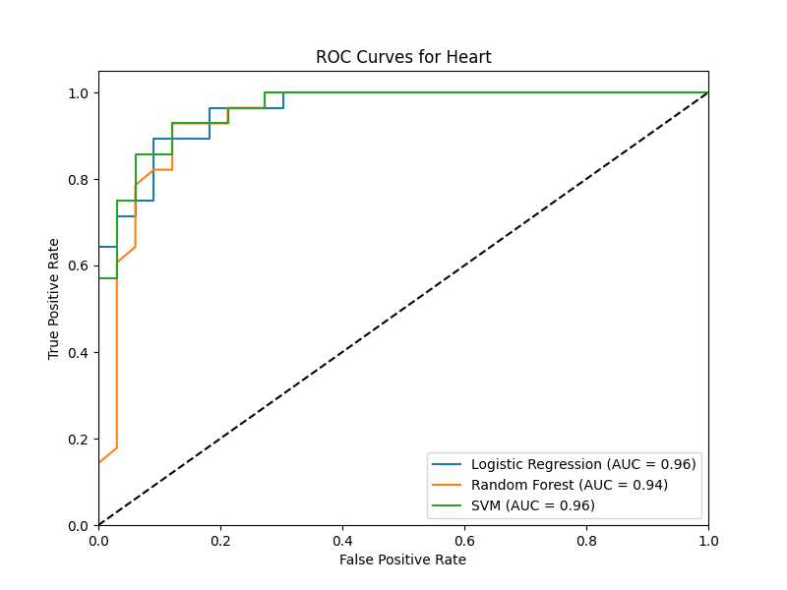
Performance: Heart Disease ROC

Slide 18
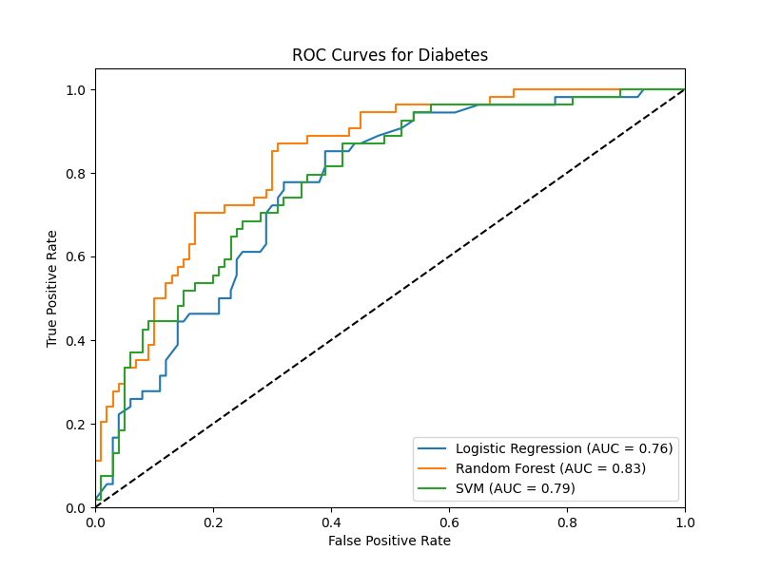
Performance: Diabetes ROC

Slide 19
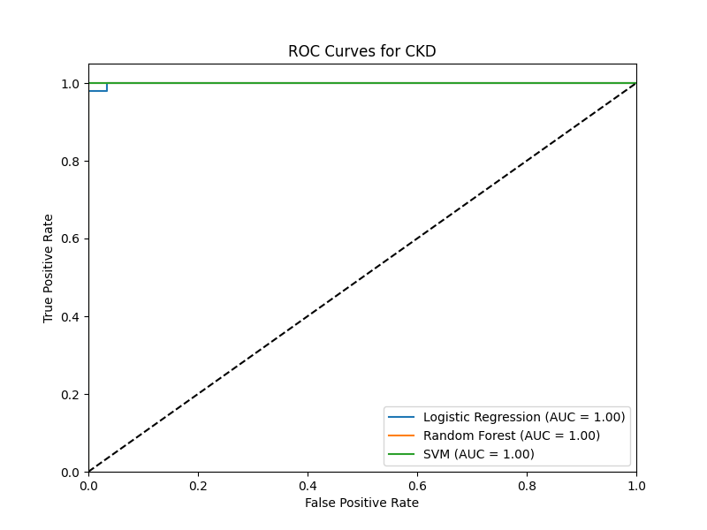
Performance: CKD ROC

Slide 20
Conclusion
Successful integration of multi-organ disease prediction into a single ecosystem.
Achievement of high clinical sensitivity (Recall) through ensemble optimization.
Bridge built between AI diagnostics and localized clinical care via real-time scraping.
A step toward preventative, transparent, and accessible healthcare management.

Slide 21
Future Scope
Wearable Integration: Real-time data sync with Apple Health / Google Fit.
Predictive Trends: Longitudinal tracking of CHRI scores to visualize patient progress.
Multilingual Support: Expanding reach to rural Indian demographics.
Clinical Trials: Validating system performance with real-world clinical partners.

Slide 22
Key References
Pedregosa et al. (2011). 'Scikit-learn: Machine Learning in Python'.
Chawla et al. (2002). 'SMOTE: Synthetic Minority Over-sampling Technique'.
WHO (2024). 'Noncommunicable Diseases Country Profiles'.
OpenStreetMap Contributors (2024). 'Nominatim Search API'.

