Slide 1
Intrusion Detection System
Vinayak Panchal
Siddhant Jaiswal
Aneesh Munnam
Saurabh Bindal

Slide 2
Table of Contents
Why to have an Intrusion Detection System?
Application Model
Hardware Setup
Demo
Questions

Slide 3
What is Intrusion and Why to use this System?
Intrusion: Presence of any unauthorized person in anyone’s personal space.
It could cause serious loss to property and life of the dwelling.

Slide 4
Application Model
Log Data
DynamoDB
Raspberry Pi
Email from SNS:
Contains time of Intrusion and Images captured as Proof
Sensor Setup
Motion Detection
Capture Images
Store in S3
SNS Implementation
Store Images
Store images
Amazon S3 Bucket
Notify the user

Slide 5
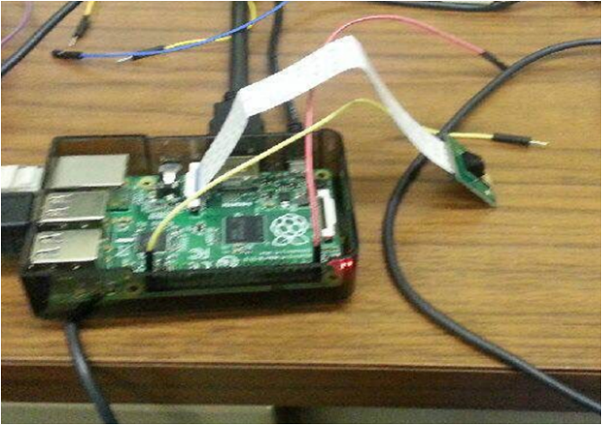
Hardware Setup

Slide 6
Time for Some action!!

Slide 7
Any Questions?
Thank you!

